Slide 1

Salaat Diary
OBF 2021

Slide 2
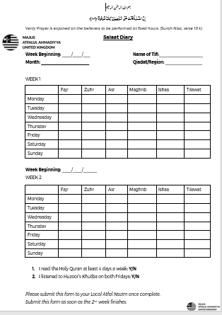


Slide 3
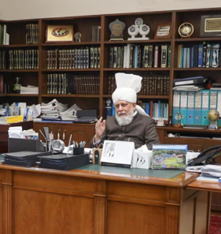
Overview
Recently in a mulaqaat with UK Murabiyaan, Huzoor-e-Anwar (aba) stated:
    “Try to bring the youth closer and in these days make a special effort to make the youth regular in observing their prayers.”
    https://www.pressahmadiyya.com/press-releases/2021/01/missionaries-serving-in-uk-have-honour-of-virtual-meeting-with-world-head-of-ahmadiyya-muslim-community/

Slide 4
AIM
Our aim is to get 100% of the Atfal tajneed regular in their prayers.
The Salaat Diary will:
Help a local Nazim keep in contact with their Atfal
Motivate Atfal to fill out the diary. Muhaasiba-e-Nafs

Slide 5

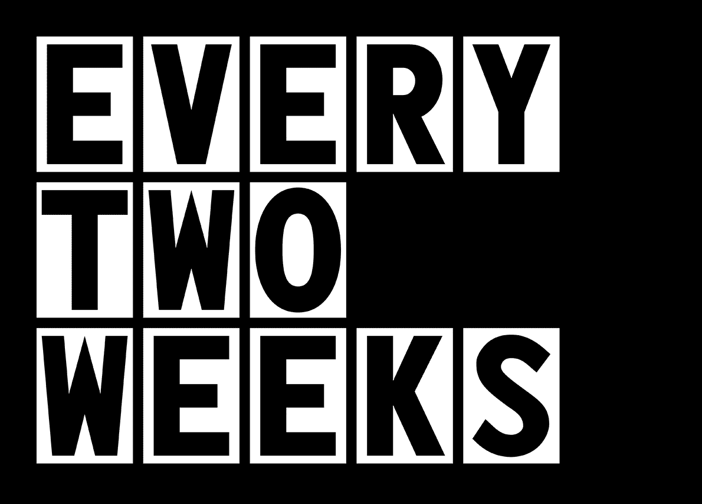
Plan – from the viewpoint of a Tifl
The Salaat Tracker Diary is a bi-weekly diary that a Tifl needs to fill out so that he can track the progress of his salaat.
The Salaat Tracker Diary is being launched for all Atfal across the UK, to help encourage the observing of the five daily prayers whilst keeping a track on the improvements that a Tifl can make, on a daily basis. To ensure that he is on the right track, these points need to be implemented:
Local Nazim Atfal needs to give every Tifl a copy of the Salaat Tracker Diary. If they do not have a printer, they can fill it out on the computer or even make their own copy.
Print the diary out and start filling it in (or if you don’t have one, request your local Nazim to deliver it to you or you can always make your own replica on paper.)
They need to make sure they fill the diary out on a daily basis.
The diary should be submitted after every two weeks to the Local Nazim – at minimum.

Slide 7
Local Nazim
As a Local Nazim for Atfal, it is your responsibility to ensure that every Tifl in your Qiadat is aware of the Salaat Tracker Diary. Please see below points that need to be actioned:
Ensure the Salaat Tracker Diary is sent to all Atfal.
Confirm acknowledgement from each Tifl that they have received the diary and understand how it works.
Regularly remind Atfal to fill the form out and check on a regular basis that this is being done.
Display a chart (of Atfal that actively submit their diaries to you and those who don’t) during your local Taleem class so it encourages Atfal to take part.
you should also show the diary in your local classes and answer any questions Atfal may have regarding the diary.
Saiqeen can be utilised but the responsibility of ensuring the smooth running of this programme lies with the local Nazim.
If a Tifl cannot print this diary – then they can make a replica of the diary or the local Nazim Atfal can hand deliver the diary.

Slide 8
Regional Nazim
As a Regional Nazim Atfal, it is your responsibility to ensure that all Local Nazimeen and all Atfal in your Region are aware of the Salaat Tracker Diary.
You must:
Ensure all Local Nazimeen have received the Salaat Tracker Diary.
Confirm with the Local Nazimeen that they have received the diary.
Ensure that the Local Nazimeen have sent the diary to all Atfal in their Qiadat.
Ensure that the Local Nazimeen are reminding their Atfal about filling the diary in.
Make sure that Local Nazimeen are collecting and recording data.
Make sure Nazimeen are displaying a chart during their local classes at least every other week of who is and isn’t submitting the diary.

Slide 9
Tracking and reporting
Local nazimeen
Local nazimeen will need to report to their regional nazim on:
How many atfal have started using the diary
How many atfal are submitting their diaries on a bi-weekly basis or a weekly basis.
Note:
Local nazimeen can obtain this data via: google forms or however they wish
A tifl can send a screenshot of his diary if that is easier for the local nazim
An excel sheet template will be available on the website [link at the end of the presentation]

Slide 10
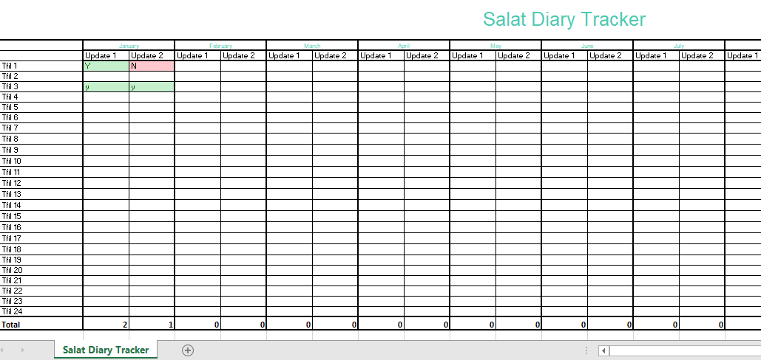
EXAMPLE OF RECORDING DATA

Slide 11

Tracking and reporting regional nazimeen
Every two weeks, regional nazimeen will need to fill out a report which will be provided from centre.
In this report, regional nazimeen will mention
how many qiadats have started using the diary system
how many atfal from the region are actively submitting their forms to their local nazim
Results will be displayed on a leader board system

Slide 12

We will:
Directly contact regional nazimeen once a week
Show progress via leader board system
Hold meetings on a monthly basis with regions and their local nazimeen
In march – we will be re-visiting those regions who have not yet had 50% of their tajneed on the salaat diary

Slide 13
Further information
www.atfal.org.uk/tarbiyyat/salaat-diary/

