Slide 1
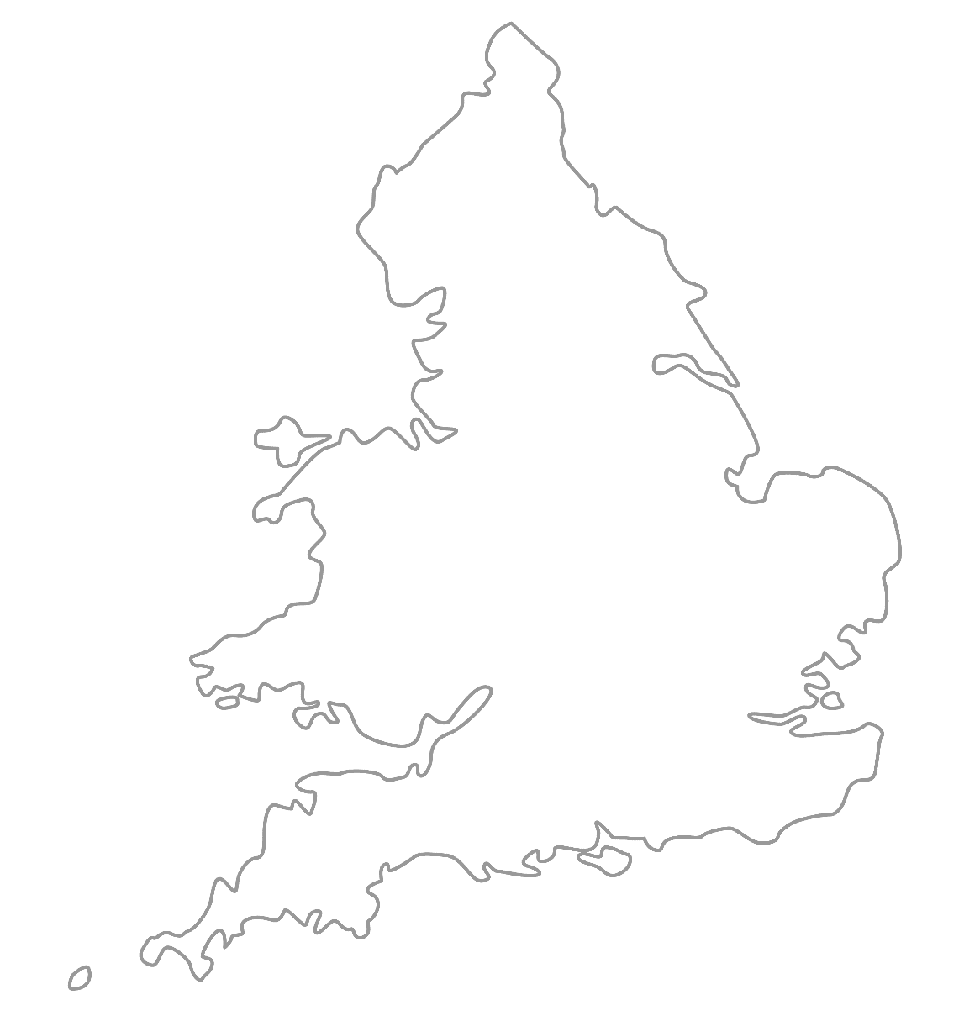

MAA National Online Talim Class
Age group 11-15
MA
A
TAL
IM
LESSON NUMBER 10
07th February 2021
The Class will begin shortly

Slide 2

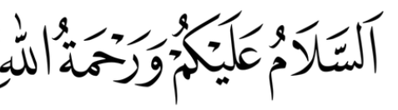
Welcome
Welcome to the Online Talim class organised by Majlis Atfal-ul-Ahmadiyya UK. Please take this time to make sure your regional Nazim knows that you are present in the class.
This class is for 11-15-year-old Atfal
Ask your regional nazim for the link to the class for younger Atfal if you do not fall in this age group or re-register.
Have you registered for the class ?
If you have not registered, please head over to Atfal.org.uk/taleem-online-classes and register. You only need to register once to get the weekly emails for the whole year.

Slide 3
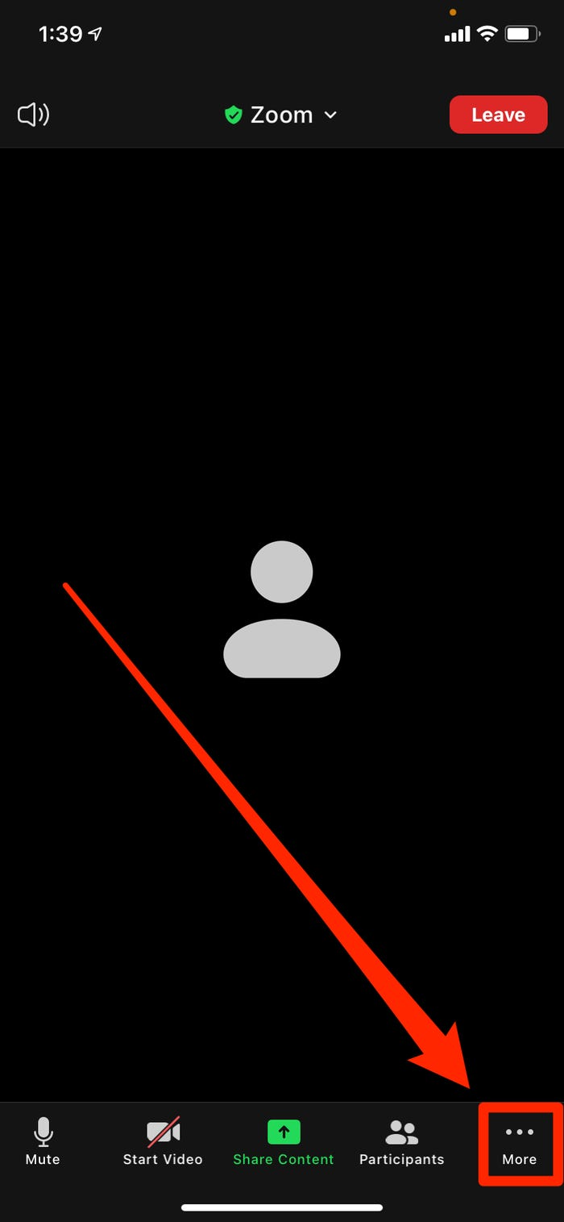
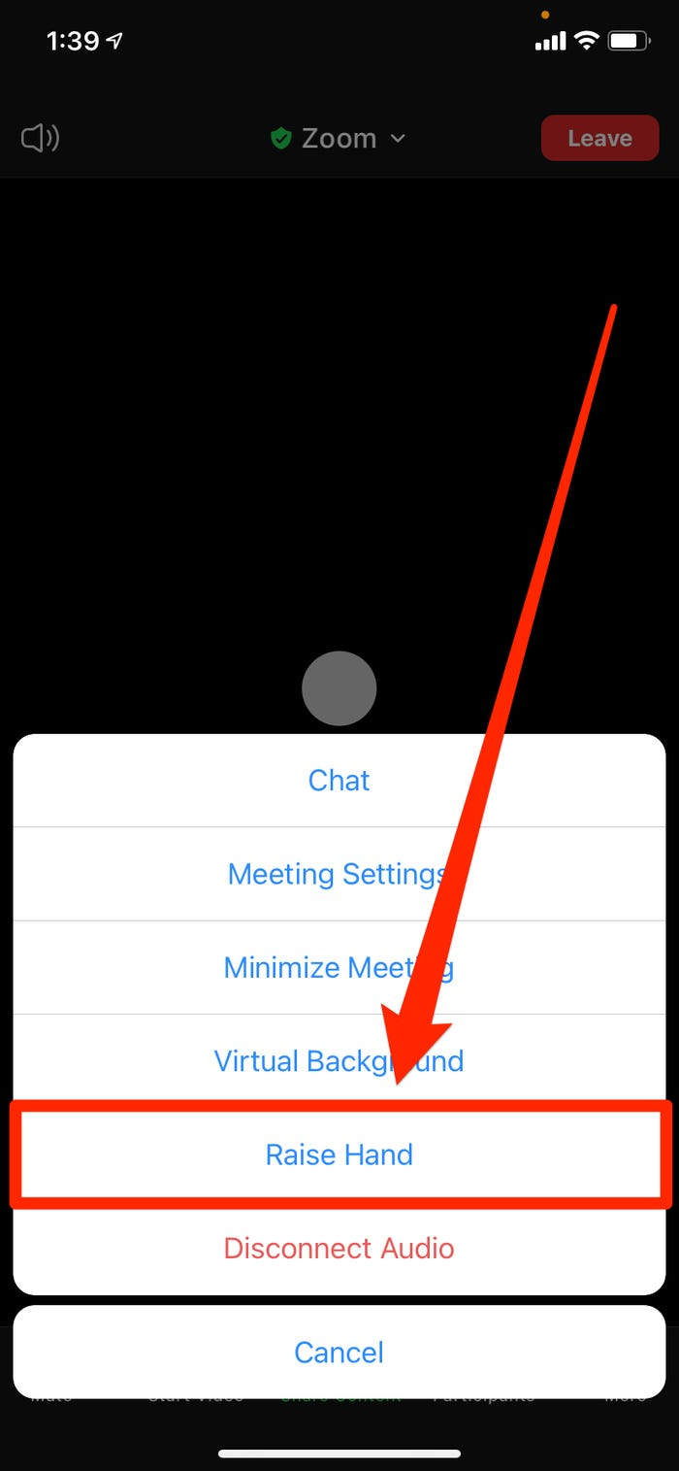
How to raise your hand from a mobile phone

Slide 4
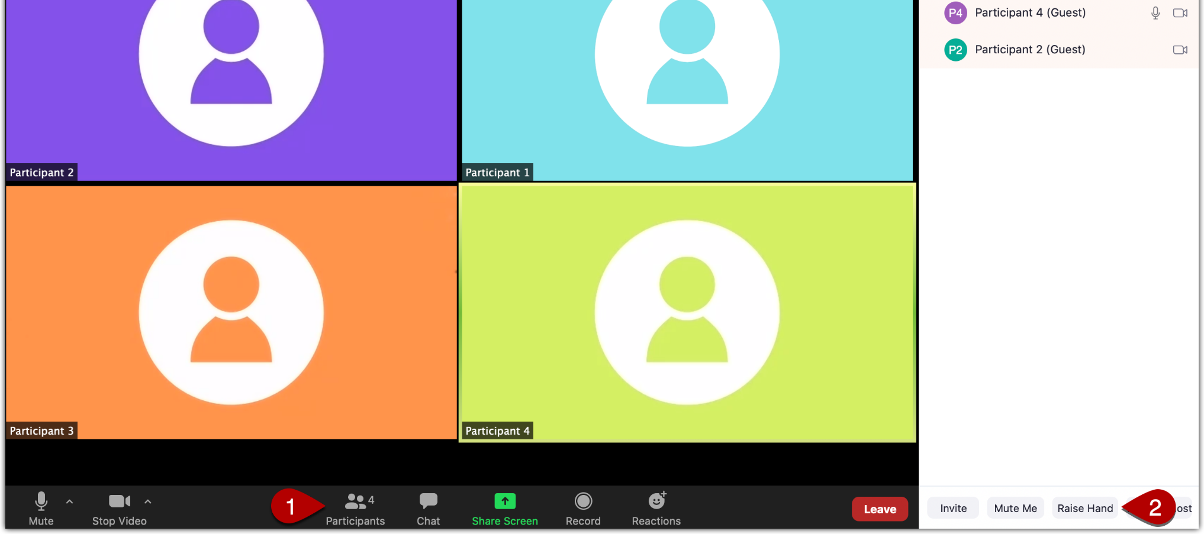
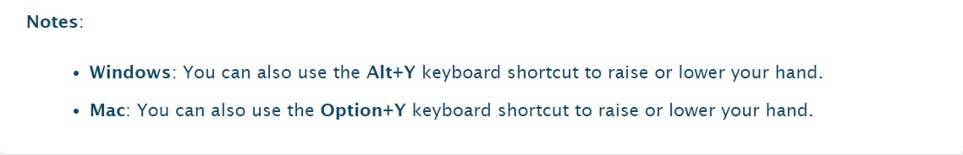
How to raise your hand from Windows or Mac
First: Open participants panel
Then, click on the Raise hand button here

Slide 5
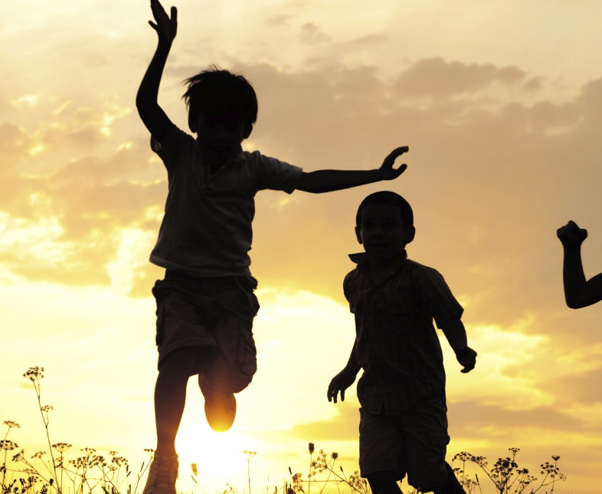
PARTNER
“What have you been up to in the past week?”

Slide 6
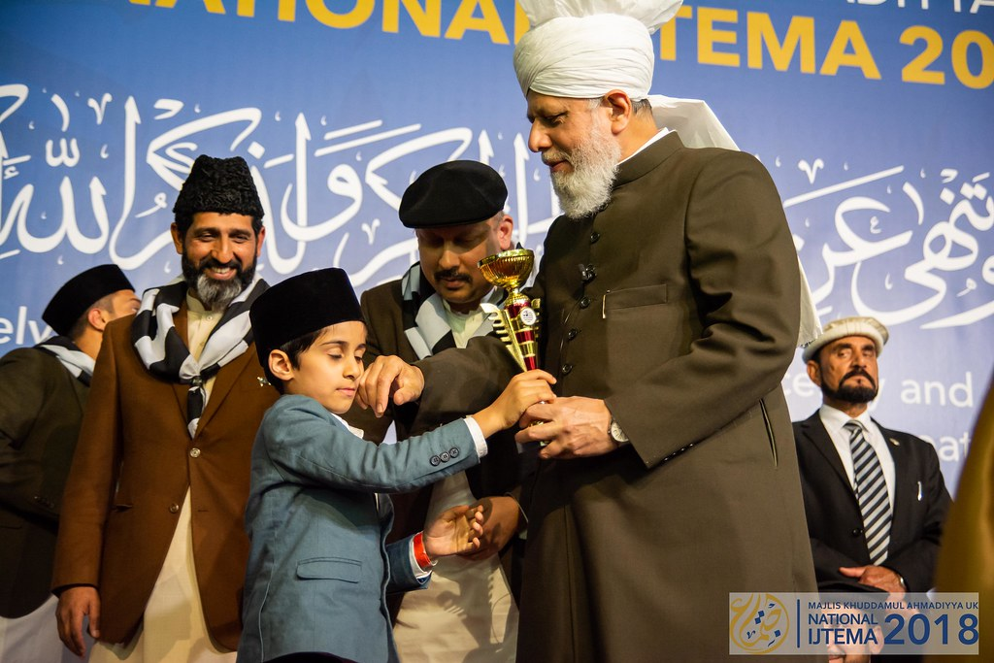
Learning
Section

Slide 7
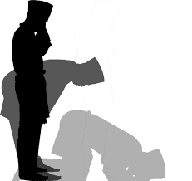
Salaat
سُبْحَانَ رَبِّیَ الْاَعْلٰی
Subhana Rabbiyal-a‘la.
Holy is my Lord, the Most High

Slide 8
Salaat
الْاَعْلٰی | رَبِّیَ | سُبْحَانَ
The Most High | My Lord | Holy
Holy is my Lord, the Most High

Slide 9
Hadith
اَلنَّاسُ كَأَسْنَانِ الْمُشْطِ
An-naasu ka asnaa-nil-musht
People are like the teeth of a comb.
How has brotherhood changed the world?
What would happen if there was no brotherhood?
What does this Hadith mean?
Why is brotherhood important?

Slide 10
Short Quiz
  If you do not know the answer, do not raise your hand
5 Questions and their answers
  If you have already had a go, let your Atfal brothers have a go too and not raise your hand again
  Raise your hand if you know the answer, or send in the chat

Slide 11
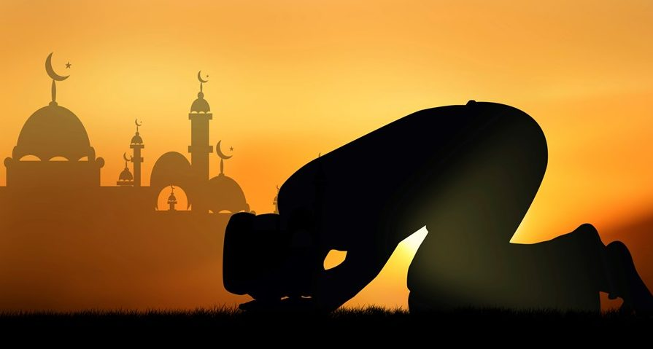
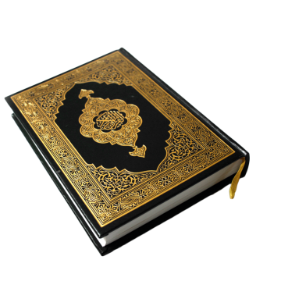
Short Quiz
Question 1
  In which year did The Promised Messiah (as) claim to be the Messiah

Slide 12
Short Quiz
Answer to Q1
1890

Slide 13
Short Quiz
Question 2
  What revelation was revealed to the Promised Messiah (as) after the demise of His (as) Father?

Slide 14
Short Quiz
Answer to Q2
27th December 1891
in Aqsa Mosque Qadian

Slide 15
Short Quiz
Question 3
  What is the Arabic revelation revealed to the Promised Messiah (as)?

Slide 16
Short Quiz
Answer to Q3
أَلَيْسَ اللَّهُ بِكَافٍ عَبْدَهُ
Translation: Is Allah not sufficient for His servant?

Slide 17
Short Quiz
Question 4
  What is the name of the first Khalifah of the Promised Messiah (as)?

Slide 18
Short Quiz
Answer to Q4
Hazrat Maulana Hakeem Noorudin ra

Slide 19
Short Quiz
Question 5
  When and where was Khalifah-tul-Masih (I) ra born?

Slide 20
Short Quiz
Answer to Q5
Bhera in Punjab in 1841

Slide 21
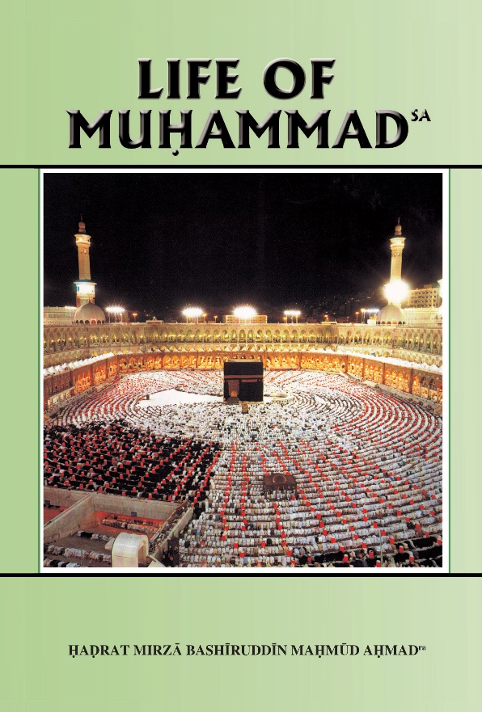
Reading Section

Slide 22
Reading section
Life of Muhammad (pbuh)
Written by: HADRAT MIRZA BASHIRUDDIN MAHMUD AHMAD
KHALIFATUL MASIH II
ARABIA AT THE TIME OF THE PROPHET’S (saw) BIRTH (Continued)
From the moral point of view the Arabs were a contradictory people. They suffered from some extreme moral defects but at the same time they possessed some admirable qualities. They were given to excessive drinking. To become drunk and to run wild under the effect of drink was for them a virtue, not a vice. Their conception of a gentleman was one who should entertain his friends and neighbours to drinking bouts. Every rich man would hold a drinking party at least five times a day. Gambling was their national sport. But they had made of it a fine art. They did not gamble in order to become rich. Winners were expected to entertain their friends. In times of war, funds were collected through gambling. Even today we have the institution of prize-bonds to raise money for war. The institution has been resuscitated in our time by the people of Europe and America. But they should remember that in this they only imitate the Arabs. When war came, Arabian tribes would hold a gambling party. Whoever won had to bear the greater part of the expenses of the war.

Slide 23
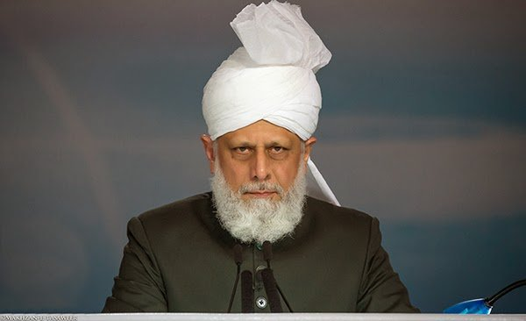
Abid Khan Sahib’s Diary
“Huzoor’s Wise Words”
I met an Ahmadi called Mashood Ahmad who told me about his previous Mulaqat which had been some years previously. He said that on the night before meeting Huzoor he had been burgled and most of his valuable possessions and all of his clothes had been stolen. He had no money or time to go shopping and so he appeared at his Mulaqat in very basic clothes and felt very embarrassed by his appearance.
Thus, as soon as he entered he told Huzoor about the burglary and apologised about his attire. Upon hearing the story, Huzoor said:
Hazrat Mirza Masroor Ahmad (aba)
“Do not worry at all – perhaps the burglar needed the clothes more than you.”
…

Slide 24
Abid Khan Sahib’s Diary
“Huzoor’s Wise Words”
Mashood sahib said he was astonished by Huzoor’s kindness and also the wisdom within Huzoor’s words. Speaking about the incident, Mashood sahib said:
“After hearing Huzoor’s words I never again felt any worry about the losses that I had incurred – even though they were significant and I did not have any insurance. And ever since that day I have seen blessings in my life and Allah has helped me repeatedly.”
Hazrat Mirza Masroor Ahmad (aba)

Slide 25
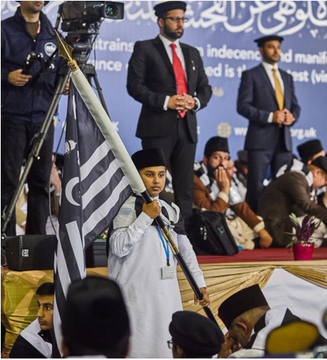
Discussion
Section

Slide 26

Discussion
Social Media
What are some of the benefits of social media?
What are some of the harms/risks of social media?
How can we stay protected from some of the dangers on social media?
How can social media affect a person’s life?
How should we best use social media so that we maximise the benefits and minimise the risks?

Slide 27
Do you have any questions?
Ask us anything!

Slide 28
Announcements
Next Class
14th February 2021 (Sunday)
Class content available on
Atfal.org.uk/taleem-online-classes
Other Initiatives
  Qaseeda Challenge
  Winter Reading Challenge
  Salaat memorisation

