Slide 1
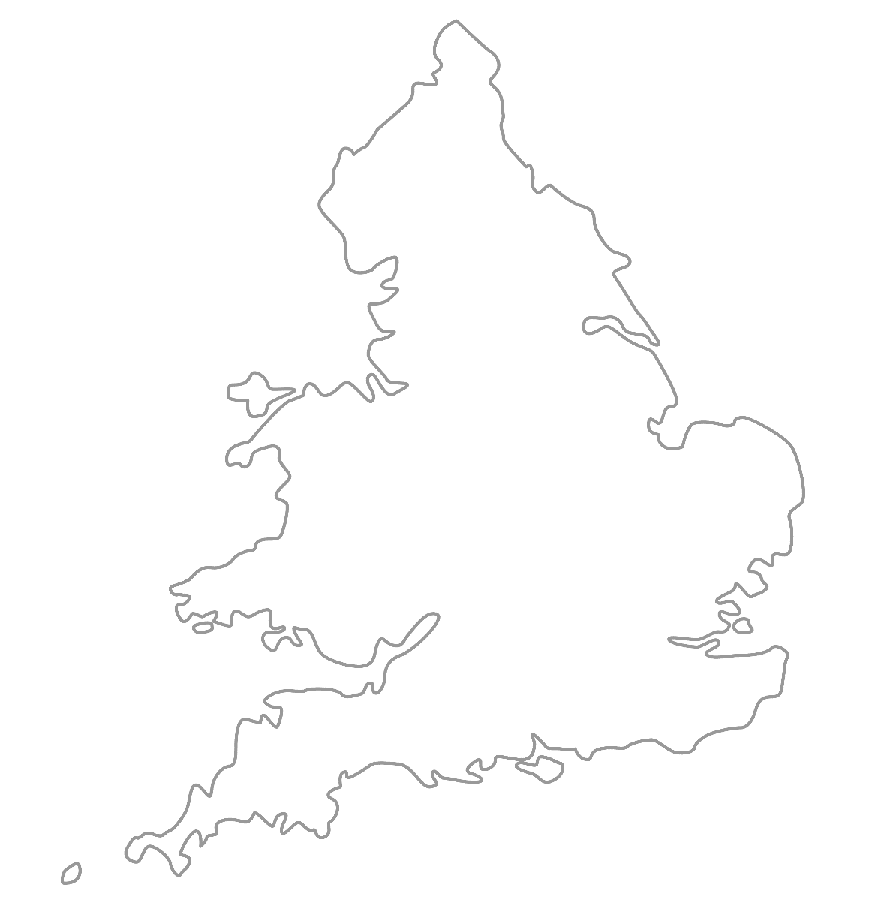

MAA National Online Talim Class
Age group 7-10
MA
A
TAL
IM
LESSON NUMBER 11
14th February 2021
The Class will begin shortly

Slide 2

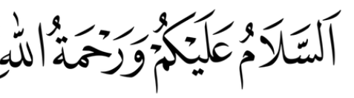
Welcome
Welcome to the Online Talim class organised by Majlis Atfal-ul-Ahmadiyya UK. Please take this time to make sure your regional Nazim knows that you are present in the class.
This class is for 7-10-year-old Atfal
Ask your regional nazim for the link to the class for older Atfal if you do not fall in this age group or re-register.
Have you registered for the class ?
If you have not registered, please head over to Atfal.org.uk/taleem-online-classes and register. You only need to register once to get the weekly emails for the whole year.

Slide 3
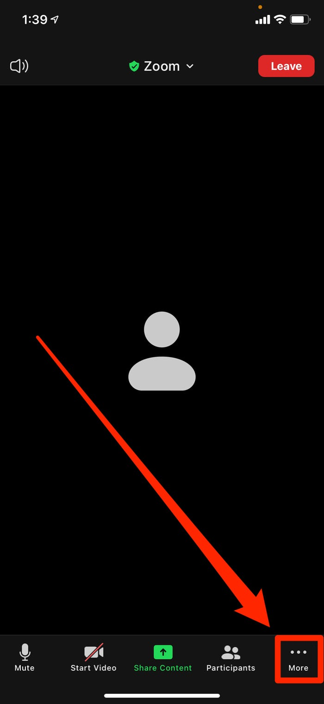
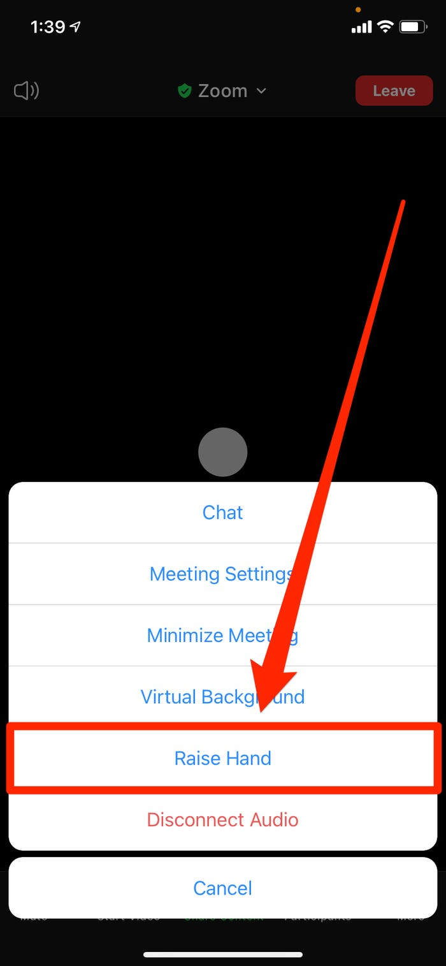
How to raise your hand from a mobile phone

Slide 4
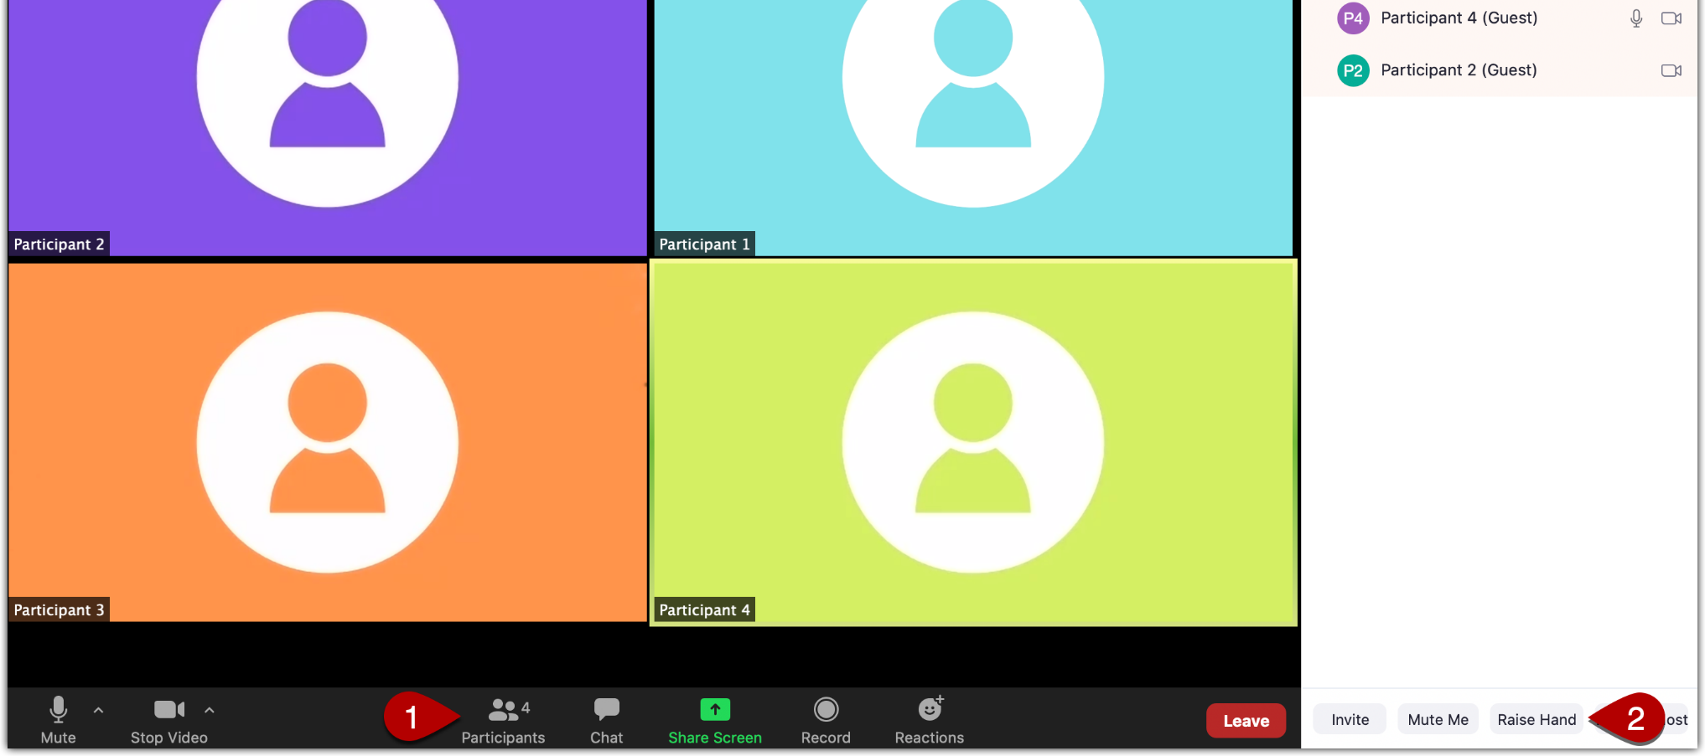
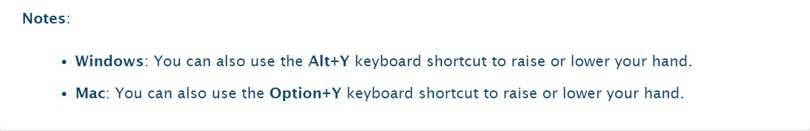
How to raise your hand from Windows or Mac
First: Open participants panel
Then, click on the Raise hand button here

Slide 5
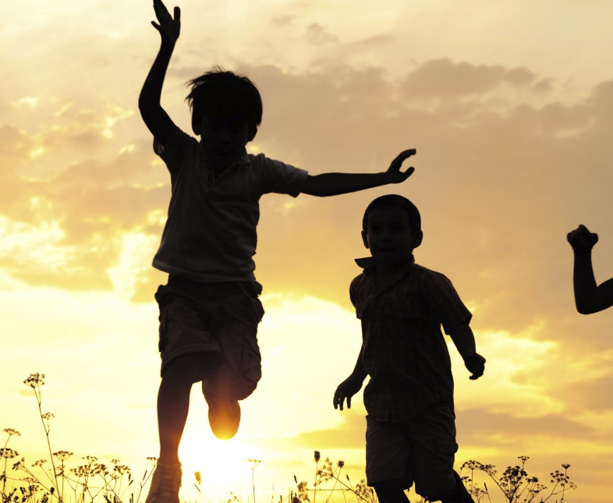
PARTNER
“What have you been up to in the past week?”

Slide 6
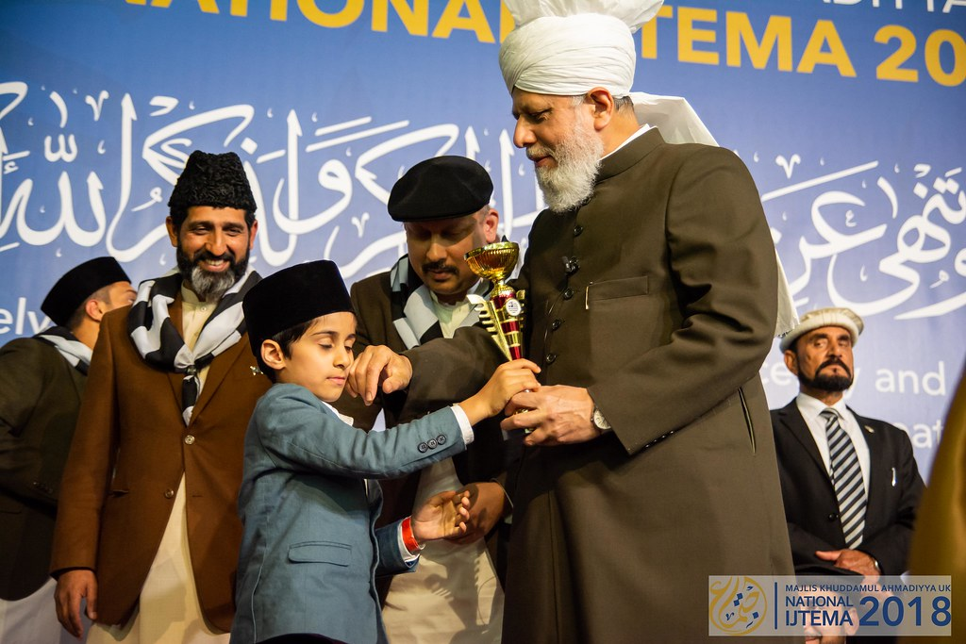
Learning
Section

Slide 7
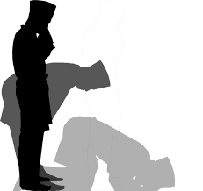
Salaat
رَبِّ اغْفِرْلِيْ وَارْ حَمْنِيْ وَاھْدِنِيْ وَ عَافِنِيْ وَجْبُرْنِيْ وَارْزُقْنِيْ وَارْفَعْنِيْ
Rabbi-gh-firlee war-hamnee wahdini wa’aafinee waj-burnee war-zuknee war-fa’nee
O my Lord, forgive me and have mercy on me and guide me and grant me security and make good my shortcomings and provide for me and raise me up in (status)

Slide 8
Hadith
اِسْتَعِيْنُوا عَلَى الْحَوَائِجِ بِالْكِتْمَانِ
Ista-eenu alal ha-waa-iji bil-kitmaan
To fulfil your needs, seek help in secret.
What is your responsibility if someone seeks help from you in secret?
Why is seeking help in secret better than in public?
What does this Hadith mean?
What does it mean by your needs?

Slide 9
Short Quiz
  If you do not know the answer, do not raise your hand
5 Questions and their answers
  If you have already had a go, let your Atfal brothers have a go too and not raise your hand again
  Raise your hand if you know the answer, or send in the chat

Slide 10
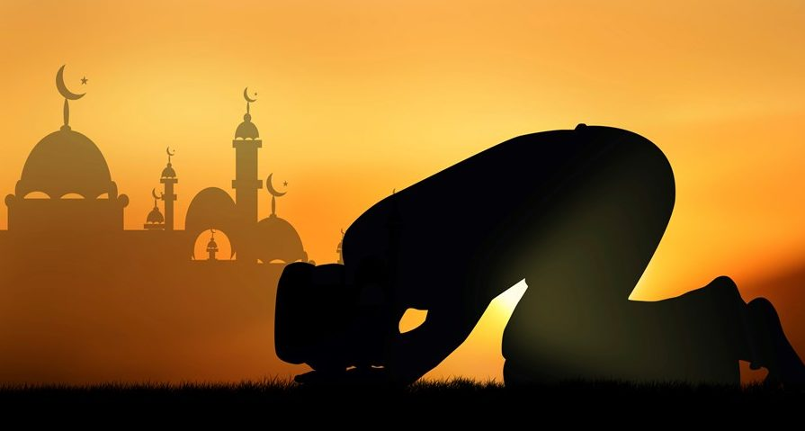
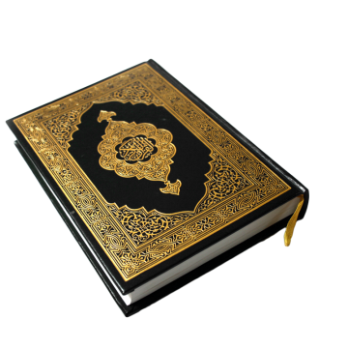
Short Quiz
Question 1
  When did the Promised Messiah (as) pass away?

Slide 11
Short Quiz
Answer to Q1
26th May 1908, in Lahore

Slide 12
Short Quiz
Question 2
  What were the last words of The Promised Messiah (as)?

Slide 13
Short Quiz
Answer to Q2
“اللہ میرے پیارے اللہ”
Translation:
“Allah, my beloved Allah”

Slide 14
Short Quiz
Question 3
  When did Khalifah-tul-Masih I (ra) pass away?

Slide 15
Short Quiz
Answer to Q3
13th March 1914

Slide 16
Short Quiz
Question 4
  What is the name of the second Khalifah of the Promised Messiah (as)?

Slide 17
Short Quiz
Answer to Q4
Hazrat Mirza Bashiruddin Mahmood Ahmad ra

Slide 18
Short Quiz
Question 5
  where was Khalifah-tul-Masih (II) ra born?

Slide 19
Short Quiz
Answer to Q5
12th January 1889

Slide 20
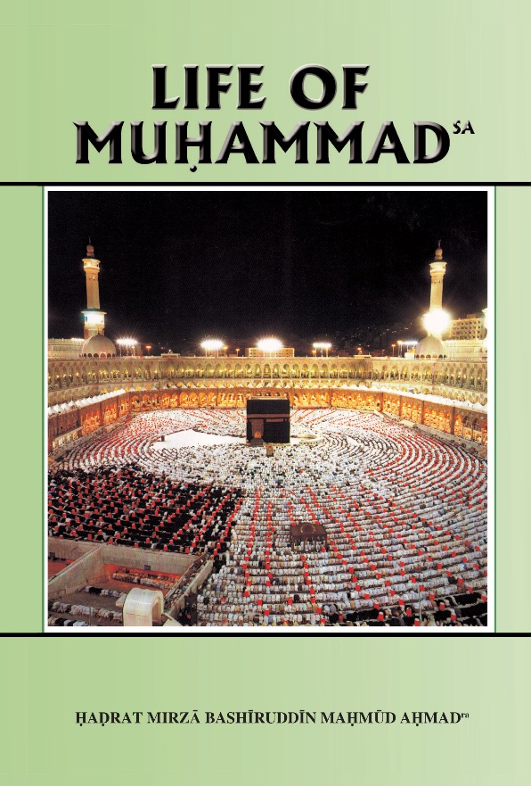
Reading Section

Slide 21
Reading section
Life of Muhammad (pbuh)
Written by: HADRAT MIRZA BASHIRUDDIN MAHMUD AHMAD
KHALIFATUL MASIH II
ARABIA AT THE TIME OF THE PROPHET’S (saw) BIRTH (Continued)
Of the amenities of civilized life, the Arabs knew nothing. Their chief occupation was trade, and to this end they sent their caravans to far-off places, such as Abyssinia, Syria, Palestine and even India. The rich among them were great admirers of Indian swords. Their clothing needs were supplied largely by Yemen and Syria. The trading centres were the towns. The rest of Arabia, excepting Yemen and some northern parts, was Bedouin. There were no permanent settlements, or places of habitation. The tribes had divided the country between them so that members of a tribe wandered about freely in their part of the country. When the water supply in any place was exhausted, they would move on to some other place and settle down Their capital consisted of sheep, goats and camels. From the wool they made cloth, and from the skins they made tents. What was left over they sold in the market. Gold and silver were not unknown, but they were certainly very rare possessions. The poor and the common folks made ornaments of cowries and sweet-smelling substances. Seeds of melons were cleaned, dried and strung together to make necklaces.

Slide 22
Reading section
Life of Muhammad (pbuh)
Written by: HADRAT MIRZA BASHIRUDDIN MAHMUD AHMAD
KHALIFATUL MASIH II
ARABIA AT THE TIME OF THE PROPHET’S (saw) BIRTH (Continued part 2)
Crime and immoralities of various kinds were rampant. Theft was rare but dacoity was common. To attack and to dispossess one another was regarded a birth right. But, at the same time, they honoured their word more than any other people. Should an individual go to a powerful leader or tribe and ask for protection, that leader or tribe was honourbound to protect that individual. If this was not done, the tribe lost caste throughout Arabia. Poets commanded great prestige. They were honoured as national leaders. Leaders were expected to possess great powers of speech and even to be able to compose verse. Hospitality had developed into a national virtue. A forlorn traveller on arrival at the headquarters of a tribe would be treated as an honoured guest. The best animals would be slaughtered for him and the utmost consideration shown. They did not care who the visitor was. It was enough that a visitor had arrived. The visit meant an increase of status and prestige for the tribe. It became the tribe's duty, therefore, to honour the visitor. By honouring him it honoured itself. Woman in this Arab society had no status and no rights.

Slide 23
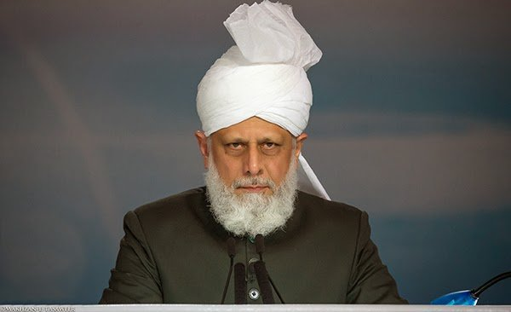
Abid Khan Sahib’s Diary
“Fadeela Doing Tilawat in Front of Huzoor”
Her father then told me that Fadeela had wanted to recite the Holy Quran in front of Huzoor but the time of their Mulaqat ended before they could ask. Hence, when she came out of Huzoor’s office Fadeela had begun to cry and was very upset.
Telling me about what happened next, Ahmad sahib said:
“One of the security guards saw Fadeela crying and informed Huzoor’s Private Secretary, who then informed Huzoor that Fadeela had wanted to do Tilawat in front of him. Our Khalifa is so kind and gracious that, even though he is so busy, he called us back in his office and my daughter recited verses of the Quran in front of him. At the end, Huzoor smiled and was pleased and he said ‘Masha’Allah’. The happiness Huzoor gave my daughter and all of us is indescribable.”
Hazrat Mirza Masroor Ahmad (aba)

Slide 24
Abid Khan Sahib’s Diary
“Fadeela Doing Tilawat in Front of Huzoor” (cont)
After hearing this, Fadeela said she would like to show me how she recited the Quran in front of Huzoor. It was a genuinely moving experience hearing her recite the Quran with such innocence and love.
I then spoke to their nine-year old son, Muhammad who said:
“I feel very lucky today because I met the person who is nearest to Allah and I also had the opportunity to do Tilawat in front of Huzoor after my sister. My biggest dream is that Amir-ul-Momineen remains always happy with me.”
Hazrat Mirza Masroor Ahmad (aba)
As our conversation concluded, I felt amazed at the faith and love for Khilafat, not just of the parents who were converts, but also of their young children.
Often when you meet Arab people who have accepted the Promised Messiah (as), their faith and passion is such that it leaves you highly embarrassed at your own weak standards by comparison.

Slide 25
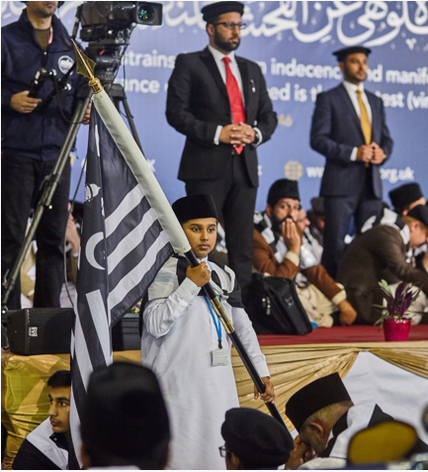
Discussion
Section

Slide 26
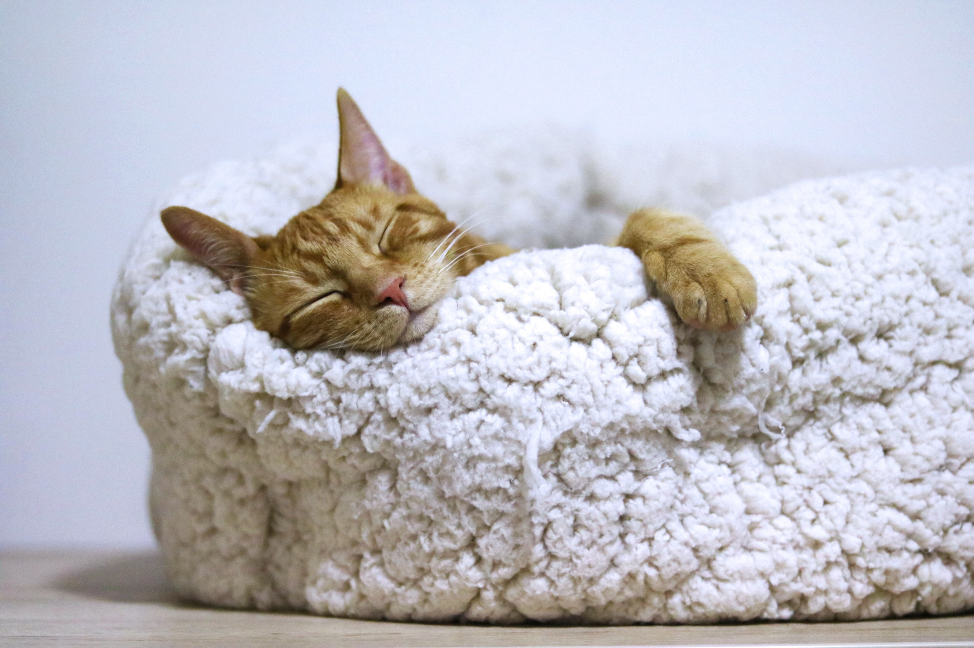
Discussion
The importance of sleep
Why does our body need sleep?
How can mental health affect sleep?
How can sleep affect mental health?
How can sleep affect how punctual you are to prayer?
How can looking at screens (such as phones, tvs or tablets) affect sleep?

Slide 27
Do you have any questions?
Ask us anything!

Slide 28
Announcements
Next Class
21th February 2021 (Sunday)
Class content available on
Atfal.org.uk/taleem-online-classes
Other Initiatives
  Qaseeda Challenge
  Winter Reading Challenge
  Salaat memorisation

