Slide 1
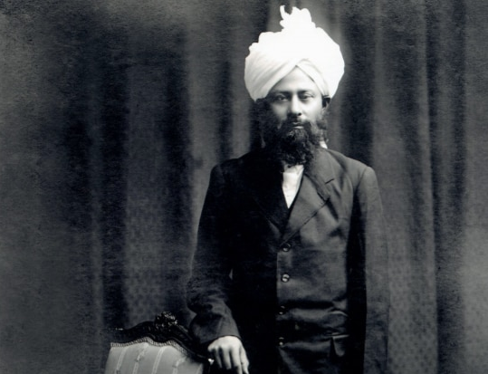

MAA National Online Talim Class
MA
A
TAL
IM
Age group 11-15
Musleh Maud Day Special
“A Nation cannot be reformed without the reformation of its youth”
LESSON NUMBER 12
21st February 2021
The Class will begin shortly

Slide 2

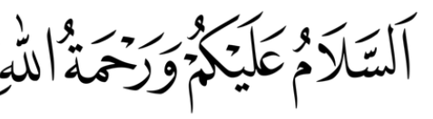
Welcome
Welcome to the Online Talim class organised by Majlis Atfal-ul-Ahmadiyya UK. Please take this time to make sure your regional Nazim knows that you are present in the class.
This class is for 11-15-year-old Atfal
Ask your regional nazim for the link to the class for younger Atfal if you do not fall in this age group or re-register.
Have you registered for the class ?
If you have not registered, please head over to Atfal.org.uk/taleem-online-classes and register. You only need to register once to get the weekly emails for the whole year.

Slide 3

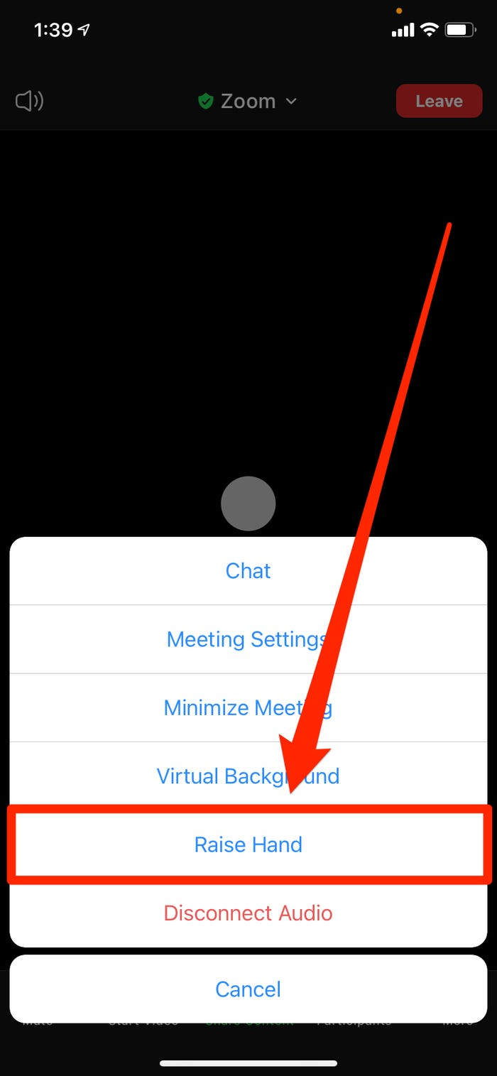
How to raise your hand from a mobile phone

Slide 4

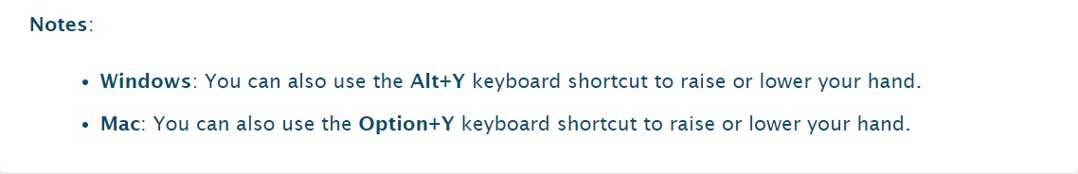
How to raise your hand from Windows or Mac
First: Open participants panel
Then, click on the Raise hand button here

Slide 5

PARTNER
“What have you been up to in the past week?”

Slide 6
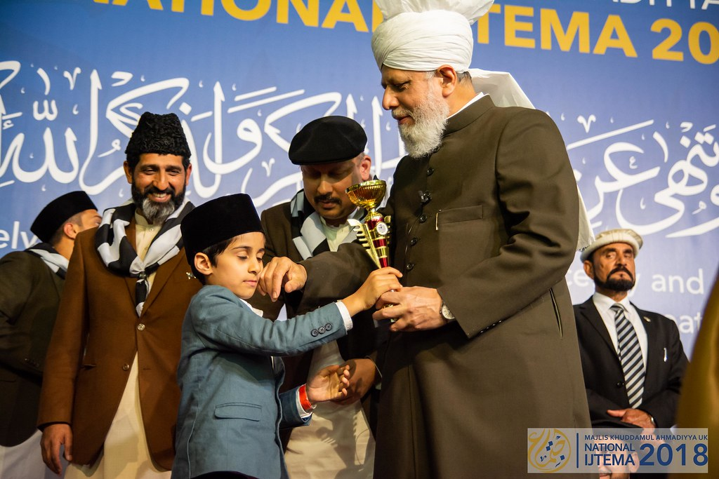
Learning
Section

Slide 7
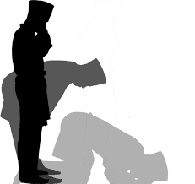
Salaat
اَلتَّحِیَّاتُ لِلّٰہِ وَالصَّلَوٰتُ وَالطَّیِّبٰتُ اَلسَّلَامُ عَلَیْکَ اَیُّھَا النَّبِيُّ وَرَحْمَۃُاللّٰہِ وَبَرَکَاتُہٗ اَلسَّلَامُ عَلَیْنَا وَعَلٰی عِبَادِ اللّٰہِ الصّٰلِحِیْنَ
At-tahiyyatu lillahi was-sala watu wat-tayyibatu assalamo ‘alaika ayyu hunna biyyu wa rah matul-laahi wabarakatuhu, assalamo ‘alaina wa ‘alaa ‘ibadillah-i-saaliheen
All verbal worship is due to Allah and all physical acts of worship and financial sacrifices, Peace be on you, O Prophet and the Mercy of Allah and His Blessings, Peace be on us, and on the righteous servants of Allah

Slide 8
Salaat
لِلّٰہِ | اَلتَّحِیَّاتُ
Is due to Allah | All verbal worship
All verbal worship is due to Allah
وَالطَّیِّبٰتُ | وَالصَّلَوٰتُ
And all financial sacrifices | And all physical worship
And all physical acts of worship and financial sacrifices
النَّبِيُّ | اَیُّھَا | عَلَیْکَ | اَلسَّلَامُ
Prophet | O! | Be on you | Peace
Peace be on you, O Prophet
وَبَرَکَاتُہٗ | اللہِ | وَرَحْمَۃُ
And His blessings | Of Allah | And the Mercy
And the Mercy of Allah and His Blessings
الصّٰلِحِیْن | اللہِ | وَعَلٰی عِبَادِ | اَلسَّلَامُ عَلَیْنَا
The righteous | Of Allah | And on the servants | Peace be on us
Peace be on us, and on the righteous servants of Allah

Slide 9
Short Quiz
  If you do not know the answer, do not raise your hand
5 Questions and their answers
  If you have already had a go, let your Atfal brothers have a go too and not raise your hand again
  Raise your hand if you know the answer, or send in the chat

Slide 10
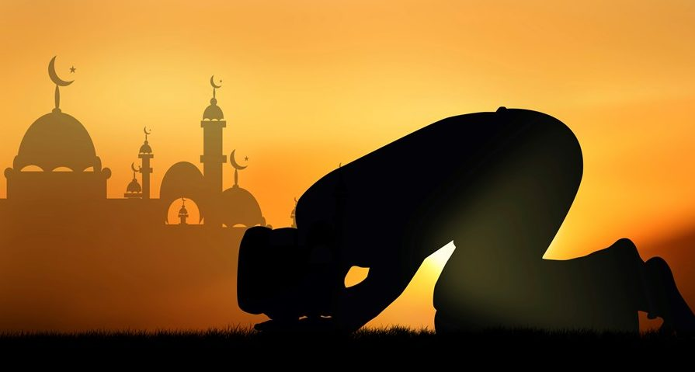
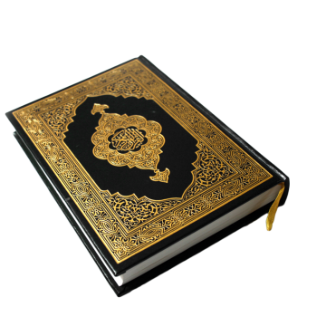
Short Quiz
Question 1
  when was Khalifah-tul-Masih (II) ra born?

Slide 11
Short Quiz
Answer to Q1
12th January 1889

Slide 12
Short Quiz
Question 2
  when was Khalifah-tul-Masih (II) ra elected as Khalifah?

Slide 13
Short Quiz
Answer to Q2
14th March, 1914

Slide 14
Short Quiz
Question 3
  Name any Auxillary organization which was initiated by Hazrat Musleh Maud ra

Slide 15
Short Quiz
Answer to Q3
Lajna Imaa’illah
Nasiratul Ahmadiyya
Masjlis Khuddam-ul-Ahmadiyya
Masjlis Atfalul Ahmadiyya

Slide 16
Short Quiz
Question 4
  When did Hazrat Musleh Maud ra receive his first revelation?

Slide 17
Short Quiz
Answer to Q4
1905
“I will place those who follow you above those who disbelieve until the day of Resurrection”

Slide 18
Short Quiz
Question 5
  Which 2 important schemes did Hazrat Musleh Maud initiate?

Slide 19
Short Quiz
Answer to Q5
Tehrik-e-Jadid and
Waqf-e-Jadid

Slide 20

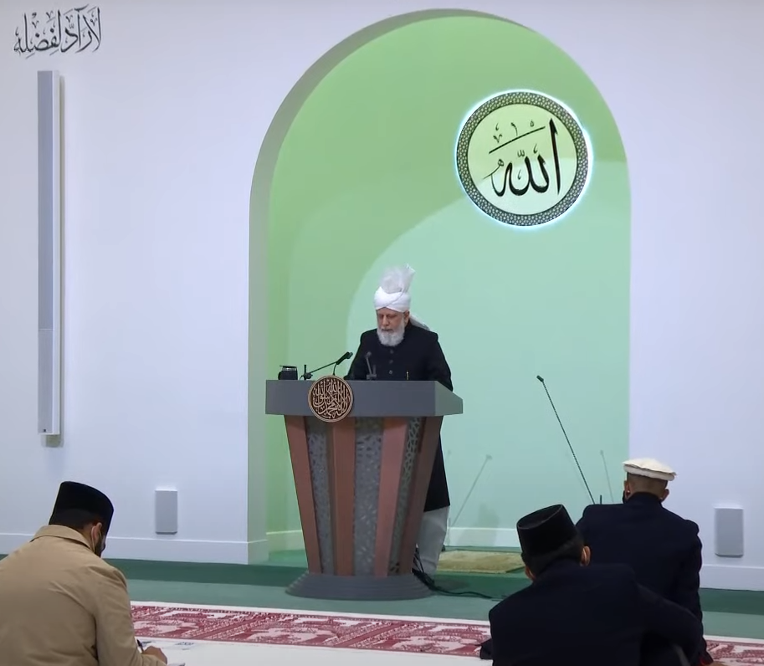
Reading Section
Extracts from Summary of the recent Friday Sermon

Slide 21
Prophecy of the Promised Son – He Will be Filled With Secular & Spiritual Knowledge
Knowledge With Regards to Attaining True Success
His Holiness (aba) said that in December of 1908, Hazrat Mirza Bashiruddin Mahmud Ahmad (ra), at the age of 19, presented a speech at the Annual Convention in Qadian on the topic of attaining true success. He said that one must realise that there is an everlasting life in the hereafter. He posed the question, that when people take every precaution in this world for a life which is temporary, but should they not also prepare more so for a life which is to last forever? He said that everyone strives for success in this world through their work or business, but there is another sort of trade, which may not bear fruit in this world, but will surely bear fruit in the hereafter. In order to be successful in this sort of trade, Hazrat Mirza Bashiruddin Mahmud Ahmad (ra) laid out some important principles which must be followed: 1) To always seek forgiveness for one’s sins 2) always pay attention to worship 3) always be thankful to God 4) enjoin good 5) be mindful of the boundaries established by God. Following these steps he said, can lead one to true success.
Extract from summary of Friday Sermon delivered By Hazrat Khalifah-tul-Masih V aba at Masjid Mubarak, Islamabad, Tilford, UK, 19/02/2021

Slide 22
Prophecy of the Promised Son – He Will be Filled With Secular & Spiritual Knowledge
Comprehension of the Love for God
His Holiness (aba) said that in March 1907, when he was only 18 years old, Hazrat Mirza Bashiruddin Mahmud Ahmad (ra) wrote a treatise on the topic of the love for God. His Holiness (aba) said that this shows that God Almighty had instilled this awareness in him from a very young age. He compared the various concepts of God across various religions, and in doing so showed that the God presented by other religions was incomplete, whereas the view of God presented by Islam is the only view that is complete and encompassing, thus enabling one to truly love God. He said that it is only the God presented by Islam, Who still guides humanity through revelation to this day. After one supplicates to God, He does not respond straight away, rather He puts the supplicant through a trial, after which God opens the door of divine communion for the supplicant. It is then that the supplicant enjoys the beauty of prayer.
Extract from summary of Friday Sermon delivered By Hazrat Khalifah-tul-Masih V aba at Masjid Mubarak, Islamabad, Tilford, UK, 19/02/2021

Slide 23
Prophecy of the Promised Son – He Will be Filled With Secular & Spiritual Knowledge
Insight into Divine Decree
His Holiness (aba) said that another speech delivered in 1919 was on the subject of ‘Divine Decree.’ His Holiness (aba) said that this, no doubt, is a difficult subject to tackle, however Hazrat Mirza Bashiruddin Mahmud Ahmad (ra) presented it in a most eloquent manner. Regarding this, the Fourth Caliph (rh) said that to deliver such a speech at the Annual Convention, where both learned and educated people were listening, as well as those who were not educated, and to present it in such a manner that both could understand is indeed a great feat. He dispelled many misconceptions regarding divine decree and explained the subject with extensive proofs and explanations. His Holiness (aba) said that this is something about which many questions arise and so people should read this book.
Extract from summary of Friday Sermon delivered By Hazrat Khalifah-tul-Masih V aba at Masjid Mubarak, Islamabad, Tilford, UK, 19/02/2021

Slide 24
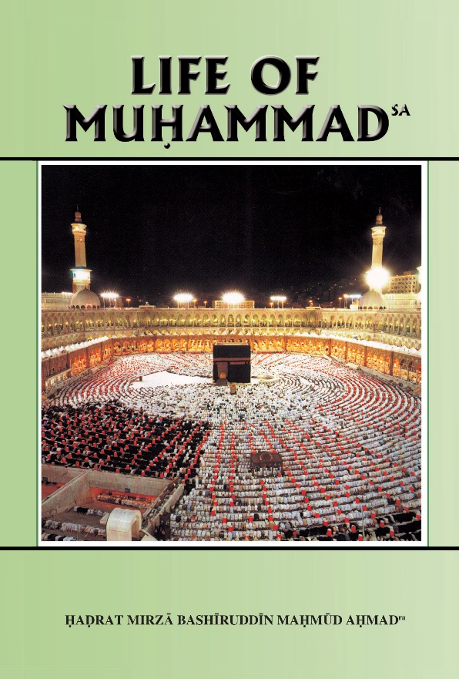
Reading Section

Slide 25
Reading section
Life of Muhammad (pbuh)
Written by: HADRAT MIRZA BASHIRUDDIN MAHMUD AHMAD
KHALIFATUL MASIH II
ARABIA AT THE TIME OF THE PROPHET’S (saw) BIRTH (Continued)
It was among such people that the Holy Prophet (saw) of Islam was born. His father ‘Abdullah had died before his birth. Accordingly, he and his mother Amina had to be looked after by the grandfather, ‘Abdul Muttalib. The child Muhammad (saw) was suckled by a countrywoman who lived in a place near Ta’if. It was a custom in Arabia in those days to hand over children to women in the country, whose duty was to bring up the children, to train their speech and to give them a good start in bodily health. When the Prophet (saw) was in his first year, his mother died while travelling from Medina to Mecca and had to be buried en route. The child was brought to Mecca by a woman servant and handed over to the grandfather. When he was in his eighth year, his grandfather also died, after which Abu Talib, his uncle, became his guardian, this being the wish expressed in a will by the grandfather. The Prophetsa had two or three opportunities to travel out of Arabia. One of these occurred when at the age of twelve he went in the company of Abu Talib to Syria.

Slide 26
Reading section
Life of Muhammad (pbuh)
Written by: HADRAT MIRZA BASHIRUDDIN MAHMUD AHMAD
KHALIFATUL MASIH II
ARABIA AT THE TIME OF THE PROPHET’S (saw) BIRTH (Continued part 2)
It seems that this journey took him only to the south-eastern towns of Syria, for in historical references to this journey there is no mention of places like Jerusalem. From now onwards until he grew up to young manhood he remained in Mecca. From very childhood he was given to reflection and meditation. In the quarrels and rivalries of others he took no part, except with a view to putting an end to them. It is said that the tribes living in Mecca and the territories around, tired of unending blood-feuds, resolved to found an association the purpose of which was to help victims of aggressive and unjust treatment. When the Holy Prophet (saw) heard of this, he gladly joined. Members of this association gave an undertaking in the following terms:
They will help those who were oppressed and will restore
them their rights, as long as the last drop of water
remained in the sea. And if they do not do so, they will
compensate the victims out of their own belongings (Sirat
Ibni Hisham by Imam Suhaili)

Slide 27
Do you have any questions?
Ask us anything!

Slide 28
Announcements
Next Class
28th February 2021 (Sunday)
Class content available on
Atfal.org.uk/taleem-online-classes
Other Initiatives
  Qaseeda Challenge
  Winter Reading Challenge
  Salaat memorisation

