Slide 1
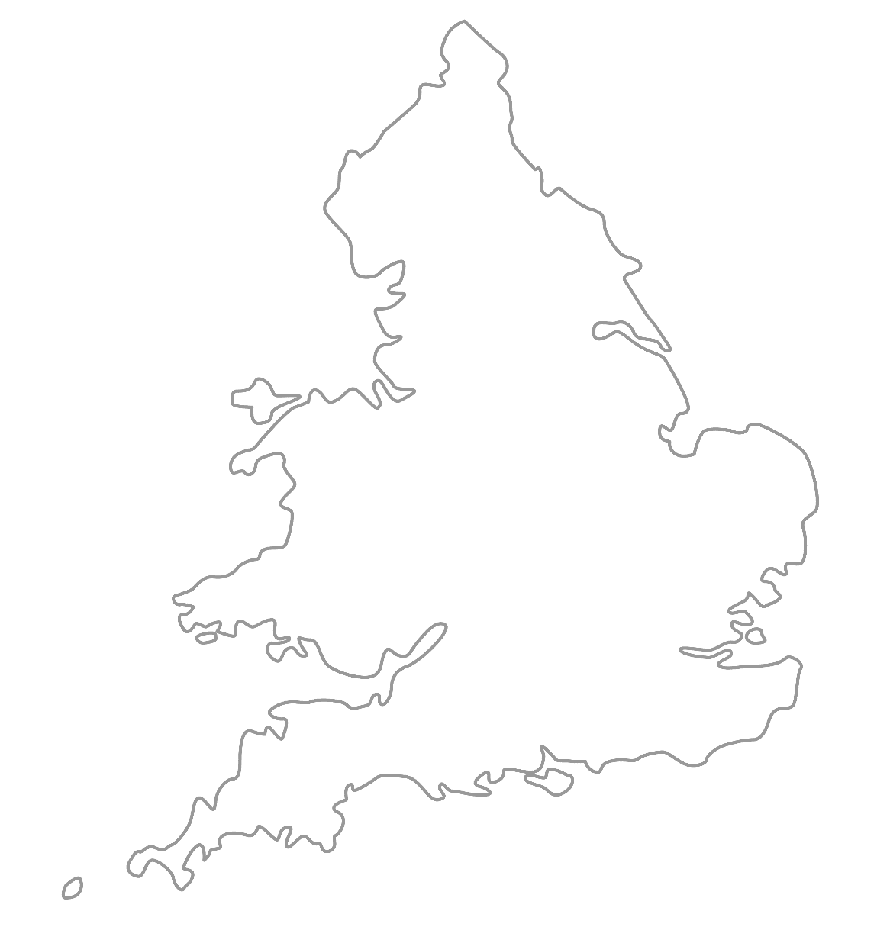

MAA National Online Talim Class
Age group 11-15
MA
A
TAL
IM
LESSON NUMBER 13
21st March 2021
The Class will begin shortly

Slide 2

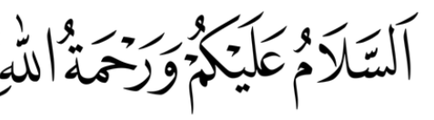
Welcome
Welcome to the Online Talim class organised by Majlis Atfal-ul-Ahmadiyya UK. Please take this time to make sure your regional Nazim knows that you are present in the class.
This class is for 11-15-year-old Atfal
Ask your regional nazim for the link to the class for younger Atfal if you do not fall in this age group or re-register.
Have you registered for the class ?
If you have not registered, please head over to Atfal.org.uk/taleem-online-classes and register. You only need to register once to get the weekly emails for the whole year.

Slide 3
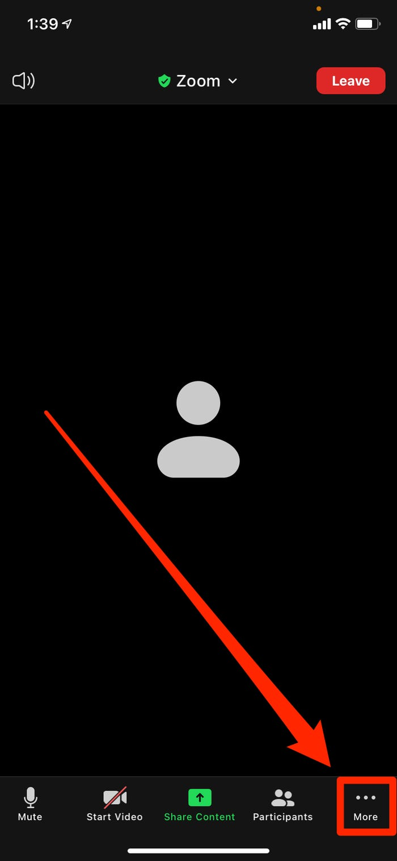
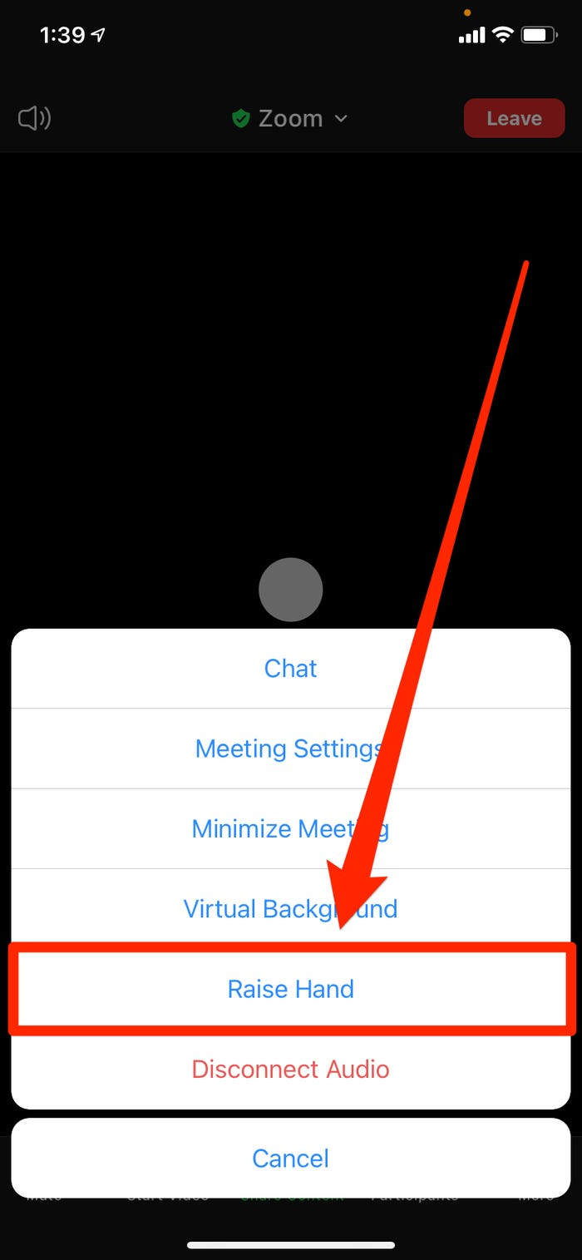
How to raise your hand from a mobile phone

Slide 4
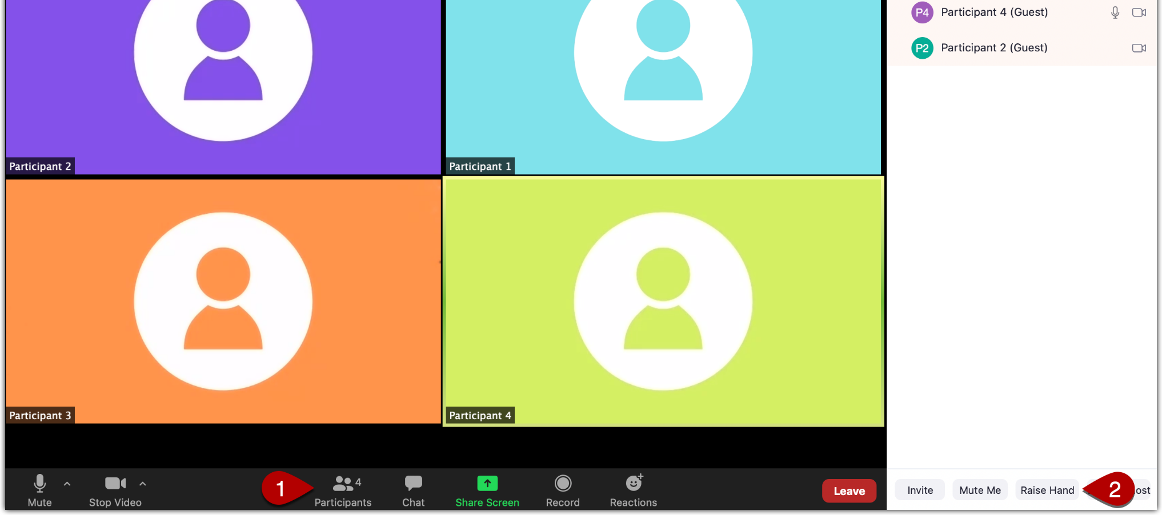
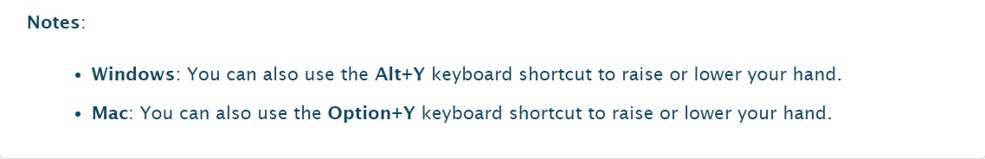
How to raise your hand from Windows or Mac
First: Open participants panel
Then, click on the Raise hand button here

Slide 5
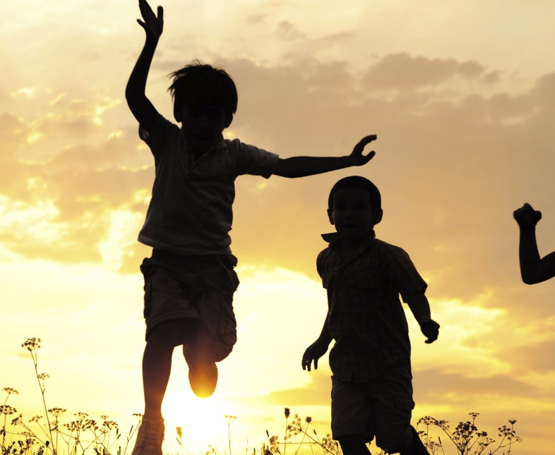
PARTNER
“What have you been up to in the past week?”

Slide 6
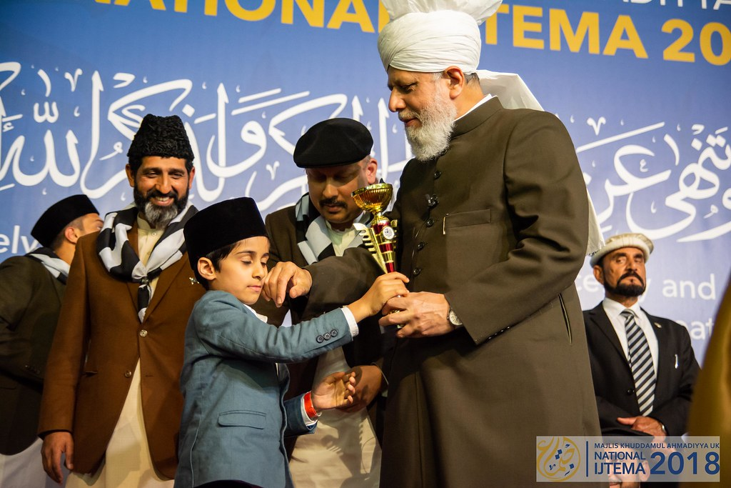
Learning
Section

Slide 7
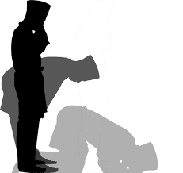
Salaat
اَشْھَدُ اَنْ لَّآ اِلٰہَ اِلَّااللّٰہُ وَ اَشْھَدُ اَنَّ مُحَمَّدًا عَبْدُہٗ وَرَسُوْلُہٗ
Ash-hadu allaa ilaha ill-lal-lahu wa ash-hadu anna muhammadan ‘abduhu warasooloh
I bear witness that there is none worthy of worship except Allah, and I bear witness that Muhammad saw is His Servant and Messenger

Slide 8
Salaat
اِلَّااللّٰہُ | اِلٰہَ | اَنْ لَّآ | اَشْھَدُ
Except Allah | God (worthy of worship) | (there is) no-that | I bear witness
I bear witness that there is none worthy of worship except Allah
وَرَسُوْلُہٗ | عَبْدُہٗ | اَنَّ مُحَمَّدًا | وَ اَشْھَدُ
And His Messenger | Is His Servant | That Muhammad ^{saw} | And I bear witness
And I bear witness that Muhammad ^{saw} is His Servant and Messenger

Slide 9
Hadith
مَنْ قُتِلَ دُوْنَ مَالِهِ فَهُوَ شَهيدٌ
Man qu-ti-la doona maa-li-hi fa-huwa sha-heed
The one who dies protecting their property is a martyr.
How can someone die protecting their property?
What is our most precious ‘property’ right now?
What does a martyr mean?
Can you give examples of this?

Slide 10
Short Quiz
Recap of last lesson
(Musleh Maud Day Special)
  If you do not know the answer, do not raise your hand
5 Questions and their answers
  If you have already had a go, let your Atfal brothers have a go too and not raise your hand again
  Raise your hand if you know the answer, or send in the chat

Slide 11
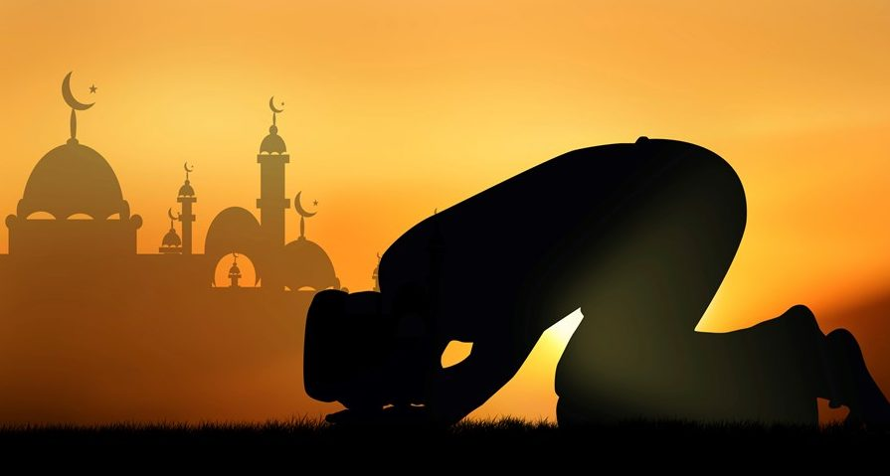
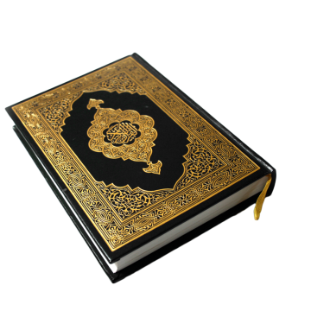
Short Quiz
Question 1
  At what age did Khalifah-tul-Masih (II)(ra) present a speech at the Annual Convention in Qadian on the topic of attaining true success?

Slide 12
Short Quiz
Answer to Q1
At the age of 19

Slide 13
Short Quiz
Question 2
  At what age did Khalifah-tul-Masih (II) (ra) write a treatise on the topic of the love for God?

Slide 14
Short Quiz
Answer to Q2
At the age of 18

Slide 15
Short Quiz
Question 3
  Which topic did Khalifah-tul-Masih (II) (ra) write about which Hazrat Mirza Tahir Ahmed (rh) praised because of how well it was presented in front of 2 different audiences?

Slide 16
Short Quiz
Answer to Q3
Insight into Divine Decree

Slide 17
Short Quiz
Question 4
  When did Hazrat Musleh Maud ra receive his first revelation?

Slide 18
Short Quiz
Answer to Q4
In 1905:
“I will place those who follow you above those who disbelieve until the day of Resurrection”

Slide 19
Short Quiz
Question 5
  Which 2 important schemes did Hazrat Musleh Maud initiate?

Slide 20
Short Quiz
Answer to Q5
Tehrik-e-Jadid and
Waqf-e-Jadid

Slide 21
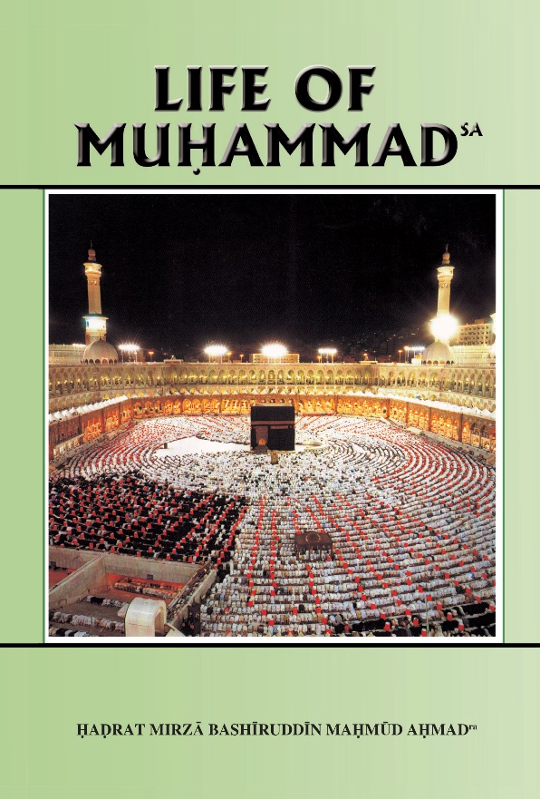

Reading Section

Slide 22
Reading section
Life of Muhammad (pbuh)
Written by: HADRAT MIRZA BASHIRUDDIN MAHMUD AHMAD
KHALIFATUL MASIH II
ARABIA AT THE TIME OF THE PROPHET’S (saw) BIRTH (Continued)
They will help those who were oppressed and will restore
them their rights, as long as the last drop of water
remained in the sea. And if they do not do so, they will
compensate the victims out of their own belongings (Sirat
Ibni Hisham by Imam Suhaili)
It seems that no other member of this association was ever called upon to discharge the undertaking solemnly entered into by members of this association. But opportunity came to the Holy Prophet (saw) when he had announced his Mission. His worst enemy was Abu Jahl, a chief of Mecca. He preached social boycott and public humiliation of the Prophet (saw). About that time a person from outside came to Mecca. Money was due to him from Abu Jahl, but Abu Jahl refused to pay. He mentioned this to people in Mecca. Some young men, out of sheer mischief, suggested that he should approach the Prophet (saw). They thought that the Prophet (saw) would refuse to do anything for fear of the general opposition to him and particularly for fear of the opposition of Abu Jahl.

Slide 23
Reading section
Life of Muhammad (pbuh)
Written by: HADRAT MIRZA BASHIRUDDIN MAHMUD AHMAD
KHALIFATUL MASIH II
ARABIA AT THE TIME OF THE PROPHET’S (saw) BIRTH (Continued part 2)
If he refused to help this man, he would be said to have broken his pledge to the association. If, on the other hand, he did not refuse and chose to approach Abu Jahl for the restitution of this loan, Abu Jahl was certain to turn him away with contempt. This man went to the Prophet (saw) and complained to him about Abu Jahl. The Prophet (saw), hesitating not a minute, stood up, went with the man and knocked at Abu Jahl's door. Abu Jahl came out and saw that his creditor was standing with the Prophet (saw). The Prophet (saw) mentioned the loan and suggested its payment. Abu Jahl was taken aback and, making no excuses, paid at once. When the other chiefs of Mecca heard of this they reproved Abu Jahl, telling him how weak and self-contradictory he had proved. He preached the social boycott of the Prophet (saw), yet he himself accepted direction from the Prophet (saw) and paid a loan on his suggestion. In self-defence, Abu Jahl pleaded that any other person would have done the same. He told them that as he saw the Prophet (saw) standing at his door, he also saw two wild camels standing one on each side, ready to attack. We cannot say what this experience was. Was it a miraculous appearance designed to upset Abu Jahl or was it the awe-inspiring presence of the Prophet (saw) which produced this hallucination?

Slide 24
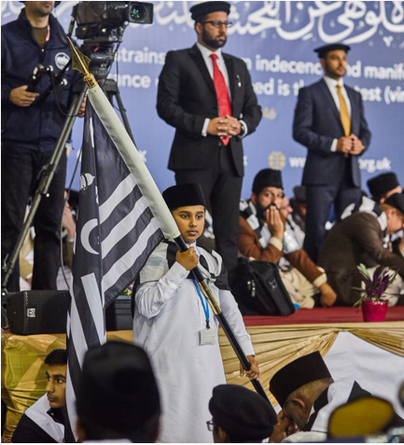
Discussion
Section

Slide 25
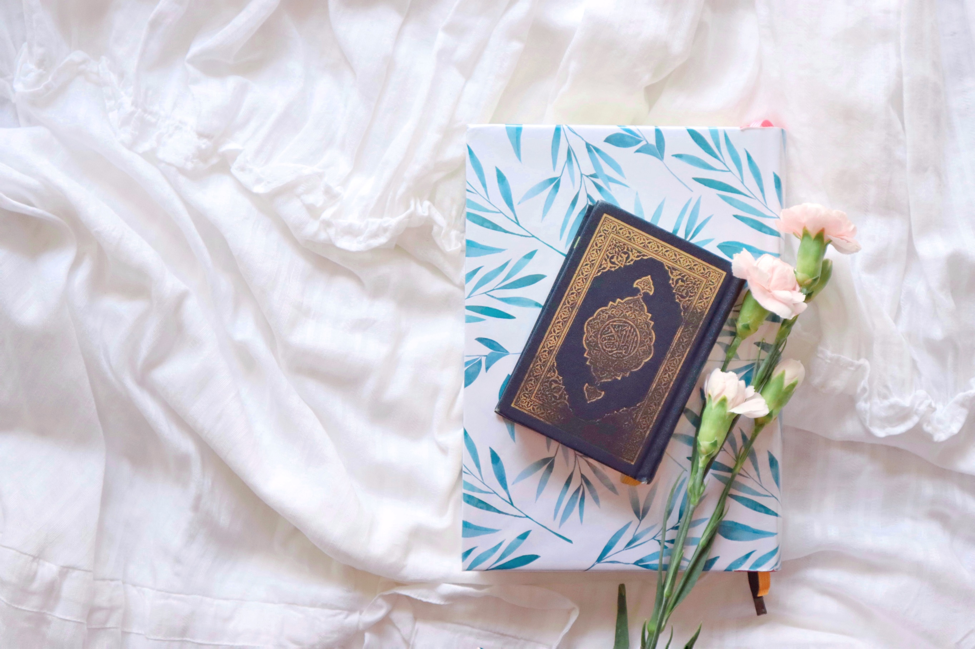
Discussion
The Importance of The Holy Qur’an
Why do we read the Holy Qur’an?
Why should we read the translation of the Holy Qur’an?
Why should we memorise the Holy Qur’an?
Do you know any prophecies in the Holy Qur’an?
How can we best understand the Holy Qur’an?

Slide 26
Do you have any questions?
Ask us anything!

Slide 27
Announcements
Next Class
28th 2021 (Sunday)
Class content available on
Atfal.org.uk/taleem-online-classes
Other Initiatives
  Qaseeda Challenge
  Winter Reading Challenge
  Salaat memorisation

