Slide 1
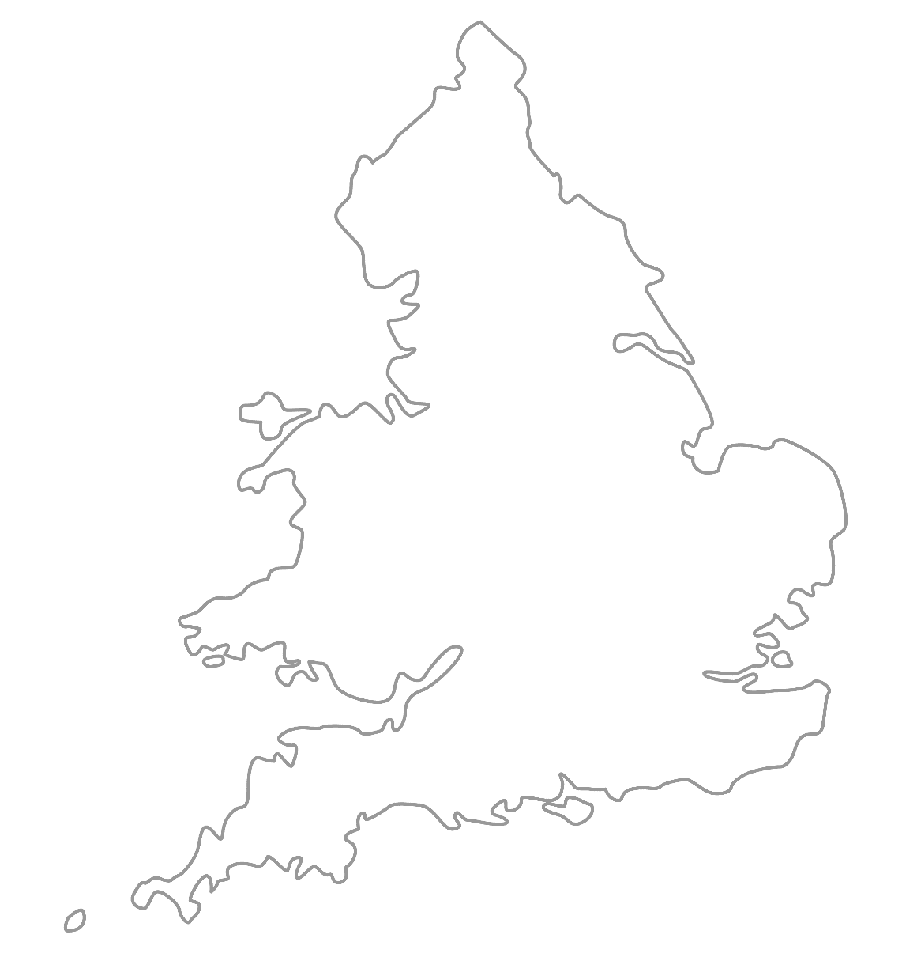

MAA National Online Talim Class
Age group 11-15
MA
A
TAL
IM
LESSON NUMBER 14
28st March 2021
The Class will begin shortly

Slide 2


Welcome
Welcome to the Online Talim class organised by Majlis Atfal-ul-Ahmadiyya UK. Please take this time to make sure your regional Nazim knows that you are present in the class.
This class is for 11-15-year-old Atfal
Ask your regional nazim for the link to the class for younger Atfal if you do not fall in this age group or re-register.
Have you registered for the class ?
If you have not registered, please head over to Atfal.org.uk/taleem-online-classes and register. You only need to register once to get the weekly emails for the whole year.

Slide 3

PARTNER
“What have you been up to in the past week?”

Slide 4
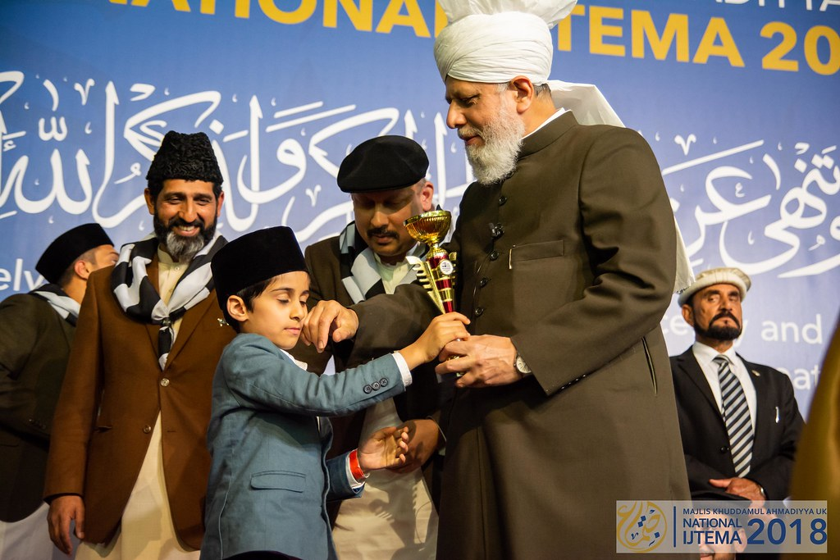
Learning
Section

Slide 5

Salaat
اَللّٰھُمَّ صَلِّ عَلٰی مُحَمَّدٍ وَّعَلٰی اٰلِ مُحَمَّدٍ کَمَا صَلَّیْتَ عَلٰی اِبْرَاھَیْمَ وَعَلٰی اٰلِ اِبْرَاھِیْمَ اِنَّکَ حَمِیْدٌ مَّجِیْدٌ
Allahumma salli ‘ala Muhammadin wa ‘ala aali Muhammadin kamaa sallaita ‘ala Ibraahima wa ‘ala Ibraahima Innaka hameed-um-majeed
Oh Allah, bless Muhammad (saw) and the people of Muhammad (saw) and You did bless Abraham (as) and the people of Abraham (as) You are indeed the Praiseworthy, the Exalted.

Slide 6
Salaat
مُحَمَّدٍ | عَلٰی | صَلِّ | اَللّٰھُمَّ
Muhammad ^{saw} | upon | Bless | Oh Allah
Oh Allah, bless Muhammad ^{saw}
مُحَمَّدٍ | اٰلِ | وَّعَلٰی
(of) Muhammad ^{saw} | people | And upon
And the people of Muhammad ^{saw}
اِبْرَاھَیْمَ | عَلٰی | صَلَّیْتَ | کَمَا
Abraham | on | You did bless | as
And You did bless Abraham
اِبْرَاھَیْمَ | اٰلِ | وَّعَلٰی
(of) Abraham | People | And upon
And the people of Abraham
مَّجِیْدٌ | حَمِیْدٌ | اِنَّکَ
The Exalted | The Praiseworthy | You are indeed
You are indeed the Praiseworthy, the Exalted

Slide 7
Hadith
اَلْحَرْبُ خُدْعَةٌ
Al-harbu khud’a
War is the name of tactics.
How are tactics important in war?
What type of ‘war’ are we fighting today?
What is the best tactic for the war we are fighting?
What does tactic mean?

Slide 8
Short Quiz
  If you do not know the answer, do not raise your hand
5 Questions and their answers
  If you have already had a go, let your Atfal brothers have a go too and not raise your hand again
  Raise your hand if you know the answer, or send in the chat

Slide 9
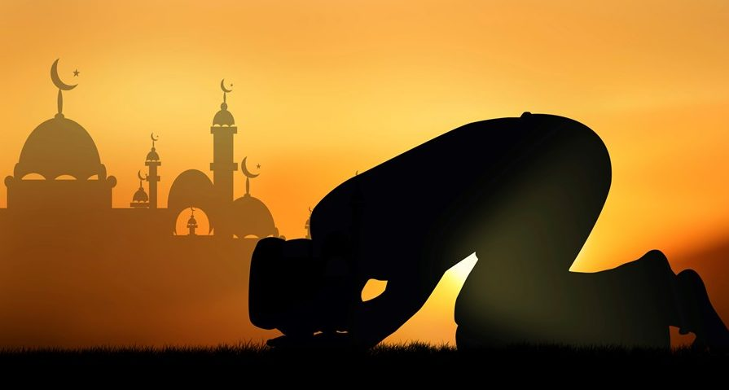
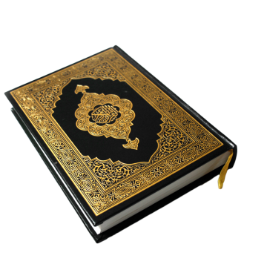
Short Quiz
Question 1
  What is the name of the 3rd Khalifah of the Promised Messiah (as)?

Slide 10
Short Quiz
Answer to Q1
Hazrat Mirza Nasir Ahmad (rh)

Slide 11
Short Quiz
Question 2
  When was Hazrat Mirza Nasir Ahmad (rh) elected as Khalifah?

Slide 12
Short Quiz
Answer to Q2
8th November 1965

Slide 13
Short Quiz
Question 3
  How was Hazrat Mirza Nasir Ahmad (rh) related to the Promised Messiah (as)?

Slide 14
Short Quiz
Answer to Q3
Hazrat Mirza Nasir Ahmad (rh) was the Grandson of the Promised Messiah (as)

Slide 15
Short Quiz
Question 4
  When was Hazrat Mirza Nasir Ahmad (rh) born?

Slide 16
Short Quiz
Answer to Q4
16th November 1909

Slide 17
Short Quiz
Question 5
  When was the demise of Hazrat Mirza Nasir Ahmad (rh)?

Slide 18
Short Quiz
Answer to Q5
8-9th June 1982

Slide 19
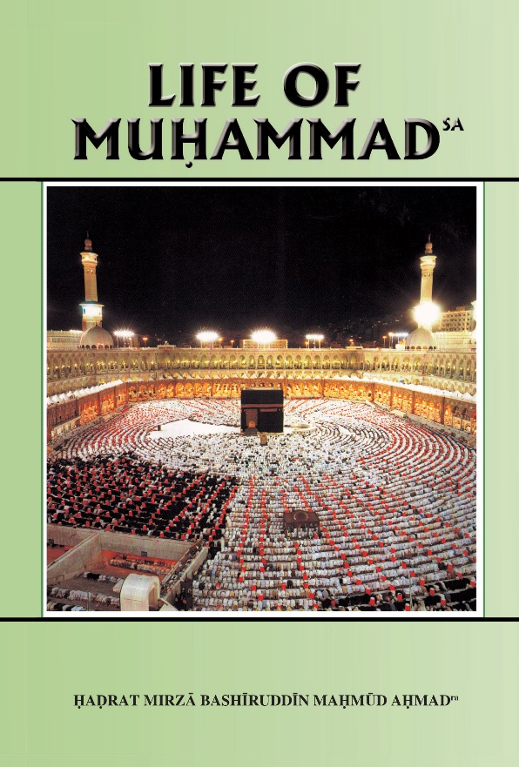

Reading Section

Slide 20
Reading section
Life of Muhammad (pbuh)
Written by: HADRAT MIRZA BASHIRUDDIN MAHMUD AHMAD
KHALIFATUL MASIH II
HOLY PROPHET’S saw MARRIAGE WITH KHADIJA ra
When the Prophet (saw) was about twenty-five years old, his reputation for integrity and fellow-feeling had spread over the whole of the town. People would point admiring fingers at him and say, here was a man who could be trusted. This reputation reached the ears of a rich widow who approached the Prophet’s (saw) uncle, Abu Talib, to let his nephew lead a trading caravan of hers to Syria. Abu Talib mentioned this to the Prophet (saw) and the Prophet (saw) agreed. The expedition met with great success and brought unexpected profits. The rich widow, Khadija (ra), was convinced that the success of the caravan was due not only to the conditions of the market in Syria, but also to the integrity and efficiency of its leader. She interrogated her slave, Maisa (ra), on this subject, and Maisa (ra) supported her view and told her that the honesty and sympathy with which this young leader of the caravan had managed her affairs would not be shown by many persons. Khadija (ra) was much impressed by this account. She was forty years of age and had already been widowed twice. She sent a woman friend of hers to the Prophet (saw) to find out whether he would be persuaded to marry her. This woman went to the Prophet (saw) and asked why he had not married.

Slide 21
Reading section
Life of Muhammad (pbuh)
Written by: HADRAT MIRZA BASHIRUDDIN MAHMUD AHMAD
KHALIFATUL MASIH II
HOLY PROPHET’S saw MARRIAGE WITH KHADIJA ra (Continued)
The Prophet (saw) replied he was not rich enough to do so. The visitor suggested whether he would agree, if a rich and respectable woman were found whom he could marry. The Prophet (saw) asked who this woman could be, and the visitor said she was Khadija (ra). The Prophet (saw) apologized, saying that Khadija (ra) was too highly placed for him. The visitor undertook to deal with all difficulties. In that case, said the Prophet (saw), there was nothing for him to say but to agree. Khadija (ra) then sent a message to the Prophet’s (saw) uncle. Marriage between the Prophet (saw) and Khadija (ra) was settled and solemnized. A poor man orphaned in, childhood had his first peep into prosperity. He became rich. But the use he made of his riches is an object-lesson to all mankind. After the marriage Khadija (ra) felt that she was rich and he was poor and that this inequality between them would not make for happiness. So she proposed to make over her property and her slaves to the Prophet (saw). The Prophet (saw), making sure that Khadija (ra) was in earnest, declared that as soon as he had any of Khadija’s (ra) slaves, he would set them free. And he did so. Moreover, the greater part of the property which he received from Khadija (ra) he distributed among the poor.

Slide 22
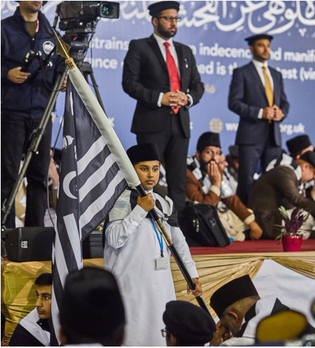
Discussion
Section

Slide 23

Discussion
Freedom of Speech
Do you know of any events recently linked with freedom of speech?
Why should we limit our freedom of speech?
Do you know of any Hadith that talks about freedom of speech?
How should we respond to someone offending our opinion or beliefs?

Slide 24
Do you have any questions?
Ask us anything!

Slide 25
Announcements
Next Class
4th April 2021 (Sunday)
Class content available on
Atfal.org.uk/taleem-online-classes
Other Initiatives
  Qaseeda Challenge
  Winter Reading Challenge
  Salaat memorisation

