Slide 1
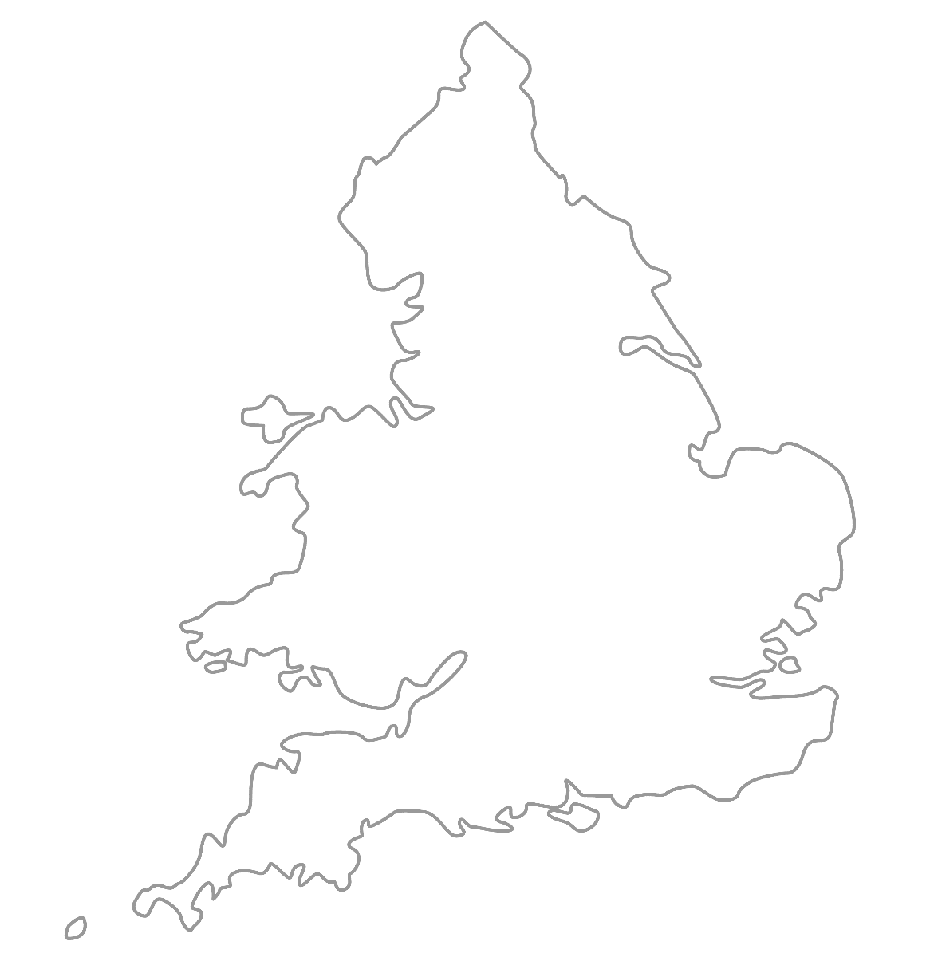

MAA National Online Talim Class
Age group 7-10
MA
A
TAL
IM
LESSON NUMBER 15
04st April 2021
The Class will begin shortly

Slide 2

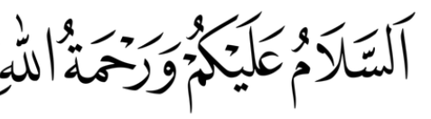
Welcome
Welcome to the Online Talim class organised by Majlis Atfal-ul-Ahmadiyya UK. Please take this time to make sure your regional Nazim knows that you are present in the class.
This class is for 7-10-year-old Atfal
Ask your regional nazim for the link to the class for older Atfal if you do not fall in this age group or re-register.
Have you registered for the class ?
If you have not registered, please head over to Atfal.org.uk/taleem-online-classes and register. You only need to register once to get the weekly emails for the whole year.

Slide 3
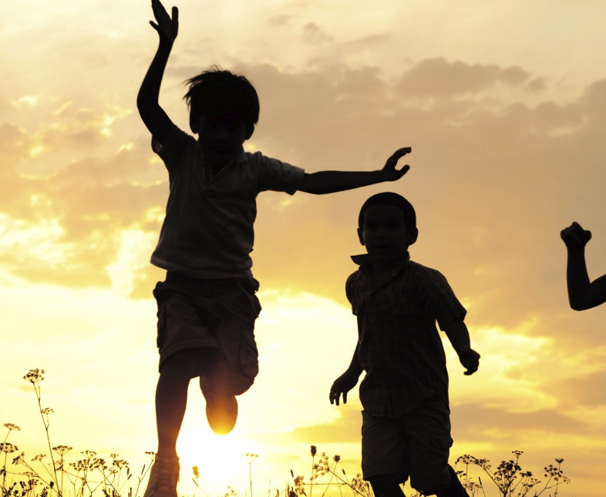
PARTNER
“What have you been up to in the past week?”

Slide 4
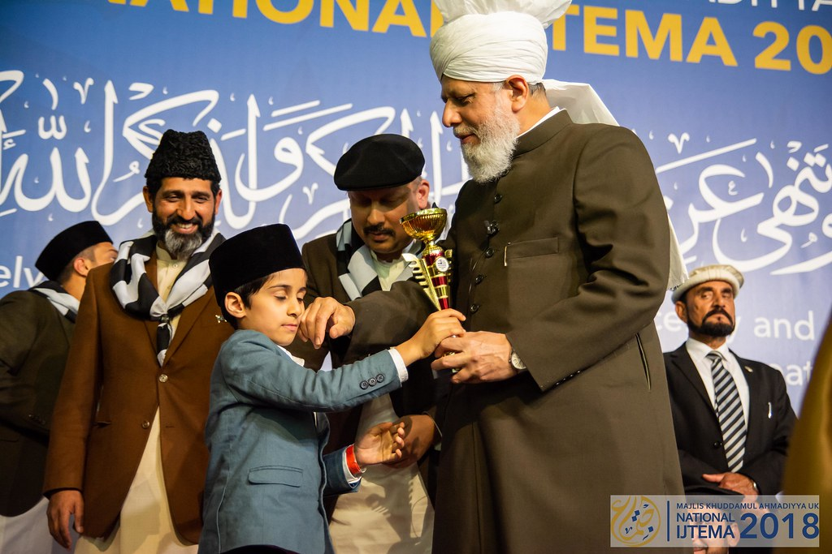
Learning
Section

Slide 5
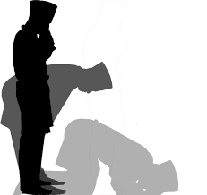
Salaat
اَللّٰھُمَّ بَارِکْ عَلٰی مُحَمَّدٍ وَّعَلٰی اٰلِ مُحَمَّدٍ کَمَا بَارَکْتَ عَلٰی اِبْرَاھَیْمَ وَعَلٰی اٰلِ اِبْرَاھِیْمَ اِنَّکَ حَمِیْدٌ مَّجِیْدٌ
Allahumma barik ‘ala Muhammadin wa ‘ala aali Muhammadin kamaa barakta ‘ala Ibraahima wa ‘ala Ibraahima Innaka hameed-um-majeed
Oh Allah, prosper Muhammad (saw) and the people of Muhammad (saw) and You did bless Abraham (as) and the people of Abraham (as) You are indeed the Praiseworthy, the Exalted.

Slide 6
Hadith
اَلْمُسْلِمُ مِرْآةُ الْمُسْلِمِ
Al-muslimu mir’aa-tul muslim
A Muslim is a mirror of another Muslim.
There can be many interpretations of this Hadith →
What is one concept you take from it?
What does a mirror show?

Slide 7
Short Quiz
  If you do not know the answer, do not raise your hand
5 Questions and their answers
  If you have already had a go, let your Atfal brothers have a go too and not raise your hand again
  Raise your hand if you know the answer, or send in the chat

Slide 8
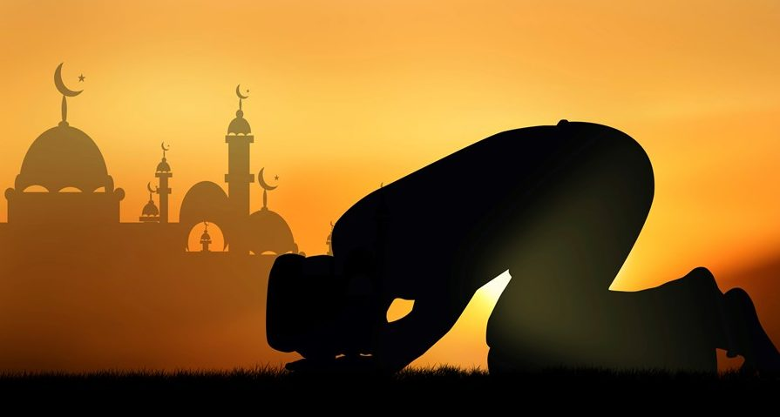
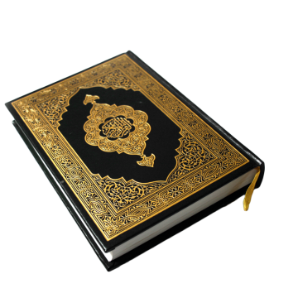
Short Quiz
Question 1
  What is the name of the 4th Khalifah of the Promised Messiah (as)?

Slide 9
Short Quiz
Answer to Q1
Hazrat Mirza Tahir Ahmad (rh)

Slide 10
Short Quiz
Question 2
  When was Hazrat Mirza Tahir Ahmad (rh) elected as Khalifah?

Slide 11
Short Quiz
Answer to Q2
10th June 1982

Slide 12
Short Quiz
Question 3
  When was Hazrat Mirza Tahir Ahmad (rh) born?

Slide 13
Short Quiz
Answer to Q3
18th December 1928

Slide 14
Short Quiz
Question 4
  Where was Hazrat Mirza Tahir Ahmad (rh) born?

Slide 15
Short Quiz
Answer to Q4
Qadian, India

Slide 16
Short Quiz
Question 5
  When was the first ever broadcast of MTA International in Europe and America?

Slide 17
Short Quiz
Answer to Q5
1st April 1996

Slide 18
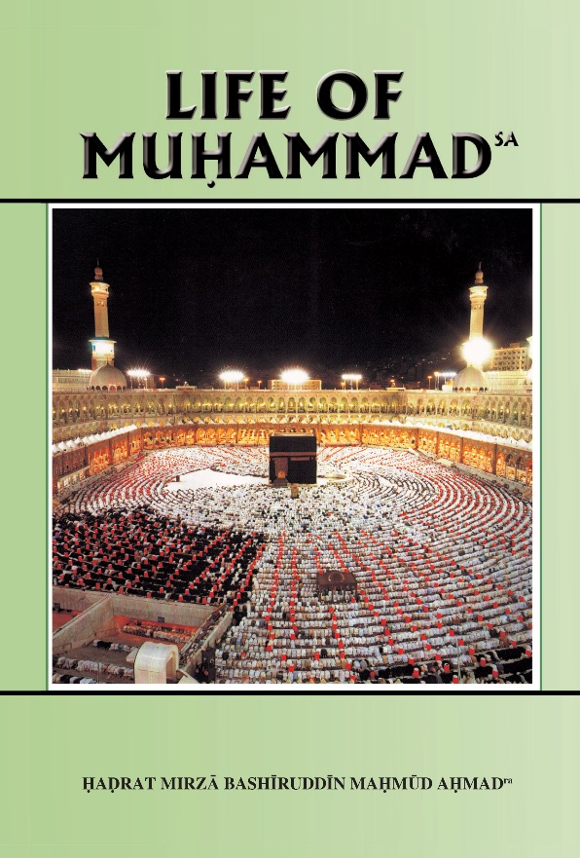

Reading Section

Slide 19
Reading section
Life of Muhammad (pbuh)
Written by: HADRAT MIRZA BASHIRUDDIN MAHMUD AHMAD
KHALIFATUL MASIH II
HOLY PROPHET’S saw MARRIAGE WITH KHADIJA ra (Continued)
Among the slaves whom he thus set free was one Zaid (ra). He appeared to be more intelligent and more alert than others. He belonged to a respectable family, had been kidnapped as a child and sold from place to place until he reached Mecca. Young Zaid (ra), newly freed, saw at once that it was better to sacrifice freedom for the sake of slavery to the Prophet (sa). When the Prophet (sa) set the slaves free, Zaid (ra) refused to be freed and asked leave to continue to live with the Prophet (sa). He did so, and as time went on his attachment to the Prophet (sa) grew. But in the meantime Zaid’s (ra) father and his uncle were on his track and they ultimately heard that he was in Mecca. In Mecca they traced him in the house of the Prophet (sa). Coming to the Prophet (sa), they asked for the liberty of Zaid (ra) and offered to pay as much ransom as the Prophet (sa) should demand. The Prophet (sa) said that Zaid (ra( was free and could go with them as he liked. He sent for Zaid (ra) and showed him his father and uncle. After the parties had met and dried their tears, Zaid’s (ra) father told him that he had been freed by his kind Master and, as his mother was much afflicted by the separation, he had better return home.

Slide 20
Reading section
Life of Muhammad (pbuh)
Written by: HADRAT MIRZA BASHIRUDDIN MAHMUD AHMAD
KHALIFATUL MASIH II
HOLY PROPHET’S saw MARRIAGE WITH KHADIJA ra (Continued part 2)
Zaid (ra) replied, "Father! who does not love his parents? My heart is full of love for you and mother. But I love this man Muhammad (sa) so much that I cannot think of living elsewhere than with him. I have met you and I am glad. But separation from Muhammad (sa) I cannot endure." Zaid’s (ra) father and his uncle did their utmost to persuade Zaid (ra) to return home with them but Zaid (ra) did not agree. Upon this the Holy Prophet (sa) said, "Zaid (ra) was a freedman already, but from today he will be my son.“ Seeing this affection between Zaid (ra) and the Prophet (sa), Zaid’s (ra) father and uncle went back and Zaid (ra) remained with the Prophet (sa) (Hisham).

Slide 21
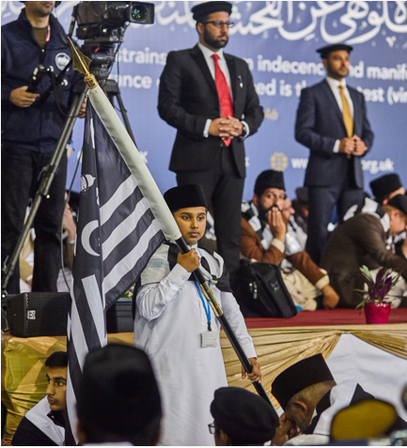
Discussion
Section

Slide 22

Discussion
Are you regularly writing letters to Huzoor?
Why is Khilafat extremely precious to us?
What are good ways of creating a good relationship with Khilafat?
How can we best serve Khilafat?
Do you know of any faith-inspiring incidents about writing letters to Huzoor?

Slide 23
Do you have any questions?
Ask us anything!

Slide 24
Announcements
Next Class
11th April 2021 (Sunday)
Class content available on
Atfal.org.uk/taleem-online-classes
Other Initiatives
  Qaseeda Challenge
  Winter Reading Challenge
  Salaat memorisation

