Slide 1
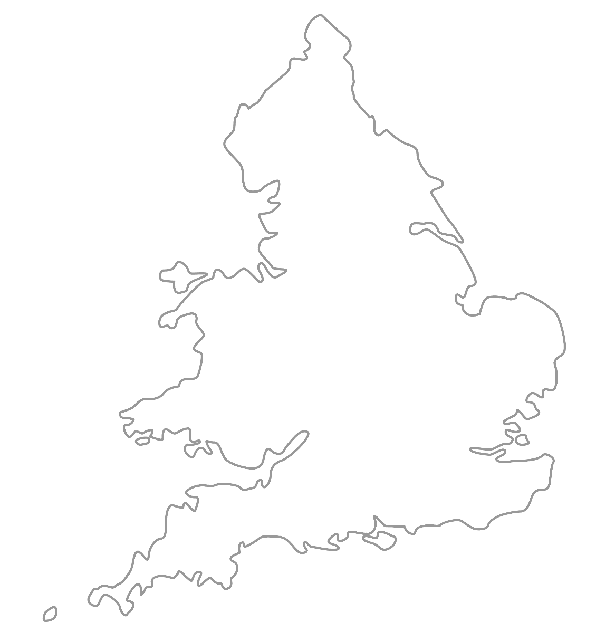

MAA National Online Talim Class
Age group 11-15
MA
A
TAL
IM
LESSON NUMBER 16
11st April 2021
The Class will begin shortly

Slide 2

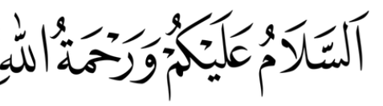
Welcome
Welcome to the Online Talim class organised by Majlis Atfal-ul-Ahmadiyya UK. Please take this time to make sure your regional Nazim knows that you are present in the class.
This class is for 11-15-year-old Atfal
Ask your regional nazim for the link to the class for younger Atfal if you do not fall in this age group or re-register.
Have you registered for the class ?
If you have not registered, please head over to Atfal.org.uk/taleem-online-classes and register. You only need to register once to get the weekly emails for the whole year.

Slide 3
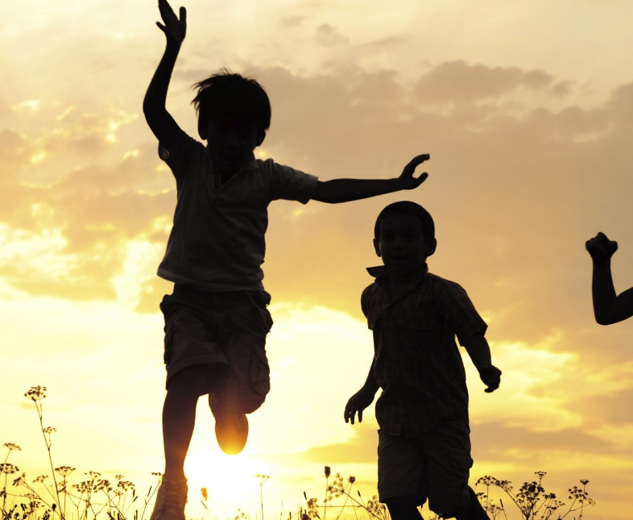
PARTNER
“What have you been up to in the past week?”

Slide 4
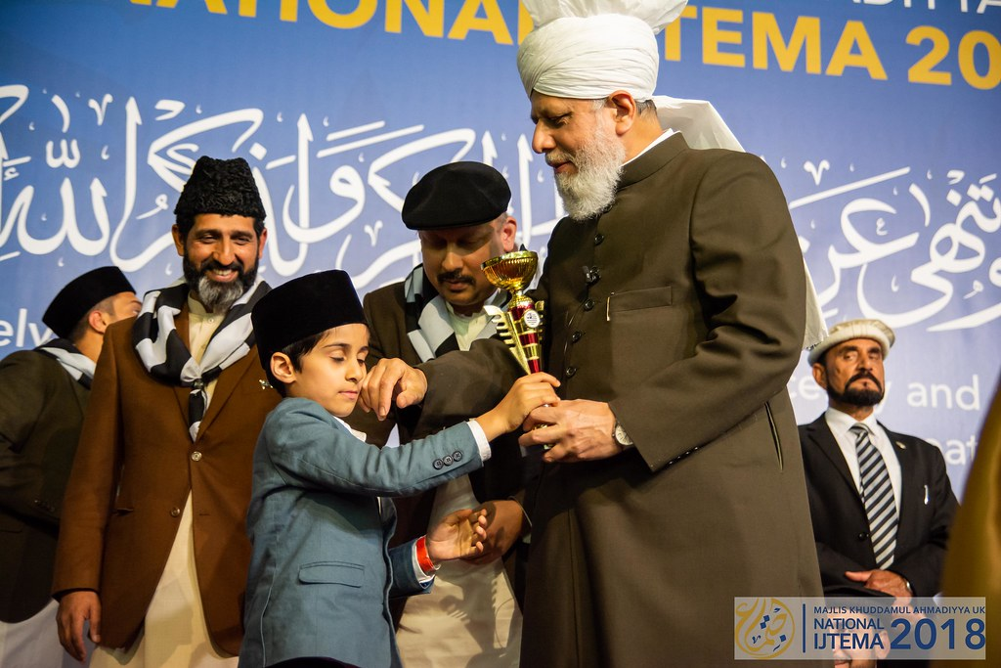
Learning
Section

Slide 5
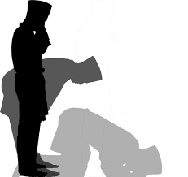
Salaat
رَبَّنَا آتِنَا فِی الدُّنْیَا حَسَنَۃً وَّ فِی الْآخِرَۃِ حَسَنَۃً وَّقِنَا عَذَابَ النَّارِ
Rabbana atina fiddunya hasanatan wa fil akhirati
hasanatan waqina adhabannar
Our Lord, grant us good in this world as well as
good in the world to come, and protect us from the
torment of the Fire.

Slide 6
Salaat
حَسَنَۃً | فِی الدُّنْیَا | آتِنَا | رَبَّنَا
Good | In this world | Grant us | Our Lord
Our Lord, Grant us good in this world
حَسَنَۃً | الْآخِرَۃِ | فِی | وَّ
good | The world to come | in | and
As well as good in the world to come
النَّارِ | عَذَابَ | وَّقِنَا
Of Fire | From the torment | And protect us
And protect us from the torment of the fire

Slide 7
Hadith
اَلْمُسْتَشَارُ مُؤْتَمَنٌ
Al musta-shaa-ru mu’-taman
A person who is consulted becomes a trustee.
What does consult mean?
What/who is a trustee?
What can we learn from this Hadith?

Slide 8
Short Quiz
10 Questions and their answers
5 religious questions and 5 general knowledge
  If you do not know the answer, do not raise your hand
  Raise your hand if you know the answer, or send in the chat
  If you have already had a go, let your Atfal brothers have a go too and not raise your hand again

Slide 9
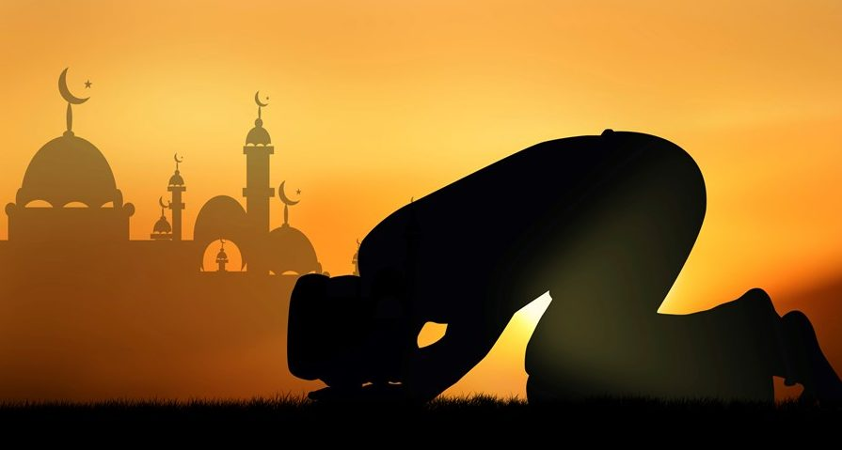
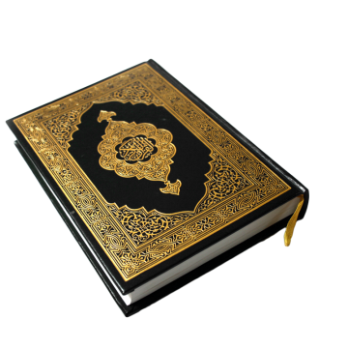
Short Quiz
Question 1
  What was the name of the Respected Father of the 4th Khalifah of the Promised Messiah (as)?

Slide 10
Short Quiz
Answer to Q1
Hazrat Mirza Bashiruddin Mahmood Ahmad (ra) (Hazrat Musleh Maud)

Slide 11
Short Quiz
Question 2
  What was the name of the Respected Mother of the 4th Khalifah of the Promised Messiah (as)?

Slide 12
Short Quiz
Answer to Q2
Hazrat Syeda Maryam Beghum Sahiba (ra)

Slide 13
Short Quiz
Question 3
  When did General Zia-ul-Haqq initiate the Anti Ahmadiyya ordinance (law)?

Slide 14
Short Quiz
Answer to Q3
26th April 1984

Slide 15
Short Quiz
Question 4
  When did Hazrat Mirza Tahir Ahmad (rh) deliver his last sermon in Rabwah before migration?

Slide 16
Short Quiz
Answer to Q4
28th April 1984, after Isha prayer

Slide 17
Short Quiz
Question 5
  When did Hazrat Mirza Tahir Ahmed (rh) migrate from Pakistan to UK?

Slide 18
Short Quiz
Answer to Q5
29th April 1984

Slide 19
Short Quiz – General Knowledge
Question 6
  What’s the collective name for trees that keep their leaves all year round?

Slide 20
Short Quiz – General Knowledge
Answer to Q6
Evergreen

Slide 21
Short Quiz – General Knowledge
Question 7
  What is the biggest ocean in the world?

Slide 22
Short Quiz – General Knowledge
Answer to Q7
Pacific

Slide 23
Short Quiz – General Knowledge
Question 8
  Name the smallest country in the world

Slide 24
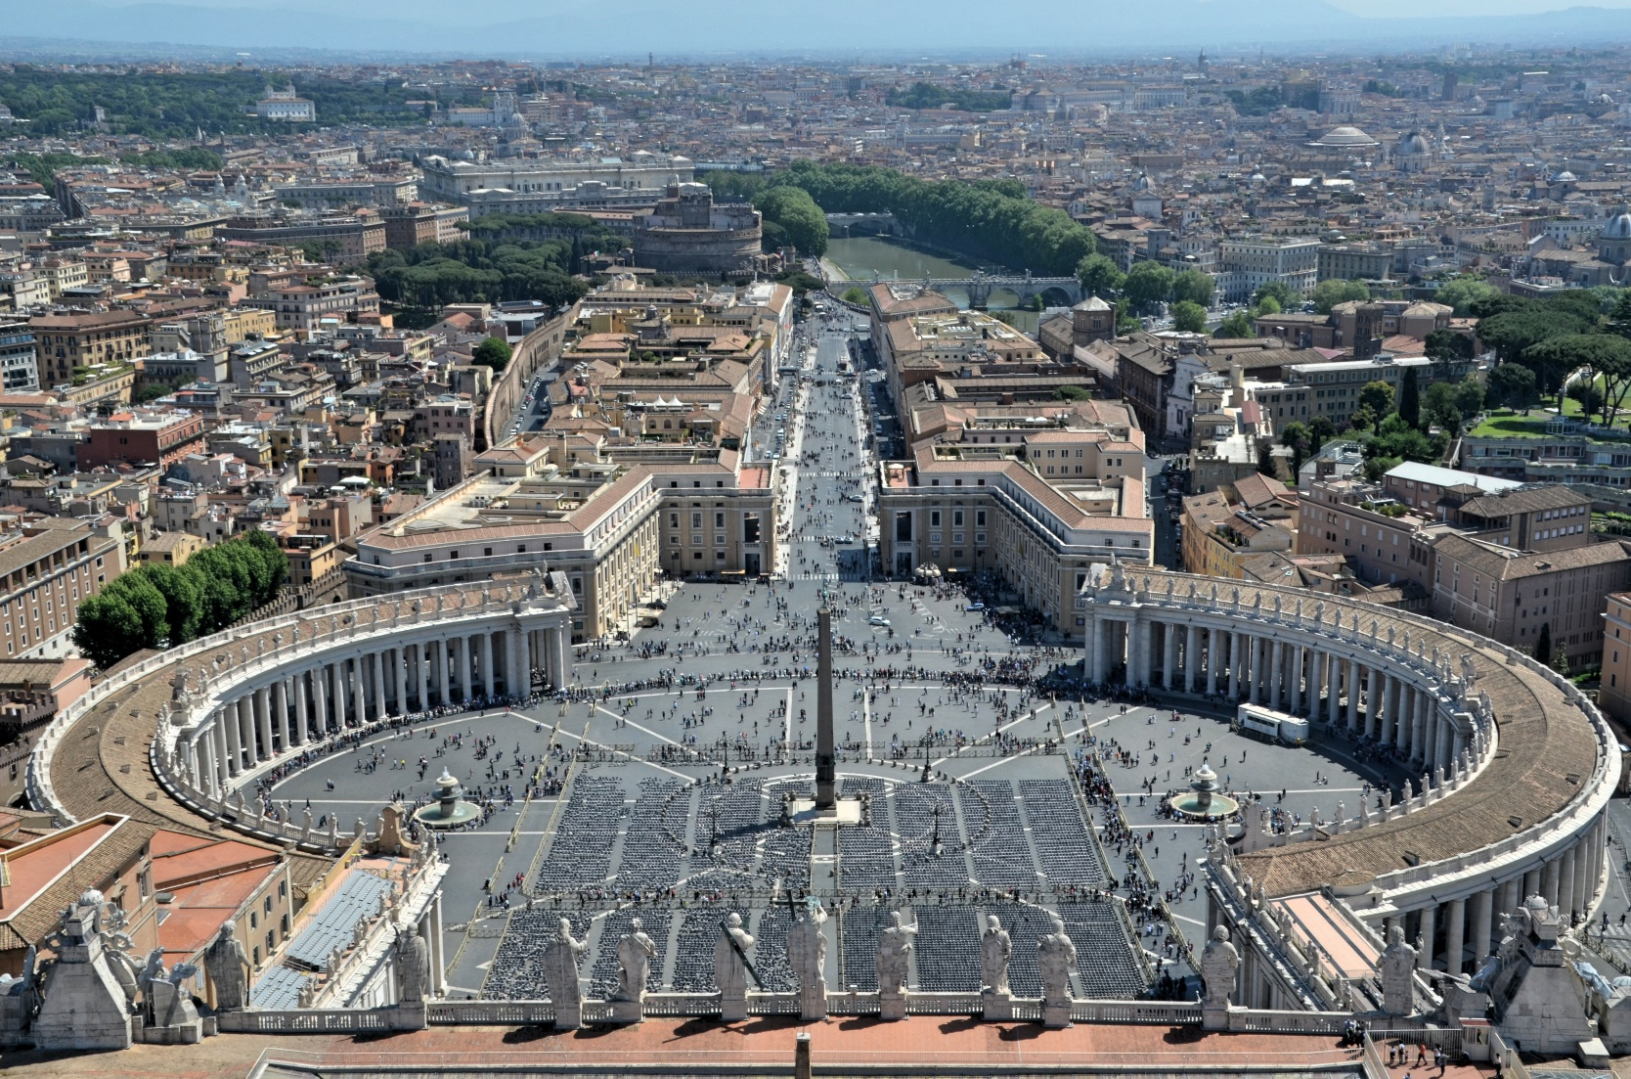
Short Quiz – General Knowledge
Answer to Q8
Vatican City

Slide 25
Short Quiz – General Knowledge
Question 9
  What country was due to host the Olympics in 2020?

Slide 26
Short Quiz – General Knowledge
Answer to Q9
Japan

Slide 27
Short Quiz – General Knowledge
Question 10
  Which country invented tea?

Slide 28
Short Quiz – General Knowledge
Answer to Q10
China

Slide 29
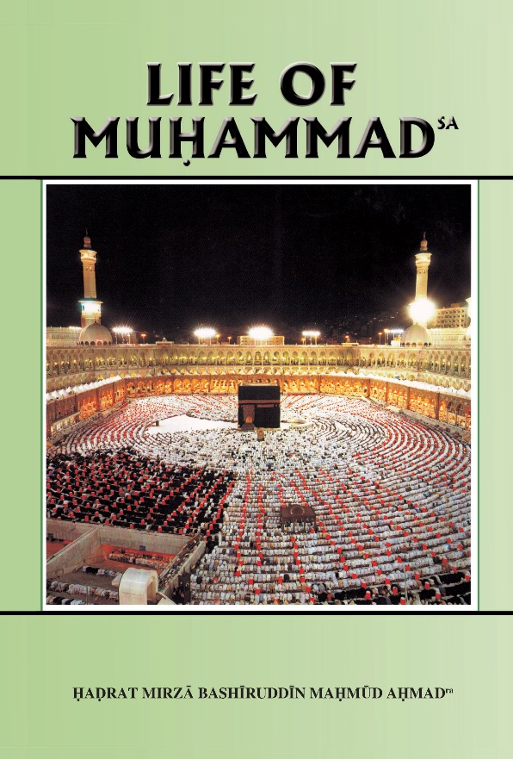

Reading Section

Slide 30
Reading section
Life of Muhammad (pbuh)
Written by: HADRAT MIRZA BASHIRUDDIN MAHMUD AHMAD
KHALIFATUL MASIH II
THE PROPHET (saw) RECEIVES HIS FIRST REVELATION
When the Prophet (saw) was over thirty years of age, love of God and love of His worship began to possess him more and more. Revolting against the mischiefs, misdeeds and the many vices of the people of Mecca, he chose a spot two or three miles away for his meditations. This was on top of a hill, a sort of cave shaped out of stone. His wife Khadija (ra) would prepare food enough for 10 Life of Muhammad (saw) several days, and with this he would repair to the cave Hira. In the cave he would worship God day and night. When he was forty years of age, he saw a vision. It was in this very cave. He saw some one commanding him to recite. The Prophet (saw) said in reply he did not know what or how to recite. The figure insisted and at last made the Prophet (saw) recite the following verses:
Recite thou in the name of thy Lord Who created, created
man from a clot of blood. Recite! And thy Lord is the Most
Beneficent, Who taught man by the pen, taught man what
he knew not (96:2-6).

Slide 31
Reading section
Life of Muhammad (pbuh)
Written by: HADRAT MIRZA BASHIRUDDIN MAHMUD AHMAD
KHALIFATUL MASIH II
THE PROPHET (saw) RECEIVES HIS FIRST REVELATION (Continued)
These verses, the first ever revealed to the Prophet (saw), became part of the Qur’an as did other verses which were revealed later. They have tremendous meaning. They command the Prophet (saw) to stand up and be ready to proclaim the name of the One God, the One Creator— of the Prophet (saw) and of all others—Who has made man and sowed the seed of His own love and that of fellowmen in his nature. The Prophet (saw) was commanded to proclaim the Message of this God, and was promised help, and protection by Him in the proclamation of this Message. The verses foretold a time when the world would be taught all manner of knowledge through the
instrumentality of the pen, and would be taught things never heard of before. The verses constitute an epitome of the Qur’an. Whatever the Prophet (saw) was to be taught in later revelations is contained in embryo in these verses. The foundation was laid in them of a great and heretofore unknown advance in the spiritual progress of
man. The meaning and explanation of these verses will be found in their place in this Commentary. We refer to them here because their revelation constitutes a great occasion in the life of the Prophet (saw)

Slide 32
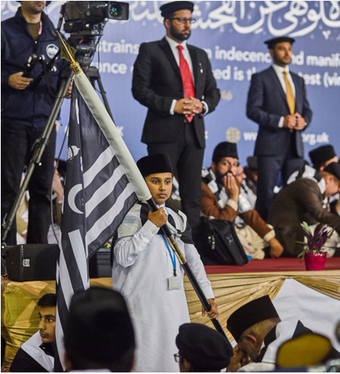
Discussion
Section

Slide 33

Discussion
What happens when we die?
What happens to your physical body when it dies?
What do you believe will happen to your soul after your body has died?
What is special about Ramadhan and the Afterlife?
Can you describe what you think life after death will be like?
Do you know any verses which describe what life after death will be like?

Slide 34
Do you have any questions?
Ask us anything!

Slide 35
Announcements
Next Class
18th April 2021 (Sunday)
Class content available on
Atfal.org.uk/taleem-online-classes
Other Initiatives
  Qaseeda Challenge
  Winter Reading Challenge
  Salaat memorisation

