Slide 1
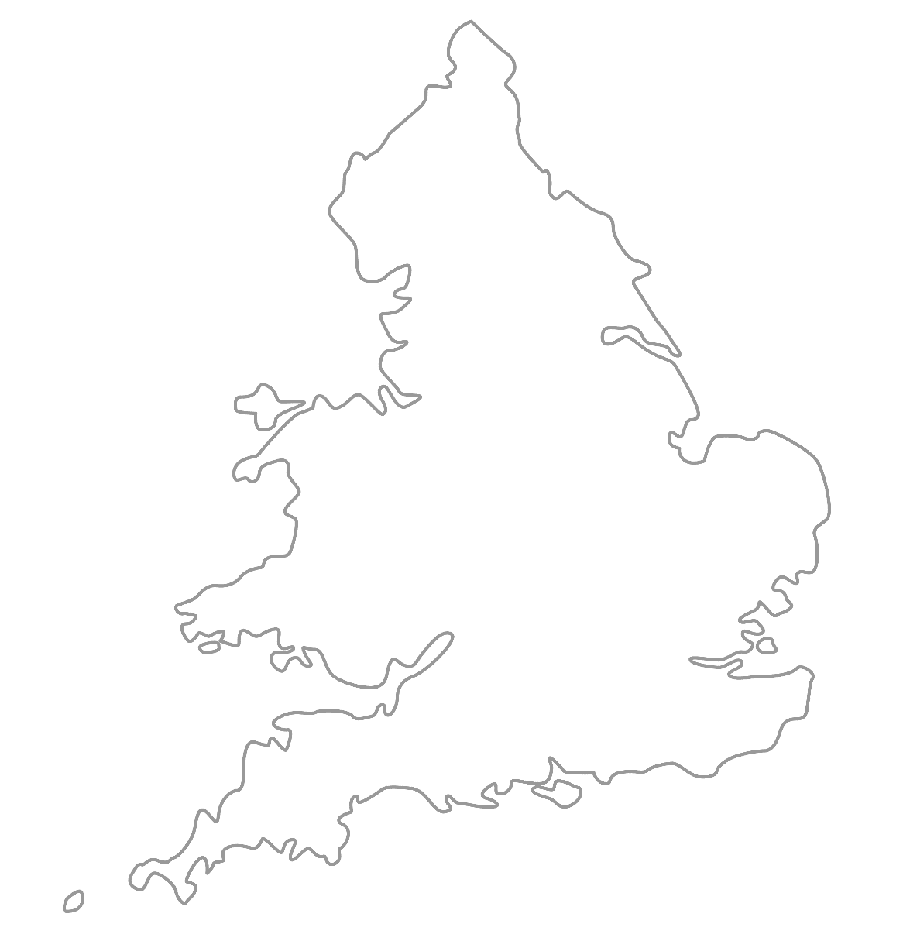

MA
A
TAL
IM
MAA National Online Talim Class
Age group 7-10
LESSON NUMBER 07
17th January 2021
The Class will begin shortly

Slide 2

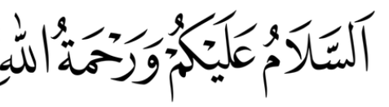
Welcome
Welcome to the Online Talim class organised by Majlis Atfal-ul-Ahmadiyya UK. Please take this time to make sure your regional Nazim knows that you are present in the class.
This class is for 7-10-year-old Atfal
Ask your regional nazim for the link to the class for older Atfal if you do not fall in this age group or re-register.
Have you registered for the class ?
If you have not registered, please head over to Atfal.org.uk/taleem-online-classes and register. You only need to register once to get the weekly emails for the whole year.

Slide 3
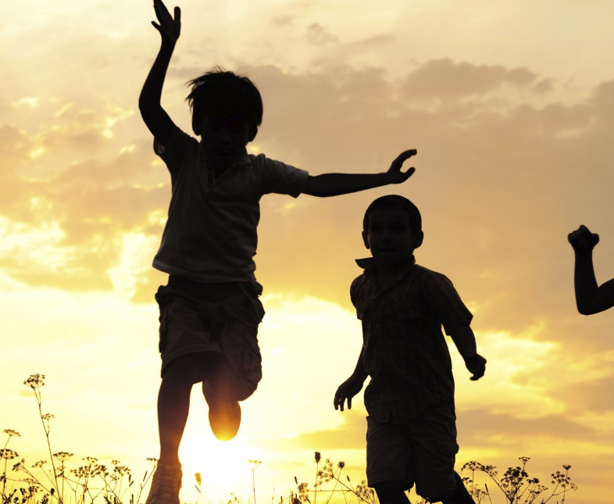
PARTNER
“What have you been up to in the past week?”

Slide 4
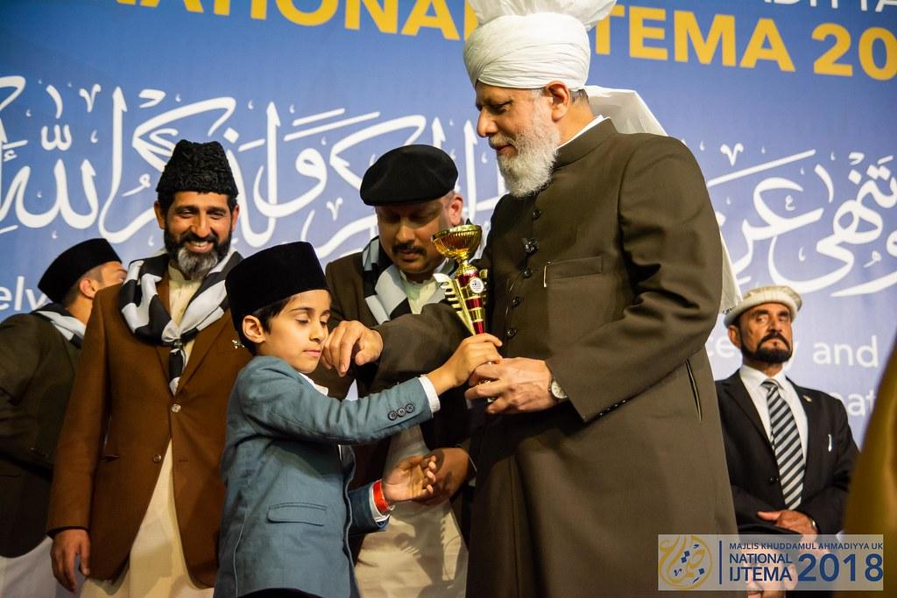
Learning
Section

Slide 5
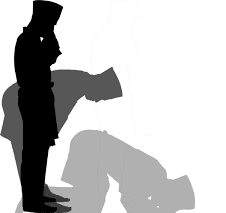
Salaat
بِسْمِ اللّٰہِ الرَّحْمٰنِ الرَّحِیمِ۔۔
قُلْ ھُوَاللّٰہُ اَحَدٌ۔ اَللّٰہُ الصَّمَدُ۔ لَمْ یَلِدْ وَلَمْ یُوْلَدُ۔ وَلَمْ یَکُنْ لَّہٗ کُفُوًا َحَدٌ۔
Bismillahir rahmaanir raheem.
Qul hu wallahu ahad. Alla hus samad. Lam yalid, wa lam yoolad. Wa lam yakullahu kufuwan ahad.
In the name of Allah, the Gracious, the Merciful
Say, He is Allah, the One
Allah, the independent and Besought of all
He begets not, nor is He begotten
And there is none like unto Him

Slide 6
Hadith
اَلْحَيَاءُ خَيْرٌ كُلُّهُ
Al-hayaa’u khairun kulluhu
Modesty is the best virtue
What is modesty?
What is a virtue?
Does this Hadith only apply to women?
How can men be modest?
Why is modesty the best virtue?

Slide 7
Short Quiz
  If you do not know the answer, do not raise your hand
5 Questions and their answers
  If you have already had a go, let your Atfal brothers have a go too and not raise your hand again
  Raise your hand if you know the answer, or send in the chat

Slide 8
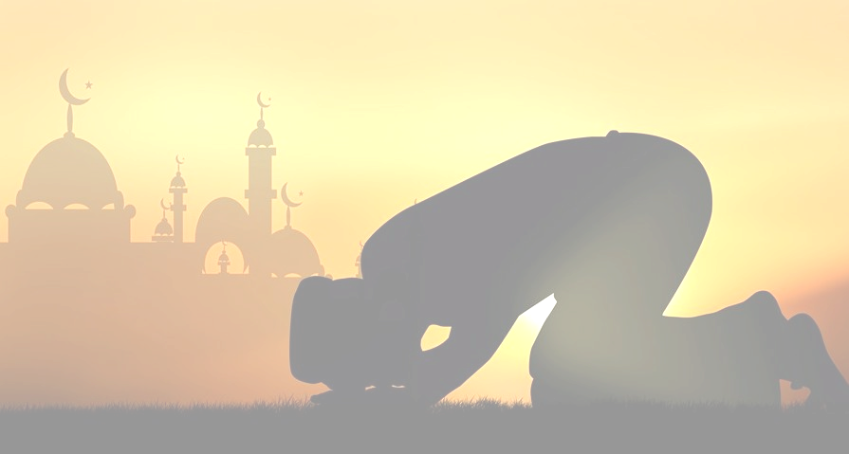
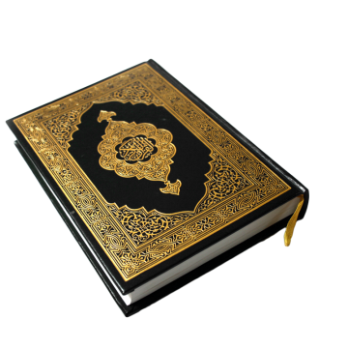
Question 1
Short Quiz
  In which year of the Christian Calendar did Islam start?

Slide 9
Answer to Q1
Short Quiz
610 (AD)

Slide 10
Question 2
Short Quiz
  When was The Promised Messiah (as) born and where?

Slide 11
Answer to Q2
Short Quiz
13th February, 1835 in Qadian, India

Slide 12
Question 3
Short Quiz
  What was the name of the Promised Messiah (as)’s mother?

Slide 13
Answer to Q3
Short Quiz
Hazrat Chiragh Bibi

Slide 14
Question 4
Short Quiz
  What was the name of the Promised Messiah (as)’s father?

Slide 15
Answer to Q4
Short Quiz
Hazrat Mirza Ghulam Murtaza

Slide 16
Question 5
Short Quiz
  When did the Promised Messiah (as) receive his first revelation?

Slide 17
Answer to Q5
Short Quiz
1865 (AD)

Slide 18
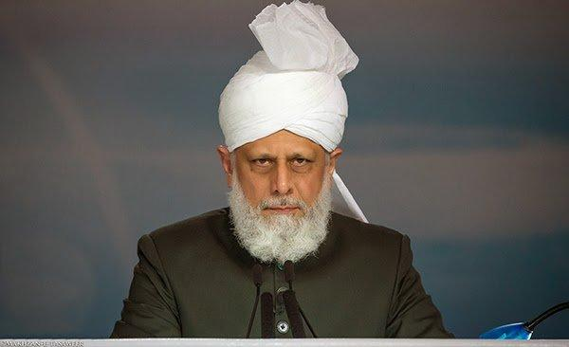
“An Inspection”
A few minutes had passed when suddenly I heard the door connecting where Huzoor was staying with the lower level where I was staying open. I felt a sudden surge of butterflies in my heart.
I hurried out of my room to the lounge and looked up as Huzoor, so elegant and graceful, walked down the stairs towards me. Huzoor was wearing a white shalwar kameez and a white cloth topi (hat). He looked radiant and so pure and noble.
Huzoor kindly enquired how I was before inspecting the different rooms on the lower level. I was surprised to see how carefully Huzoor was checking each cupboard and drawer in the kitchen. 15 After a few minutes, Huzoor explained why he was doing such a thorough inspection. Huzoor said:
Abid Khan Sahib’s Diary
Hazrat Mirza Masroor Ahmad (aba)
“From the Markaz (centre) we provided the Holland Jamaat with new crockery for here and I am just checking to see that it remains in good condition.”

Slide 19
“An Inspection”
….I was taken aback. Huzoor has so many issues to deal with at a Jamaat level, whilst countless Ahmadis from across the world share their burdens with him on a daily basis.
Yet somehow, he still remembers things that an average person, who had nowhere near the same level of responsibilities or duties, would struggle to recall.
Simply, to ensure that the resources of the Jamaat were not being wasted, Huzoor carried out that initial inspection.
Abid Khan Sahib’s Diary
Hazrat Mirza Masroor Ahmad (aba)

Slide 20
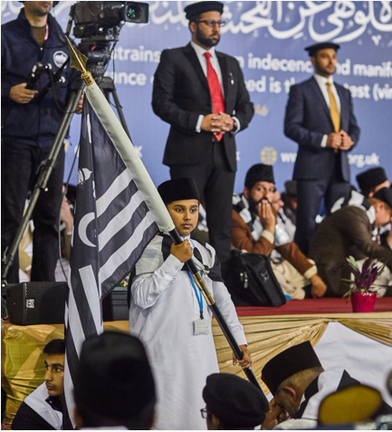
Discussion
Section

Slide 21
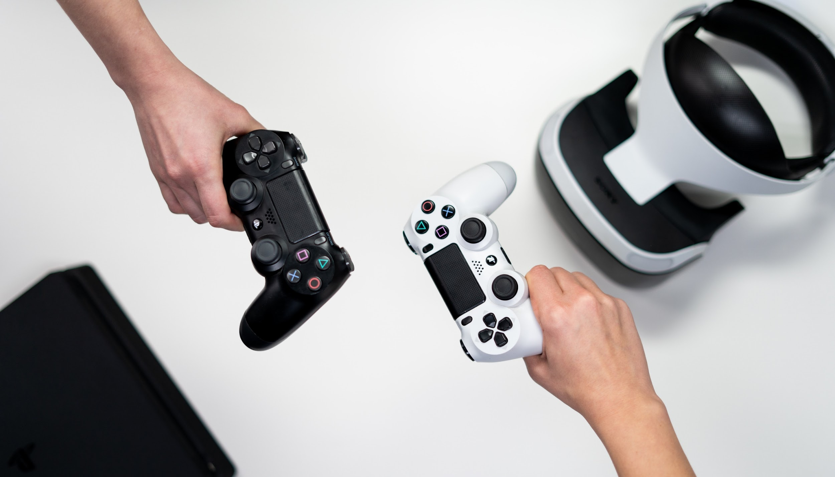
Video games
What has our Beloved Huzoor (aba) said about video games?
What are the risks of playing video games?
What is gaming addiction?
What are some alternatives to playing video games?
Discussion

Slide 22
Do you have any questions?
Ask us anything!

Slide 23
Announcements
Next Class
23th January 2020 (Sunday)
Class content available on
Atfal.org.uk/taleem-online-classes
Other Initiatives
  Qaseeda Challenge
  Winter Reading Challenge
  Salaat memorisation

