Slide 1
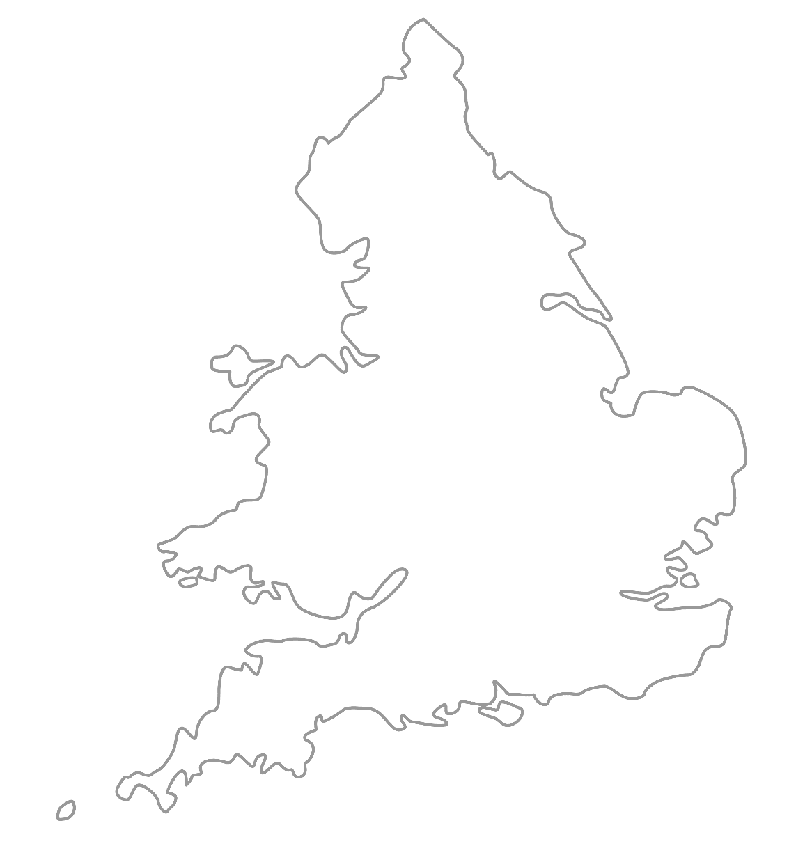

MAA National Online Talim Class
Age group 11-15
MA
A
TAL
IM
LESSON NUMBER 08
24th January 2021
The Class will begin shortly

Slide 2

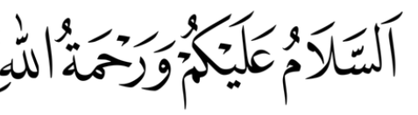
Welcome
Welcome to the Online Talim class organised by Majlis Atfal-ul-Ahmadiyya UK. Please take this time to make sure your regional Nazim knows that you are present in the class.
This class is for 11-15-year-old Atfal
Ask your regional nazim for the link to the class for younger Atfal if you do not fall in this age group or re-register.
Have you registered for the class ?
If you have not registered, please head over to Atfal.org.uk/taleem-online-classes and register. You only need to register once to get the weekly emails for the whole year.

Slide 3
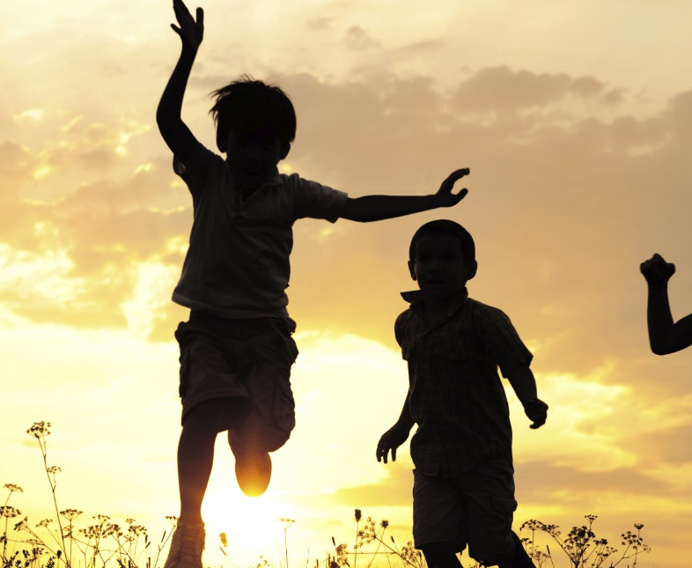
PARTNER
“What have you been up to in the past week?”

Slide 4
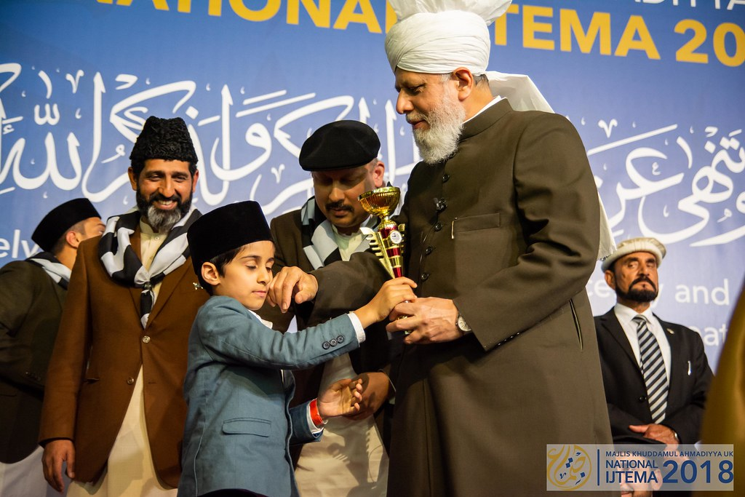
Learning
Section

Slide 5
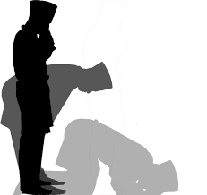
Salaat
سُبْحَانَ رَبِّیَ الْعَظِیْم
سَمِعَ اللّٰہُ لِمَنْ حَمِدَہٗ
Subhaana Rabbi-yal `Azeem
Sami`-Allaahu liman hamidah
Holy is my Lord, the Most Great.
Allah hears him who praises Him.

Slide 6
Salaat
الْعَظِیْم |  | رَبِّی |  | سُبْحَانَ
The Most Great |  | My Lord |  | Holy is
Holy is my Lord, the Most Great.
حَمِدَہُ | لِمَنْ |  | اللّٰہُ |  | سَمِعَ
Praises Him | Him who |  | Allah |  | Hears
Allah hears him who praises Him.

Slide 7
Hadith
اَلسَّعِيْدُ مَنْ وُّعِظَ بِغَيْرِهِ
As-sa’eedu maw-wu’iza bi-ghairi-hi
A pious person learns from others (other’s mistakes).
What does pious mean?
If we make a mistake, should we give up?
How can we learn from our own mistakes?
How can we learn from other’s mistake?

Slide 8
Short Quiz
  If you do not know the answer, do not raise your hand
5 Questions and their answers
  If you have already had a go, let your Atfal brothers have a go too and not raise your hand again
  Raise your hand if you know the answer, or send in the chat

Slide 9
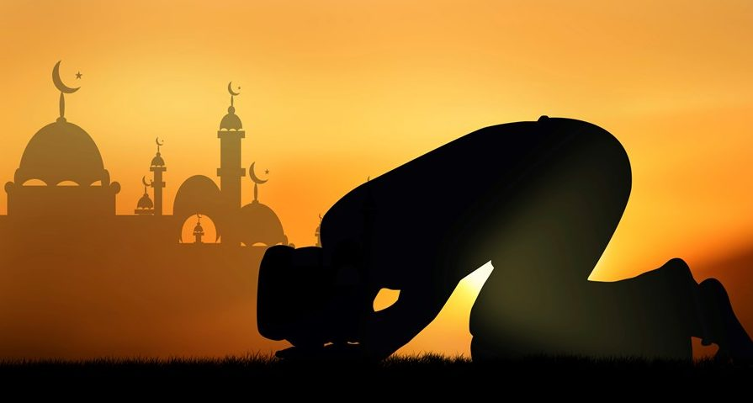
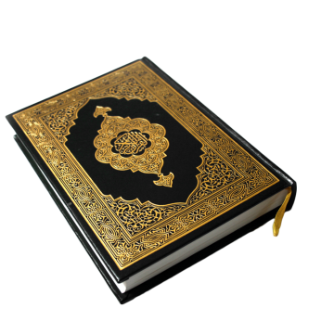
Short Quiz
Question 1
  When was the battle of Uhud fought?

Slide 10
Short Quiz
Answer to Q1
Around March 624AD (3 Hijri)

Slide 11
Short Quiz
Question 2
  When was the battle of the Ditch fought?

Slide 12
Short Quiz
Answer to Q2
627AD (5 hijri Shawal)

Slide 13
Short Quiz
Question 3
  Who was the companion of the Holy Prophet (saw) who suggested the idea to build a ditch in the battle of the ditch?

Slide 14
Short Quiz
Answer to Q3
Hazrat Salman Farsi (ra)

Slide 15
Short Quiz
Question 4
  Name the Khulafa-e-Rashideen

Slide 16
Short Quiz
Answer to Q4
Hazrat Abu Bakr (ra)
Hazrat Umar (ra)
Hazrat Usman (ra)
Hazrat Ali (ra)

Slide 17
Short Quiz
Question 5
  When was Jama’at Ahmadiyya named Ahmadiyya?

Slide 18
Short Quiz
Answer to Q5
March 1901

Slide 19
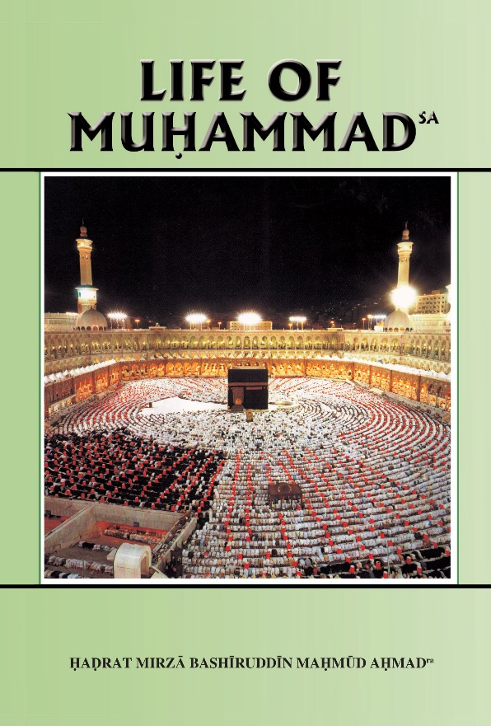
Reading Section

Slide 20
Reading section
Life of Muhammad (pbuh)
Written by: HADRAT MIRZA BASHIRUDDIN MAHMUD AHMAD
KHALIFATUL MASIH II
ARABIA AT THE TIME OF THE PROPHET’Ssa BIRTH
The Prophet (sa) was born in Mecca in August 570 A.D. He was given the name Muhammad (sa) which means, the Praised One. To understand his life and character we must have some idea of the conditions which obtained in Arabia at the time of his birth.
When he was born almost the whole of Arabia believed in a polytheistic form of religion. The Arabs traced their descent to Abraham (as). They knew that Abraham (as) was a monotheistic Teacher. In spite of this, they entertained polytheistic beliefs and were given to polytheistic practices. In defence, they said that some human beings are outstanding in their contact with God. Their intercession on behalf of others is accepted by God. To reach Him is difficult for ordinary human beings. They must have others to intercede for them in order to obtain God's pleasure and help. Thus they were able to combine their reverence for Abraham (as) with their own polytheistic beliefs. Abraham (as), they said, was a holy man. He was able to reach God without intercession, whilst ordinary Meccans could not do so.

Slide 21
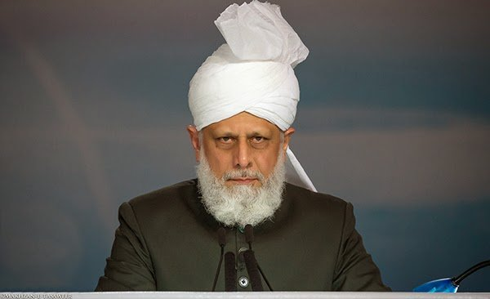
Abid Khan Sahib’s Diary
“Birthdays”
[A] member of the Khuddam Amila mentioned that his daughter attended a school that celebrated the birthday of each child and he sought Huzoor’s guidance over this matter.
In reply, Huzoor said:
““If the school wants to mark the birthday of every child, including your children, then let them do it. However, you can let the school know that within your home you do not celebrate birthdays and consider them to be a waste of expense that could be put to better use.”
Hazrat Mirza Masroor Ahmad (aba)
Advising how the Khadim should do the Tarbiyyat of his child, Huzoor said:
“You should also explain to your daughter the true Islamic way of commencing a new year in their life”…

Slide 22
Abid Khan Sahib’s Diary
“Birthdays”
…
“Instead of expecting others to spend lavishly, our Ahmadi children should be taught that they should give one or two euros in charity and offer Nafl (voluntary) prayers. If other parents want to give your child a gift you do not have to reject it but let them know that we prefer for our children to give to charities on birthdays, rather than receiving gifts themselves.”
Thereafter, illustrating the moderate teachings of Islam, Huzoor said:
Hazrat Mirza Masroor Ahmad (aba)
“You should not be harsh or overly strict with your child. Marking a birthday is not a matter of Sharia and it is not haram. There is even no harm if you bring a small cake for your children to have within the home on their birthday. What is wrong is for them to expect gifts or to have a party.”

Slide 23
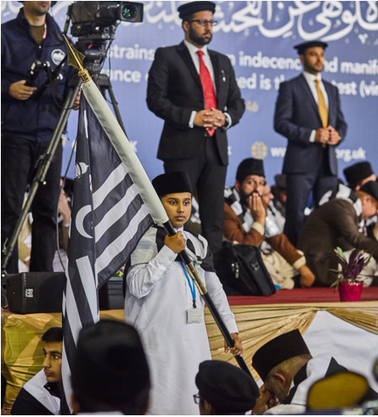
Discussion
Section

Slide 24
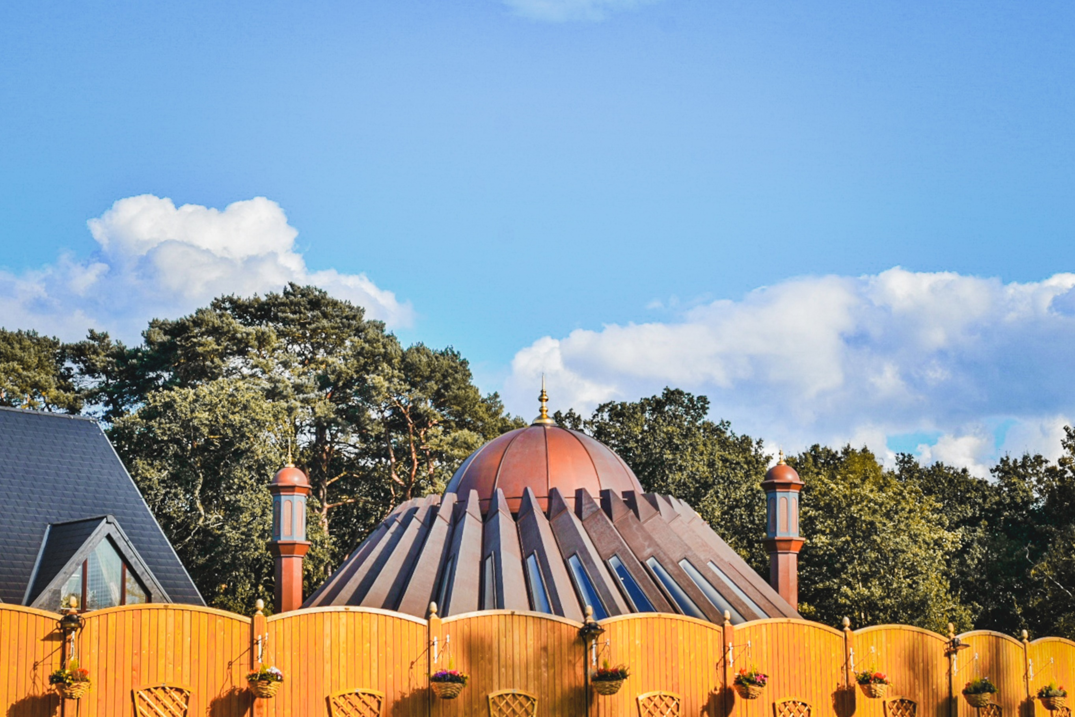
Discussion
The need for Khilafat
What is the difference between non Ahmadi Muslims and Ahmadi Muslims?
What are some of the problems in the modern Muslim society?
Have you heard of the challenge Huzoor gave to all of the Muslim Ummah?
What is the need for Khilafat?

Slide 25
Do you have any questions?
Ask us anything!

Slide 26
Announcements
Next Class
31th January 2021 (Sunday)
Class content available on
Atfal.org.uk/taleem-online-classes
Other Initiatives
  Qaseeda Challenge
  Winter Reading Challenge
  Salaat memorisation

