Slide 1
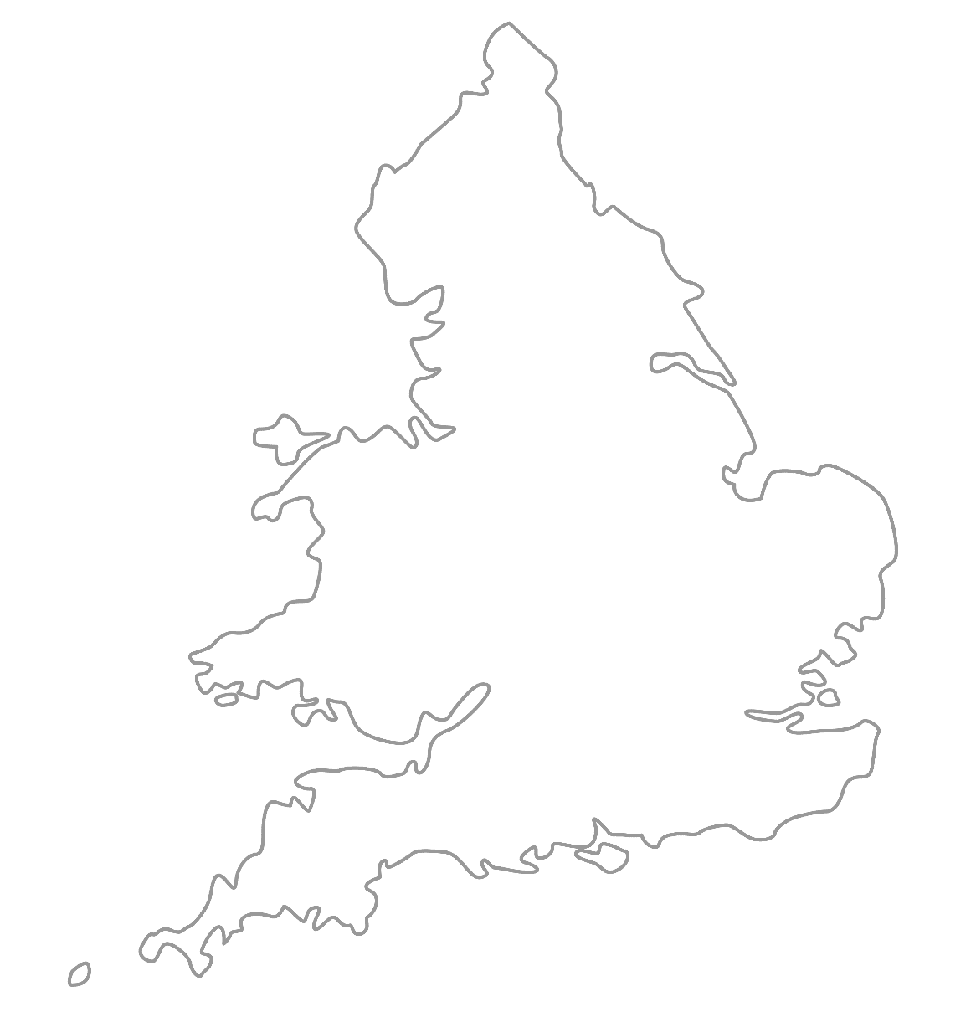

MAA National Online Talim Class
Age group 7-10
MA
A
TAL
IM
LESSON NUMBER 09
31st January 2021
The Class will begin shortly

Slide 2

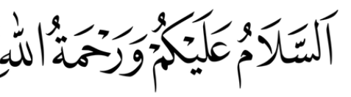
Welcome
Welcome to the Online Talim class organised by Majlis Atfal-ul-Ahmadiyya UK. Please take this time to make sure your regional Nazim knows that you are present in the class.
This class is for 7-10-year-old Atfal
Ask your regional nazim for the link to the class for older Atfal if you do not fall in this age group or re-register.
Have you registered for the class ?
If you have not registered, please head over to Atfal.org.uk/taleem-online-classes and register. You only need to register once to get the weekly emails for the whole year.

Slide 3
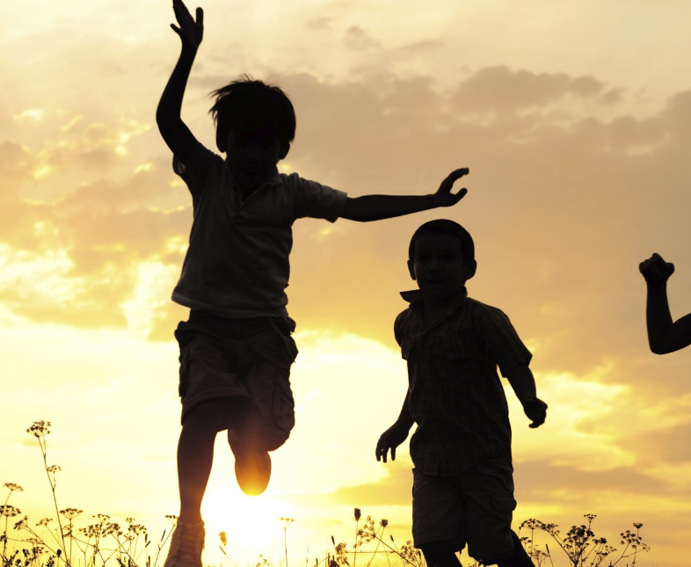
PARTNER
“What have you been up to in the past week?”

Slide 4
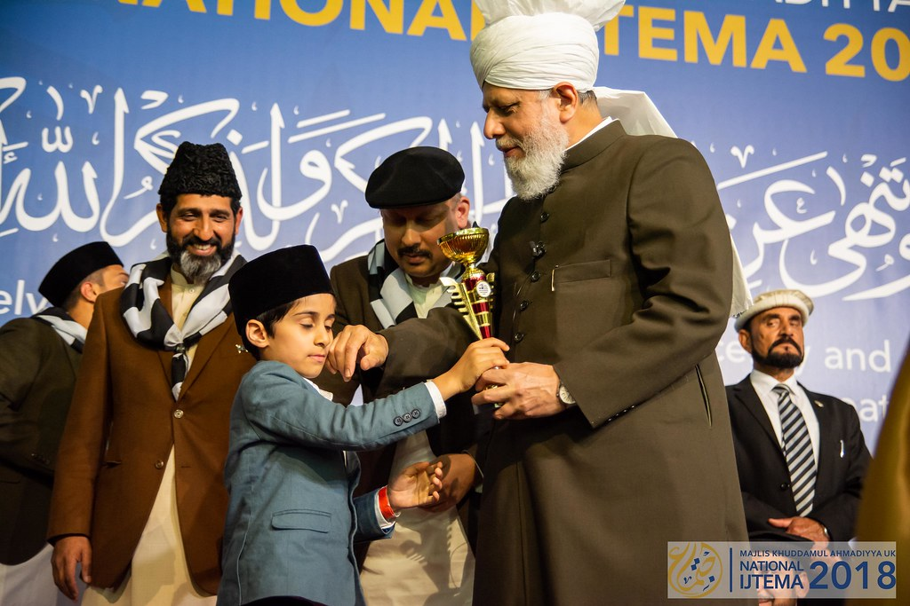
Learning
Section

Slide 5
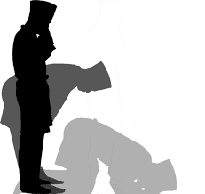
Salaat
رَبَّنَا وَلَکَ الْحَمْدُ۔ حَمْدًا کَثِیْرًا طَیِّبًا مُبَارَکًا فِیْہِ
Rabba-na walakal hamd hamdan kaseeran tayyiban mobarakan fee-hee
Our Lord, Yours is the praise
Praise that is abundant, pure and full of blessings.

Slide 6
Hadith
لَيْسَ الْخَبَرُ كَالْمُعَايَنةِ
Laysal-khabaru kal-mu’ayana
Hearing is not like seeing.
What factors can we look at to assess truthfulness of something?
What does this Hadith mean?
How does this relate to nowadays?
Why should we not spread news?

Slide 7
Short Quiz
  If you do not know the answer, do not raise your hand
5 Questions and their answers
  If you have already had a go, let your Atfal brothers have a go too and not raise your hand again
  Raise your hand if you know the answer, or send in the chat

Slide 8
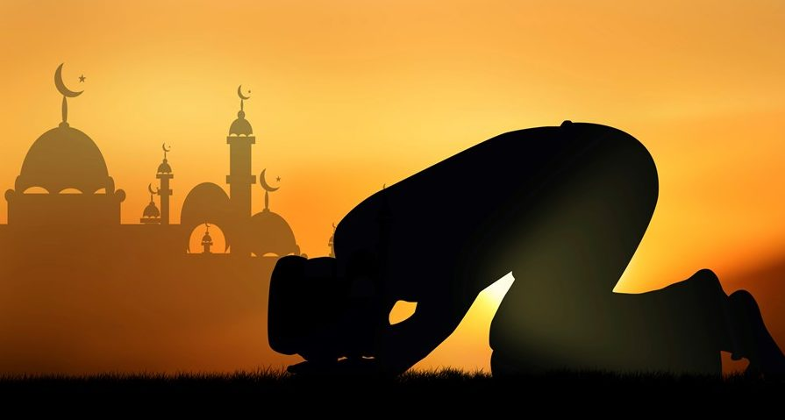
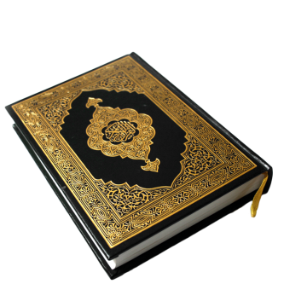
Short Quiz
Question 1
  Where and when did the first Bai’t take place?

Slide 9
Short Quiz
Answer to Q1
23rd March 1889 in Ludhiana

Slide 10
Short Quiz
Question 2
  Who was the first person to take Bai’t on the hand of the Promised Messiah?

Slide 11
Short Quiz
Answer to Q2
Hazrat Hakeem Moulana Noor-ud-Din

Slide 12
Short Quiz
Question 3
  How many people took Bai’t on the first day?

Slide 13
Short Quiz
Answer to Q3
40

Slide 14
Short Quiz
Question 4
  How many writings are there the of the Promised Messiah (as)?

Slide 15
Short Quiz
Answer to Q4
85

Slide 16
Short Quiz
Question 5
  Name the first and last books of the Promised Messiah (as)

Slide 17
Short Quiz
Answer to Q5
Baraheen-e-Ahmadiyya (Vol I and II)
Pegham-e-Sulh

Slide 18
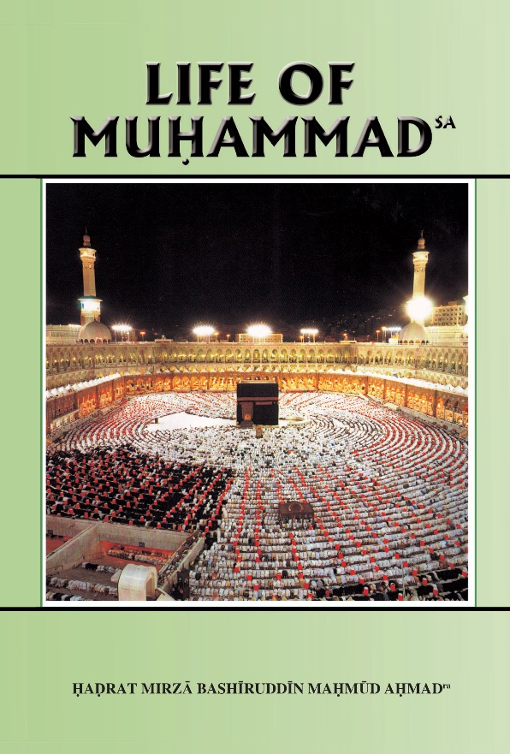
Reading Section

Slide 19
Reading section
Life of Muhammad (pbuh)
Written by: HADRAT MIRZA BASHIRUDDIN MAHMUD AHMAD
KHALIFATUL MASIH II
ARABIA AT THE TIME OF THE PROPHET’S (saw) BIRTH (Continued)
The people of Mecca, therefore, had made idols of holy and righteous persons, and these they worshipped and to these they made offerings in order to please God through them. This attitude was primitive, illogical and full of defects. But the Meccans were not worried by these. They had not had a monotheistic Teacher for a long time, and polytheism, once it takes root, spreads and knows no bounds. The number of gods begins to increase. At the time of the Prophet’s (sa) birth, it is said that in the Ka‘ba alone, the Sacred Mosque of all Islam and the house of worship built by Abrahamas and his son Ishmael, there were 360 idols. It seems that for every day of the lunar year the Meccans had an idol. In other big centres there were other idols, so that we can say that every part of Arabia was steeped in polytheistic belief. The Arabs were devoted to the culture of speech. They were much interested in their spoken language and were very keen on its advance. Their intellectual ambitions, however, were scant. Of History, Geography, Mathematics, etc., they knew nothing. But as they were a desert people and had to find their way about in the desert without the assistance of landmarks, they had developed a keen interest in Astronomy. There was in the whole of Arabia not a single school. It is said that in Mecca only a few individuals could read and write

Slide 20
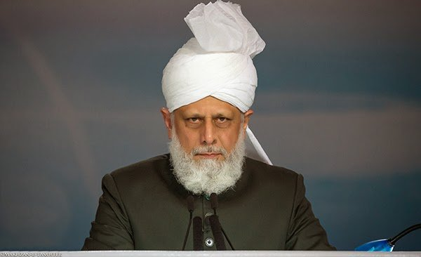
Abid Khan Sahib’s Diary
“Khilafat is like a Magnet”
Another person I met was called Syed Zaki Ahmad (37) who told me how the presence of Huzoor had inspired him and many others.
Zaki sahib said:
“Sometimes we become lazy in our duties and service to the Jamaat but when you see Huzoor and you observe his piety it inspires and energises you. Huzoor’s presence makes you determined to serve the Jamaat and to spread the true message of Islam. Khilafat is like a magnet because its pull is so strong that the more you see Huzoor the more you want to be closer to him.”
Hazrat Mirza Masroor Ahmad (aba)

Slide 21
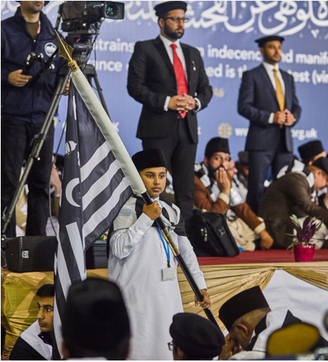
Discussion
Section

Slide 22
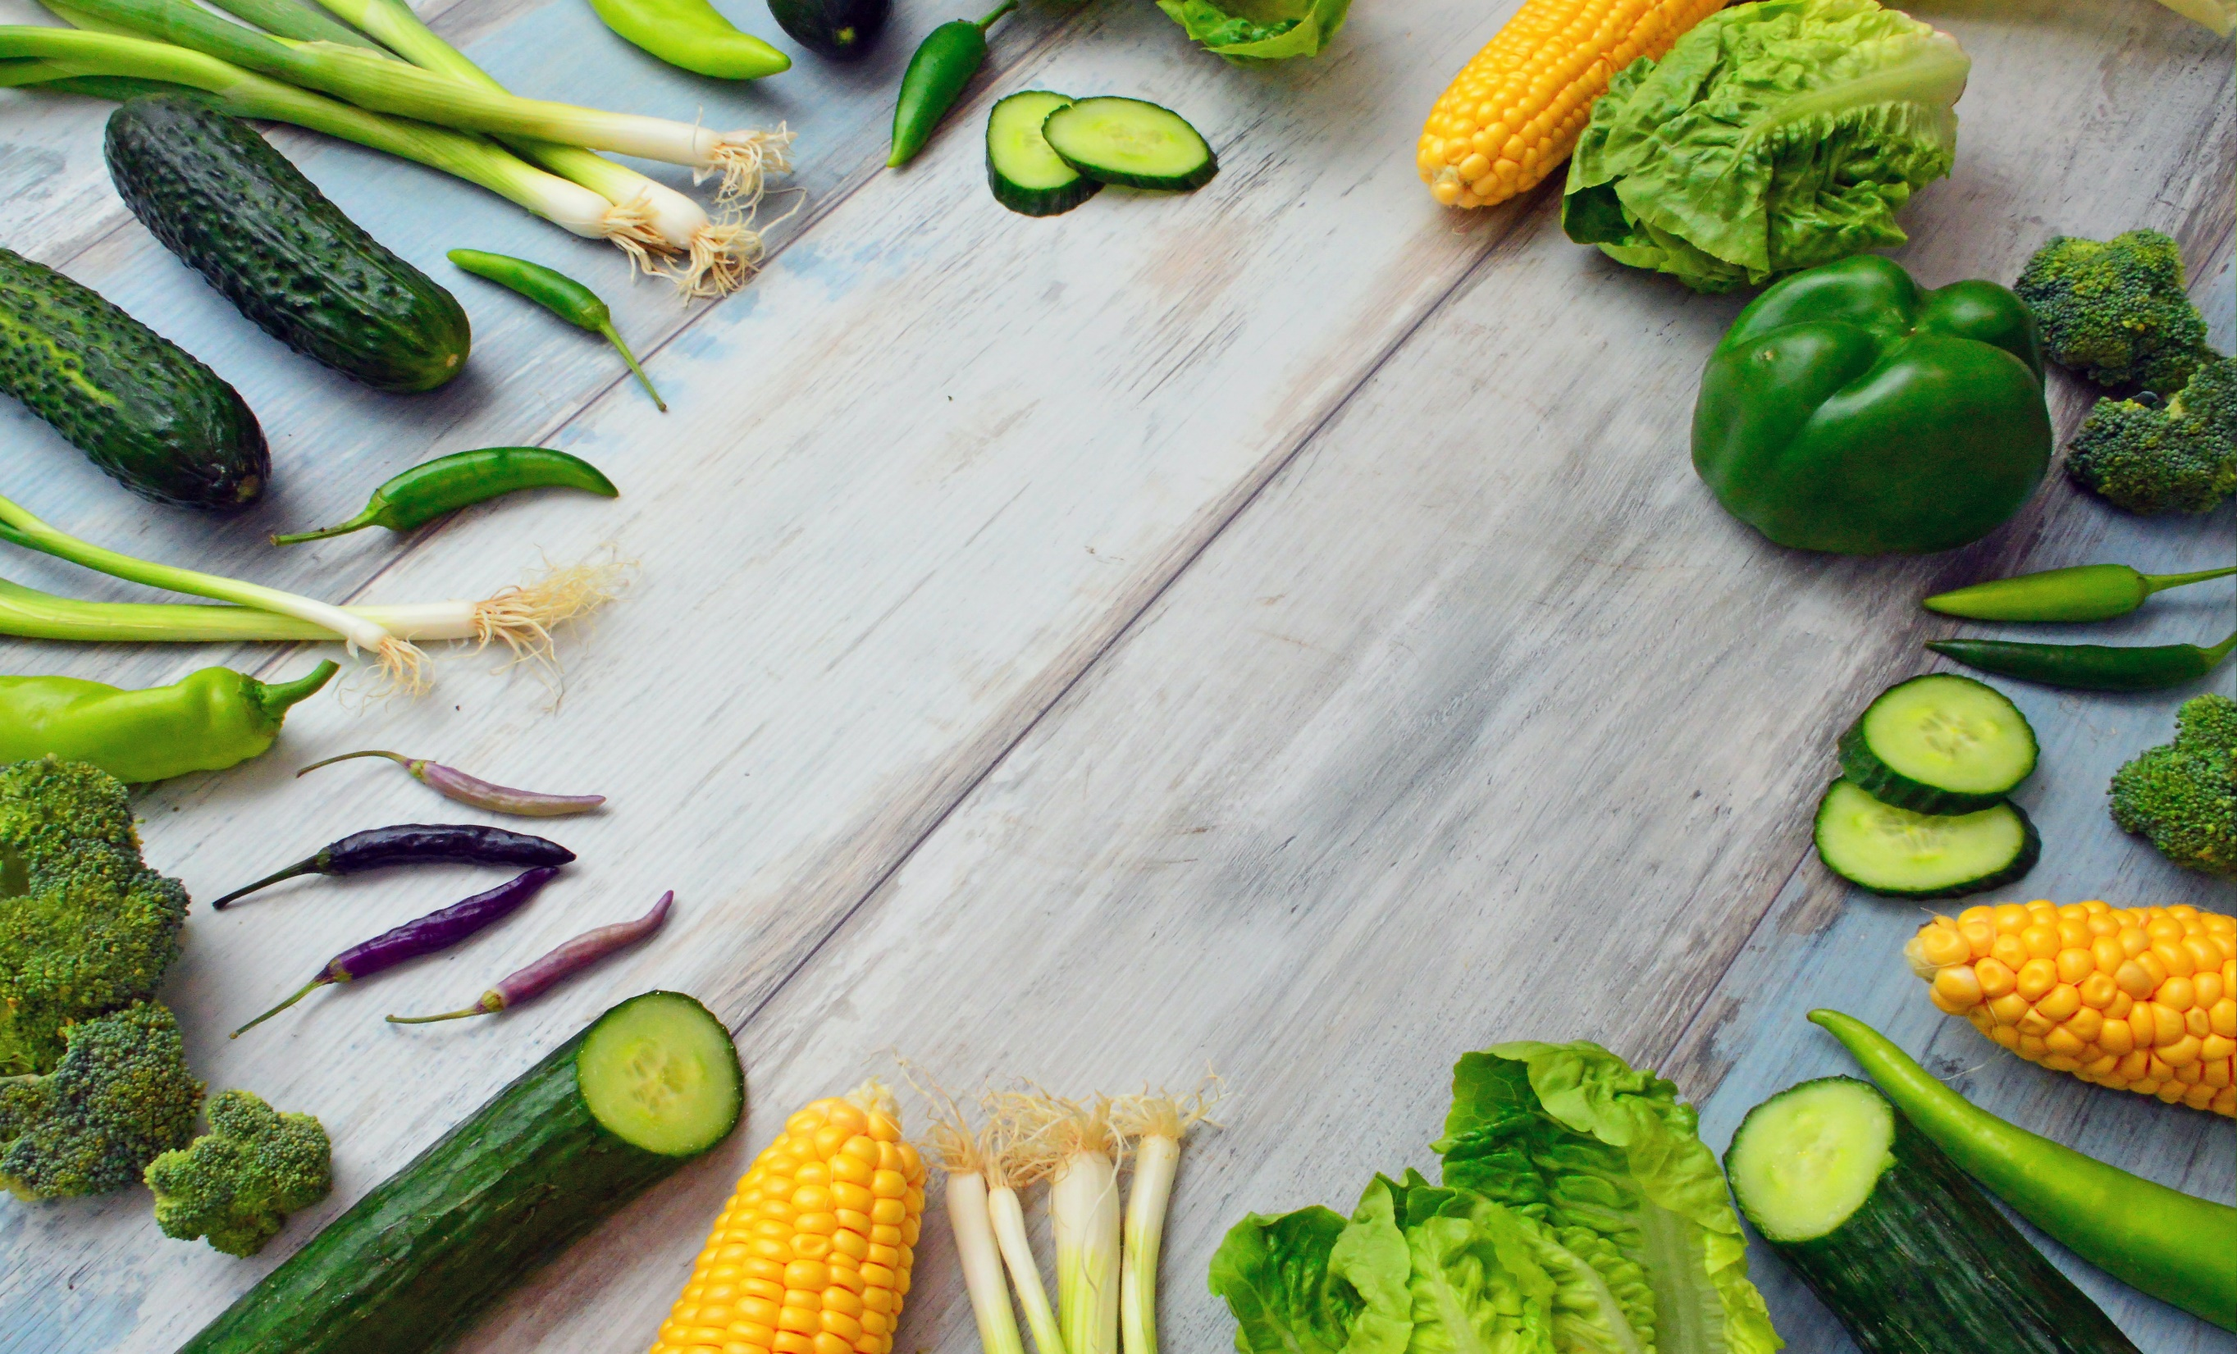
Discussion
Healthy eating
Do you know of any Hadith that can be related to this topic?
Do you know what Allah has said in the Qur'an about eating and drinking?
How can we eat healthily?
Why is keeping our bodies healthy especially important nowadays?
In which other ways can we remain healthy?

Slide 23
Do you have any questions?
Ask us anything!

Slide 24
Announcements
Next Class
7th February 2021 (Sunday)
Class content available on
Atfal.org.uk/taleem-online-classes
Other Initiatives
  Qaseeda Challenge
  Winter Reading Challenge
  Salaat memorisation

