Slide 1
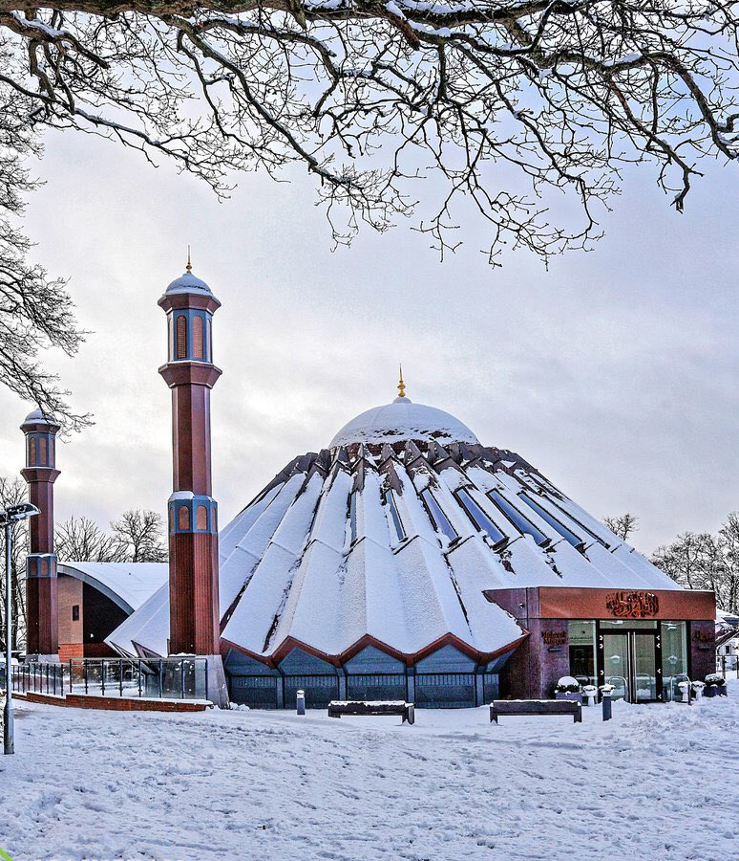


TALIM DEPARTMENT MAA UK
WEEKLY
ATFAL CLASS
(February – Week 2)
TALIM DEPARTMENT MAA UK
www.atfal.org.uk/talim
talim@atfal.co.uk

Slide 2

Class Rules
Arrive on time and be prepared
Always say “Assalamu Alaikum” when you enter the room
Pay attention and listen to the teacher quietly.
Raise your hand if you have a question.
Listen to others when they are speaking.
Work hard and try your best to learn something new.

Slide 3

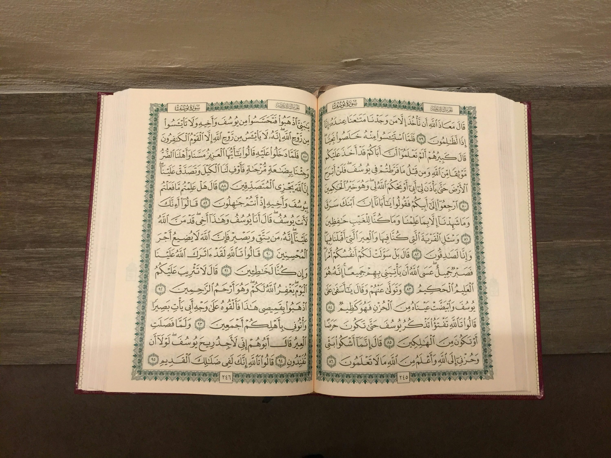

TILAWAT
لَیۡسَ عَلَی الۡاَعۡمٰی حَرَجٌ وَّلَا عَلَی الۡاَعۡرَجِ حَرَجٌ وَّلَا عَلَی الۡمَرِیۡضِ حَرَجٌ وَّلَا عَلٰۤی اَنۡفُسِکُمۡ اَنۡ تَاۡکُلُوۡا مِنۡۢ بُیُوۡتِکُمۡ
TRANSLATION
“There is no harm for the blind and there is no harm for the disabled, and there is no harm for the sick and none for yourselves, that you eat from your own houses.”
(The Holy Quran, Surah An-Nur, 24:62)

Slide 4


Lesson Plan
1. Tilawat
2. Hadith
3. Thought of the Week
4. Homework Recap
5. Salat Recap
6. Friday Sermon
7. Learning Time
8. Announcements!
Are you prepared for today’s lesson?
Topi
Class Handout
Pen / Pencil

Slide 5

HADITH
(saying of the Holy Prophet Muhammad^{sa})
اِبْغُوْنِيْ فِي الضُّعَفَاءِ ، فَإِنَّمَا تُنْصَرُوْنَ، وَتُرْزَقُوْنَ بِضُعَفَائِكُمْ‏
Ibghooni fid-duafai fa innama tunsaruna wa turzakuna bidu’afaikum
(Riyad as-Salihin, 272)
Translation:
“Seek among your weak ones, for you are given provision and help only because of the weak amongst you.”
Notes:
After Tilawat, spend 5 mins catching up with Atfal. What they've been getting up to in the past week.
Hadith:
Whoever, reads the Hadith out, should do so in the proper manner. i.e. recite Durood Shareef first and then the Hadith.
Have a brief discussion about the meaning of this hadith in light of the questions on the screen.

Slide 6



THOUGHT
OF THE WEEK
TOPIC:
“World Cancer Day!”

Slide 7


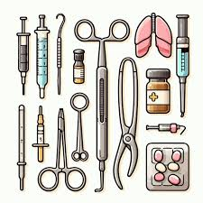
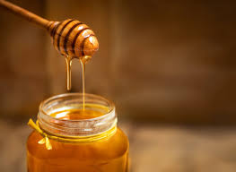
WHAT FAMOUS MUSLIMS DO WE KNOW THAT CONTRIBUTED TO MEDICINE?
Ibn Sina
Widely regarded as the ‘father of early modern medicine.’ He was an extraordinary physician and memorized the Holy Quran by 10. His works include ‘Al-Qanun fil Tibb’ (The Canon of Medicine) a medical encyclopaedia that remained a standard reference for both the Islamic and European world.
Al-Zahrawi
He is known as the ‘father of operative surgery.’ He designed and described over 200 surgical instruments which are used for modern day surgery. His book devotes three chapters to surgery, detailing several pioneering techniques and procedures.
Zakariyya al-Razi
He was also one of the towering figures in the history of medicine. Al-Razi was one of the first to differentiate between measles and smallpox. He introduced innovative treatments for treatments like poisonous insect bites. Al-Rawi also advocated for the use of honey as natural medicine.

Slide 8





HOMEWORK
Have you done your homework for this week?
Make sure to note down your homework for next week!

Slide 9

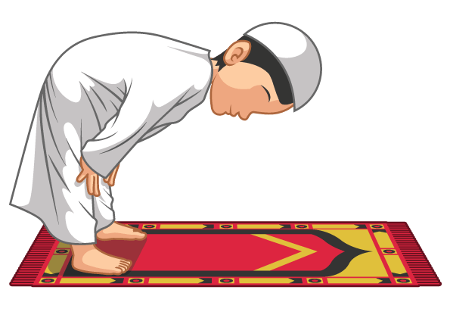
Tasmee
سَمِعَ اللّٰہُ لِمَنْ حَمِدَہُ
SALAT
Sami Allahu Liman Hamidah
Lets Recap a part of our Salat!
Translation:
Allah hears him who praises Him
NEXT WEEK RECAP:
Tahmeed
حَمِدَہُ | لِمَنْ | اللّٰہُ | سَمِعَ
Praises Him | Him who | Allah | Hears

Slide 10

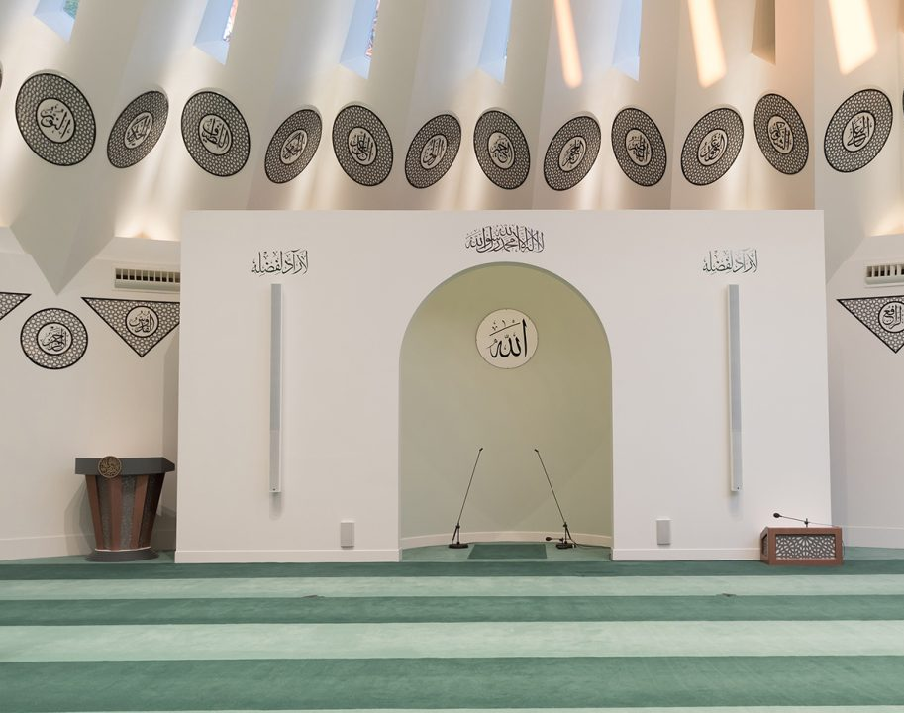
FRIDAY
SERMON
Friday 6th February
2026

Slide 11
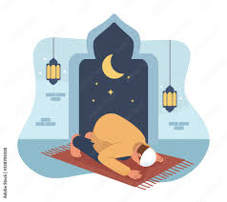




FRIDAY SERMON
Genuine Worship
The Holy Prophet^{sas} showed kindness and simplicity in prayer by shortening it when he heard a child crying, so that the mother would not feel worried or uncomfortable.
Praying at the Mosque in Congregation
The Holy Prophet^{sas} taught that praying together in the mosque is very important, especially when a person can hear the call to prayer.
Encouragement on Tahajjud
The Holy Prophet^{sas} strongly encouraged waking up early for the pre-dawn prayer, teaching that even a small effort in this prayer brings great blessings from Allah.
Watch this weeks Friday Sermon 4 Kids!

Slide 12



LEARNING
TIME

Slide 13

PAIR ACTIVITy
Discuss today’s lesson with the Tifl next to you and come up with 3 new things you learned today!

Slide 14

ANNOUNCEMENTS
NEW RAMADAN JOURNAL!
Head over to the following website to buy the latest Ramadan Journal!
https://shop.khuddam.org.uk/product/my-ramadan-journal/

Slide 15

ANNOUNCEMENTS
National Atfal Explorers Club
Keep a lookout for upcoming trips!
Visit: www.atfal.org.uk/atfal-travel-logs

