Slide 1
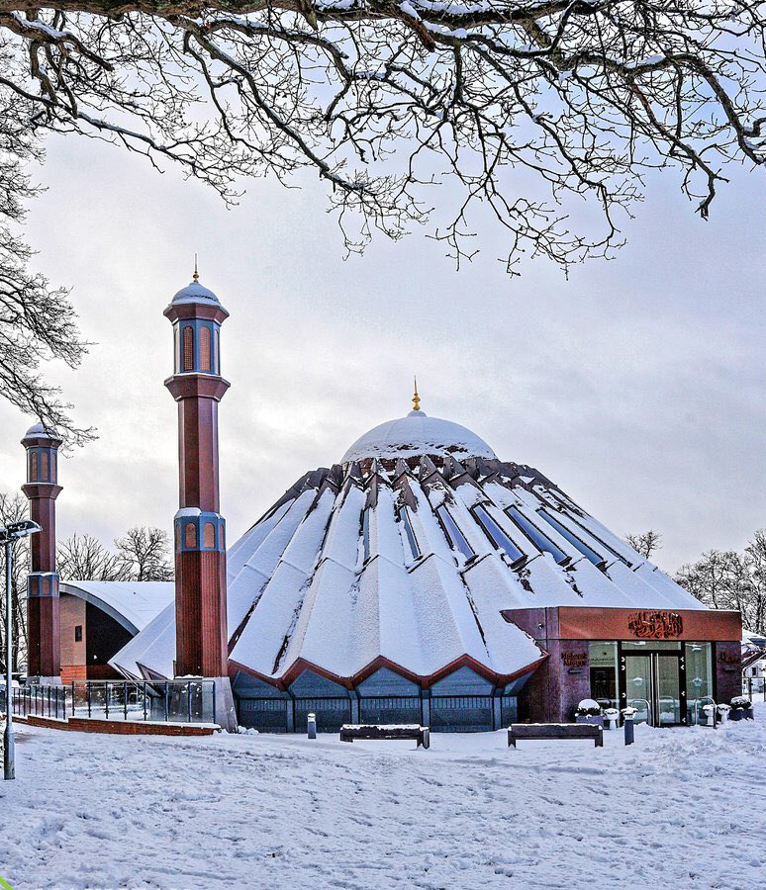


TALIM DEPARTMENT MAA UK
WEEKLY
ATFAL CLASS
(February – Week 3)
TALIM DEPARTMENT MAA UK
www.atfal.org.uk/talim
talim@atfal.co.uk

Slide 2

Class Rules
Arrive on time and be prepared
Always say “Assalamu Alaikum” when you enter the room
Pay attention and listen to the teacher quietly.
Raise your hand if you have a question.
Listen to others when they are speaking.
Work hard and try your best to learn something new.

Slide 3


Lesson Plan
1. Tilawat
2. Hadith
3. Thought of the Week
4. Homework Recap
5. Salat Recap
6. Friday Sermon
7. Learning Time
8. Announcements!
Are you prepared for today’s lesson?
Topi
Class Handout
Pen / Pencil

Slide 4

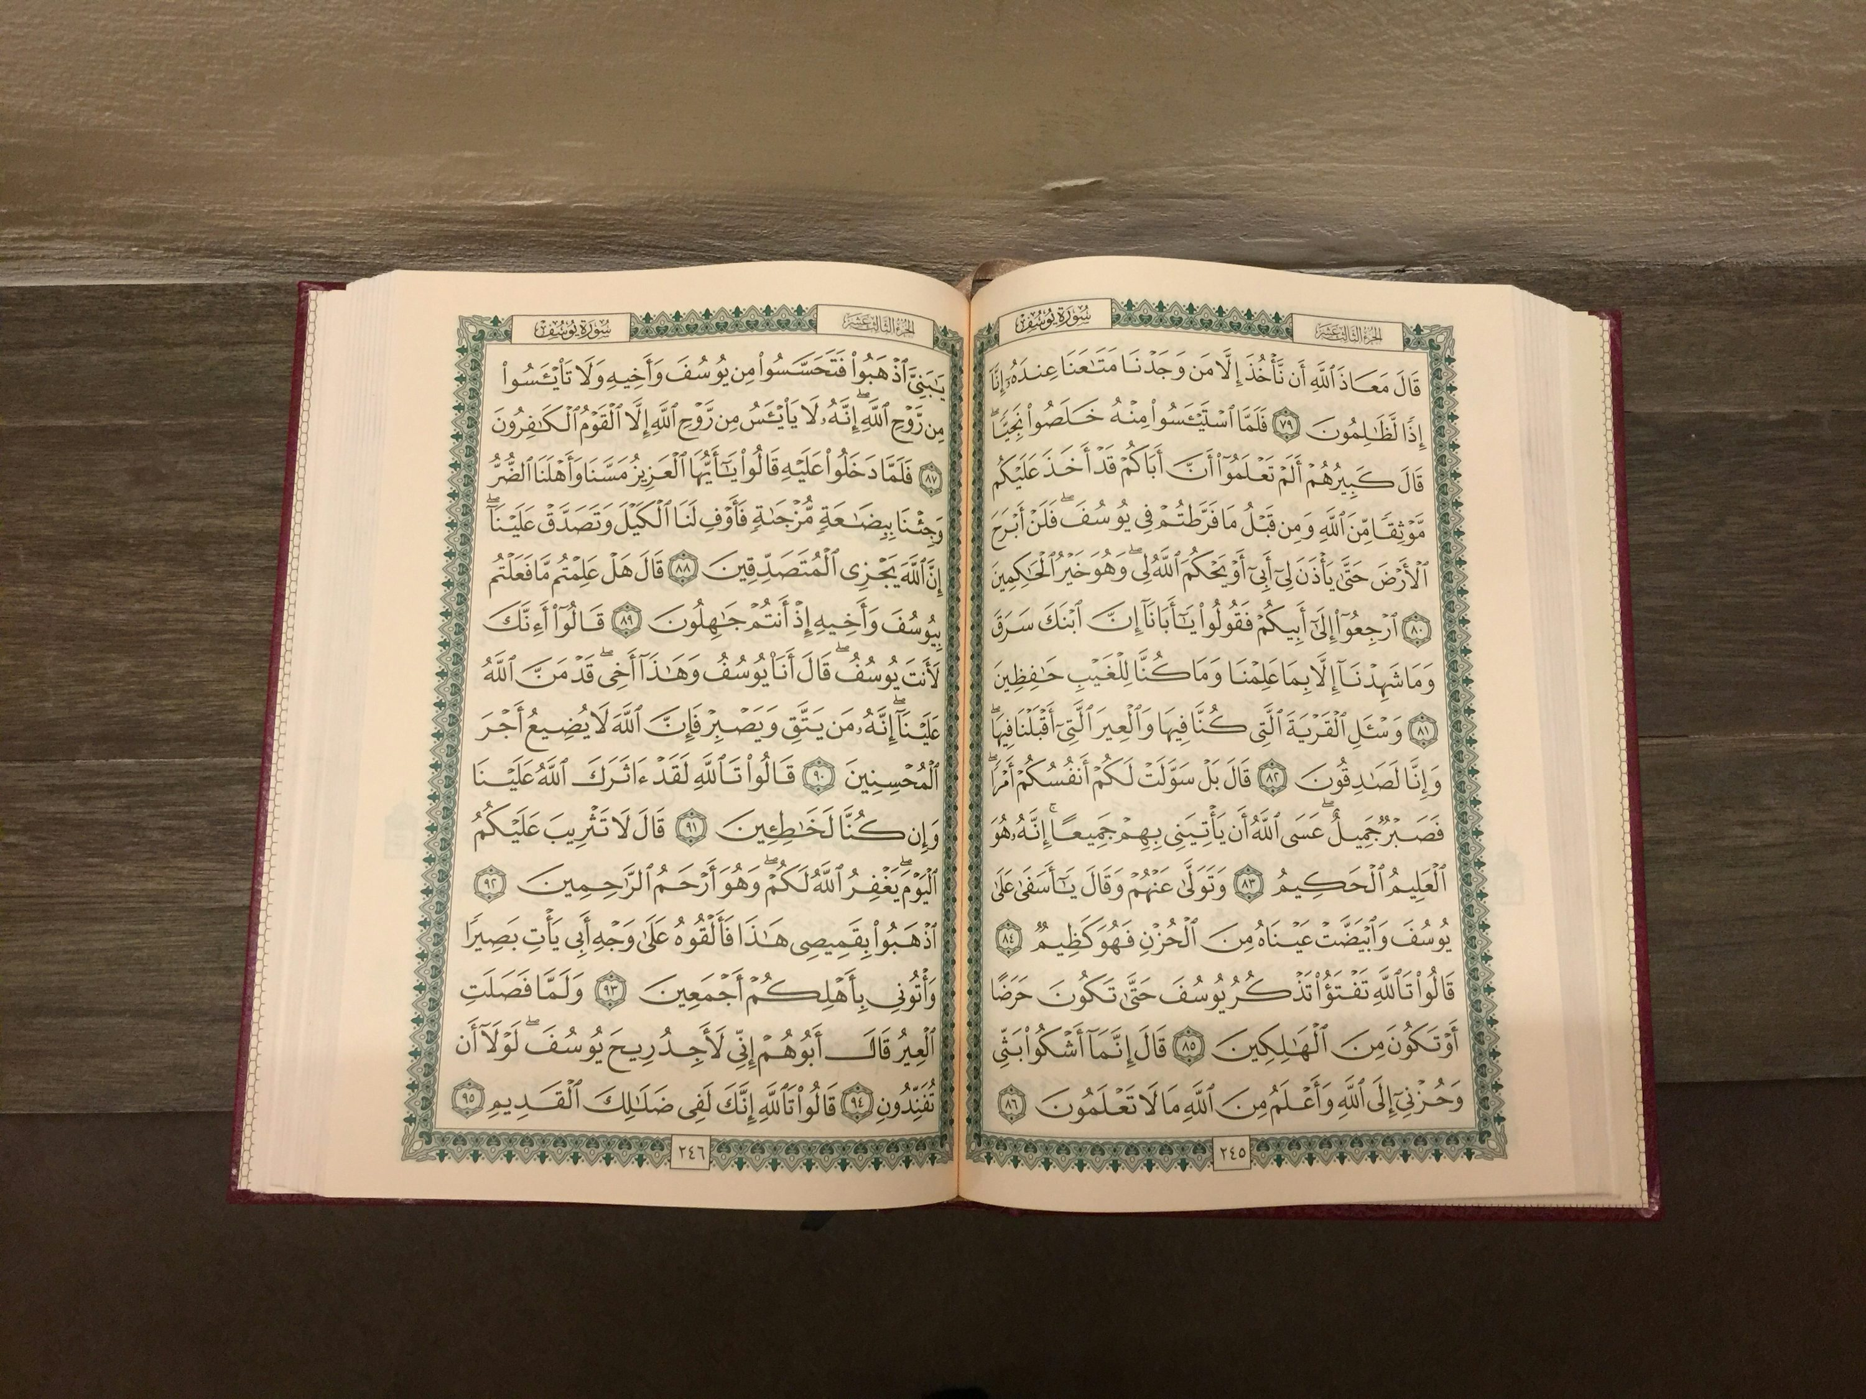

TILAWAT
یٰۤاَیُّہَا الَّذِیۡنَ اٰمَنُوۡا کُتِبَ عَلَیۡکُمُ الصِّیَامُ کَمَا کُتِبَ عَلَی الَّذِیۡنَ مِنۡ قَبۡلِکُمۡ لَعَلَّکُمۡ تَتَّقُوۡنَ
TRANSLATION
“O ye who believe! fasting is prescribed for you, as it was prescribed for those before you, so that you may become righteous.”
(The Holy Quran, Surah Al-Baqarah, 2:184)

Slide 5

HADITH
(sayings of the Holy Prophet Muhammad^{sas})
“مَنْ صَامَ رَمَضَانَ إِيمَانًا وَاحْتِسَابًا غُفِرَ لَهُ مَا تَقَدَّمَ مِنْ ذَنْبِهِ”
Man Saama Ramadana Imanan wahtisaban ghufira lahu ma taqaddama min zanbihi
(Sahih al-Bukhari, 1901)
Translation:
“Whoever fasts in the month of Ramadan out of sincere faith, and hoping for a reward from Allah, then all his previous sins will be forgiven.”
Notes:
After Tilawat, spend 5 mins catching up with Atfal. What they've been getting up to in the past week.
Hadith:
Whoever, reads the Hadith out, should do so in the proper manner. i.e. recite Durood Shareef first and then the Hadith.
Have a brief discussion about the meaning of this hadith in light of the questions on the screen.

Slide 6


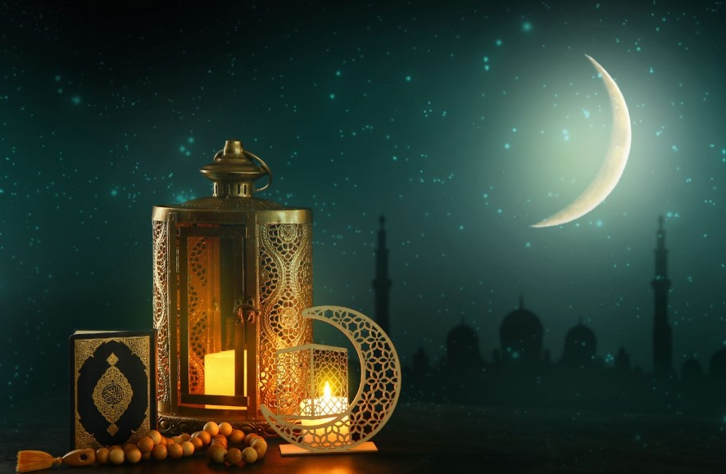
THOUGHT
OF THE WEEK
TOPIC:
“Ramadan – The Greatest of all Months!”

Slide 7

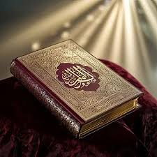

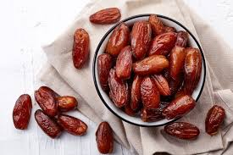
Did you know? (Ramadhan Edition)
Revelation of the Holy Quran
During this blessed month, Allah began sending down the revelation of the Holy Quran. During this month Angel Gabriel would come to the Holy Prophet^{sas} and revise whatever he had learnt. Muslims aim to finish one reading of the Holy Quran in the month of Ramdhan.
Who can fast?
Fasting is only for adults. Those who are Ill and are on a journey have been instructed by Allah not to fast. Thos who cannot fast should pay extra Charity called ‘Fidya’ which will be used to feed the poor and needy. They should make for these fast later, when in good health.
Fasting before Islam
Many religions have practised fasting before Islam. Christians observe during Lent (the time period of preparation before Easter.) Budhists observe fasting in memory of Budha(as) worship and life of full of striving. Jews observe fasting on a day called ‘Yom Kipper.’

Slide 8





HOMEWORK
Have you done your homework for this week?
Make sure to note down your homework for next week!

Slide 9


Tahmeed
رَبَّنَا وَلَکَ الۡحَمۡدُ حَمۡدًا کَثِیۡرًا طَیِّبًا مُبَارَکًا فِیۡہِ
SALAT
Rabbana walaka alhamdu hamdan kasiran tayiban mubarakan feeh
Lets Recap a part of our Salat!
Translation:
Our Lord, Yours is the praise – praise that is abundant, pure and full of blessings.
NEXT WEEK RECAP:
Jilsah
حَمۡدًا | الۡحَمۡدُ | وَلَکَ | رَبَّنَا
Praise | The Praise | Yours is | Our Lord

Slide 10
Tahmeed
رَبَّنَا وَلَکَ الۡحَمۡدُ حَمۡدًا کَثِیۡرًا طَیِّبًا مُبَارَکًا فِیۡہِ
SALAT
Rabbana walaka alhamdu hamdan kasiran tayiban mubarakan feeh
Lets Recap a part of our Salat!
Translation:
Our Lord, Yours is the praise – praise that is abundant, pure and full of blessings.
NEXT WEEK RECAP:
Jilsah
فِیۡہِ | مُبَارَکًا | طَیِّبًا | کَثِیۡرًا
Full of | Blessings | Pure | Abundant

Slide 11

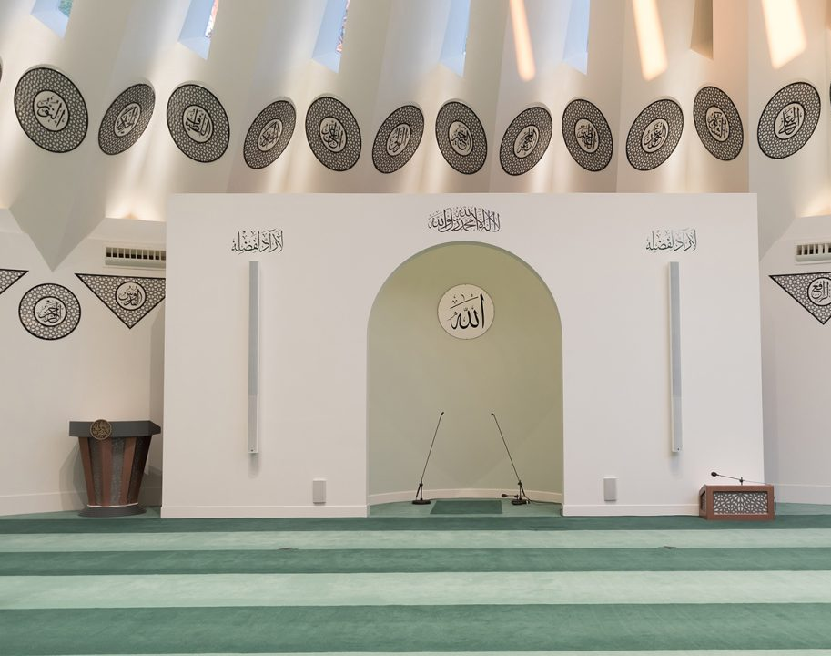
FRIDAY
SERMON
Friday 13th February
2026

Slide 12
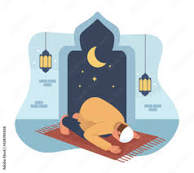
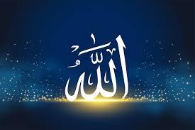
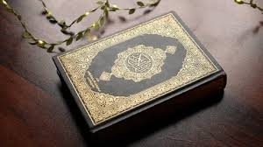
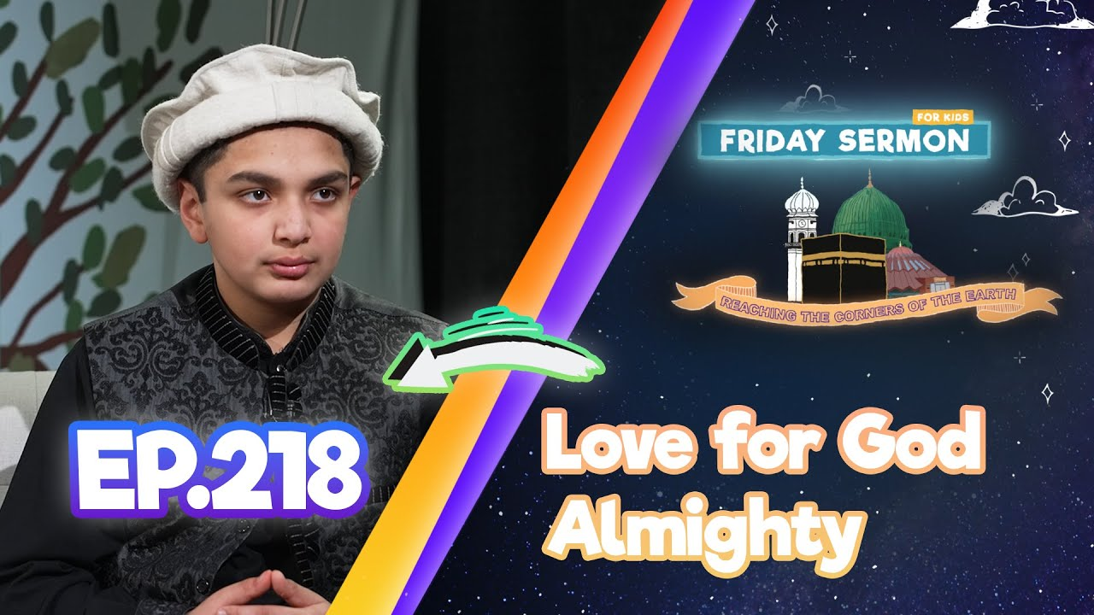

FRIDAY SERMON
Worship from Young
The Promised Messiah(as) was devoted to worship from a very young age. Once, as a child, he fell and became unconscious. When he awoke, the first thing he said was to ask whether it was time for Prayer.
Remembrance of Allah during Illness
Even at times of extreme illness when the Promised Messiah(as) could not formally offer the pre-dawn voluntary prayer, he would still be awake in bed and engaged in the remembrance of God and praying to Him.
Love for the Holy Quran
The Promised Messiah(as) would recite the Holy Qur’an with great attention and passions. In fact from the age of 14 or 15 he would spend his day reciting the Holy Qur’an and he would make notes in the margins.
Watch this weeks Friday Sermon 4 Kids!

Slide 13



LEARNING
TIME

Slide 14

PAIR ACTIVITy
Discuss today’s lesson with the Tifl next to you and come up with 3 new things you learned today!

Slide 15

ANNOUNCEMENTS
NEW RAMADAN JOURNAL!
Head over to the following website to buy the latest Ramadan Journal!
https://shop.khuddam.org.uk/product/my-ramadan-journal/

Slide 16
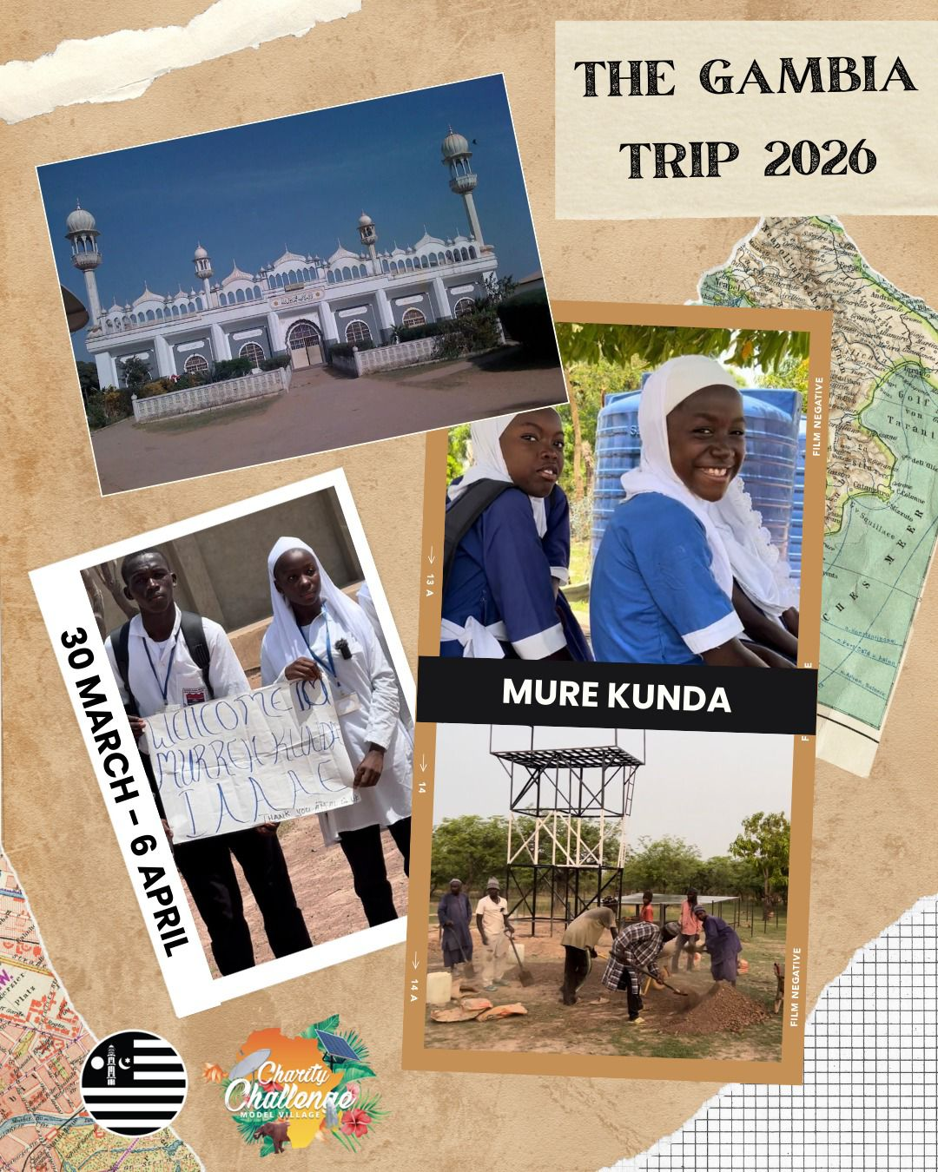
ANNOUNCEMENTS
National Atfal Explorers Club
Keep a lookout for upcoming trips!
Visit: www.atfal.org.uk/atfal-travel-logs

