Slide 1
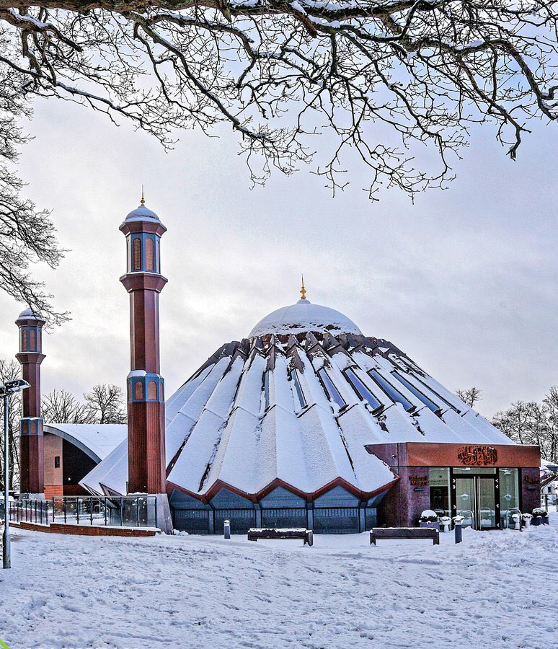


TALIM DEPARTMENT MAA UK
WEEKLY
ATFAL CLASS
(February – Week 4)
TALIM DEPARTMENT MAA UK
www.atfal.org.uk/talim
talim@atfal.co.uk

Slide 2

Class Rules
Arrive on time and be prepared
Always say “Assalamu Alaikum” when you enter the room
Pay attention and listen to the teacher quietly.
Raise your hand if you have a question.
Listen to others when they are speaking.
Work hard and try your best to learn something new.

Slide 3


Lesson Plan
1. Tilawat
2. Hadith
3. Thought of the Week
4. Homework Recap
5. Salat Recap
6. Friday Sermon
7. Learning Time
8. Announcements!
Are you prepared for today’s lesson?
Topi
Class Handout
Pen / Pencil

Slide 4

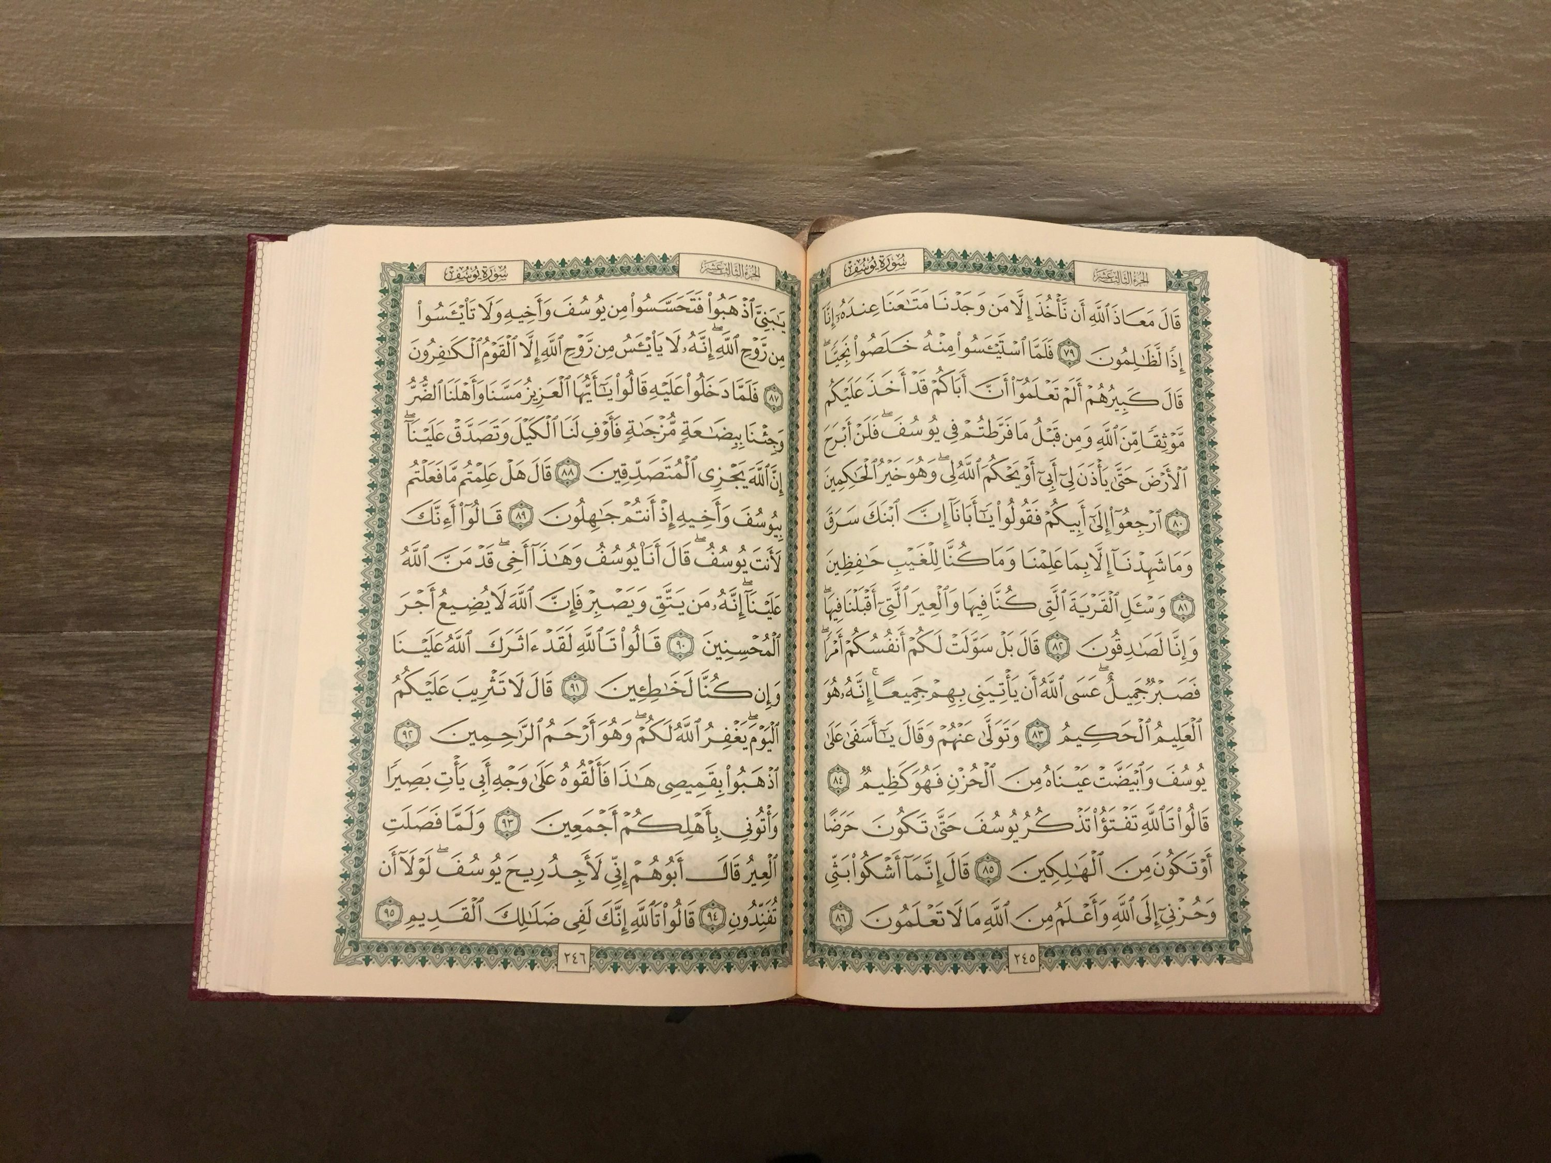

TILAWAT
یٰۤاَیُّہَا الَّذِیۡنَ اٰمَنُوۡا کُوۡنُوۡا قَوّٰمِیۡنَ لِلّٰہِ شُہَدَآءَ بِالۡقِسۡطِ وَلَا یَجۡرِمَنَّکُمۡ شَنَاٰنُ قَوۡمٍ عَلٰۤی اَلَّا تَعۡدِلُوۡا اِعۡدِلُوۡا ہُوَ اَقۡرَبُ لِلتَّقۡوٰی وَاتَّقُوا اللّٰہَ اِنَّ اللّٰہَ خَبِیۡرٌۢ بِمَا تَعۡمَلُوۡن
(The Holy Quran, Surah Al-Maidah, 5:9)

Slide 5
TRANSLATION
“O ye who believe! be steadfast in the cause of Allah, bearing witness in equity; and let not a people’s enmity incite you to act otherwise than with justice. Be always just, that is nearer to righteousness. And fear Allah. Surely, Allah is aware of what you do.”
(The Holy Quran, Surah Al-Maidah, 5:9)

Slide 6

HADITH
(sayings of the Holy Prophet Muhammad^{sas})
لَا فَضْلَ لِعَرَبِيٍّ عَلَى أَعْجَمِيٍّ وَلَا لِعَجَمِيٍّ عَلَى عَرَبِيٍّ وَلَا لِأَحْمَرَ عَلَى أَسْوَدَ وَلَا أَسْوَدَ عَلَى أَحْمَرَ إِلَّا بِالتَّقْوَى
La Fadla Li Arabiy ala ajami wa la li ajami ala arabi wa la liahmara ala aswada wa la aswada ala ahmara illa bi taqwa.
(Musnad Ahmad - 23489)
Translation:
“Verily there is no superiority of an Arab over a non-Arab or of a non-Arab over an Arab, or of a red man over a black man, or of a black man over a red man, except in terms of Taqwa (piety).”
Notes:
After Tilawat, spend 5 mins catching up with Atfal. What they've been getting up to in the past week.
Hadith:
Whoever, reads the Hadith out, should do so in the proper manner. i.e. recite Durood Shareef first and then the Hadith.
Have a brief discussion about the meaning of this hadith in light of the questions on the screen.

Slide 7



THOUGHT
OF THE WEEK
TOPIC:
“World Day of Social Justice!”

Slide 8

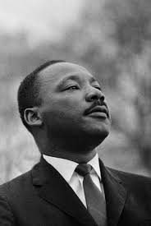
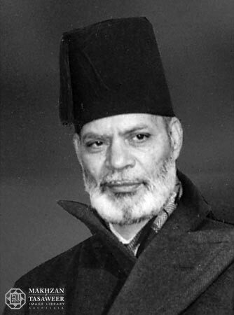
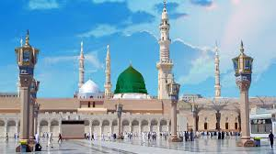

Famous Personalities who upheld Justice
Martin Luther King Jr.
He led the American Civil Rights Movement in the 1950s and 1960s, peacefully protesting against racism and unfair laws that treated Black people differently. He taught that people should respond to hatred with patience, love, and justice — not violence.
Hazrat Muhammad Zafrullah Khan^{ra}
He was Pakistan’s first Foreign Minister. In 1947, he gave a long and powerful speech at the United Nations defending the rights of the Palestinian Arab people, arguing that their land and freedoms should be respected.
Hazrat Umar Farooq^{ra}
Hazrat Umar^{ra} would often explore the streets of Madinah at night in disguise. One night, Hazrat Umar^{ra} carried a sack of food on his back to help a hungry family without them finding out who he was, showing that leaders must care for the poor.

Slide 9





HOMEWORK
Have you done your homework for this week?
Make sure to note down your homework for next week!

Slide 10


Jilsah
رَبِّ اغۡفِرۡ لِیۡ وَ ارۡحَمۡنِیۡ وَاھۡدِنِیۡ وَعَافِنِیۡ وَاجۡبُرۡنِیۡ وَارۡزُقۡنِیۡ وَارۡفَعۡنِیۡ
SALAT
Rabbighfirli warhamni wahdini wa afini wajburni warzuqni warfani.
Lets Recap a part of our Salat!
Translation:
O my Lord, forgive me and have mercy on me and guide me and keep me in good health, and make good my shortcomings and provide for me and raise me up.
NEXT WEEK RECAP:
Durood
وَاھۡدِنِیۡ | وَارۡحَمۡنِیۡ | اغۡفِرۡلِیۡ | رَبِّ
And guide me | And have mercy on me | Forgive me | O my Lord

Slide 11
Jilsah
رَبِّ اغۡفِرۡ لِیۡ وَ ارۡحَمۡنِیۡ وَاھۡدِنِیۡ وَعَافِنِیۡ وَاجۡبُرۡنِیۡ وَارۡزُقۡنِیۡ وَارۡفَعۡنِیۡ
SALAT
Rabbighfirli warhamni wahdini wa afini wajburni warzuqni warfani.
Lets Recap a part of our Salat!
Translation:
O my Lord, forgive me and have mercy on me and guide me and keep me in good health, and make good my shortcomings and provide for me and raise me up.
NEXT WEEK RECAP:
Durood
وَارۡفَعۡنِیۡ | وَارۡزُقۡنِیۡ | وَاجۡبُرۡنِیۡ | وَعَافِنِیۡ
And raise me up | And provide for me | And make good my shortcomings | And keep me in good health

Slide 12

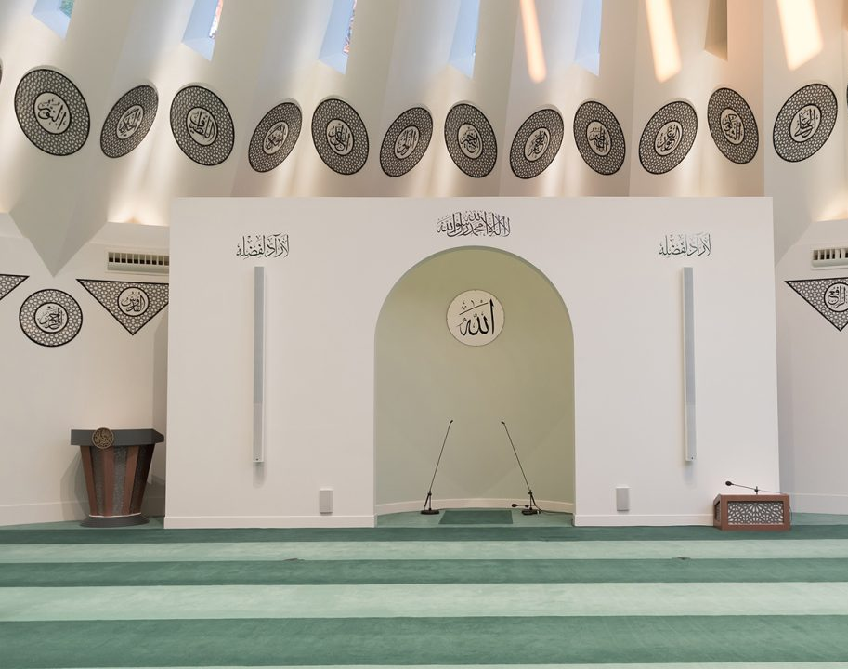
FRIDAY
SERMON
Friday 20th February
2026

Slide 13
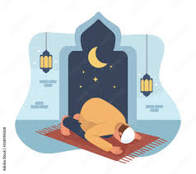
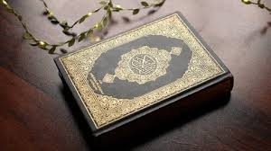

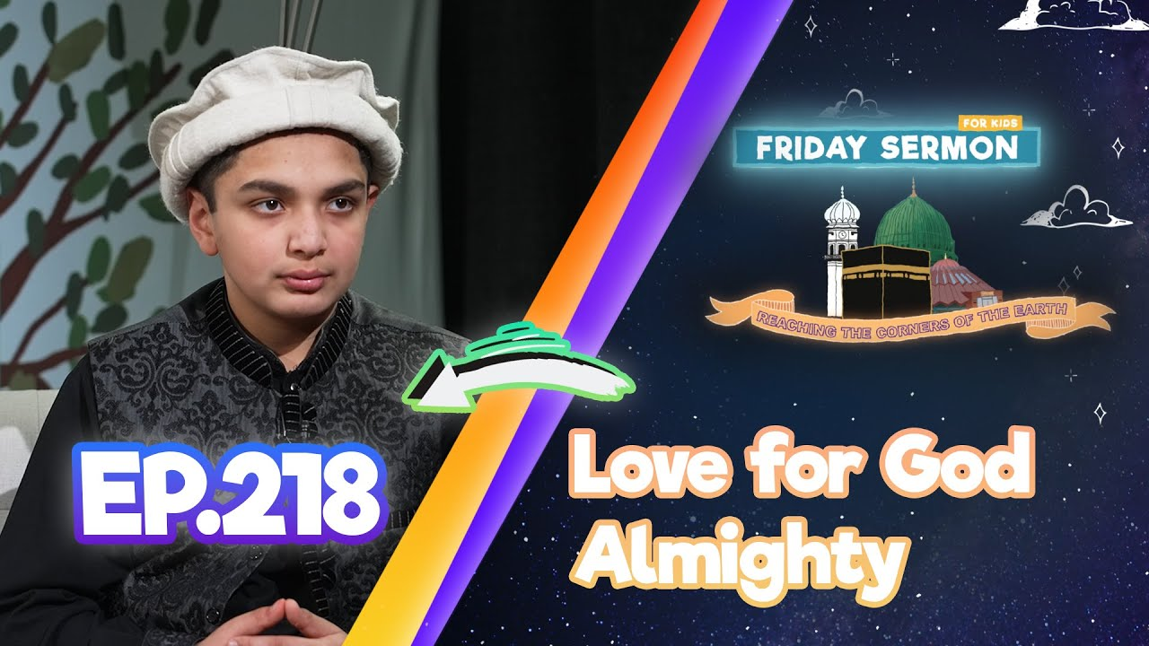

FRIDAY SERMON
Prophecy of Musleh Maud^{ra}
During his 40-day retreat in Hoshiarpur, Allah gave the Promised Messiah^{as} special blessings, spoke to him, and gave the prophecy of the Promised Son, which was fulfilled in Mirza Bashiruddin Mahmud Ahmad^{ra}.
Divine Visions
During his journey from Hoshiarpur, The Promised Messiah^{as} saw a saint in a vision while praying at his grave, and the saint’s appearance matched real descriptions, showing that God grants true visions to those who are very close to Him.
‘Guide us on the Right Path’
The companions of the Promised Messiah^{as} saw him praying late at night and repeating “Guide us to the right path,” and even when others tried to match his Tahajjud prayer, they became tired, showing his devotion and love for worship.
Watch this weeks Friday Sermon 4 Kids!

Slide 14



LEARNING
TIME

Slide 15

PAIR ACTIVITY
Discuss today’s lesson with the Tifl next to you and come up with 3 new things you learned today!

Slide 16

ANNOUNCEMENTS
RAMADHAN CHALLENGE IS OUT!
Head over to the following website to find out how to take part!
https://www.atfal.org.uk/Ramadan-Challenge-2026

Slide 17

ANNOUNCEMENTS
National Atfal Explorers Club
Keep a lookout for upcoming trips!
Visit: www.atfal.org.uk/atfal-travel-logs

