Slide 1
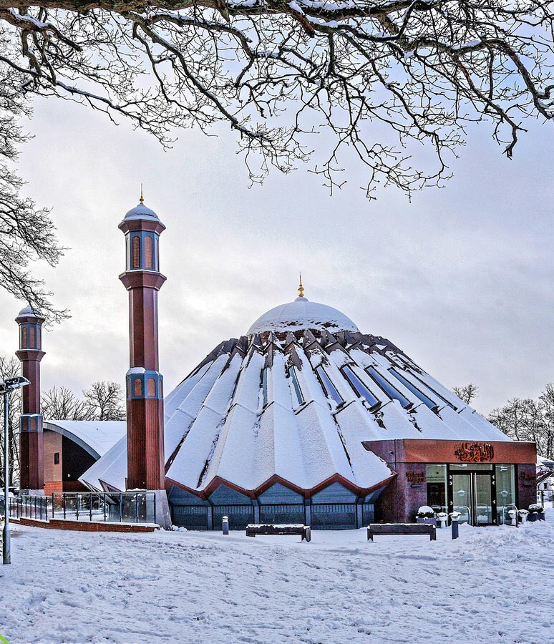


TALIM DEPARTMENT MAA UK
WEEKLY
ATFAL CLASS
TALIM DEPARTMENT MAA UK
www.atfal.org.uk/talim
talim@atfal.co.uk

Slide 2

Class Rules
Arrive on time and be prepared
Always say “Assalamu Alaikum” when you enter the room
Pay attention and listen to the teacher quietly.
Raise your hand if you have a question.
Listen to others when they are speaking.
Work hard and try your best to learn something new.

Slide 3

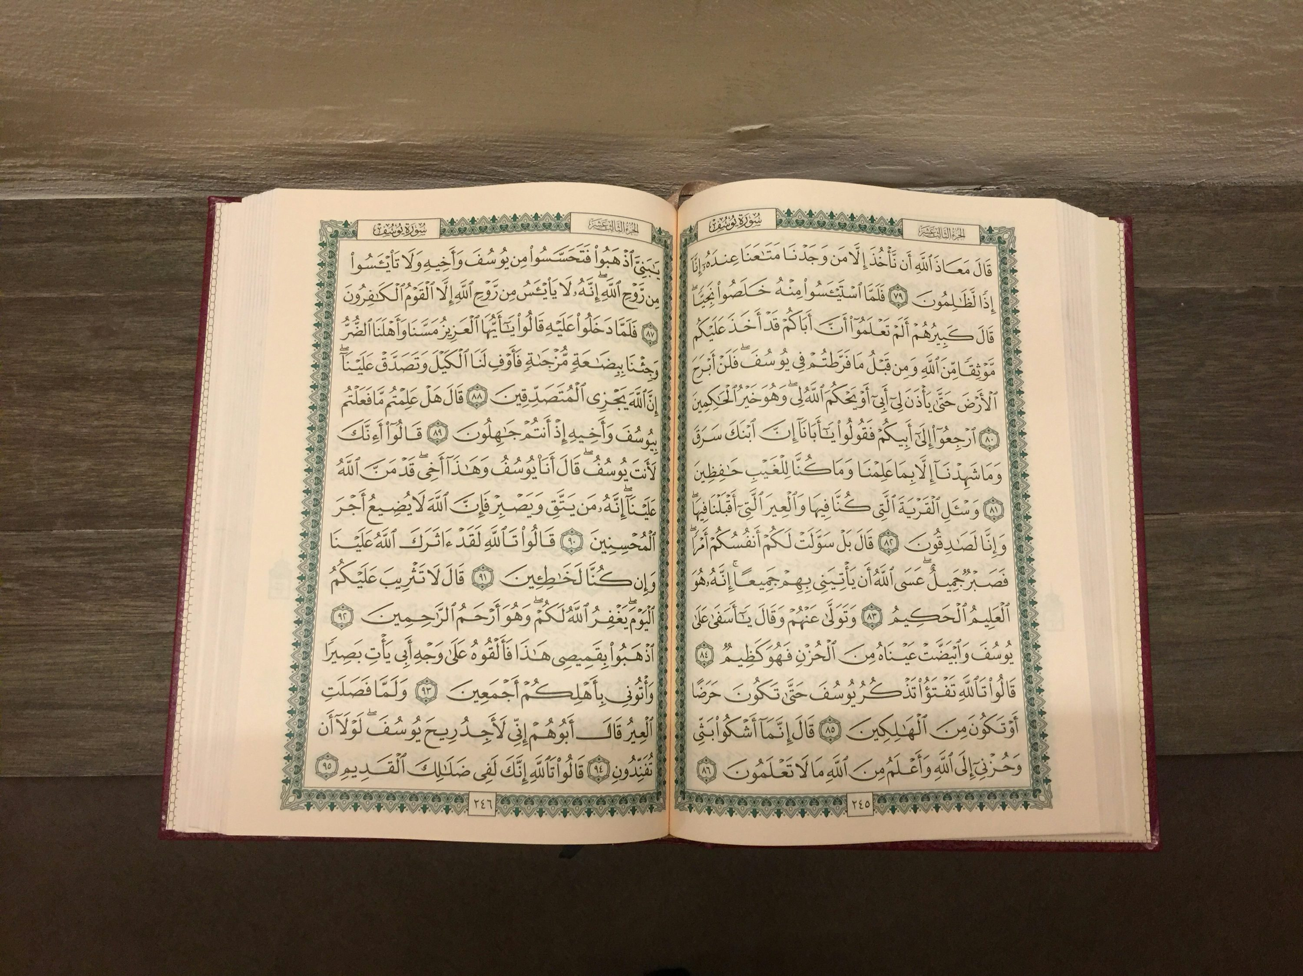

TILAWAT
رَّبِّ زِدۡنِیۡ عِلۡمًا
TRANSLATION
O my Lord, increase me in knowledge
(The Holy Qur’an 20:115)

Slide 4


Lesson Plan
1. Tilawat
2. Hadith
3. Thought of the Week
4. Homework Recap
5. Salat Recap
6. Friday Sermon
7. Learning Time
8. Announcements!
Are you prepared for today’s lesson?
Topi
Class Handout
Pen / Pencil

Slide 5

HADITH
(saying of the Holy Prophet Muhammad^{sa})
طَلَبُ الْعِلْمِ فَرِيضَةٌ عَلَى كُلّ مُسْلِمٍ
Talabu al-'ilmi faridatun 'ala kulli muslim
(Sunan Ibn Majah, Hadith 224)
Translation:
It is the duty of every Muslim to seek knowledge
Notes:
After Tilawat, spend 5 mins catching up with Atfal. What they've been getting up to in the past week.
Hadith:
Whoever, reads the Hadith out, should do so in the proper manner. i.e. recite Durood Shareef first and then the Hadith.
Have a brief discussion about the meaning of this hadith in light of the questions on the screen.

Slide 6



THOUGHT
OF THE WEEK
TOPIC:
“International Day for Education”

Slide 7



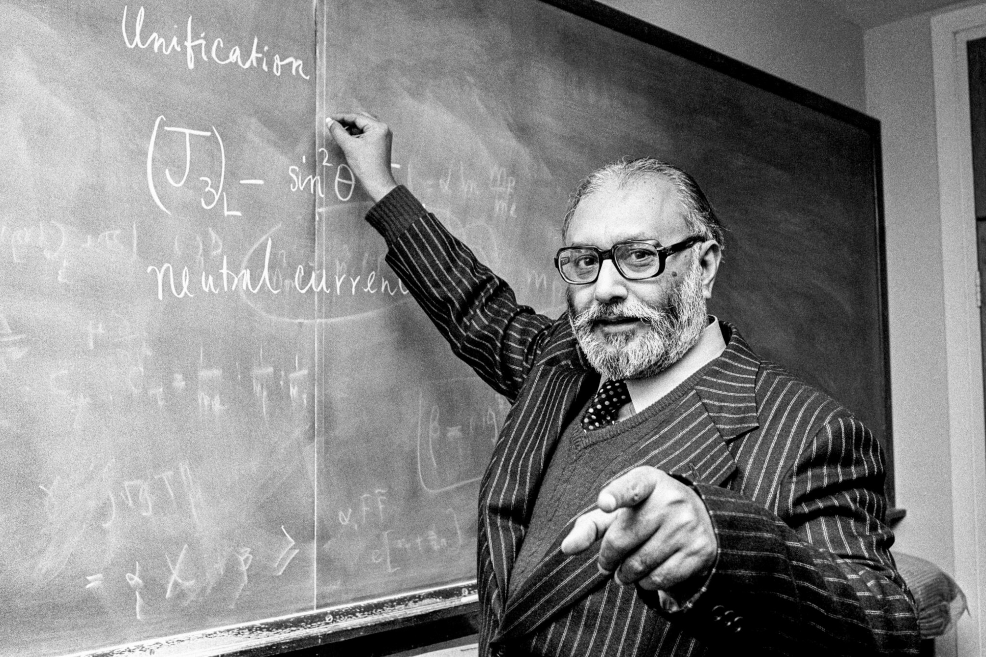
WHAT FAMOUS MUSLIMS DO WE KNOW THAT CONTRIBUTED TO EDUCATION?
Al-Khwarizmi
Al-Khwarizmi set out the basics of algebraic equations in his book Kitab al-mukhtasar fi hisab al-jabr wal-muqabala, which went on to be translated by a British Arabist into what is known as The Compendious Book on Calculation by Completion and Balancing.
Fatima Al-Fihri
The first university to be formally established was by a Muslim lady by the name of Fatima Al-Fihri. It is famously known as Al-Qarawiyin. Students were able to reside on at campus and had to pay no “tuition” fees.
Professor Mohammad Abdus Salam Sahib
Professor Mohammad Abdus Salam Sahib is very well known as the first Pakistani and first Muslim to receive the Nobel Prize in physics. He was a nuclear physicist whose work on electroweak theory earned great recognition.

Slide 8





HOMEWORK
Have you done your homework for this week?
Make sure to note down your homework for next week!

Slide 9

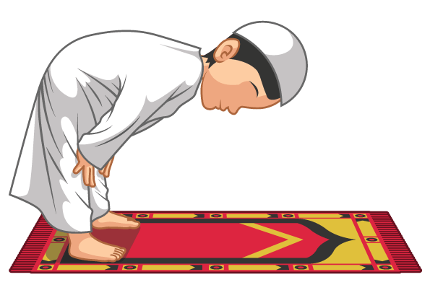
Rukoo
سُبْحَانَ رَبِّیَ الْعَظِیْم
SALAT
Subhaana Rabbi-yal `Azeem
Lets Recap a part of our Salat!
Translation:
Holy is my Lord, the most Great
NEXT WEEK RECAP:
Tasmee
الْعَظِیْم | رَبِّی | سُبْحَانَ
The Most Great | My Lord | Holy is

Slide 10

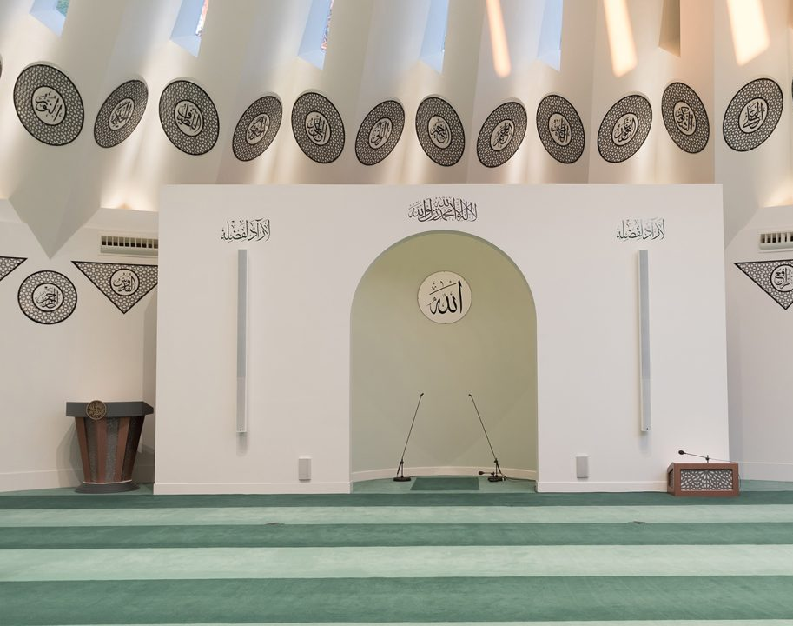
FRIDAY
SERMON
Friday 23rd January

Slide 11



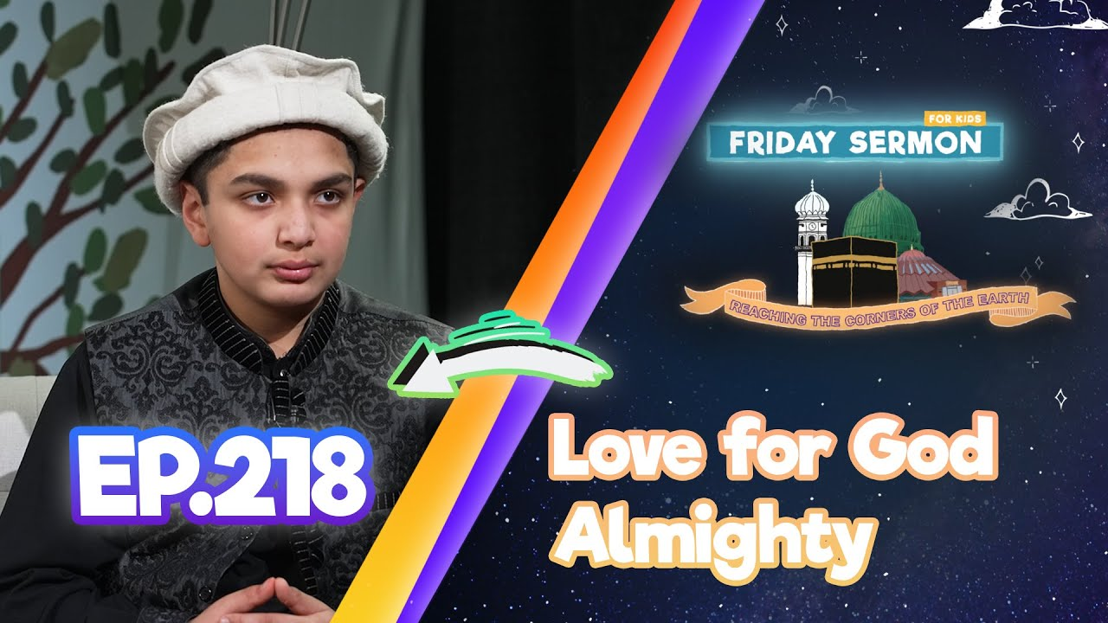

FRIDAY SERMON
Acceptance of the Holy Prophet’s (sa) prayers
During the Battle of Badr, the Holy Prophet (sa) prayed very hard for the success of Islam and Allah responded by promising His help through a thousand angels.
Showing Mercy
Despite being cruelly stoned at Ta’if, the Holy Prophet (sa) showed mercy by not allowing punishment for its people, hoping that one day their people would give up worshipping idols and believe in the One True God
Holy Prophet’s (sa) Long and Heartfelt prayers
The Holy Prophet (sa) showed extreme love to Allah in his prayers and offered them slowly over a long period of time, often repeating verses throughout the night with deep humility and reflection
Watch this weeks Friday Sermon 4 Kids!

Slide 12



LEARNING
TIME

Slide 13

PAIR ACTIVITy
Discuss today’s lesson with the Tifl next to you and come up with 3 new things you learned today!

Slide 14
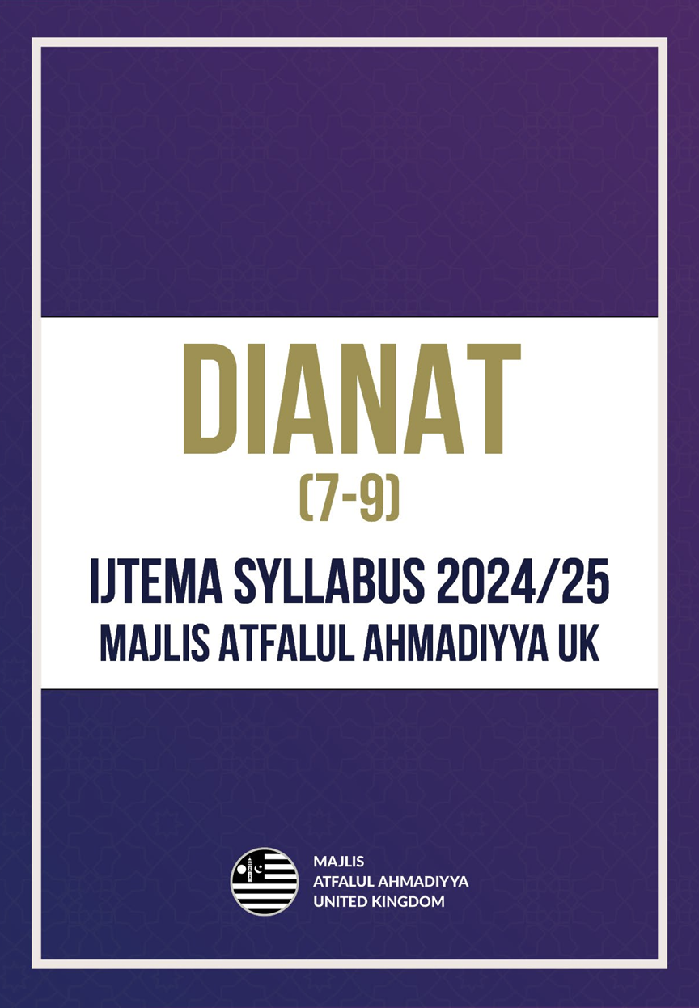
ANNOUNCEMENTS
Its Local Ijtema Season!
If you have your local Atfal Ijtema coming soon – be sure to prepare for it!
Visit: www.atfal.org.uk/ijtema

Slide 15

ANNOUNCEMENTS
National Atfal Explorers Club
Keep a lookout for upcoming trips!
Visit: www.atfal.org.uk/atfal-travel-logs

