Slide 1
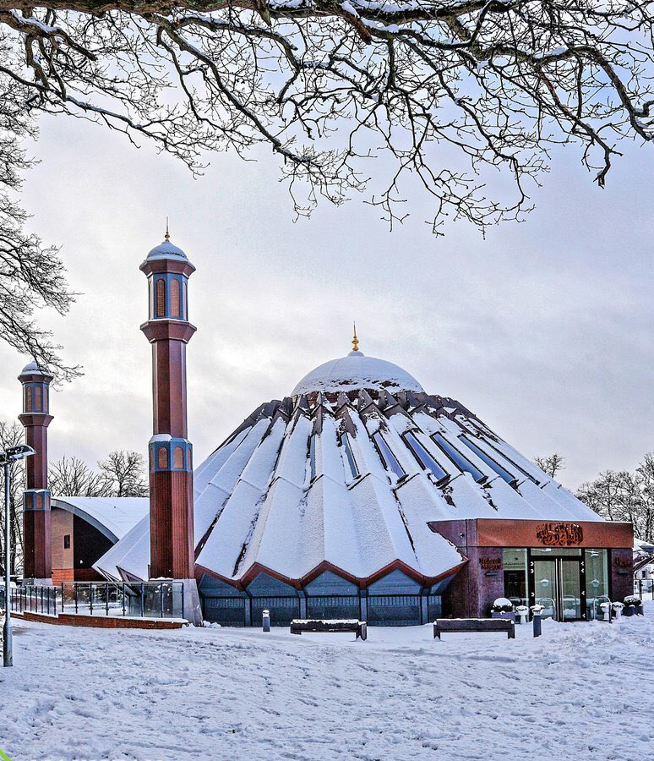


TALIM DEPARTMENT MAA UK
WEEKLY
ATFAL CLASS
(March – Week 1)
TALIM DEPARTMENT MAA UK
www.atfal.org.uk/talim
talim@atfal.co.uk

Slide 2

Class Rules
Arrive on time and be prepared
Always say “Assalamu Alaikum” when you enter the room
Pay attention and listen to the teacher quietly.
Raise your hand if you have a question.
Listen to others when they are speaking.
Work hard and try your best to learn something new.

Slide 3


Lesson Plan
1. Tilawat
2. Hadith
3. Thought of the Week
4. Homework Recap
5. Salat Recap
6. Friday Sermon
7. Learning Time
8. Announcements!
Are you prepared for today’s lesson?
Topi
Class Handout
Pen / Pencil

Slide 4

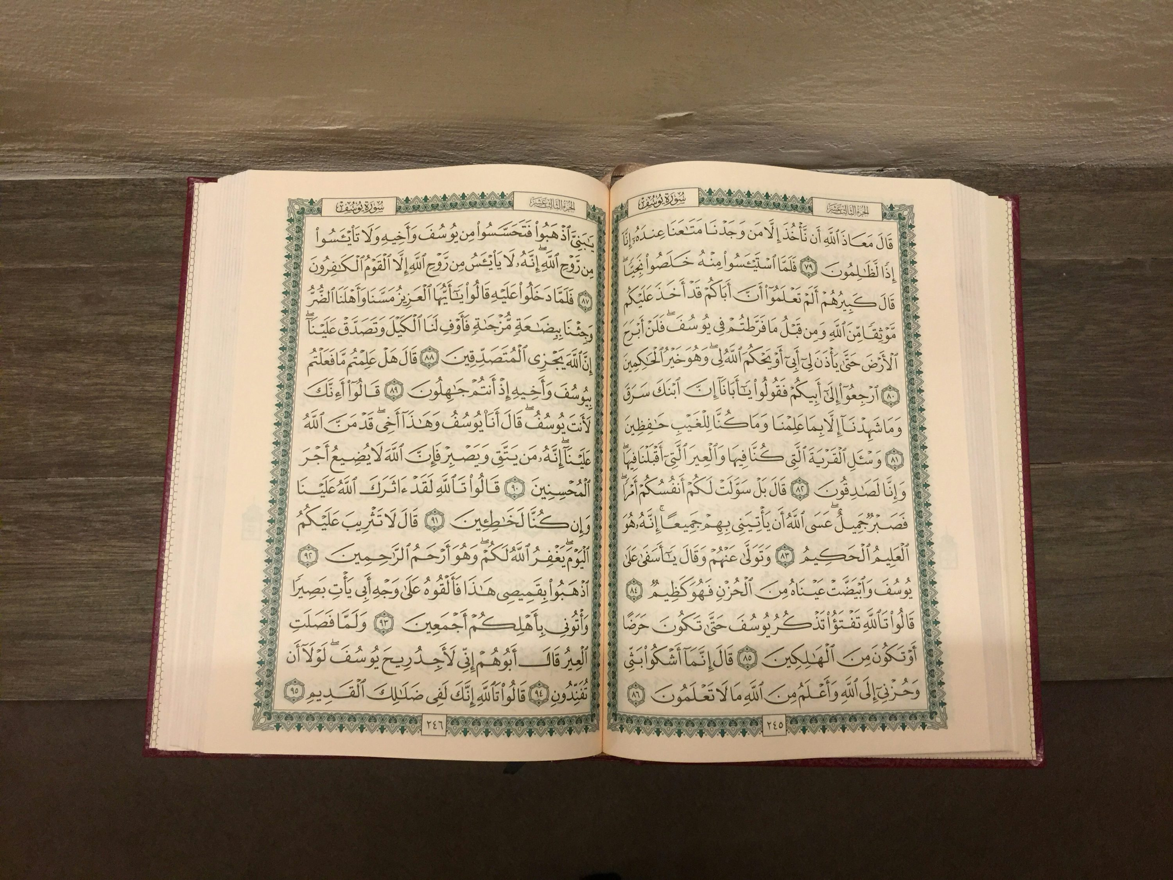

TILAWAT
فَقُلۡتُ اسۡتَغۡفِرُوۡا رَبَّکُمۡؕ اِنَّہٗ کَانَ غَفَّارًا
TRANSLATION
“And I said, ‘Seek forgiveness of your Lord; for He is the Great Forgiver.”
(The Holy Quran, Surah An-Nuh, 71:11)

Slide 5

HADITH
(sayings of the Holy Prophet Muhammad^{sas})
مَنْ قَامَ لَيْلَةَ الْقَدْرِ إِيمَانًا وَاحْتِسَابًا غُفِرَ لَهُ مَا تَقَدَّمَ مِنْ ذَنْبِهِ
Man qaama laylat-al-qadari eemaanan wa ehtisaaban ghufira lahu maa taqaddama min thanbihi
(Sahih Al Bukhari, Hadith 2014)
Translation:
“Whoever prayed at night in the month of Ramadan out of sincere faith and hoping for a reward from Allah, then all his previous sins will be forgiven.”
Notes:
After Tilawat, spend 5 mins catching up with Atfal. What they've been getting up to in the past week.
Hadith:
Whoever, reads the Hadith out, should do so in the proper manner. i.e. recite Durood Shareef first and then the Hadith.
Have a brief discussion about the meaning of this hadith in light of the questions on the screen.

Slide 6



THOUGHT
OF THE WEEK
TOPIC:
“3 Ashra’s of Ramadan!”

Slide 7
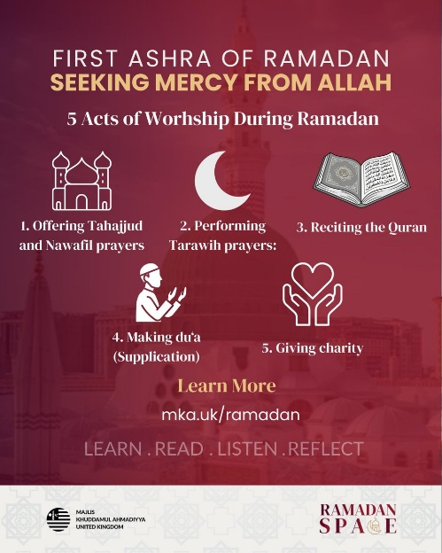
WHAT IS AN ASHRA?
Ashra is the Arabic word for the number 10.
This means that the blessed month of Ramadan is split into 3 sections, each of which last 10 days.
Each of the 3 Ashras have something special that we should focus on in those ten days i.e Mercy, Forgiveness and Salvation from Hell but this does not mean that after a set of ten days have passed by, we should stop focusing on them and move onto the next one.

Slide 8

FIRST ASHRA OF MERCY
In the first ten days of Ramadan, our aim as Ahmadi Muslims is to try and attain the Mercy of Allah the Almighty.
The Arabic word for “Mercy” isرحم and one of the attributes of Allah the Almighty is الرحیم meaning “The Most Merciful” which appears a total of 425 times in the Holy Qu’ran.
Therefore, we should make an effort to continuously pray by using this Attribute of Allah.
Each Ashra has its own specific prayers which we are urged to recite as frequently as possible and the prayer for the First Ashra is as follows:
وَقُلۡ رَّبِّ اغۡفِرۡ وَارۡحَمۡ وَاَنۡتَ خَیۡرُ الرّٰحِمِیۡنَ
“And say, ‘My Lord, forgive and have mercy, and Thou art the Best of those who show mercy.’”
(The Holy Quran, Surah Al Mu’minoon, 23:119)

Slide 9
SECOND ASHRA OF MERCY
In the middle ten days of Ramadan, we should make an effort to seek Allah’s forgiveness for any sins that we may have committed from the previous Ramadan till now.
We prostrate to Allah the Almighty because we may have taken part in things that have led us to the wrong path and now we seek his help and guidance to forgive us so that we may tread back onto the right path.
Mistakes happen with anyone but the most important thing is that we learn from them and seek forgiveness from them so that we do not commit the same mistakes in the future.
The specific prayer for the second set of ten days is as follows:
أَسْتَغْفِرُ ٱللَّهَ رَبِّي مِنْ كُلِّ ذَنْبٍ وَأَتُوبُ إِلَيْهِ
“I seek forgiveness from Allah, my Lord, for all my sins, and turn towards Him.”

Slide 10

THIRD ASHRA OF SALVATION
Salvation is the religious concept of being saved from sin.
This means that in the last ten days of Ramadan, our main focus is saving ourselves from Hell.
Our main focus is to enter Heaven and that is why we have to make sure that in order to be saved, we seek forgiveness and the love of Allah for this to happen.
Both the second and the third Ashra are very similar and require seeking forgiveness from Allah the Almighty.
The specific prayer for the last ten days of Ramadan is as follows:
الَّهُمَّ إنَّكَ عَفُوٌ ‌تُحِبُّ ‌العَفْوَ فَاعْفُ عَنّي
“O Allah, You are Most Forgiving, You love forgiveness; so forgive me.”

Slide 11

A SHORT CLIP ON THE SECOND ASHRA OF RAMADAN
Click this link to access the video

Slide 12





HOMEWORK
Have you done your homework for this week?
Make sure to note down your homework for next week!

Slide 13

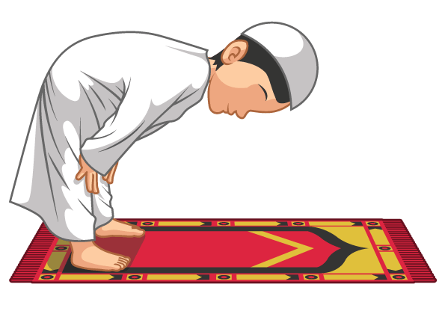
Durud Sharif
اللّٰهُمَّ صَلِّ عَلٰى مُحَمَّدٍ
SALAT
Allāhumma ṣalli ʿalā Muḥammadin
Lets Recap a part of our Salat!
Translation:
O Allah bless Muhammmad^{SAS}
NEXT WEEK RECAP:
Tashahhud
مُحَمَّدٍ | عَلٰى | صَلِّ | اللّٰهُمَّ
Muhammad^{sas} | Upon | Send blessings | O Allah

Slide 14
وَعَلٰی آلِ مُحَمَّدٍ
wa ʿalā āli Muḥammadin
Translation:
And (send blessings) on the Progeny of Muhammad^{sas}
مُحَمَّدٍ | آلِ | عَلٰی | وَ
Muhammad^{sas} | Progeny | Upon | And
Durud Sharif
كَمَا صَلَّيْتَ عَلٰی إِبْرَاهِيمَ
Allāhumma ṣalli ʿalā Muḥammadin
Translation:
As you did send blessings upon Abraham
إِبْرَاهِيمَ | عَلٰی | صَلَّيْتَ | كَمَا
Abraham | Upon | You Sent blessings | As

Slide 15
وَعَلٰی آلِ إِبْرَاهِيمَ
wa ʿalā āli Ibrāhīma
Translation:
And upon the Progeny of Abraham
إِبْرَاهِيمَ | آلِ | عَلٰی | وَ
Abraham | Progeny | Upom | And
Durud Sharif
إِنَّكَ حَمِيدٌ مَجِيدٌ
innaka ḥamīdun majīd
Translation:
Surely you are the Praiseworthy, the Exalted
مَجِيدٌ | حَمِيدٌ | كَ | إِنَّ
The Exalted | The Praiseworthy | You | Surely

Slide 16
اللّٰهُمَّ بَارِكْ عَلٰی مُحَمَّدٍ
Allāhumma bārik ʿalā Muḥammadin
Translation:
O Allah prosper Muhammad^{sas}
مُحَمَّدٍ | عَلٰی | بَارِكْ | اللّٰهُمَّ
Muhammad^{sas} | Upon | proper | O Allah
Durud Sharif
وَعَلٰی آلِ مُحَمَّدٍ
wa ʿalā āli Muḥammadin
Translation:
And (prosper) the Progeny of Muhammad
مُحَمَّدٍ | آلِ | عَلٰی | وَ
Muhammad^{sas} | Progeny | Upon | And

Slide 17
كَمَا بَارَكْتَ عَلٰی إِبْرَاهِيمَ
Allāhumma ṣalli ʿalā Muḥammadin
Translation:
As you did propser Abraham
إِبْرَاهِيمَ | عَلٰی | بَارَكْتَ | كَمَا
Abraham | Upon | Prosper | As
Durud Sharif
وَعَلٰی آلِ إِبْرَاهِيمَ
wa ʿalā āli Ibrāhīma
Translation:
And the Progeny of Abraham
إِبْرَاهِيمَ | آلِ | عَلٰی | وَ
Abraham | Progeny | Upom | And

Slide 18
إِنَّكَ حَمِيدٌ مَجِيدٌ
innaka ḥamīdun majīd
Translation:
Surely you are the Praiseworthy, the Exalted
Durud Sharif
مَجِيدٌ | حَمِيدٌ | كَ | إِنَّ
The Exalted | The Praiseworthy | You | Surely

Slide 19

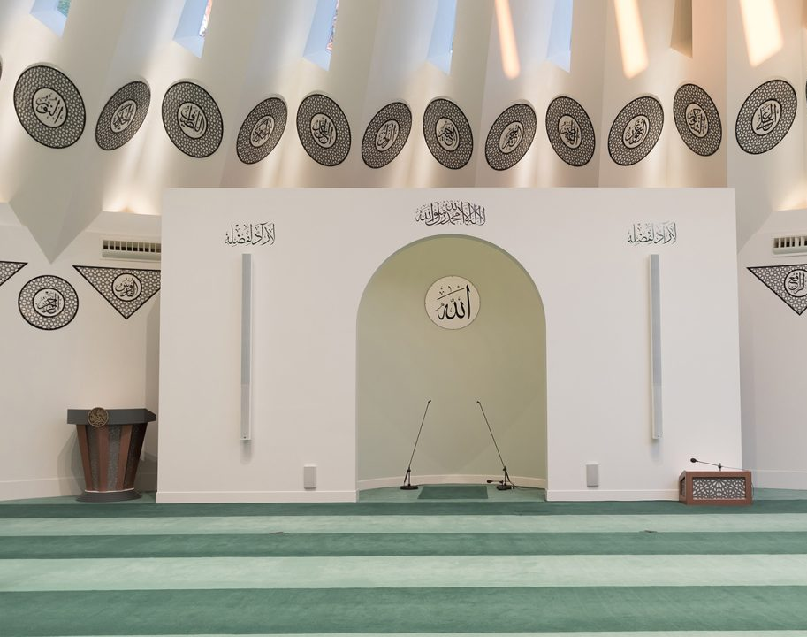
FRIDAY
SERMON
Friday 27th February
2026

Slide 20

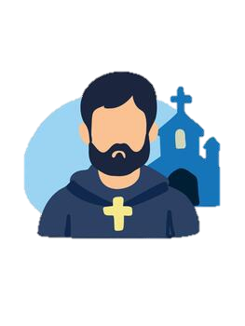


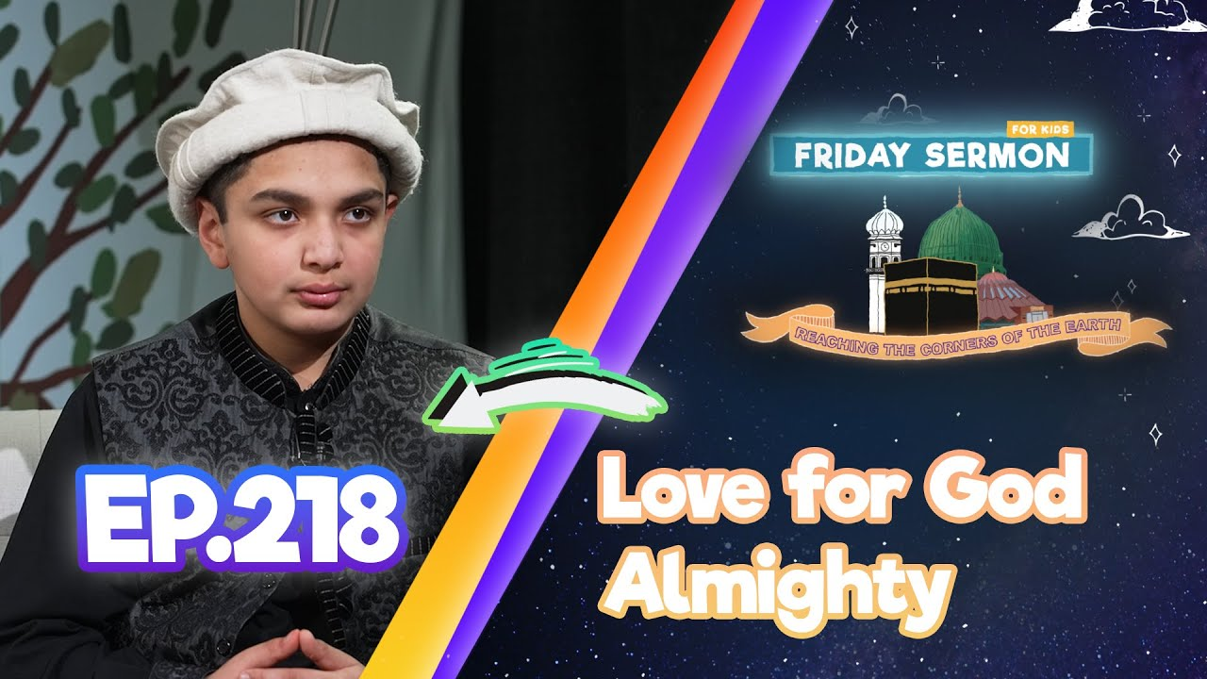
FRIDAY SERMON
The Holy Prophet Muhammad (saw) - The Perfect Herald of Divine Unity
Meeting the Monk Bahira
Once, during a trip to Syria with his uncle, the young Muhammad (sa) was met by a Christian priest named Bahira. Bahira asked a question, to which the young Muhammad (sa) replied, ‘Do not speak to me about Lat or Uzza. By God, I despise nothing more than them.’
Refusal of an Oath to Idols
The Holy Prophet (sa) went to Syria with the wealth of Hazrat Khadijah (ra) for the purposes of trade. During this time, there arose a dispute between the Holy Prophet (sa) and another man on a certain matter. To this, the other man told the Holy Prophet (sa) to swear by Lat and Uzza. The Holy Prophet (sa) replied, ‘I have never sworn by these idols. In fact when I pass by them I turn away.’
Encouragement on Tahajjud
The Holy Prophet (sa) was indeed given a message for the entire world. But here, God instructs that in conveying that message, the Holy Prophet(sa) should start with his own home, with his own family, as they too were going astray like others, and by virtue of being his family, their forefathers had done some good towards the Holy Prophet (sa). Thus, it was only right that the Holy Prophet (sa) convey this lifesaving message to them.
Watch this weeks Friday Sermon 4 Kids!

Slide 21



LEARNING
TIME

Slide 22

PAIR ACTIVITY
Discuss today’s lesson with the Tifl next to you and come up with 3 new things you learned today!

Slide 23

ANNOUNCEMENTS
RAMADHAN CHALLENGE IS OUT!
Head over to the following website to find out how to take part!
https://www.atfal.org.uk/Ramadan-Challenge-2026

Slide 24

ANNOUNCEMENTS
RAMADAN CHALLENGE!
Send us updates on your progress so far! We would love to see you completing the Daily Quests!

