Slide 1
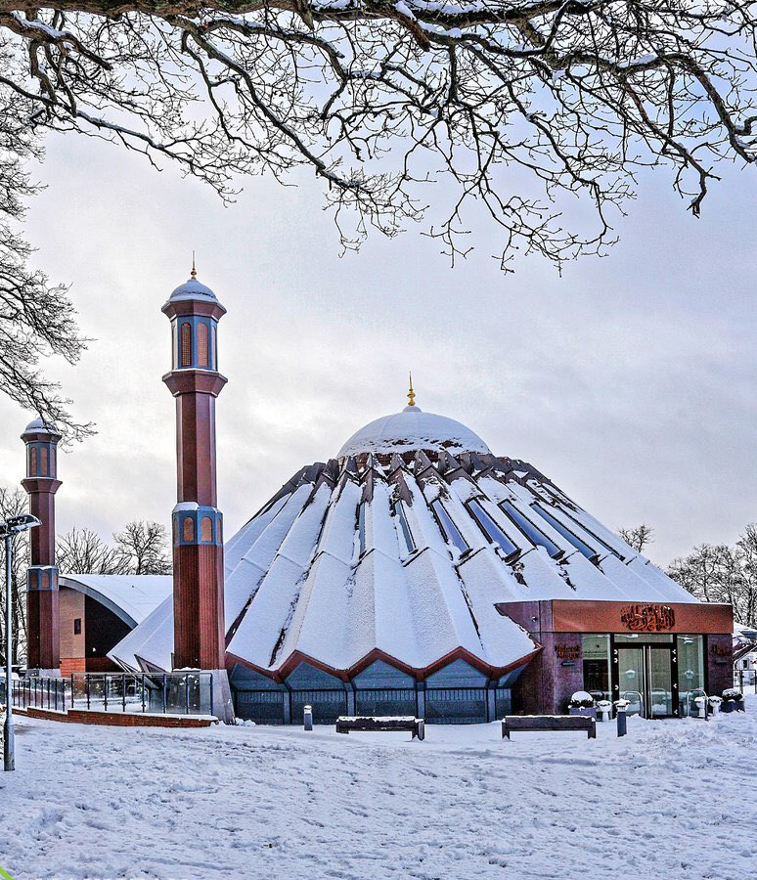


TALIM DEPARTMENT MAA UK
WEEKLY
ATFAL CLASS
(March – Week 2)
TALIM DEPARTMENT MAA UK
www.atfal.org.uk/talim
talim@atfal.co.uk

Slide 2

Class Rules
Arrive on time and be prepared
Always say “Assalamu Alaikum” when you enter the room
Pay attention and listen to the teacher quietly.
Raise your hand if you have a question.
Listen to others when they are speaking.
Work hard and try your best to learn something new.

Slide 3


Lesson Plan
1. Tilawat
2. Hadith
3. Thought of the Week
4. Homework Recap
5. Salat Recap
6. Friday Sermon
7. Learning Time
8. Announcements!
Are you prepared for today’s lesson?
Topi
Class Handout
Pen / Pencil

Slide 4

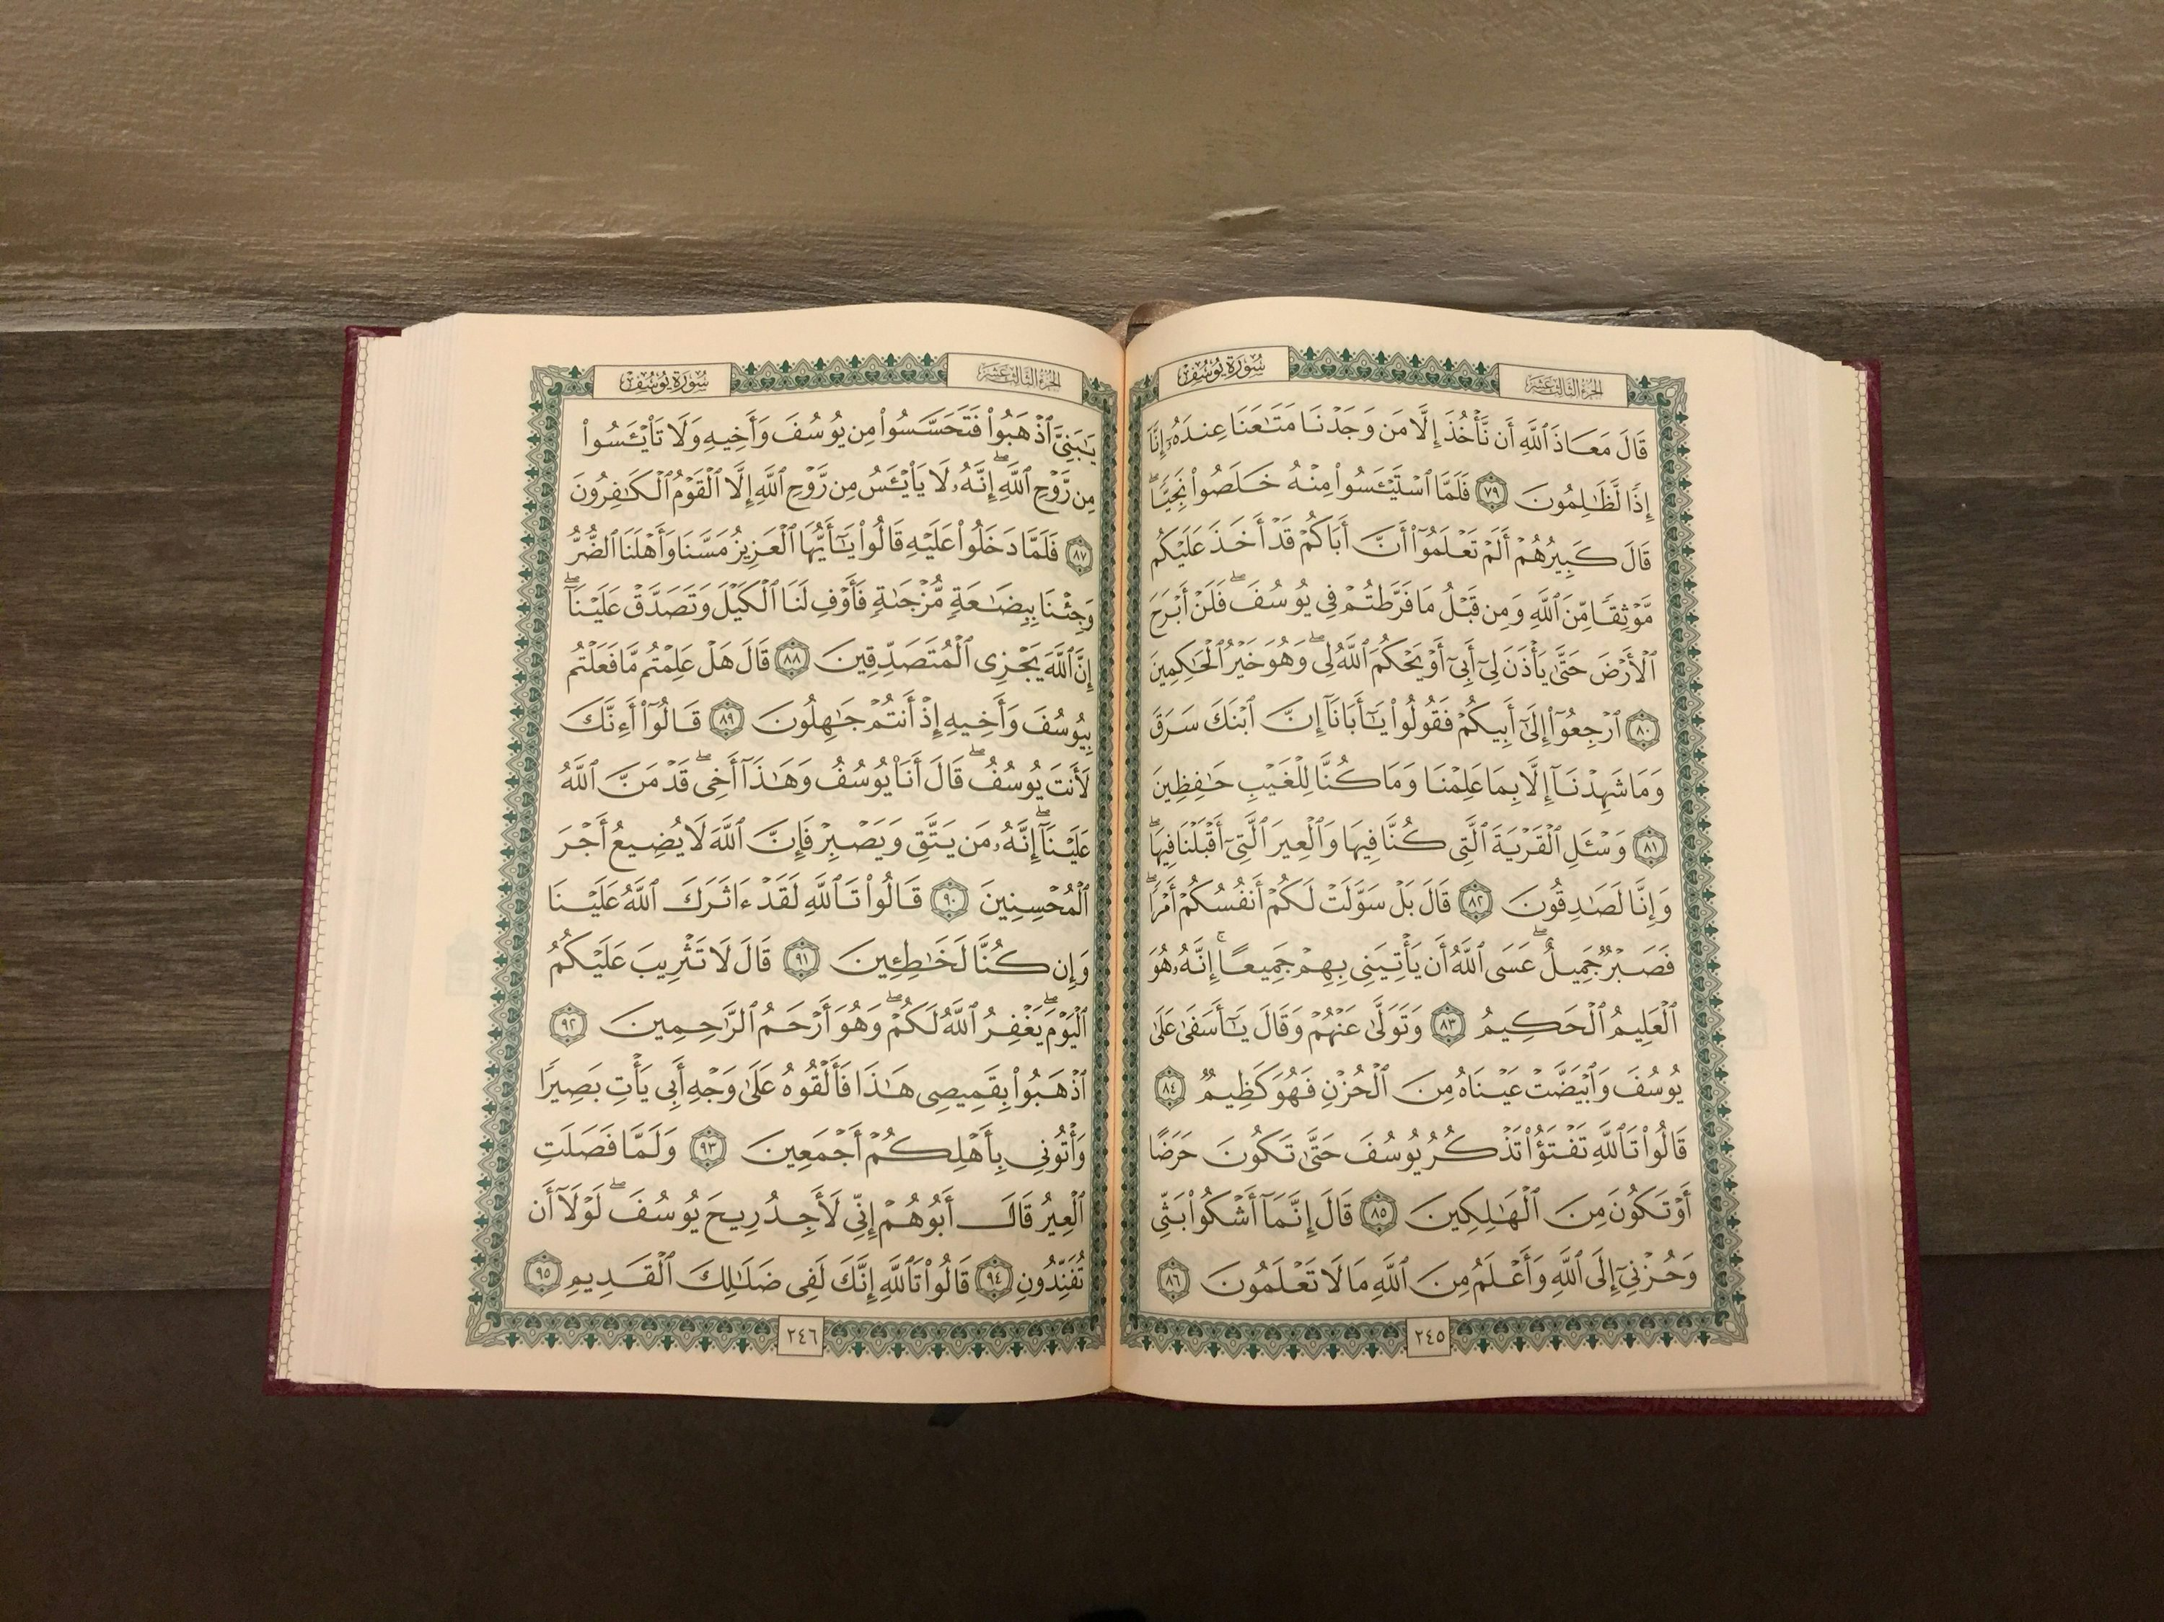

TILAWAT
بِسۡمِ اللّٰہِ الرَّحۡمٰنِ الرَّحِیۡمِ ﴿۱﴾ اِنَّاۤاَنۡزَلۡنٰہُ فِیۡ لَیۡلَۃِ الۡقَدۡرِ ۚ﴿ۖ۲﴾ وَمَاۤ اَدۡرٰٮکَ مَا لَیۡلَۃُ الۡقَدۡرِ ؕ﴿۳﴾ لَیۡلَۃُ الۡقَدۡرِ ۬ۙ خَیۡرٌ مِّنۡ اَلۡفِ شَہۡرٍ ؕ﴿ؔ۴﴾ تَنَزَّلُ الۡمَلٰٓئِکَۃُ وَالرُّوۡحُ فِیۡہَا بِاِذۡنِ رَبِّہِمۡ ۚ مِنۡ کُلِّ اَمۡرٍ ۙ﴿ۛ۵﴾ سَلٰمٌ ۟ۛ ہِیَ حَتّٰی مَطۡلَعِ الۡفَجۡرِ ﴿۶

Slide 5
TRANSLATION
“In the name of Allah, the Gracious, the Merciful. Surely, We sent it down on the Night of Destiny. And what should make thee know what the Night of Destiny is? The Night of Destiny is better than a thousand months. Therein descend angels and the Spirit by the command of their Lord — with every matter. It is all peace till the rising of the dawn.”
(The Holy Quran, Surah Al-Qadr, 97:1-6)

Slide 6

HADITH
(sayings of the Holy Prophet Muhammad^{sas})
عَنْ سَالِمٍ، عَنْ أَبِيهِ، - رضى الله عنه - قَالَ رَأَى رَجُلٌ أَنَّ لَيْلَةَ الْقَدْرِ لَيْلَةُ سَبْعٍ وَعِشْرِينَ ‏.‏ فَقَالَ النَّبِيُّ صلى اللّٰہ عليه وسلم ‏ ’’ أَرَى رُؤْيَاكُمْ فِي الْعَشْرِ الأَوَاخِرِ فَاطْلُبُوهَا فِي الْوِتْرِ مِنْهَ‘‘
ʿan Sālimin, ʿan abīhi – raḍiya Allāhu ʿanhu – qāla: raʾā rajulun anna laylata al-qadri laylatu sabʿin wa ʿishrīn. Faqāla an-nabiyyu ṣallā Allāhu ʿalayhi wa sallam: “Arā ruʾyākum fī al-ʿashri al-awākhir, fa-ṭlubūhā fī al-witr minhā.”
(Sahih Al Bukhari, Hadith 1165)
Notes:
After Tilawat, spend 5 mins catching up with Atfal. What they've been getting up to in the past week.
Hadith:
Whoever, reads the Hadith out, should do so in the proper manner. i.e. recite Durood Shareef first and then the Hadith.
Have a brief discussion about the meaning of this hadith in light of the questions on the screen.

Slide 7
HADITH
(sayings of the Holy Prophet Muhammad^{sas})
Translation:
Salim reported on the authority of his father that a person saw Lailat-ul- Qadr on the 27th (of Ramadan). Thereupon Allah's Apostle (ﷺ) said:
“I see that your dreams agree regarding the last ten (nights of Ramadan). So seek it on an odd number (of these ten nights).”
(Sahih Al Bukhari, Hadith 1165)
Notes:
After Tilawat, spend 5 mins catching up with Atfal. What they've been getting up to in the past week.
Hadith:
Whoever, reads the Hadith out, should do so in the proper manner. i.e. recite Durood Shareef first and then the Hadith.
Have a brief discussion about the meaning of this hadith in light of the questions on the screen.

Slide 8



THOUGHT
OF THE WEEK
TOPIC:
LAILATUL QADR
THE NIGHT OF DESTINY!

Slide 9

WHAT IS LAILATUL QADR?
Lailat-ul-Qadr means “The Night of Decree”
Lailat-ul-Qadr is a special night which takes place in the blessed month of Ramadan.
It has been commanded upon Muslims to find this night in the odd days of the last ten days of Ramadan.
This night is special and different for everyone. Just because you may be witnessing this night, that doesn’t mean that all Ahmadis around the world will also be witnessing it. It is unique and personal to everyone.

Slide 10
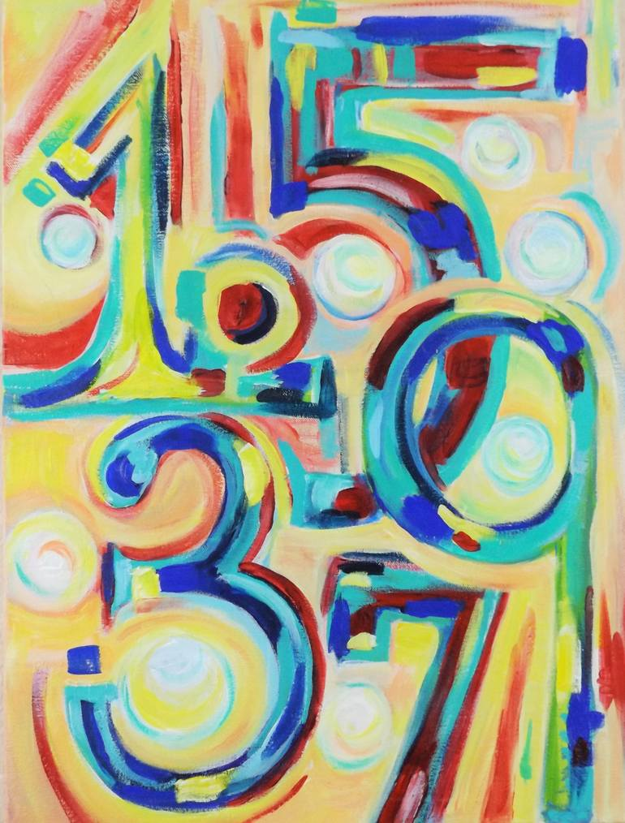
WHY ODD NIGHTS?
The simple reason is that Allah loves odd numbers.
In Hadith it is stated:
‏ لِلَّهِ تِسْعَةٌ وَتِسْعُونَ اسْمًا مَنْ حَفِظَهَا دَخَلَ الْجَنَّةَ وَإِنَّ اللَّهَ وِتْرٌ يُحِبُّ الْوِتْرَ
“There are ninety-nine names of Allah; he who commits them to memory would get into Paradise. Verily, Allah is Odd (He is one, and it is an odd number) and He loves the odd number.” (Sahih Muslim, Hadith 2677)

Slide 11
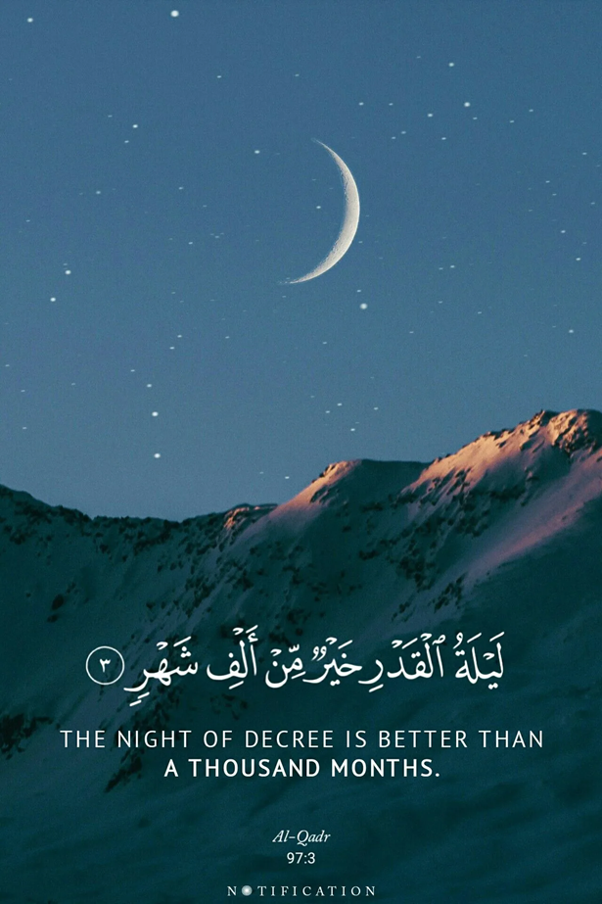
WHY IS THE NUMBER 1000 SO SPECIFIC?
The Quran says that this night is better than 1000 months. This is equal to 83 years, roughly a person’s lifetime.
In the 5 Vol Commentary it states:
“ألف (a thousand) being the highest number of count in Arabic signifies a number beyond count, and the verse means, that the Night of Destiny is better than countless number of months.”
This means that the benefits of witnessing this night are so magnificent that it makes it necessary for a person to try his best to find this special night.

Slide 12
HOW TO SEEK THIS NIGHT
Wake up for Tuhajjud
The first 20 days of Ramadan help build a habit of waking up for Tuhajjud
On this night you shoudn’t just wake up for Tuhajjud as is routine BUT try and wake up even earlier and maximise the benefit you can receive from this night
No deed is complete without intention. MAKE SURE you make a firm intention the night before and pray to Allah for help waking up.

Slide 13
VIDEO ON LAILATUL QADR
https://youtu.be/GHBXxVc6qa0?si=FnIQ64WQoSCYbZ8V

Slide 14





HOMEWORK
Have you done your homework for this week?
Make sure to note down your homework for next week!

Slide 15

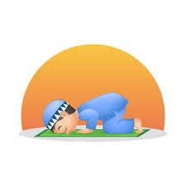
Sajdah Prayer
سُبْحَانَ رَبِّيَ الأَعْلَى
SALAT
Subḥāna rabbiyal-aʿlā
Lets Recap a part of our Salat!
Translation:
Glory be to my Lord, the Most High
NEXT WEEK RECAP:
Tashahhud
الأَعْلَى | رَبِّيَ | سُبْحَانَ
The Most High | My Lord | Glory be to

Slide 16

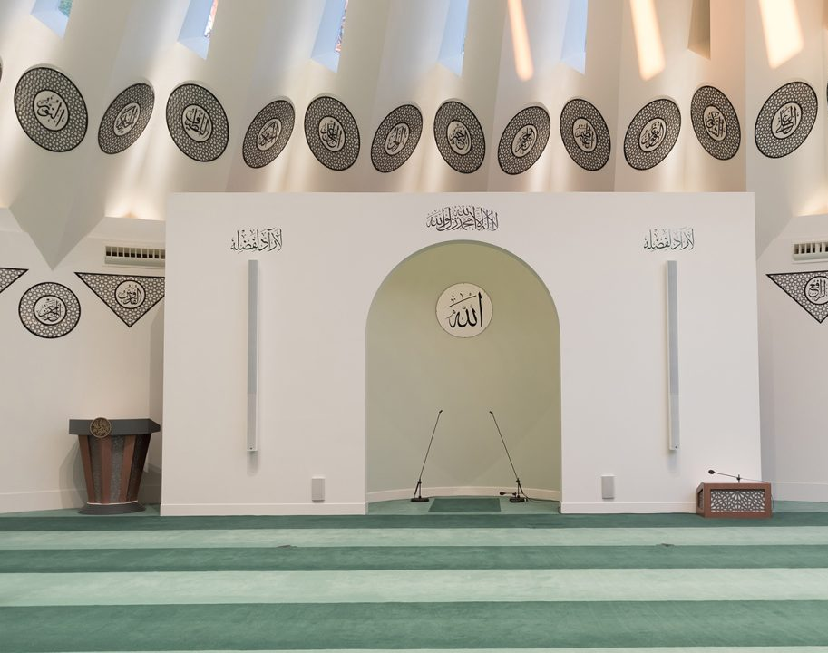
FRIDAY
SERMON
Friday 6th March
2026

Slide 17



FRIDAY SERMON
Unity and Prayers: The Shield of The Ummah
Because of war breaking out between America and Iran, Huzoor-e-Aqdas (aba) reminded us about the importance of prayer and unity.
Despite us all having the same Shahada, there is still disagreement between Muslims
The Muslim countries have neither a good standing on the world stage, nor do they have God standing in terms of the faith.
The leaders of the Muslim world must realise that they need to unite as one
The purpose of the Holy Prophet’s^{sas} advent was to direct people to belief in one God and unify all people under this banner of Tawhid.
Watch this weeks Friday Sermon 4 Kids!

Slide 18



LEARNING
TIME

Slide 19

PAIR ACTIVITY
Discuss today’s lesson with the Tifl next to you and come up with 3 new things you learned today!

Slide 20

ANNOUNCEMENTS
RAMADAN CHALLENGE!
Send us updates on your progress so far! We would love to see you completing the Daily Quests!

