Slide 1
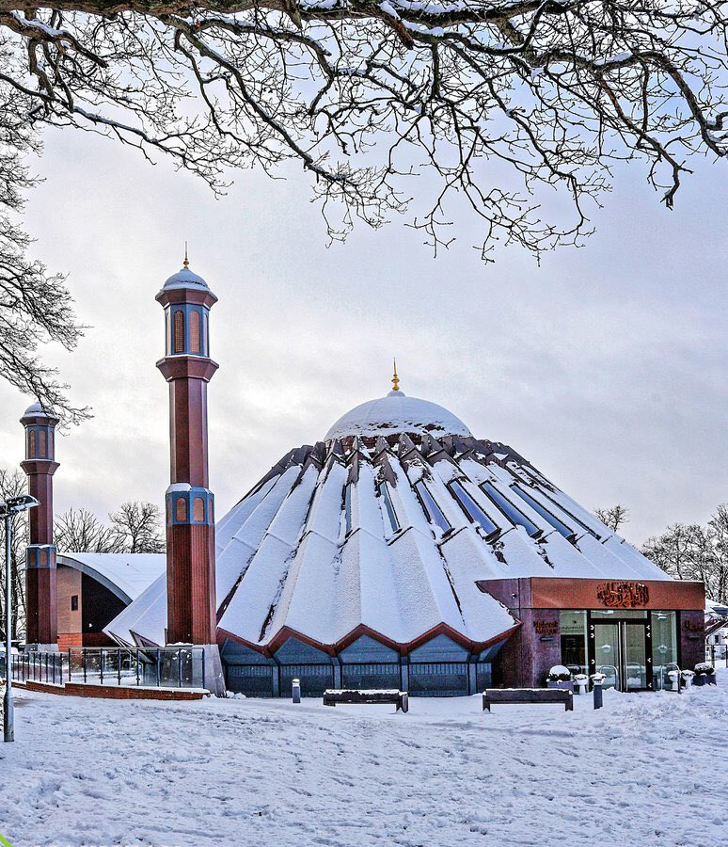


TALIM DEPARTMENT MAA UK
WEEKLY
ATFAL CLASS
(March – Week 3)
TALIM DEPARTMENT MAA UK
www.atfal.org.uk/talim
talim@atfal.co.uk

Slide 2

Class Rules
Arrive on time and be prepared
Always say “Assalamu Alaikum” when you enter the room
Pay attention and listen to the teacher quietly.
Raise your hand if you have a question.
Listen to others when they are speaking.
Work hard and try your best to learn something new.

Slide 3


Lesson Plan
1. Tilawat
2. Hadith
3. Thought of the Week
4. Homework Recap
5. Salat Recap
6. Friday Sermon
7. Learning Time
8. Announcements!
Are you prepared for today’s lesson?
Topi
Class Handout
Pen / Pencil

Slide 4

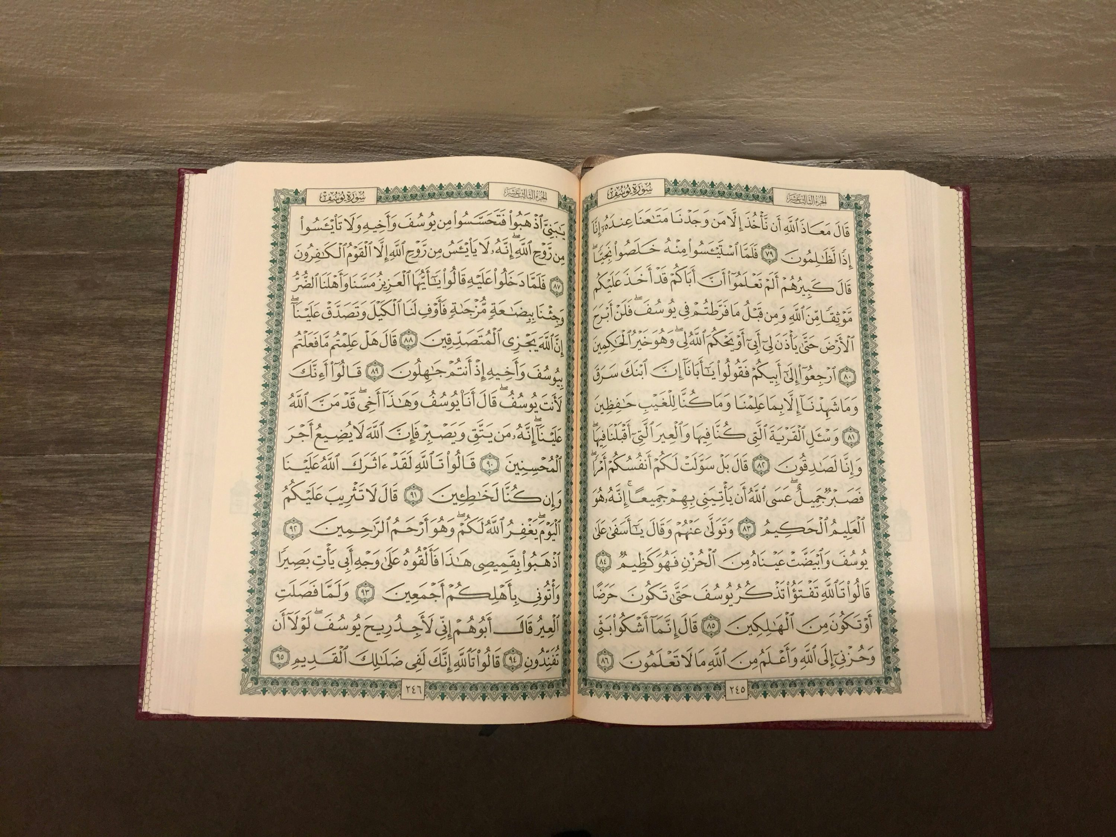

TILAWAT
قُلۡ بِفَضۡلِ اللّٰہِ وَبِرَحۡمَتِہٖ فَبِذٰلِکَ فَلۡیَفۡرَحُوۡا ؕ ہُوَ خَیۡرٌ مِّمَّا یَجۡمَعُوۡنَ ﴿۵۹
TRANSLATION
Say, ‘All this is through the grace of Allah and through His mercy; therein, therefore, let them rejoice. That is better than what they hoard.’
(The Holy Quran, Surah Yunus, 10:59)

Slide 5

HADITH
(sayings of the Holy Prophet Muhammad^{sas})
عَنْ عَبْدِ اللّٰہِ بْنِ عُمَرَ،‏.‏ أَنَّ رَسُولَ اللّٰہِ صَلَّى اللّٰهُ عَلَيْهِ وَسَلَّمَ كَانَ يُصَلِّي فِي الْأَضْحَى وَالْفِطْرِ، ثُمَّ يَخْطُبُ بَعْدَ الصَّلاَةِ‏
ʿAn ʿAbdillāh ibn ʿUmar, anna Rasūlallāh ṣallallāhu ʿalayhi wa sallam kāna yuṣallī fī al-Aḍḥā wa al-Fiṭr, thumma yakhṭubu baʿda aṣ-ṣalāh.
(Sahih Al Bukhari, Hadith 957)
Notes:
After Tilawat, spend 5 mins catching up with Atfal. What they've been getting up to in the past week.
Hadith:
Whoever, reads the Hadith out, should do so in the proper manner. i.e. recite Durood Shareef first and then the Hadith.
Have a brief discussion about the meaning of this hadith in light of the questions on the screen.

Slide 6
HADITH
(sayings of the Holy Prophet Muhammad^{sas})
Translation:
Narrated `Abdullah bin `Umar:
Allah's Messenger (ﷺ) used to offer the prayer of `Id-ul-Adha and `Id-ul-Fitr and then deliver the Khutba after the prayer.
(Sahih Al Bukhari, Hadith 1165)
Notes:
After Tilawat, spend 5 mins catching up with Atfal. What they've been getting up to in the past week.
Hadith:
Whoever, reads the Hadith out, should do so in the proper manner. i.e. recite Durood Shareef first and then the Hadith.
Have a brief discussion about the meaning of this hadith in light of the questions on the screen.

Slide 7



THOUGHT
OF THE WEEK
TOPIC:
What is Eid-ul-Fitr?

Slide 8
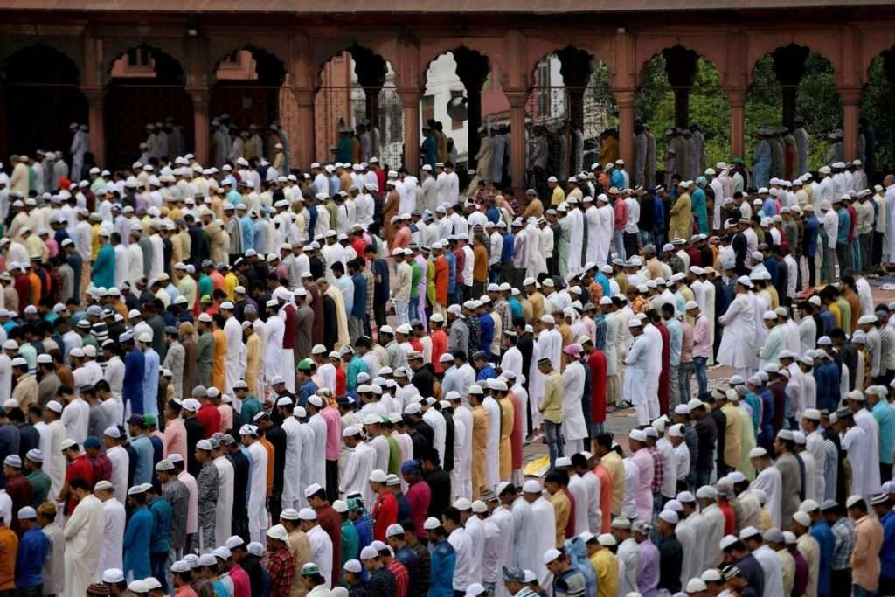
WHAT IS EID-UL-FITR?
Eid-ul-Fitr is one of the Muslim Celebrations celebrated at the end of the month of Ramadan.
On this day, Muslims all over the world go to the Mosque and offer 2 Raka’at of prayer called Eid prayer and then listen to a sermon.
Then, they spend the rest of the day with family and friends.

Slide 9

WHAT IS THE PURPOSE OF EID?
The purpose of Eid is not just to have fun and enjoy with close relatives.
The essence of this month is showing thankfulness to Allah the Almighty that they were able to witness another month of Ramadan.
They should also give money to charity which is known as Sadaqat-ul-Fitr or Fitrana.

Slide 10
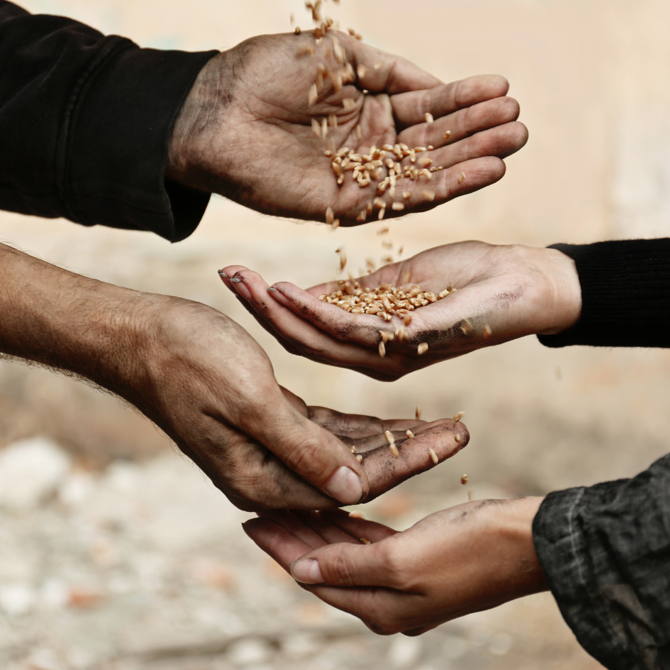
WHAT IS FITRANA, FIDYA AND EID FUND?
FITRANA - Another name for Fitrana is called Sadaqat-ul-Fitr which is £5 and is obligatory for all members to pay regardless of whether they are young or old.
A Hadith regarding this states:
“Hazrat Ibn Abbas^{ra} relates, “The Holy Prophet^{sa} deemed Sadaqat-ul-Fitr obligatory upon Muslims. It is a means of purifying the fasting person from idle talk and foul language and also to feed the poor.”
(Sunan Abu Dawood, Kitab az-Zakat)

Slide 11
WHAT IS FITRANA, FIDYA AND EID FUND?
FIDYA - This is paid by those members that were unable to keep fasts during the month. This could be due to illness or undertaking journey or old age. For any fast that is missed, a person needs to pay £2 per day.
This amount is equivalent to the average cost of a meal, as calculated by the Jama’at
EID FUND - This is £10 for all earning member that are working.

Slide 12
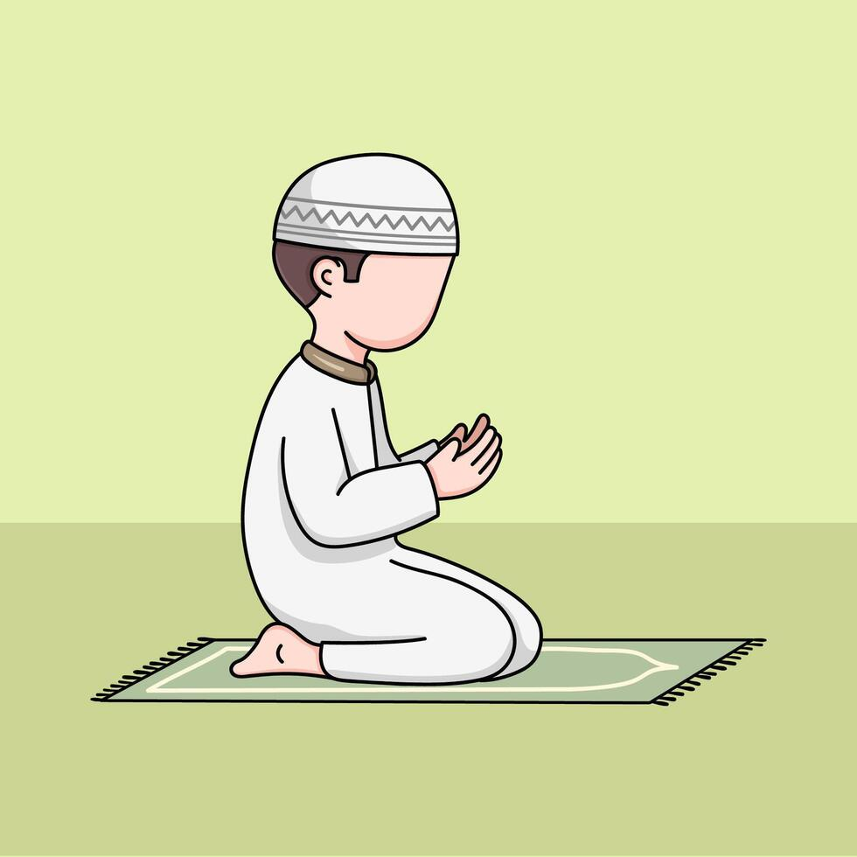
HOW IS EID PRAYER OFFERED?
Eid prayer is a very special prayer which is offered only 2 times in a year: Eid-ul-Fitr and Eid-ul-Adha.
The prayer consists of 2 Raka’at where the Imam starts the prayer by saying “Allahu Akbar” and then continues by saying it 7 more times and then continues with the normal method of offering prayer.
Then, in the second Raka’at, the Imam gets up from Sajdah by saying “Allahu Akbar” and then continues by saying it a further 5 times and then continues with the normal method of offering prayer.

Slide 13
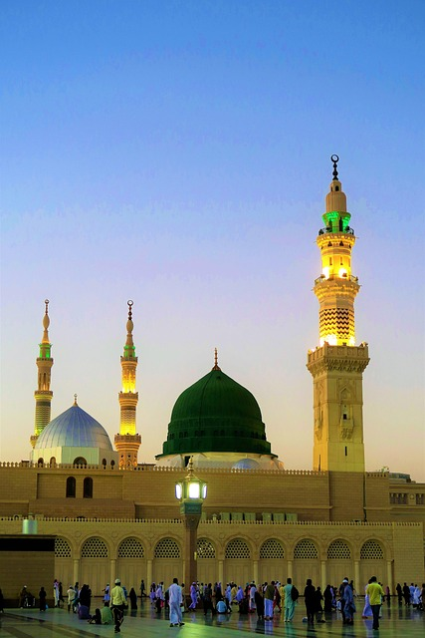
WHAT ARE THE PRACTICES OF THE HOLY PROPHET MUHAMMAD (SAS) ON THIS DAY?
Hazrat Anas bin Malik, Allah be pleased with him, narrates: That the Holy Prophet, peace and blessings of Allah be upon him, never proceeded (for the prayer) on the Day of Eid-ul-Fitr unless he had eaten some dates. Hazrat Anas^{ra} also narrated that the Prophet^{sas} used to eat odd number of dates.
(Sahih Bukhari, Hadith 953)

Slide 14
WHAT ARE THE PRACTICES OF THE HOLY PROPHET MUHAMMAD (SAW) ON THIS DAY?
The Holy Prophet^{sa} has stated that one who offers prayers on the nights of two Eids, his heart will be granted eternal life. (Sunan Ibn-e-Majah, Hadith 1782)
Narrated Jabir bin `Abdullah^{ra}: On the Day of Eid the Prophet^{sas} used to return (after offering the Eid prayer) through a way different from that by which he went. (Sahih al-Bukhari, Hadith 986)

Slide 15
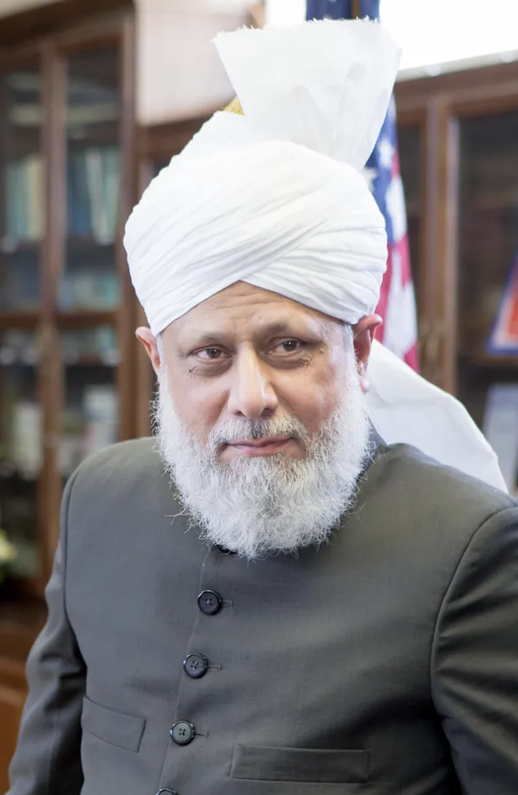
HOW SHOULD WE LIVE OUR LIVES ON EID AND AFTER RAMADAN?
Hazrat Mirza Masroor Ahmad^{aba} said:
“Today, by the grace of Allah the Almighty, we are celebrating Eid-ul-Fitr. It is a day of joy because we are rejoicing in the good deeds we performed during Ramadan. Thus, this Eid is not just a day of celebration but also a day to pledge that we will continue all the good practices we observed during Ramadan. Only then will it be a true Eid.”
(Eid Sermon, 1st April 2025)

Slide 16
HOW SHOULD WE LIVE OUR LIVES ON EID AND AFTER RAMADAN?
At another place, Huzoor-e-Anwar (aba) states:
“We need to make our Ramadan like a fruitful tree that continuously bears fruit, only then can our Eid be truly celebrated. Allah the Almighty is so merciful to us that He provides us with various opportunities to attain His pleasure, and Ramadan is one of those opportunities.”
(Eid Sermon, 10th April 2024)

Slide 17
HOW SHOULD WE LIVE OUR LIVES ON EID AND AFTER RAMADAN?
Regarding the Eid day, Huzoor (aba) states
“We should always remember that Eid is not just about eating, drinking, and celebrating, but it is about observing piety and fulfilling the rights of Allah and the rights of His creation. Only those who attain this status and make every effort towards it can truly benefit from the blessings of Eid.”
(Eid Sermon, 10th April 2024)

Slide 18

VIDEOS ON EID
https://youtu.be/8uEF8aznbiM?si=tgNxxSN4m4SwjcLb
https://youtu.be/YQlDyyQhNPs?si=v1xv3mD1Fgs31y1w
(16:58-19:51)

Slide 19





HOMEWORK
Have you done your homework for this week?
Make sure to note down your homework for next week!

Slide 20

Concluding Prayers
رَبَّنَا آتِنَا فِی الدُّنۡیَا حَسَنَۃً وَّ فِی الۡآخِرَۃِ حَسَنَۃً وَّ قِنَا عَذَابَ النَّارِ
SALAT
Lets Recap a part of our Concluding Prayers!
Rabbana aatina fid dunya hasnatan wa fil aakhirati hasanatan wa qina azaban nar.
Translation:
Our Lord, grant us good in this world, as well as good in the world to come and protect us from the torment of fire.
NEXT WEEK RECAP:
Tashahhad

Slide 21
Concluding Prayers
SALAT
حَسَنَۃً | فِی الدُّنۡیَا | آتِنَا | رَبَّنَا
Good | In this world | Grant us | Our Lord
Lets Recap a part of our Concluding Prayers!
وَّ قِنَا | حَسَنَۃً | فِی الۡآخِرَۃِ | وَّ
And protect us | Good | In the world to come | And
NEXT WEEK RECAP:
Tashahhad
النَّارِ | عَذَابَ
Of the fire | From the torment

Slide 22

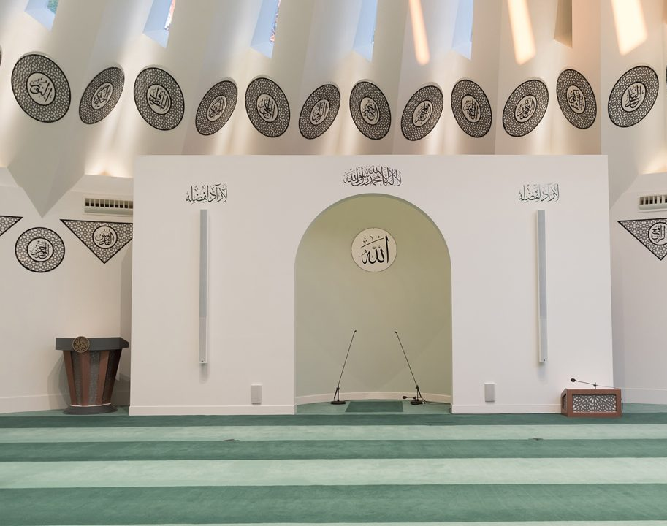
FRIDAY
SERMON
Friday 6th March
2026

Slide 23

FRIDAY SERMON
The Prophet (sa) as the Guardian and Teacher of Tauheed
Not only did the Holy Prophet(sa) himself strive for its establishment, but he established within his companions a passion for the establishment of the unity of God as well, to the extent that they offered many sacrifices to uphold the unity of God.
The mob of disbelievers pulled the Holy Prophet(sa) by the hair on his head and his beard so severely that much of his hair fell out. It was upon this that Hazrat Abu Bakr(ra) came to the Holy Prophet’s (sa) defence. The Holy Prophet(sa) told Hazat Abu Bakr(ra) to leave those people, saying, ‘By He in Whose hands is my life, I have been sent to these very people so that I may be sacrificed.

Slide 24
FRIDAY SERMON
The Prophet (sa) as the Guardian and Teacher of Tauheed
Harith bin Harith Ghamdi saw the Quraish inflicting cruelties upon the Holy Prophet(sa), and he asked his father who those people were. His father replied that they had gathered around ‘Sabi’, a name which the Quraish had given the Holy Prophet(sa) to deride him. Harith says he went to take a closer look and found the Holy Prophet(sa) encouraging the people to believe in One God, even as they continued to cause him trouble.

Slide 25

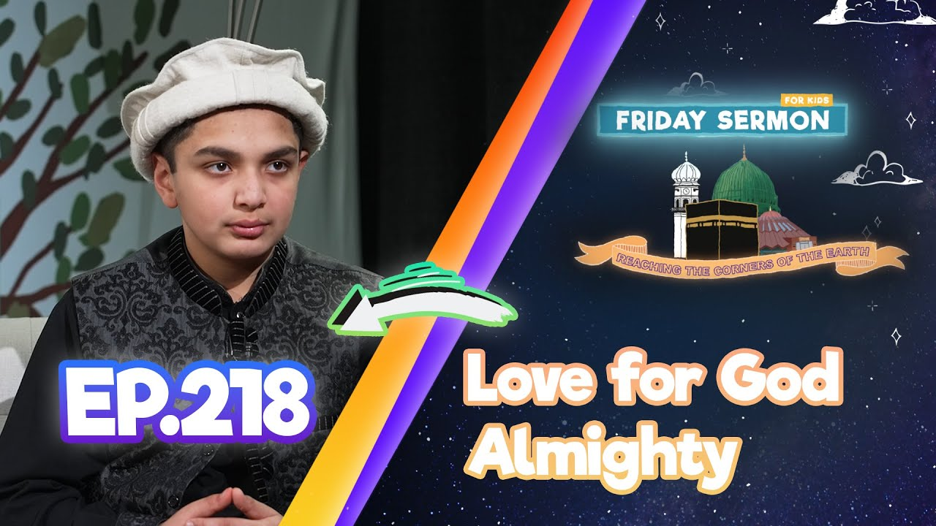
FRIDAY SERMON
The Prophet (sa) as the Guardian and Teacher of Tauheed
Here is the famous incident from the Battle of Uhud, when Abu Sufyan was calling out saying that the Holy Prophet(sa), Hazrat Abu Bakr(ra) and Hazrat Umar(ra) had been killed. As he proclaimed this, the Holy Prophet(sa) instructed his companions to remain silent. Then, Abu Sufyan went on to raise slogans with the names of the Makkan idols. This was unbearable for the Holy Prophet(sa) and so at that point he instructed his companions to respond by saying that Allah is the Highest, the Most Magnificent and that there was no helper except Allah.
Watch this weeks Friday Sermon 4 Kids!

Slide 26



LEARNING
TIME

Slide 27

PAIR ACTIVITY
Discuss today’s lesson with the Tifl next to you and come up with 3 new things you learned today!

Slide 28

ANNOUNCEMENTS
RAMADAN CHALLENGE!
Send us updates on your progress so far! We would love to see you completing the Daily Quests!

