Slide 1
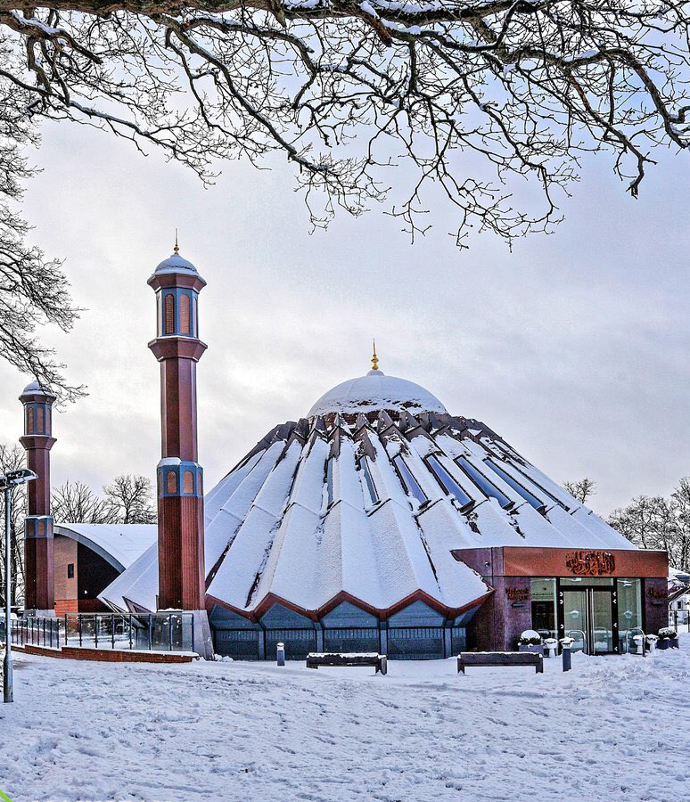


TALIM DEPARTMENT MAA UK
WEEKLY
ATFAL CLASS
(March – Week 4)
TALIM DEPARTMENT MAA UK
www.atfal.org.uk/talim
talim@atfal.co.uk

Slide 2

Class Rules
Arrive on time and be prepared
Always say “Assalamu Alaikum” when you enter the room
Pay attention and listen to the teacher quietly.
Raise your hand if you have a question.
Listen to others when they are speaking.
Work hard and try your best to learn something new.

Slide 3


Lesson Plan
1. Tilawat
2. Hadith
3. Thought of the Week
4. Homework Recap
5. Salat Recap
6. Friday Sermon
7. Learning Time
8. Announcements!
Are you prepared for today’s lesson?
Topi
Class Handout
Pen / Pencil

Slide 4

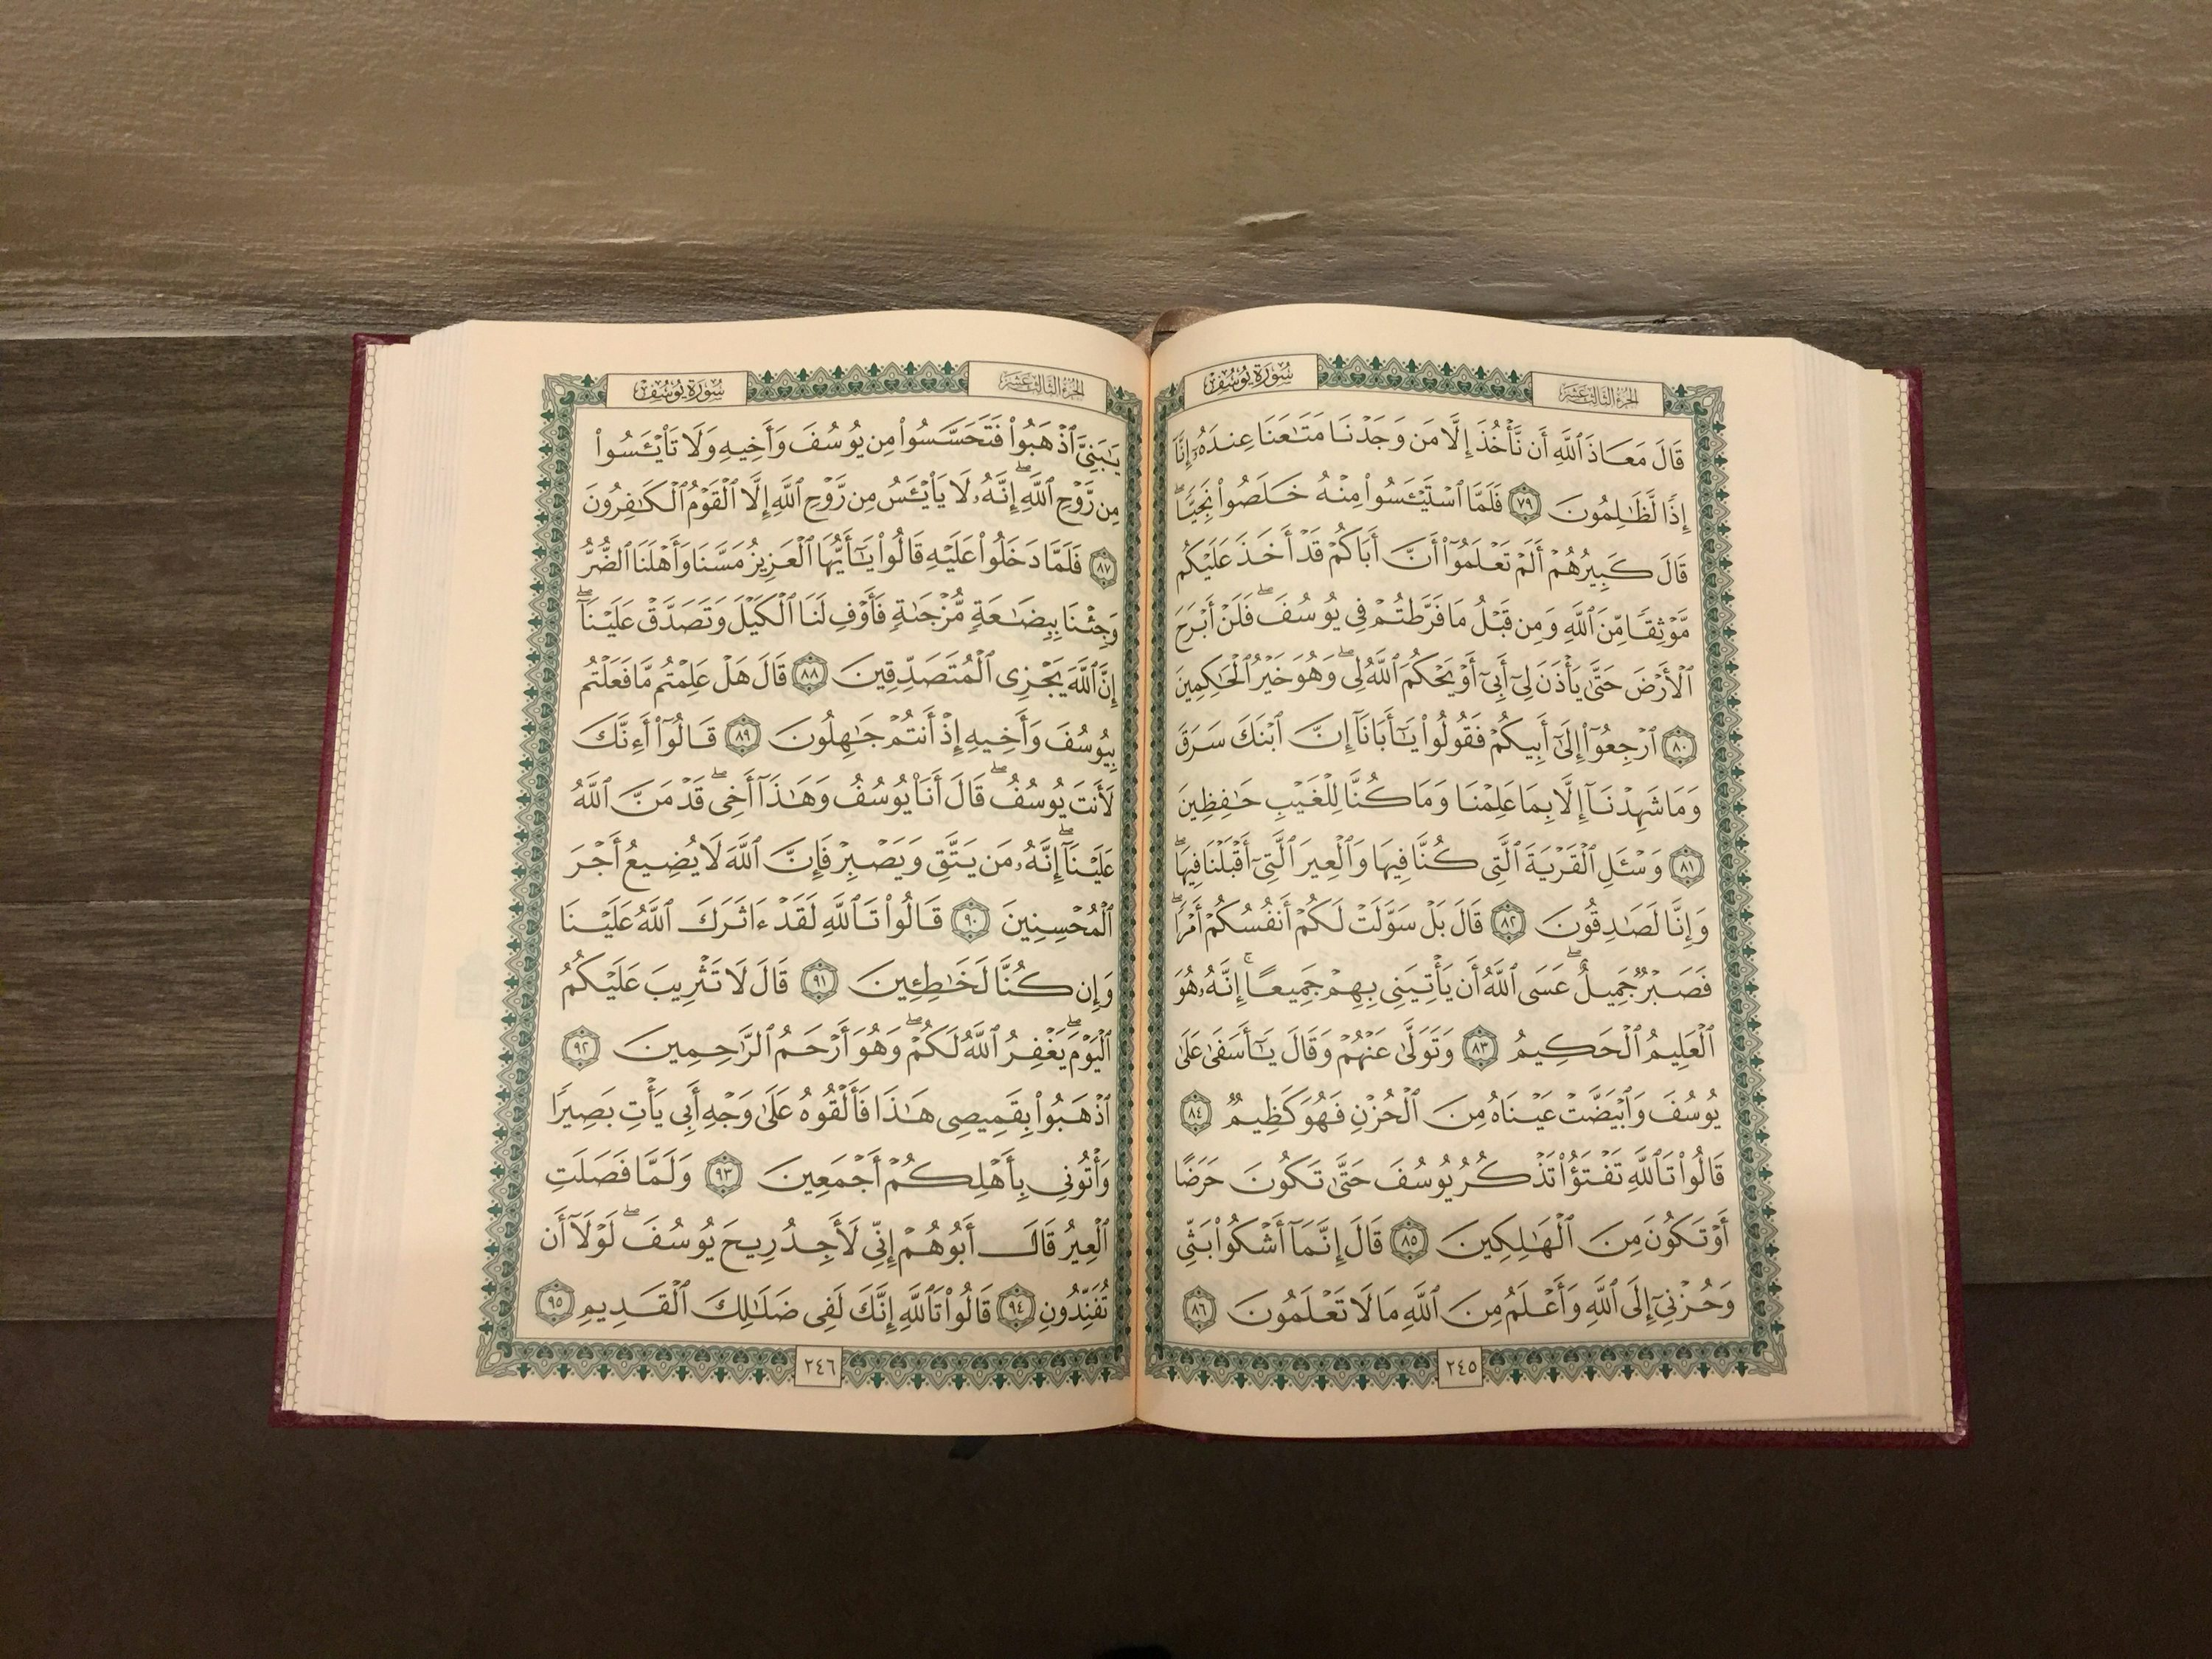
TILAWAT
وَعَدَ اللّٰہُ الۡمُؤۡمِنِیۡنَ وَالۡمُؤۡمِنٰتِ جَنّٰتٍ تَجۡرِیۡ مِنۡ تَحۡتِہَا الۡاَنۡہٰرُ خٰلِدِیۡنَ فِیۡہَا وَمَسٰکِنَ طَیِّبَۃً فِیۡ جَنّٰتِ عَدۡنٍ ؕ وَرِضۡوَانٌ مِّنَ اللّٰہِ اَکۡبَرُ ؕ ذٰلِکَ ہُوَ الۡفَوۡزُ الۡعَظِیۡمُ ﴿۷۲﴾

Slide 5

TRANSLATION
Allah has promised to believers, men and women, Gardens beneath which rivers flow, wherein they will abide, and delightful dwelling-places in Gardens of Eternity. And the pleasure of Allah is the greatest of all. That is the supreme triumph.
(The Holy Quran, Surah Tauba, 9:72)

Slide 6

HADITH
(sayings of the Holy Prophet Muhammad^{sas})
إِذَا دَخَلَ أَهْلُ الْجَنَّةِ الْجَنَّةَ - قَالَ - يَقُولُ اللَّهُ تَبَارَكَ وَتَعَالَى تُرِيدُونَ شَيْئًا أَزِيدُكُمْ فَيَقُولُونَ أَلَمْ تُبَيِّضْ وُجُوهَنَا أَلَمْ تُدْخِلْنَا الْجَنَّةَ وَتُنَجِّنَا مِنَ النَّارِ - قَالَ - فَيَكْشِفُ الْحِجَابَ فَمَا أُعْطُوا شَيْئًا أَحَبَّ إِلَيْهِمْ مِنَ النَّظَرِ إِلَى رَبِّهِمْ عَزَّ وَجَلَّ
Idhā dakhala ahlu al-jannati al-jannah – qāla – yaqūlu Allāhu tabāraka wa taʿālā: turīdūna shayʾan azīdukum? fa-yaqūlūna: alam tubayyiḍ wujūhanā? alam tudkhilnā al-jannah wa tunajjina mina al-nār? – qāla – fa-yakshifu al-ḥijāb, fa-mā uʿṭū shayʾan aḥabba ilayhim mina al-naẓari ilā rabbihim ʿazza wa jall.
(Sahih Al Muslim, Hadith 181A)
Notes:
After Tilawat, spend 5 mins catching up with Atfal. What they've been getting up to in the past week.
Hadith:
Whoever, reads the Hadith out, should do so in the proper manner. i.e. recite Durood Shareef first and then the Hadith.
Have a brief discussion about the meaning of this hadith in light of the questions on the screen.

Slide 7
HADITH
(sayings of the Holy Prophet Muhammad^{sas})
Translation:
Narrated by Hadrat Suhaib^{ra}:
“When those deserving of Paradise would enter Paradise, the Blessed and the Exalted would ask: Do you wish Me to give you anything more? They would say: Hast Thou not brightened our faces? Hast Thou not made us enter Paradise and saved us from Fire? He (the narrator) said: He (God) would lift the veil, and of things given to them nothing would he dearer to them than the sight of their Lord, the Mighty and the Glorious.”
(Sahih Al Muslim, Hadith 181A)
Notes:
After Tilawat, spend 5 mins catching up with Atfal. What they've been getting up to in the past week.
Hadith:
Whoever, reads the Hadith out, should do so in the proper manner. i.e. recite Durood Shareef first and then the Hadith.
Have a brief discussion about the meaning of this hadith in light of the questions on the screen.

Slide 8



THOUGHT
OF THE WEEK
TOPIC:
Our Paradies Lies in Our God

Slide 9

The Promised Messiah^{as} states:
“Our paradise lies in our God. Our highest delight is in our God for we have seen Him and found every beauty in Him. This wealth is worth procuring though one might have to lay down one’s life to procure it. This ruby is worth purchasing though one may have to lose oneself to acquire it. O ye, who are deprived! Hasten to this fountain as it will satiate you. It is this fountain of life that will save you. What am I to do? How shall I impress the hearts with this good news? What sort of a drum am I to beat in the streets in order to make the announcement that this is your God, so that people might hear?”
(The Holy Quran, Surah Tauba, 9:72)

Slide 10

What does the phrase “OUR PARADISE LIES IN OUR GOD” mean in this context?
The phrase means that to obtain paradise, we need to obtain God.
This means that our relationship and connection with Allah the Almighty will depend on whether we attain paradise in the afterlife.
Another meaning of this is that our “happiness” also lies in our God.

Slide 11
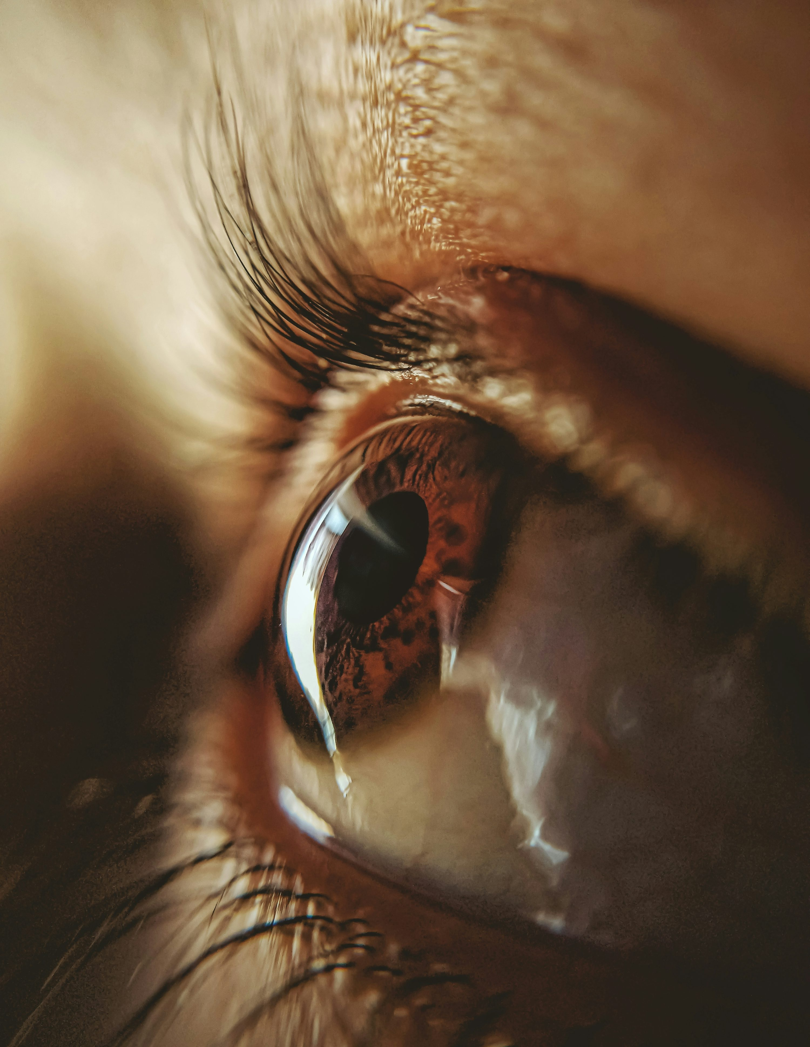
How can we “SEE AND FIND BEAUTY IN GOD ALMIGHTY”?
We cannot physically see God Almighty with our eyes.
We should take the metaphorical meaning that through prayers and establishing a living connection with God Almighty, we can find God.
Once we find God through Him having accepted our prayers, we can see the beauties and characteristics that are present in God.

Slide 12

Who is referred to by the words “WEALTH,” RUBY” and “FOUNTAIN OF LIFE”?
The words “Wealth, Ruby and Fountain of Life” refer to God Almighty.
The passage continues by stating that “one may have to lay down one’s life in order to precure it.”
This refers to a person having attained the status of martyr to obtain and receive the love of Allah the Almighty.
A person may have to go to the extreme end of sacrificing himself just so that he can attain paradise through God Almighty.
A person may have to lose himself in the remembrance and worship of Allah so that he attains “The Ruby.”

Slide 13
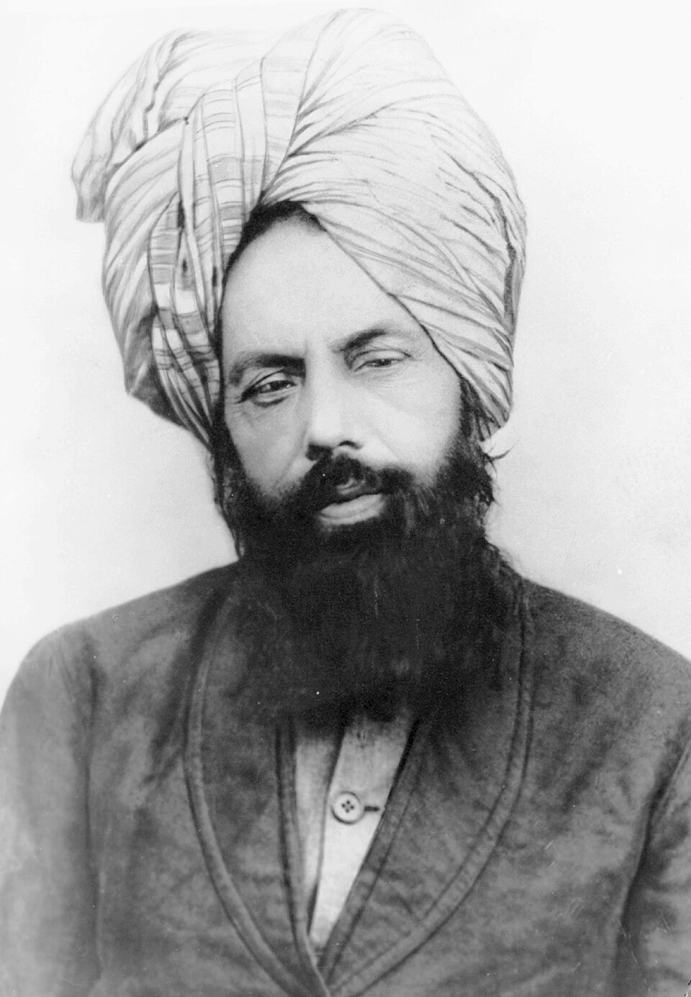
What is the OVERALL message of this Quote?
The overall message is that the Promised Messiah (as) explains that our happiness in this world and attaining paradise is through God Almighty alone.
This is because he is the only One that leads us towards the right path so that we can find Him.
The Promised Messiah (as) then explains that we can find Him through prayers and sacrificing our life, wealth and time for His sake.
At the end, the Promised Messiah (as) desires to spread this to everyone so that they are able to behold God Almighty as well and partake in the blessings.

Slide 14

A VIDEO ON OUR THEME OF THE YEAR
https://youtu.be/9_CtMhFio0c?si=U3RY_xZkpydSEPEt

Slide 15





HOMEWORK
Have you done your homework for this week?
Make sure to note down your homework for next week!

Slide 16

Tashahhud
أَشْهَدُ أَنْ لَا إِلٰهَ إِلَّا اللَّهُ، وَأَشْهَدُ أَنَّ مُحَمَّدًا عَبْدُهُ وَرَسُوْلُهُ
SALAT
Lets Recap a part of our Tashahhud Prayers!
Ashhadu an lā ilāha illā Allāh, wa ashhadu anna Muḥammadan ʿabduhu wa rasūluh
Translation:
I bear witness that there is none worthy of worship except Allah and I bear witness that Muhammad^{sa} is his servant and messenger.
NEXT WEEK RECAP:
Concluding Prayers of Hazrat Ibrahim^{as}.

Slide 17
Tashahhud
إِلٰهَ | لَا | أَنْ | أَشْهَدُ
Worthy of worship | (there is) no | that | I bear witness
SALAT
Lets Recap a part of our Tashahhud Prayers!
أَنَّ | وَأَشْهَدُ | اللَّهُ | إِلَّا
That | And I bear witness | Allah | Except
NEXT WEEK RECAP:
Concluding Prayers of Hazrat Ibrahim^{as}.
وَرَسُولُهُ | عَبْدُهُ | مُحَمَّدًا
And His messenger | His servant | Muhammad

Slide 18

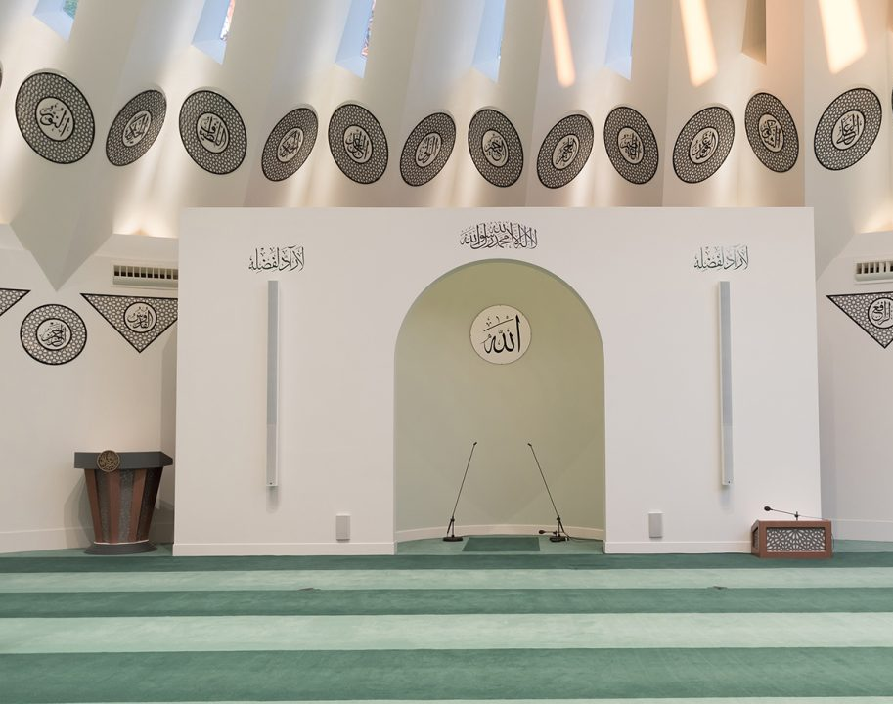
EID
SERMON
Friday 20th March
2026

Slide 19



EID-UL-FITR SERMON
‘Thee alone do we worship and thee alone do we implore for help’
Huzoor^{aba} emphasized compassion for others, especially the poor, so that Eid becomes a source of joy for all. He also highlighted the prayer إِيَّاكَ نَعْبُدُ وَإِيَّاكَ نَسْتَعِينُ teaching that one must first strive and work hard, then place trust in Allah and seek His help.

Slide 20

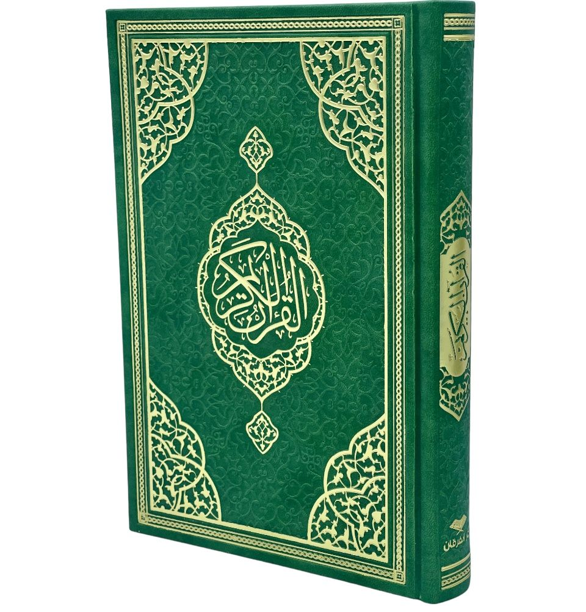
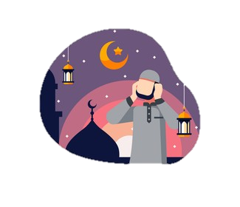
EID-UL-FITR SERMON
‘Thee alone do we worship and thee alone do we implore for help’
Huzoor^{aba} explained that Ramadan is for gaining blessings and doing good deeds, and these should continue after Ramadan; otherwise, Eid becomes just a festival without real purpose.
Huzoor^{aba} stated that the real Eid is in following the commands of God Almighty found in the Quran.

Slide 21
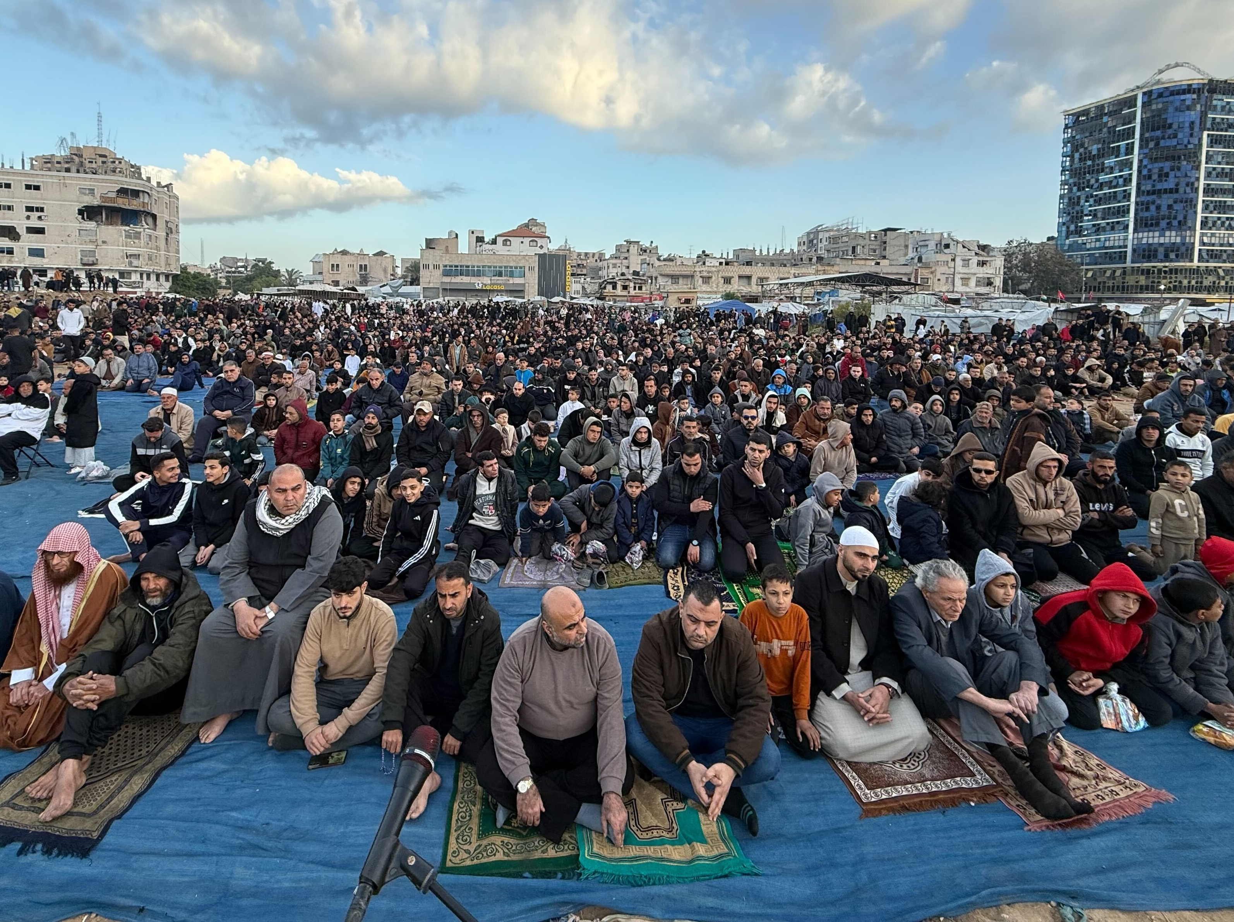

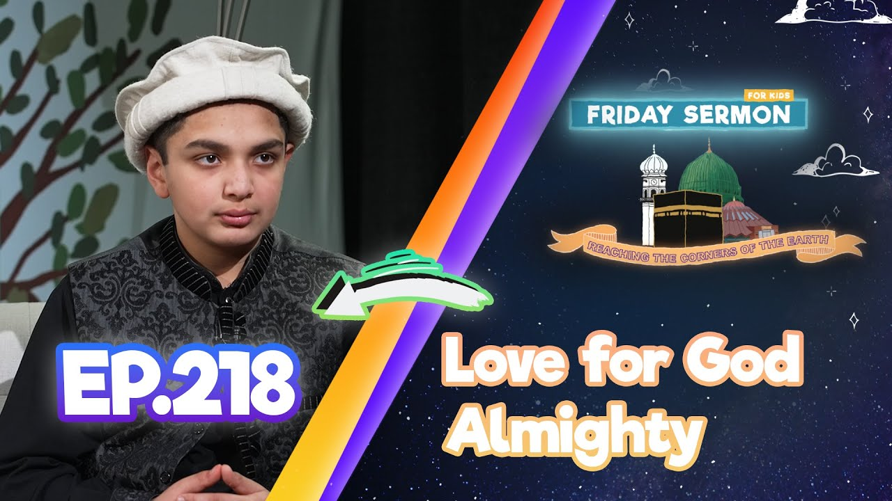
EID-UL-FITR SERMON
‘Thee alone do we worship and thee alone do we implore for help’
Huzoor^{aba} also drew attention to the pitiable condition of Muslims globally and said that we should remember our fellow Muslims, whose homes are destroyed due to the war caused by corruption. They are in a state of fear and they are still fulfilling Allah’s commandment and offering Eid prayers.
Watch this weeks Friday Sermon 4 Kids!

Slide 22



LEARNING
TIME

Slide 23

PAIR ACTIVITY
Discuss today’s lesson with the Tifl next to you and come up with 3 new things you learned today!

Slide 24
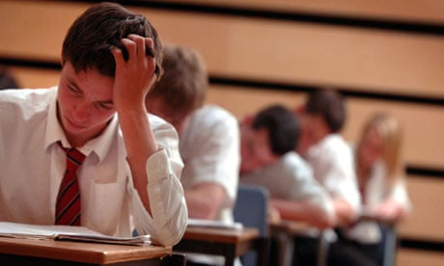
ANNOUNCEMENTS
TEST WEEK!!!
Next week’s class will be a test covering all of the content taught this month: 3 Ashras of Ramadan, Lailatul Qadr, Eid-ul-Fitr and Our Paradise Lies in Our God
You can find the material at atfal.org.uk/taleem
Prepare Well and Good Luck!

