Slide 1
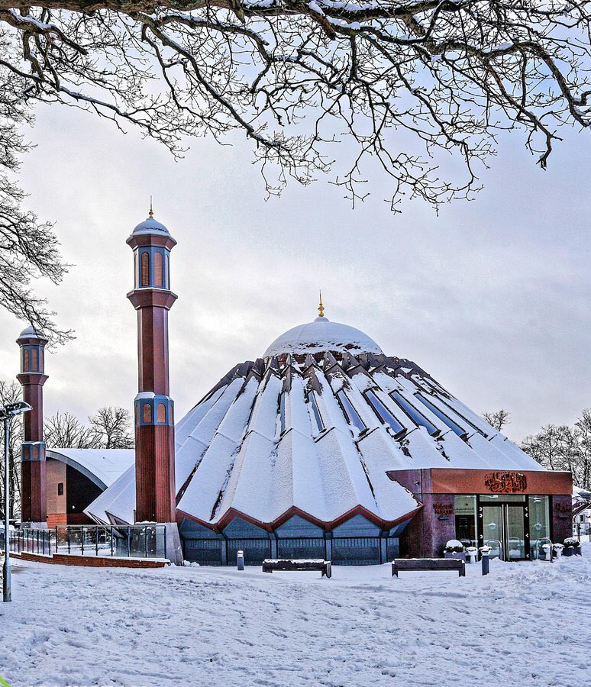


TALIM DEPARTMENT MAA UK
THE EXISTENCE OF GOD
Learning Time Topic 1 Module 1
TALIM DEPARTMENT MAA UK
www.atfal.org.uk/talim
talim@atfal.co.uk

Slide 2

Lesson Objectives
Understand that God is a supreme and universal being.
Look at one way to understand that God exists.
Answer the Allegation ‘God does not speak anymore.’

Slide 3



PAIR ACTIVITY
Discuss the following 3 questions with the person next to you:
Is there a God out there?
If yes, how do we know that he is there?
“God used to speak but does not speak anymore?” Is this true?
THE EXISTENCE OF GOD

Slide 4



Different Ways Of Proving God’s Existence
Acceptance of Prayer
The Holy Quran States:
وَ اِذَا سَاَلَکَ عِبَادِیۡ عَنِّیۡ فَاِنِّیۡ قَرِیۡبٌ ؕ اُجِیۡبُ دَعۡوَۃَ الدَّاعِ اِذَا دَعَانِ
ALLAH’S REPLY IN THE HOLY QURAN
TRANSLATION
And when My servants ask thee about Me, say: ‘I am near. I answer the prayer of the supplicant when he prays to Me.
(The Holy Quran, Surah Al Baqarah, 2:187)

Slide 5
Different Ways Of Proving God’s Existence
Acceptance of Prayer
This verse is a promise to the believers and a sign for believers and non-believers alike.
GOD IS REAL – the proof lies in the acceptance of prayers.
He always helps us in difficult times.
ALLAH’S REPLY IN THE HOLY QURAN

Slide 6
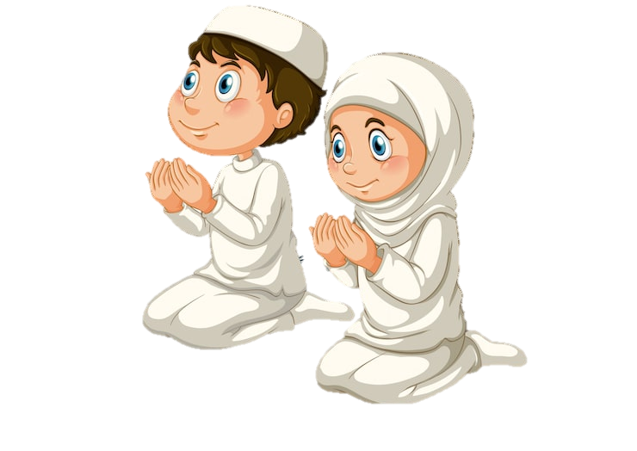
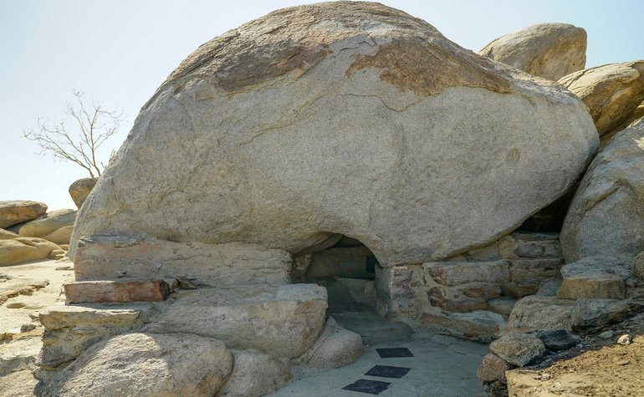
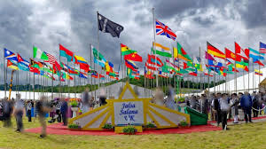
Different Ways Of Proving God’s Existence
Acceptance of Prayer
HE saved the Jews from Pharoah.
HE protected Huzoor^{sa} in the cave of Thaur.
HE answered the Promised Messiah’s prayers and spread Ahmadiyyat to the corners of the globe.
AND
HE will also answer your prayers.
ALLAH’S REPLY IN THE HOLY QURAN

Slide 7

Different Ways Of Proving God’s Existence
Belief in the Unseen
Describing us, the believers Allah says:
اَلَّذِیۡنَ یُؤۡمِنُوۡنَ بِالۡغَیۡبِ وَیُقِیۡمُوۡنَ الصَّلٰوۃَ
TRANSLATION
Who believe in the unseen and observe Prayer.
(The Holy Quran, Surah Al Baqarah, 2:187)
BUT HOW CAN WE BELIEVE IN GOD IF WE CAN’T SEE HIM?

Slide 8



Different Ways Of Proving God’s Existence
Belief in the Unseen
Proving that we don’t need to SEE to BELIEVE
THERE ARE MANY THINGS WE CAN’T SEE
Sound, Smell, Pain
We can’t see them, but we can feel them through our other senses.

Slide 9

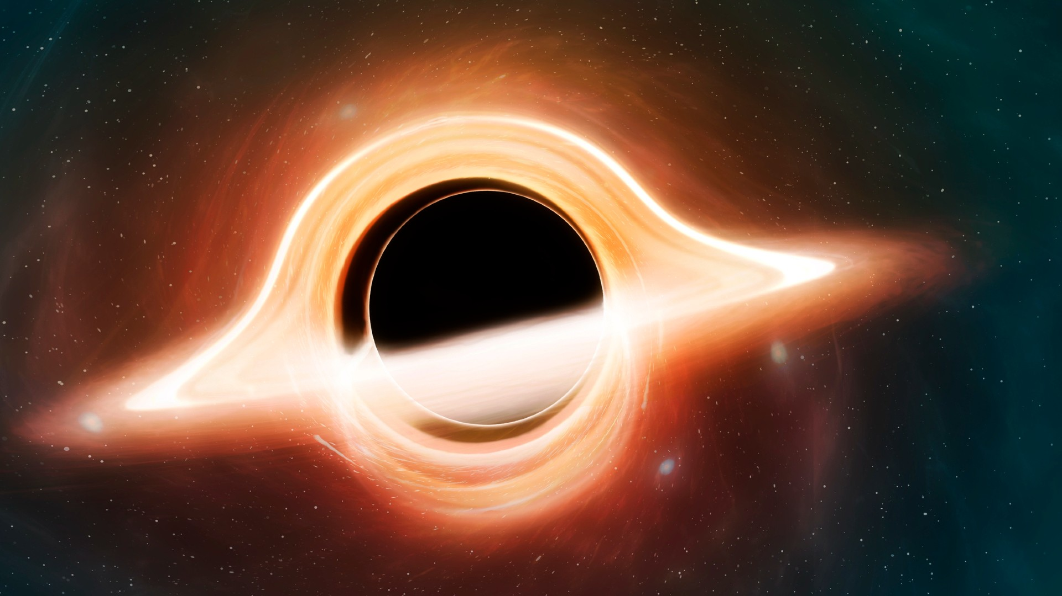

Different Ways Of Proving God’s Existence
Belief in the Unseen
Proving that we don’t need to SEE to BELIEVE
BUT THERE ARE THINGS WE CAN’T PERCIEVE AT ALL:
Gravity, Black Holes, Air
We believe in these because we can see their EFFECTS.
GRAVITY MADE
THE APPLE FALL
BLACK HOLES BEND LIGHT
AIR HELPS US BREATH

Slide 10
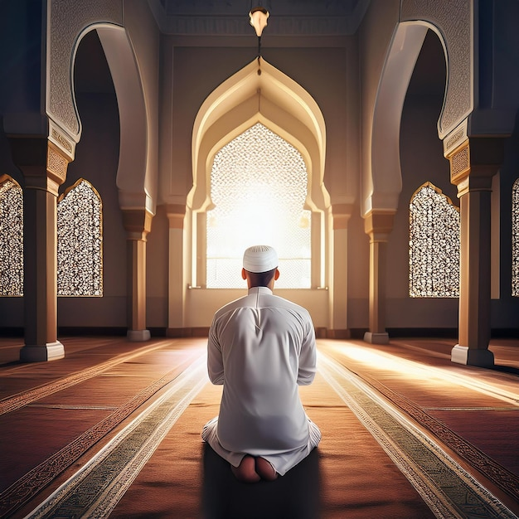
Different Ways Of Proving God’s Existence
Belief in the Unseen
Proving that we don’t need to SEE to BELIEVE
1. So, we believe in ALLAH, because we have seen HIS EFFECTS.
2. We have seen his power through the ACCEPTANCE OF PRAYERS.

Slide 11

“God used to speak, but does not speak anymore”
Answering a misconception held by some Muslims
Allah used to speak to Prophets in the past, and he still does.

Slide 12
“God used to speak, but does not speak anymore”
Answering a misconception held by some Muslims
Just like Allah promised in the Quran, he speaks by listening to prayers and accepting them.

Slide 13
“God used to speak, but does not speak anymore”
Answering a misconception held by some Muslims
Anyone can speak to God, not just Prophets and Messengers, whether they are RICH or POOR, OLD or YOUNG.

Slide 14
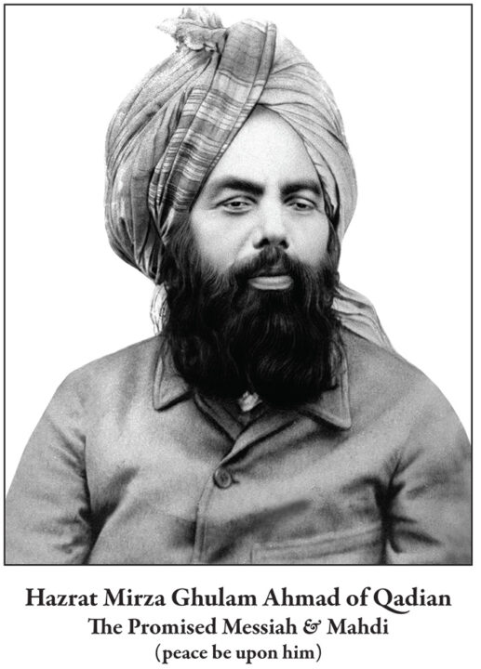
“God used to speak, but does not speak anymore”
Answering a misconception held by some Muslims
In every era, there are those who have an extraordinary and special relationship with Allah.

Slide 15
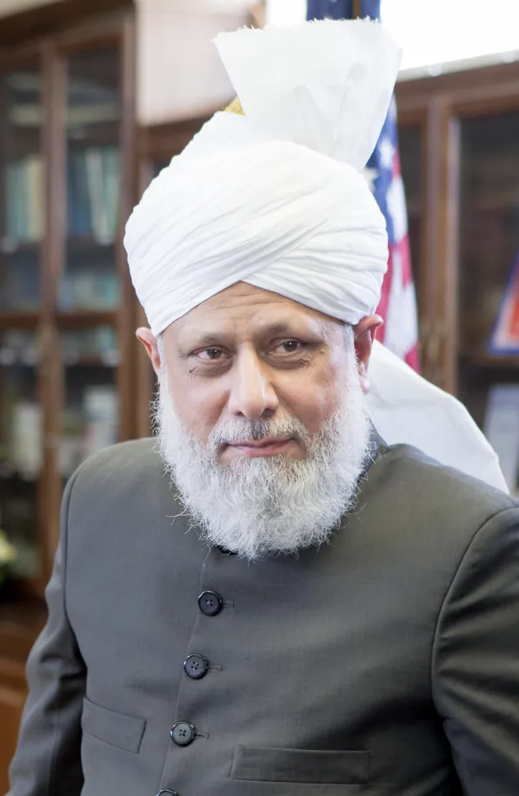
“God used to speak, but does not speak anymore”
Answering a misconception held by some Muslims
Just look towards Huzoor-e-Anwar^{aba} who has a direct link with God. Allah is always guiding him and blessing the Ahmadiyya Community.

Slide 16
Fulfilling Our Rights To Allah
What should we DO?
When we believe Allah exists, THEN we will be more inclined to PRAY TO HIM, as Allah’s worship is the purpose of our lives.

Slide 17
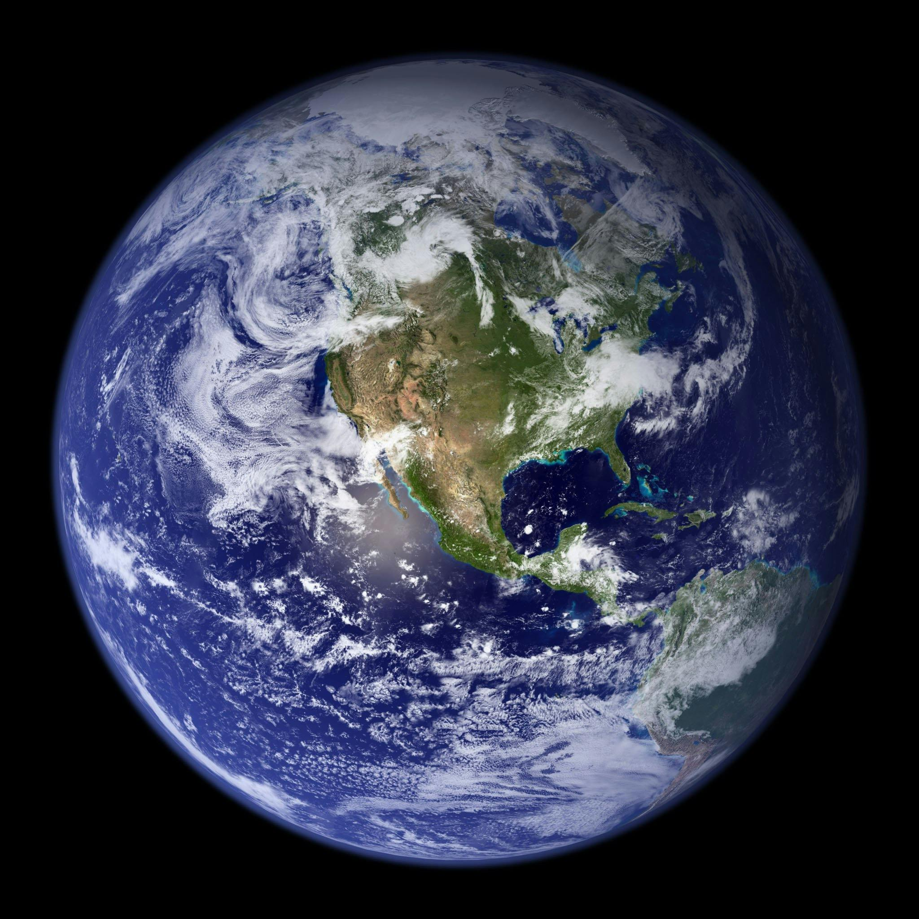
Fulfilling Our Rights To Allah
What should we DO?
When we understand that it is Allah who gave us our lives, brought us into this world, gave us the sun, moon, and stars, gave us air to breathe, houses to live in, only THEN will we show gratitude to him and fulfil OUR obligation to him.

Slide 18

Fulfilling Our Rights To Allah
What should we DO?
When we are
Grateful to Allah,
Then Allah too will answer our prayers and show us His Existence!

Slide 19
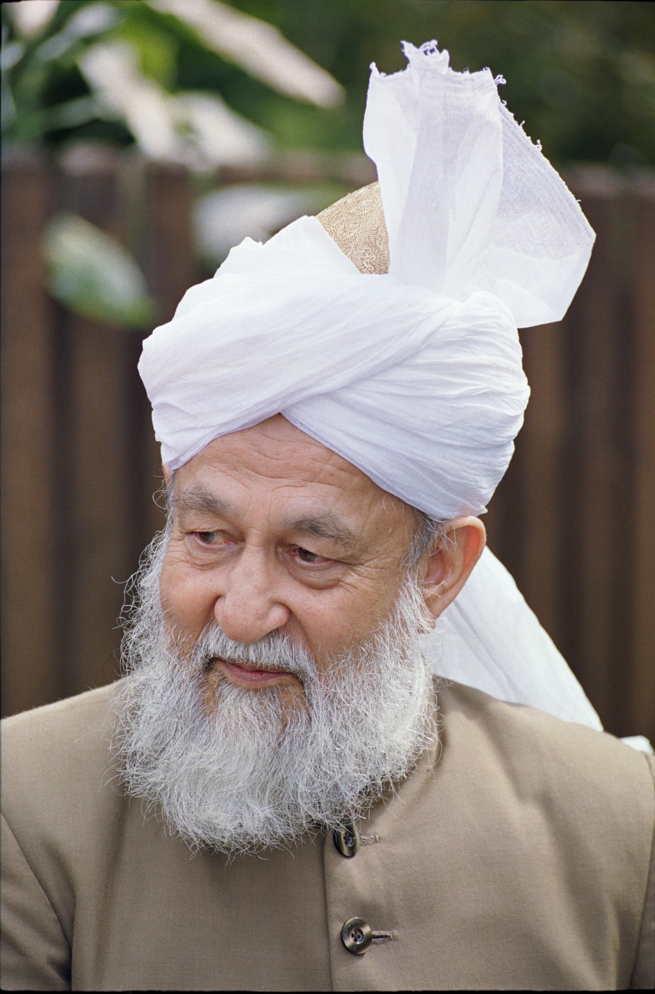
The Existence Of God
Explained by Hadrat Khalifatul Masih IV
https://www.youtube.com/watch?v=zOdbmCA52jU
THE EXISTENCE OF GOD THROUGH PERSONAL EXPERIENCE

Slide 20

Today’s Recap
Allah is a supreme being who has created this world.
Allah the Almighty answers our prayers.
Allah speaks today, just like he spoke to Prophets.
Allah is the ‘Self Sustaining’ and so will never leave us humans alone.

