Slide 1



TALIM DEPARTMENT MAA UK
WEEKLY
ATFAL CLASS
(April – Week 1)
TALIM DEPARTMENT MAA UK
www.atfal.org.uk/talim
talim@atfal.co.uk

Slide 2

Class Rules
Arrive on time and be prepared
Always say “Assalamu Alaikum” when you enter the room
Pay attention and listen to the teacher quietly.
Raise your hand if you have a question.
Listen to others when they are speaking.
Work hard and try your best to learn something new.

Slide 3


Lesson Plan
1. Tilawat
2. Hadith
3. Thought of the Week
4. Homework Recap
5. Salat Recap
6. Friday Sermon
7. Learning Time
8. Announcements!
Are you prepared for today’s lesson?
Topi
Class Handout
Pen / Pencil

Slide 4

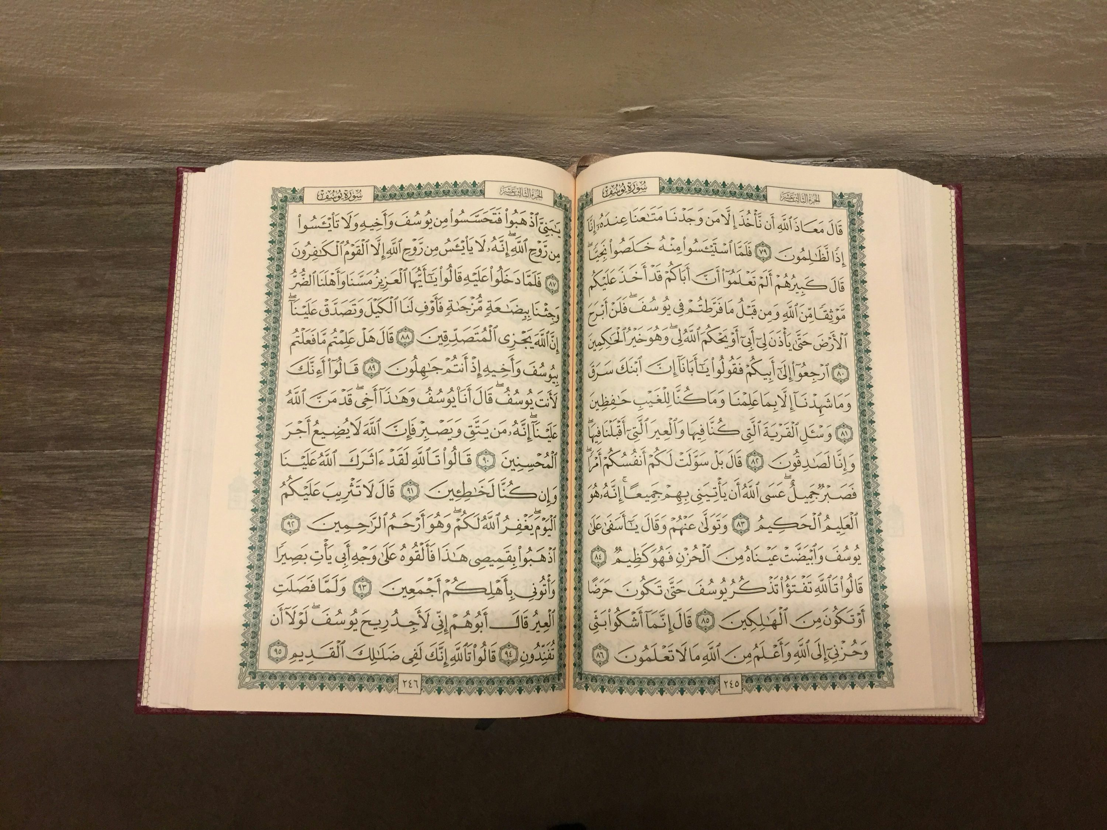

TILAWAT
وَّقَوۡلِہِمۡ اِنَّا قَتَلۡنَا الۡمَسِیۡحَ عِیۡسَی ابۡنَ مَرۡیَمَ رَسُوۡلَ اللّٰہِ ۚ وَمَا قَتَلُوۡہُ وَمَا صَلَبُوۡہُ وَلٰکِنۡ شُبِّہَ لَہُمۡ
TRANSLATION
“And their saying, ‘We did kill the Messiah, Jesus, son of Mary, the Messenger of Allah;’ whereas they slew him not, nor crucified him, but he was made to appear to them like one crucified”
(The Holy Quran, Surah An-Nisa, 4:158)

Slide 5

HADITH
(sayings of the Holy Prophet Muhammad^{sas})
عَنْ عَائِشَةَ ـ رَضِىَ اللّٰہُ عَنْهَا
قَالَتْ فَقَالَ رَسُولُ اللّٰہِ صَلَّى اللّٰہُ عَلَیْہِ وَسَلَّمَ يَا أَبَا بَكْرٍ إِنَّ لِكُلِّ قَوْمٍ عِيدًا وَهَذَا عِيدُنَا
ʿAn ʿĀʾishah (raḍiya Allāhu ʿanhā) qālat: fa-qāla Rasūlullāh ṣallā Allāhu ʿalayhi wa-sallam:"Yā Abā Bakr, inna li-kulli qawmin ʿīdan wa-hādhā ʿīdunā.”
(Sahih Al Bukhari, Hadith 952)
Translation:
Hazrat Ayesha (ra) narrates that the Holy Prophet Muhammad (saw) said:
“O Abu Bakr, every people have an Eid, and this is our Eid”
Notes:
After Tilawat, spend 5 mins catching up with Atfal. What they've been getting up to in the past week.
Hadith:
Whoever, reads the Hadith out, should do so in the proper manner. i.e. recite Durood Shareef first and then the Hadith.
Have a brief discussion about the meaning of this hadith in light of the questions on the screen.

Slide 6



THOUGHT
OF THE WEEK
TOPIC:
“Easter!”

Slide 7



WHAT IS EASTER?
Easter is a Christian festival.
Christians celebrate it to remember Jesus.
Many Christians believe Jesus rose again from the dead on Easter.
People often go to church on Easter.
Families may share meals and spend time together.
Easter is celebrated on different dates each year.

Slide 8
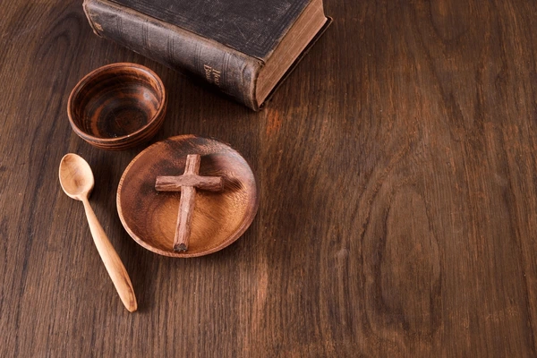
WHAT IS THE HOLY WEEK?
Before Easter, Christians have a period called Lent.
Lent lasts for about 40 days.
During Lent, many Christians fast, pray more and try to do good deeds.

Slide 9

WHAT IS THE “HOLY WEEK?”
The week before Easter is called Holy Week.
Palm Sunday comes first and remembers Jesus entering Jerusalem.
Then comes Maundy Thursday, which remembers the Last Supper.
After this comes Good Friday, when Christians remember the crucifixion of Jesus.
Then comes Easter Sunday, which is a joyful celebration for Christians.

Slide 10





HOMEWORK
Have you done your homework for this week?
Make sure to note down your homework for next week!

Slide 11

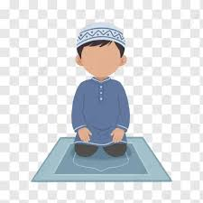
Concluding Prayers
رَبَّنَا اغْفِرْ لِيْ وَلِوَالِدَيَّ وَلِلْمُؤْمِنِينَ يَوْمَ يَقُومُ الْحِسَابُ
SALAT
Rabbana ighfir li wa li-wālidayya wa lil-mu’minīna yawma yaqūmul ḥisāb
Lets Recap a part of our Salat!
NEXT WEEK RECAP:
Surah Al-Fatihah
Translation:
Our Lord, forgive me, my parents, and the believers on the Day when the reckoning will take place.

Slide 12
وَلِوَالِدَيَّ | لِي | اغْفِرْ | رَبَّنَا
And my parents | Me | Forgive | Our Lord
Concluding Prayers
الْحِسَابُ | يَقُومُ | يَوْمَ | وَلِلْمُؤْمِنِينَ
reckoning | Will take place | The day | And the believers

Slide 13

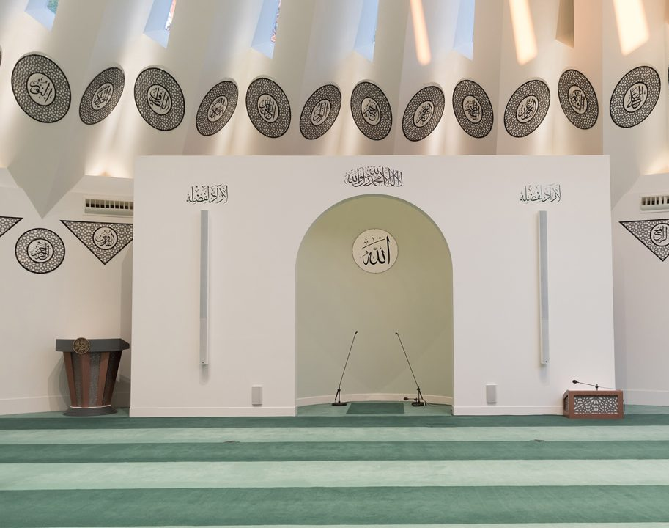
FRIDAY
SERMON
Friday 3rd April
2026

Slide 14

FRIDAY SERMON
THE PROPHET’S^{SA} UNYIELDING STRUGGLE FOR DIVINE UNITY
The Promised Messiah (as) was also sent to uphold Tawhid.
The Promised Messiah(as) writes: ‘He should also abstain from Shirk. His soul should always lie prostrate at the threshold of the Almighty, seeking His grace through prayer and supplication.

Slide 15
FRIDAY SERMON
THE PROPHET’S^{SA} UNYIELDING STRUGGLE FOR DIVINE UNITY
The Promised Messiah (as) said that the true Tauhid is to believe that God has no associate and to consider Him alone as the Source of all power and sustenance, honour and humiliation, help and succour.

Slide 16

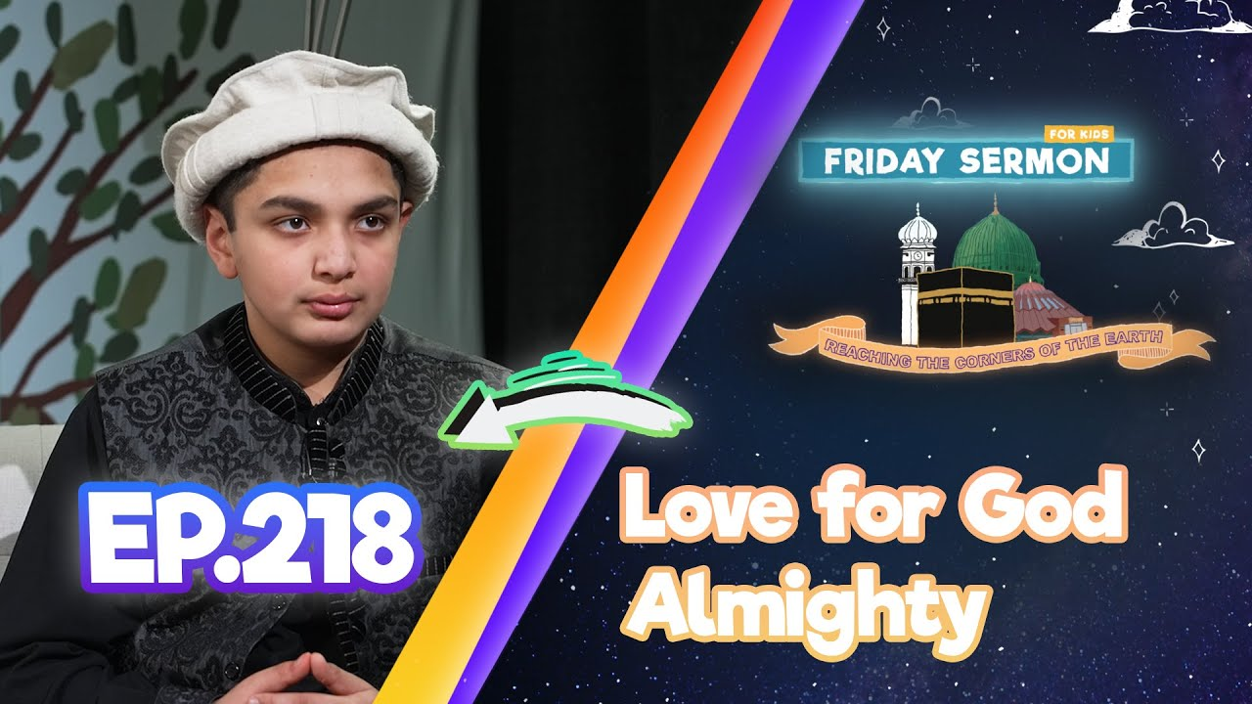
FRIDAY SERMON
THE PROPHET’S^{SA} UNYIELDING STRUGGLE FOR DIVINE UNITY
He further states that no concept of Tauhid is complete without the following three aspects:
Tauhid
In the context of God’s Attributes.
In the context of Love, Sincerity and Devotion.
In the context of God’s Person.
His Holiness^{aba} said that we must endeavour our utmost to spread the message of the unity of God.
Watch this weeks Friday Sermon 4 Kids!

Slide 17

FRIDAY SERMON
TAKEAWAY AND TASK FOR THIS WEEK
Continue to establish the unity of God Almighty in society and the environment around you.
Pray for the conditions of the world to become better.
Follow the practices of the Holy Prophet Muhammad (saw) and the Promised Messiah (as) in upholding unity of God Almighty.

Slide 18

PAIR ACTIVITY
Discuss today’s lesson with the Tifl next to you and come up with 3 new things you learned today!

Slide 19

ANNOUNCEMENTS
National Atfal Explorers Club - London Zoo trip!
(7–10yrs)
Limited spaces
📅 2nd May 2026
💷 £23 per Tifl
💷 £30 per Parent
📍ZSL London Zoo - Depart from Bait ul Futuh via Morden underground station.
Sign up now - Limited Spaces
🔗 REGISTERATION LINK - https://forms.cloud.microsoft/Pages/ResponsePage.aspx?id=DQSIkWdsW0yxEjajBLZtrQAAAAAAAAAAAAO__aa42SJURFhGR0xBRlRaRjM1OFNYNkRXTEpGRkpSUS4u

Slide 20
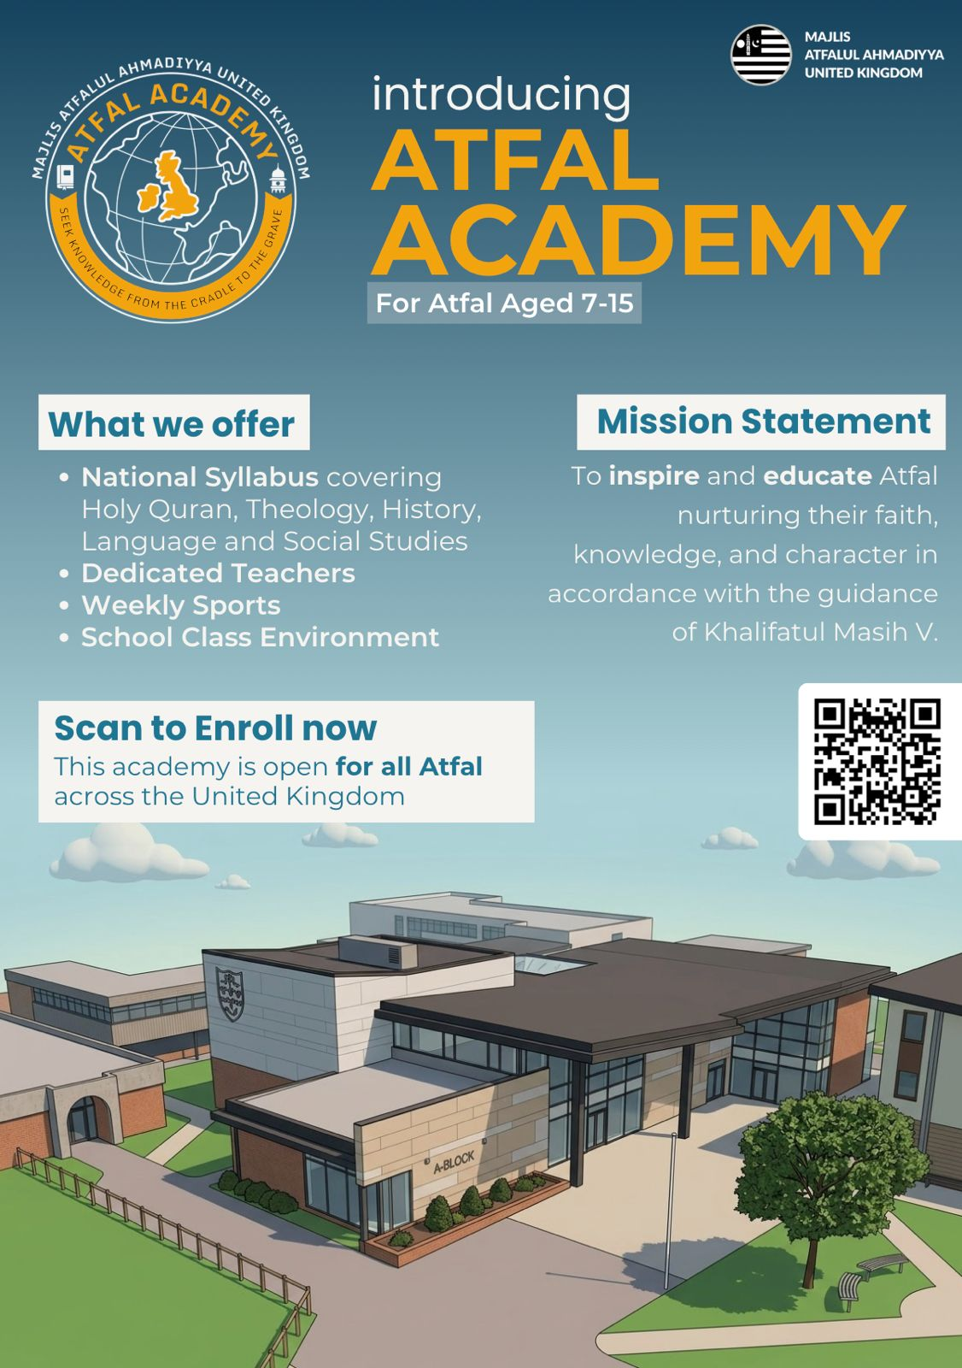
ANNOUNCEMENTS
The Atfal Academy is officially launching on Sunday 3rd May 2026!
📍Location: Weydon School, GU9 8UG (12 mins from Islamabad)
⏰ Timings: Every Sunday, 09:00 - 13:00
📝 Fee: £30 per tifl (Complete 10-Week Term, 3rd May to 12th July 2026)
Deadline for registration is 20th April!
🔗 Register Here: www.Atfal.org.uk/Atfal-Academy

