Slide 1
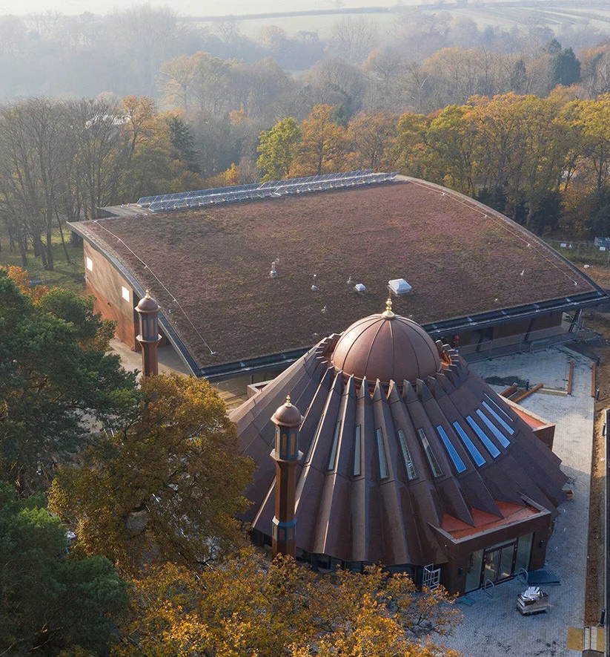


TALIM DEPARTMENT MAA UK
WEEKLY
ATFAL CLASS
(April – Week 2)
TALIM DEPARTMENT MAA UK
www.atfal.org.uk/talim
talim@atfal.co.uk

Slide 2

Class Rules
Arrive on time and be prepared
Always say “Assalamu Alaikum” when you enter the room
Pay attention and listen to the teacher quietly.
Raise your hand if you have a question.
Listen to others when they are speaking.
Work hard and try your best to learn something new.

Slide 3


Lesson Plan
1. Tilawat
2. Hadith
3. Thought of the Week
4. Homework Recap
5. Salat Recap
6. Friday Sermon
7. Learning Time
8. Announcements!
Are you prepared for today’s lesson?
Topi
Class Handout
Pen / Pencil

Slide 4

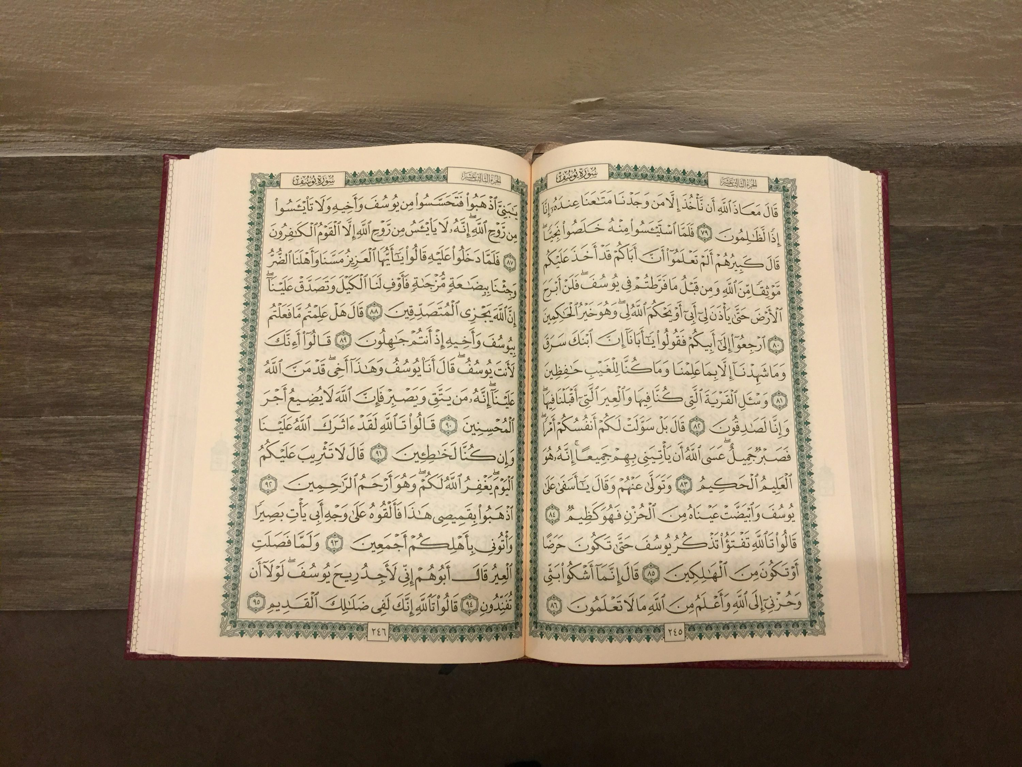

TILAWAT
الَّذِیۡ عَلَّمَ بِالۡقَلَمِ
TRANSLATION
“Who taught man by the pen.”
(The Holy Quran, Surah An-Nuh, 71:11)

Slide 5

HADITH
(sayings of the Holy Prophet Muhammad^{sas})
Hazrat Ayesha (ra) relates: “The Holy Prophet (saw) returned from a journey and in his absence I had screened a platform in front of my house with a curtain on which there were pictures. When the Holy Prophet (saw) saw it, he changed colour and said: Ayesha, the worst chastised by Allah on the Day of Judgment will be those who copy Allah’s creation. So I cut it up and made one or two pillow covers from it.”
(Gardens of the Righteous, On Prohibition of Portraits and Likenesses, Hadith Number 1685, Page Number 283)
Notes:
After Tilawat, spend 5 mins catching up with Atfal. What they've been getting up to in the past week.
Hadith:
Whoever, reads the Hadith out, should do so in the proper manner. i.e. recite Durood Shareef first and then the Hadith.
Have a brief discussion about the meaning of this hadith in light of the questions on the screen.

Slide 6



THOUGHT
OF THE WEEK
TOPIC:
“WORLD ART DAY!”

Slide 7
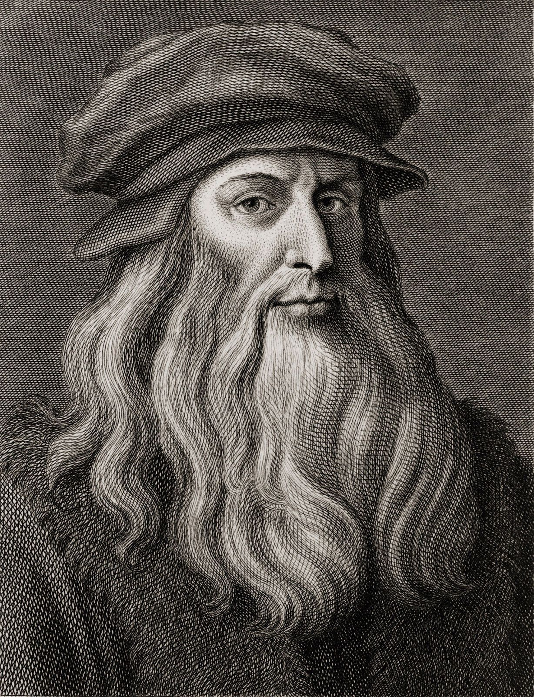
WHAT IS WORLD ART DAY?
World Art Day is celebrated every year on April 15 every year
It honours Leonardo da Vinci, a famous artist
Art means expressing ideas and feelings, like drawing, painting etc.
It is celebrated to encourage creativity and to learn the different types of arts of different cultures.

Slide 8
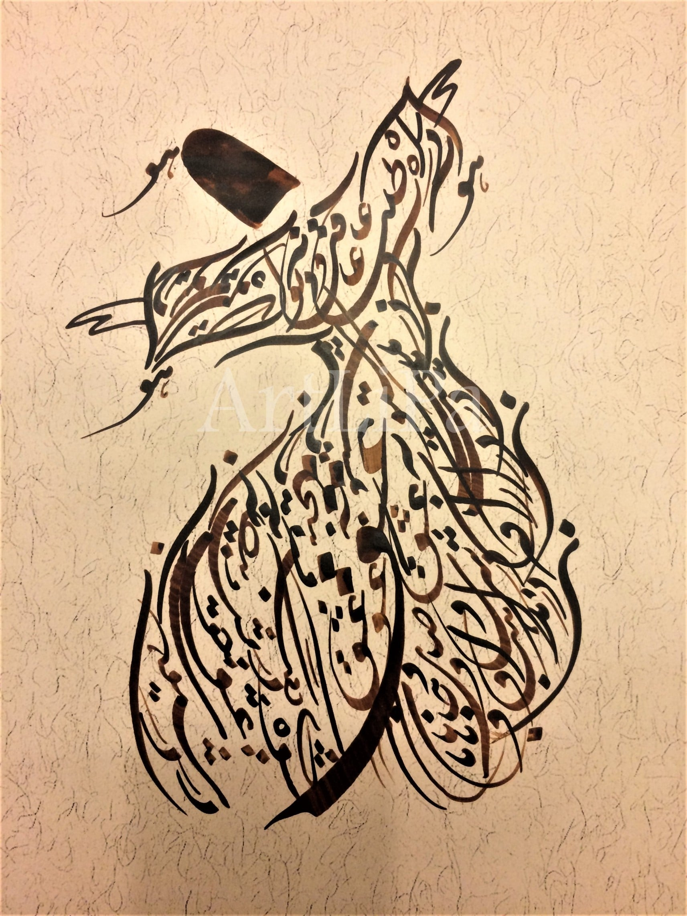
ISLAMIC ART
Islamic Art is art inspired by the religion of Islam and Muslim cultures
It often includes: Arabic calligraphy and Geometric patterns
It usually does not show people or animals in religious places (like mosques)
Famous examples can be seen in places like: Alhambra and Blue Mosque
It is special because it shows beauty and creativity and uses patterns that can go on forever signifying eternity.

Slide 9





HOMEWORK
Have you done your homework for this week?
Make sure to note down your homework for next week!

Slide 10
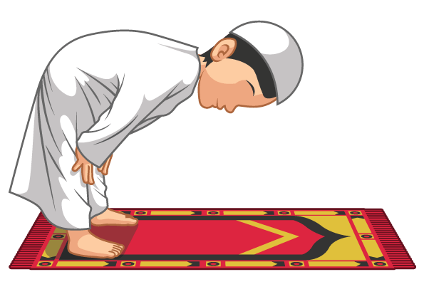

Salam And The Dua After Salam
SALAT
السَّلَامُ عَلَيْكُمْ وَرَحْمَةُ اللّٰه
اللَّهُمَّ أَنْتَ السَّلَامُ وَمِنْكَ السَّلَامُ، تَبَارَكْتَ يَا ذَا الْجَلَالِ وَالْإِكْرَامِ
Lets Recap a part of our Salat!
Assalamu alaikum wa rahmatullah
Allahumma antas-salamu wa minkas-salamu, tabarakta ya dhal-jalali wal-ikram
NEXT WEEK RECAP:
Tahmeed
Translation:
"O Allah, You are the Source of Peace and from You comes peace. Blessed are You, O Possessor of Majesty and Honor."

Slide 11
وَمِنْكَ | السَّلَامُ | أَنْتَ | اللَّهُمَّ
And From You | The Source of Peace | You | O Allah
ذَا الْجَلَالِ | يَا | تَبَارَكْتَ | السَّلَامُ
Posseesor of Majesty | O | Blessed are you | Peace
Dua After Salam
وَالْاِكْرَامِ
And Honour

Slide 12

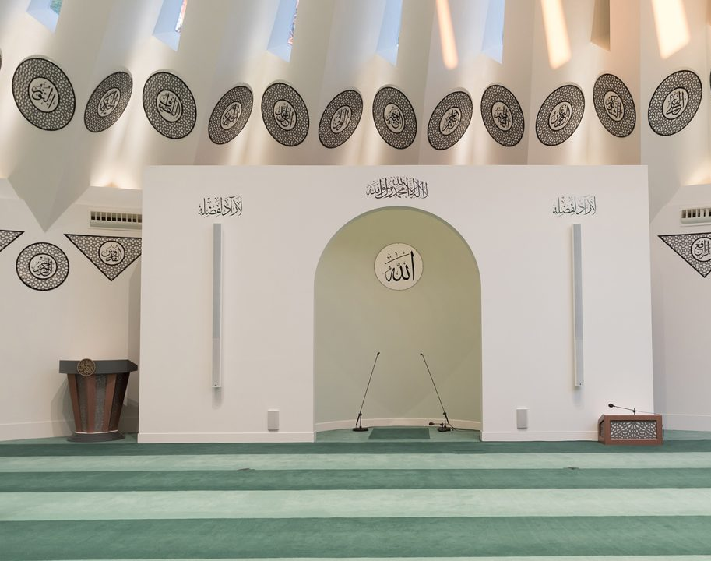
FRIDAY
SERMON
Friday 10th April
2026

Slide 13

FRIDAY SERMON
Reflecting his Master (saw): The Promised Messiah (as) call to Tauheed
The Promised Messiah(as) said that once, someone’s child passed away. One of his friends went to offer his condolences, only to find the father of the child screaming and saying that God had been unjust to him. Hazrat Mirza Bashiruddin Mahmud Ahmad (ra) said that everything, even our lives and everything in them, has been given to us by God.

Slide 14
FRIDAY SERMON
Reflecting his Master (saw): The Promised Messiah (as) call to Tauheed
The Promised Messiah (as) was very attached to his youngest son, Mubarak Ahmad. When his son fell ill, the Promised Messiah(as) diligently tended to him. Hazrat Hakim Maulvi Nooruddin(ra) was concerned about how the Promised Messiah(as) would handle it if his youngest son were to succumb to his illness and pass away. However, when that time came, and Mubarak Ahmad passed away, the Promised Messiah(as) exhibited immense patience. He said they should not despair, as this was the will of God.

Slide 15


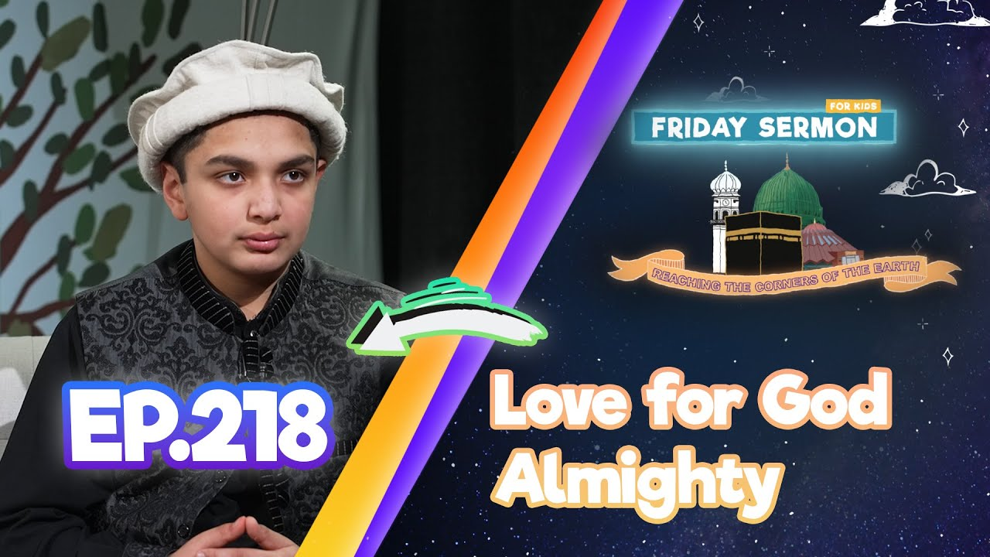
FRIDAY SERMON
Once, a group of people went to meet the Promised Messiah (as). They shook his hand; however, one of them fell to the ground at his feet. The Promised Messiah (as) held him by his arm and lifted him up as he said, ‘This is the very shirk that God has sent me to eradicate in this era. To kiss another’s feet is shirk.’
Even saying Jazakallah without saying Alhamdulillah is shirk.
Watch this weeks Friday Sermon 4 Kids!

Slide 16
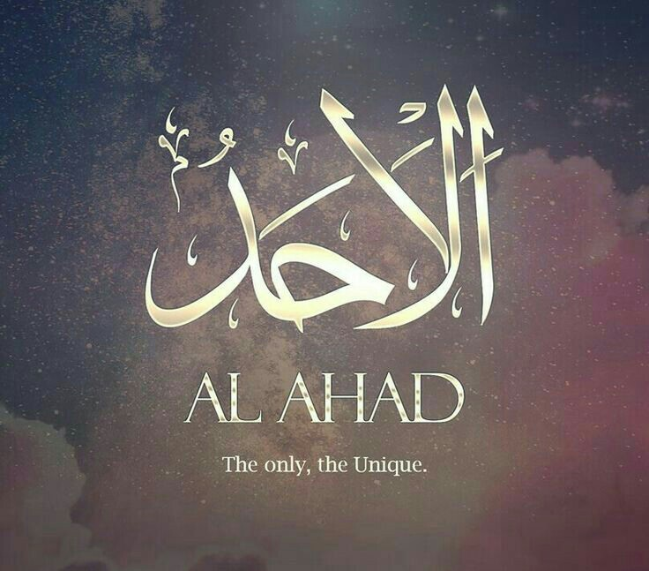
FRIDAY SERMON TAKEAWAY POINTS
Promote the message of the Promised Messiah (as) to family friends that his arrival was to establish the unity of Allah.
Avoid Shirk in all possible ways.
Always be thankful to Allah for everything you do because it is only Him that has enabled you to complete a task.

Slide 17

PAIR ACTIVITY
Discuss today’s lesson with the Tifl next to you and come up with 3 new things you learned today!

Slide 18
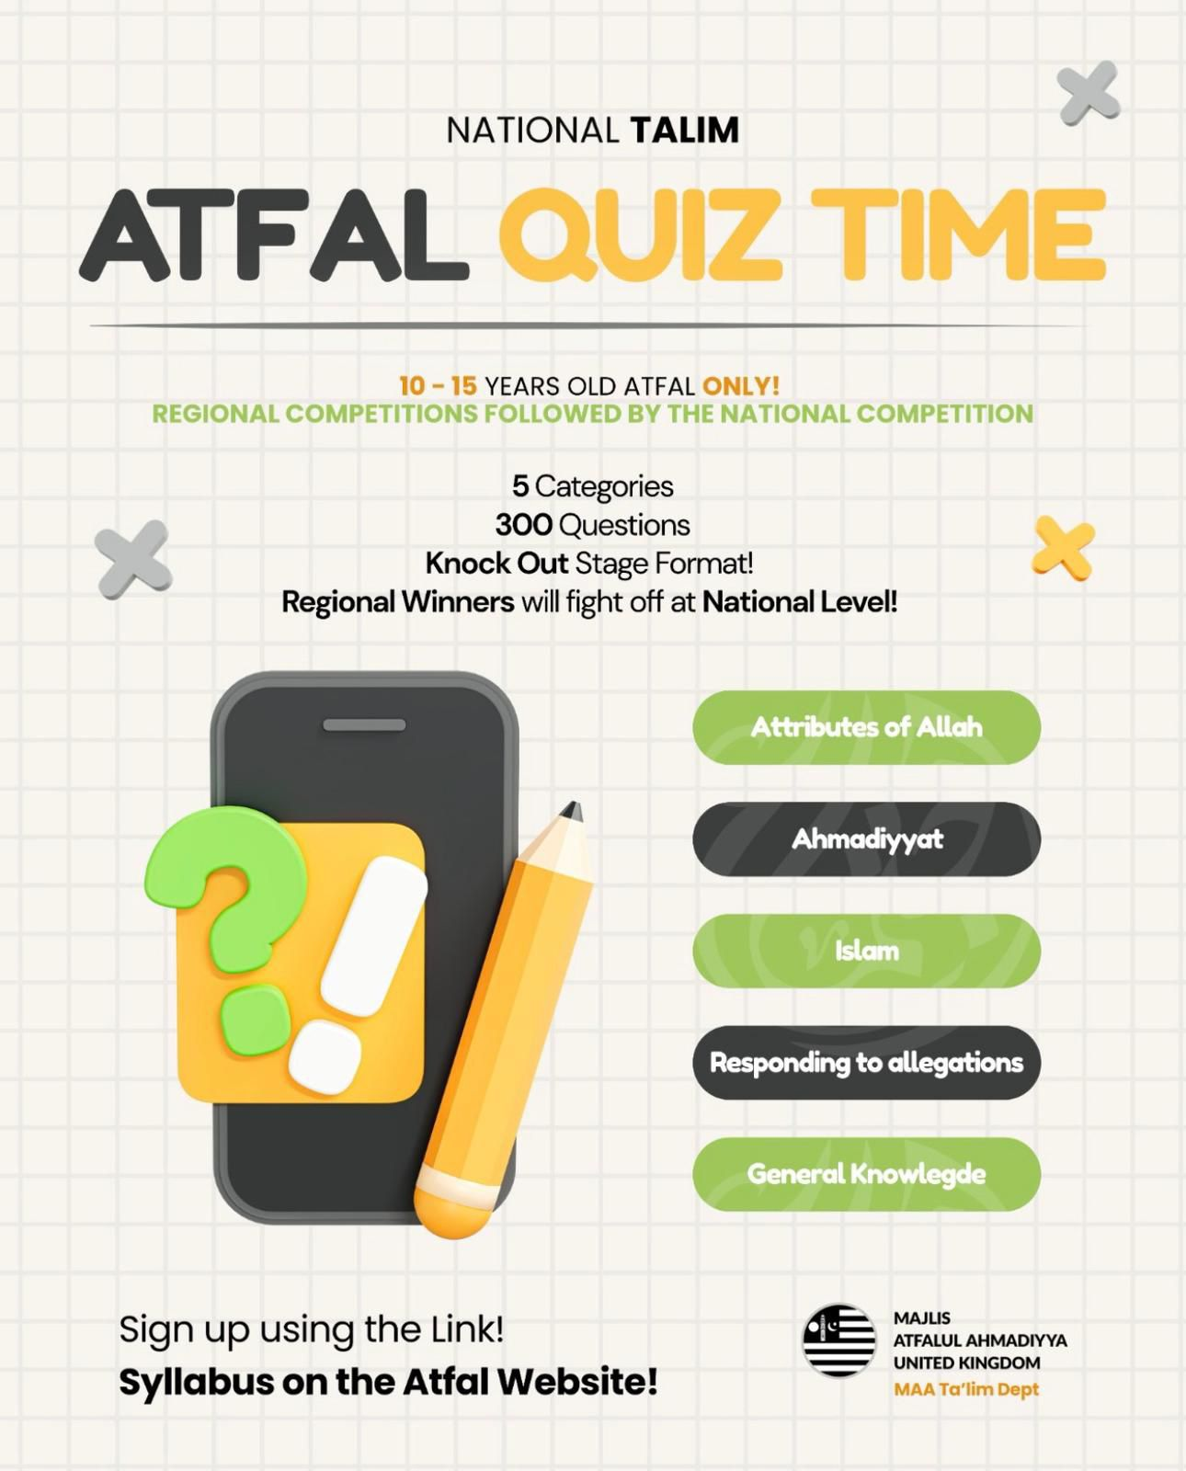
ANNOUNCEMENTS
National Atfal Quiz Time is out!
We are delighted to announce the National Atfal Talim Quiz, beginning at Regional levels soon!
🌟 Why take part?
Compete with fellow Atfal across 6 exciting topics!
Open to Atfal aged 10–15
🏆 Regional Winners through to the Final!
📌 Don’t miss your chance to showcase your knowledge and have fun along the way!
👉 For Sign up & Syllabus:
https://www.atfal.org.uk/atfal-quiz-time📖 Be sure to check out the Rules and Syllabus provided in the above link!
Let the challenge begin!

