Slide 1
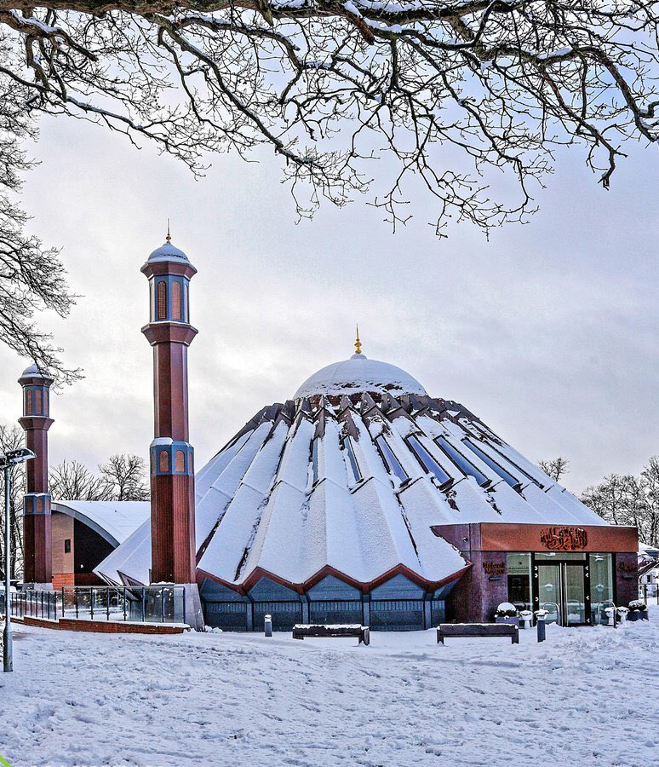


TALIM DEPARTMENT MAA UK
WEEKLY
ATFAL CLASS
(March – Week 5)
TALIM DEPARTMENT MAA UK
www.atfal.org.uk/talim
talim@atfal.co.uk

Slide 2

Class Rules
Arrive on time and be prepared
Always say “Assalamu Alaikum” when you enter the room
Pay attention and listen to the teacher quietly.
Raise your hand if you have a question.
Listen to others when they are speaking.
Work hard and try your best to learn something new.

Slide 3


Lesson Plan
1. Tilawat
2. Hadith
3. Thought of the Week
4. Homework Recap
5. Salat Recap
6. Friday Sermon
7. Learning Time
8. Announcements!
Are you prepared for today’s lesson?
Topi
Class Handout
Pen / Pencil

Slide 4

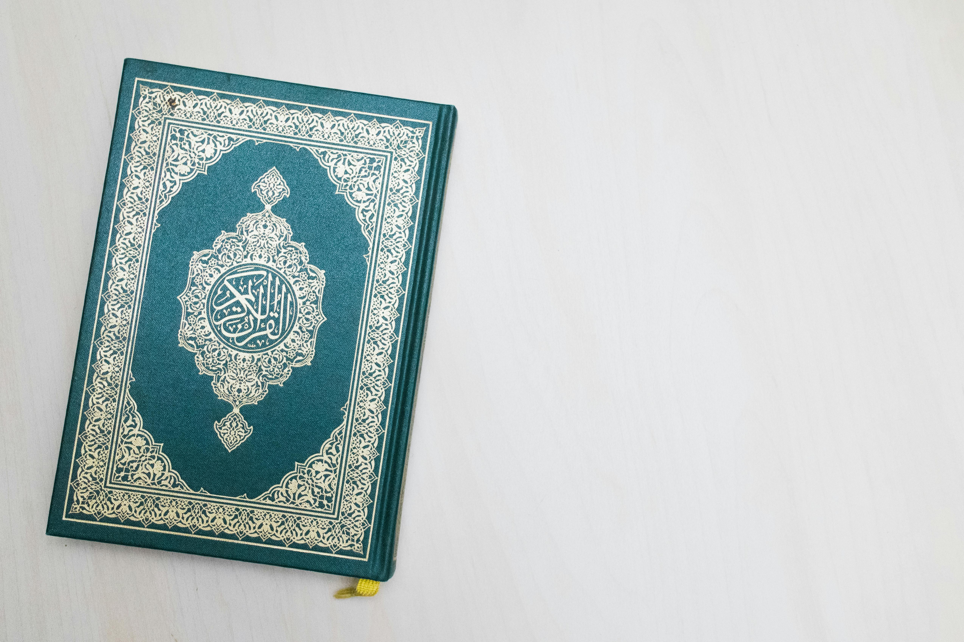

TILAWAT
وَاٰخَرِیۡنَ مِنۡہُمۡ لَمَّا یَلۡحَقُوۡا بِہِمۡ ؕ وَہُوَ الۡعَزِیۡزُ الۡحَکِیۡمُ
TRANSLATION
“And among others, from among them who have not yet joined them. He is the Mighty, the Wise.”
(The Holy Quran, Surah Al-Jumu’ah, 62:4)

Slide 5

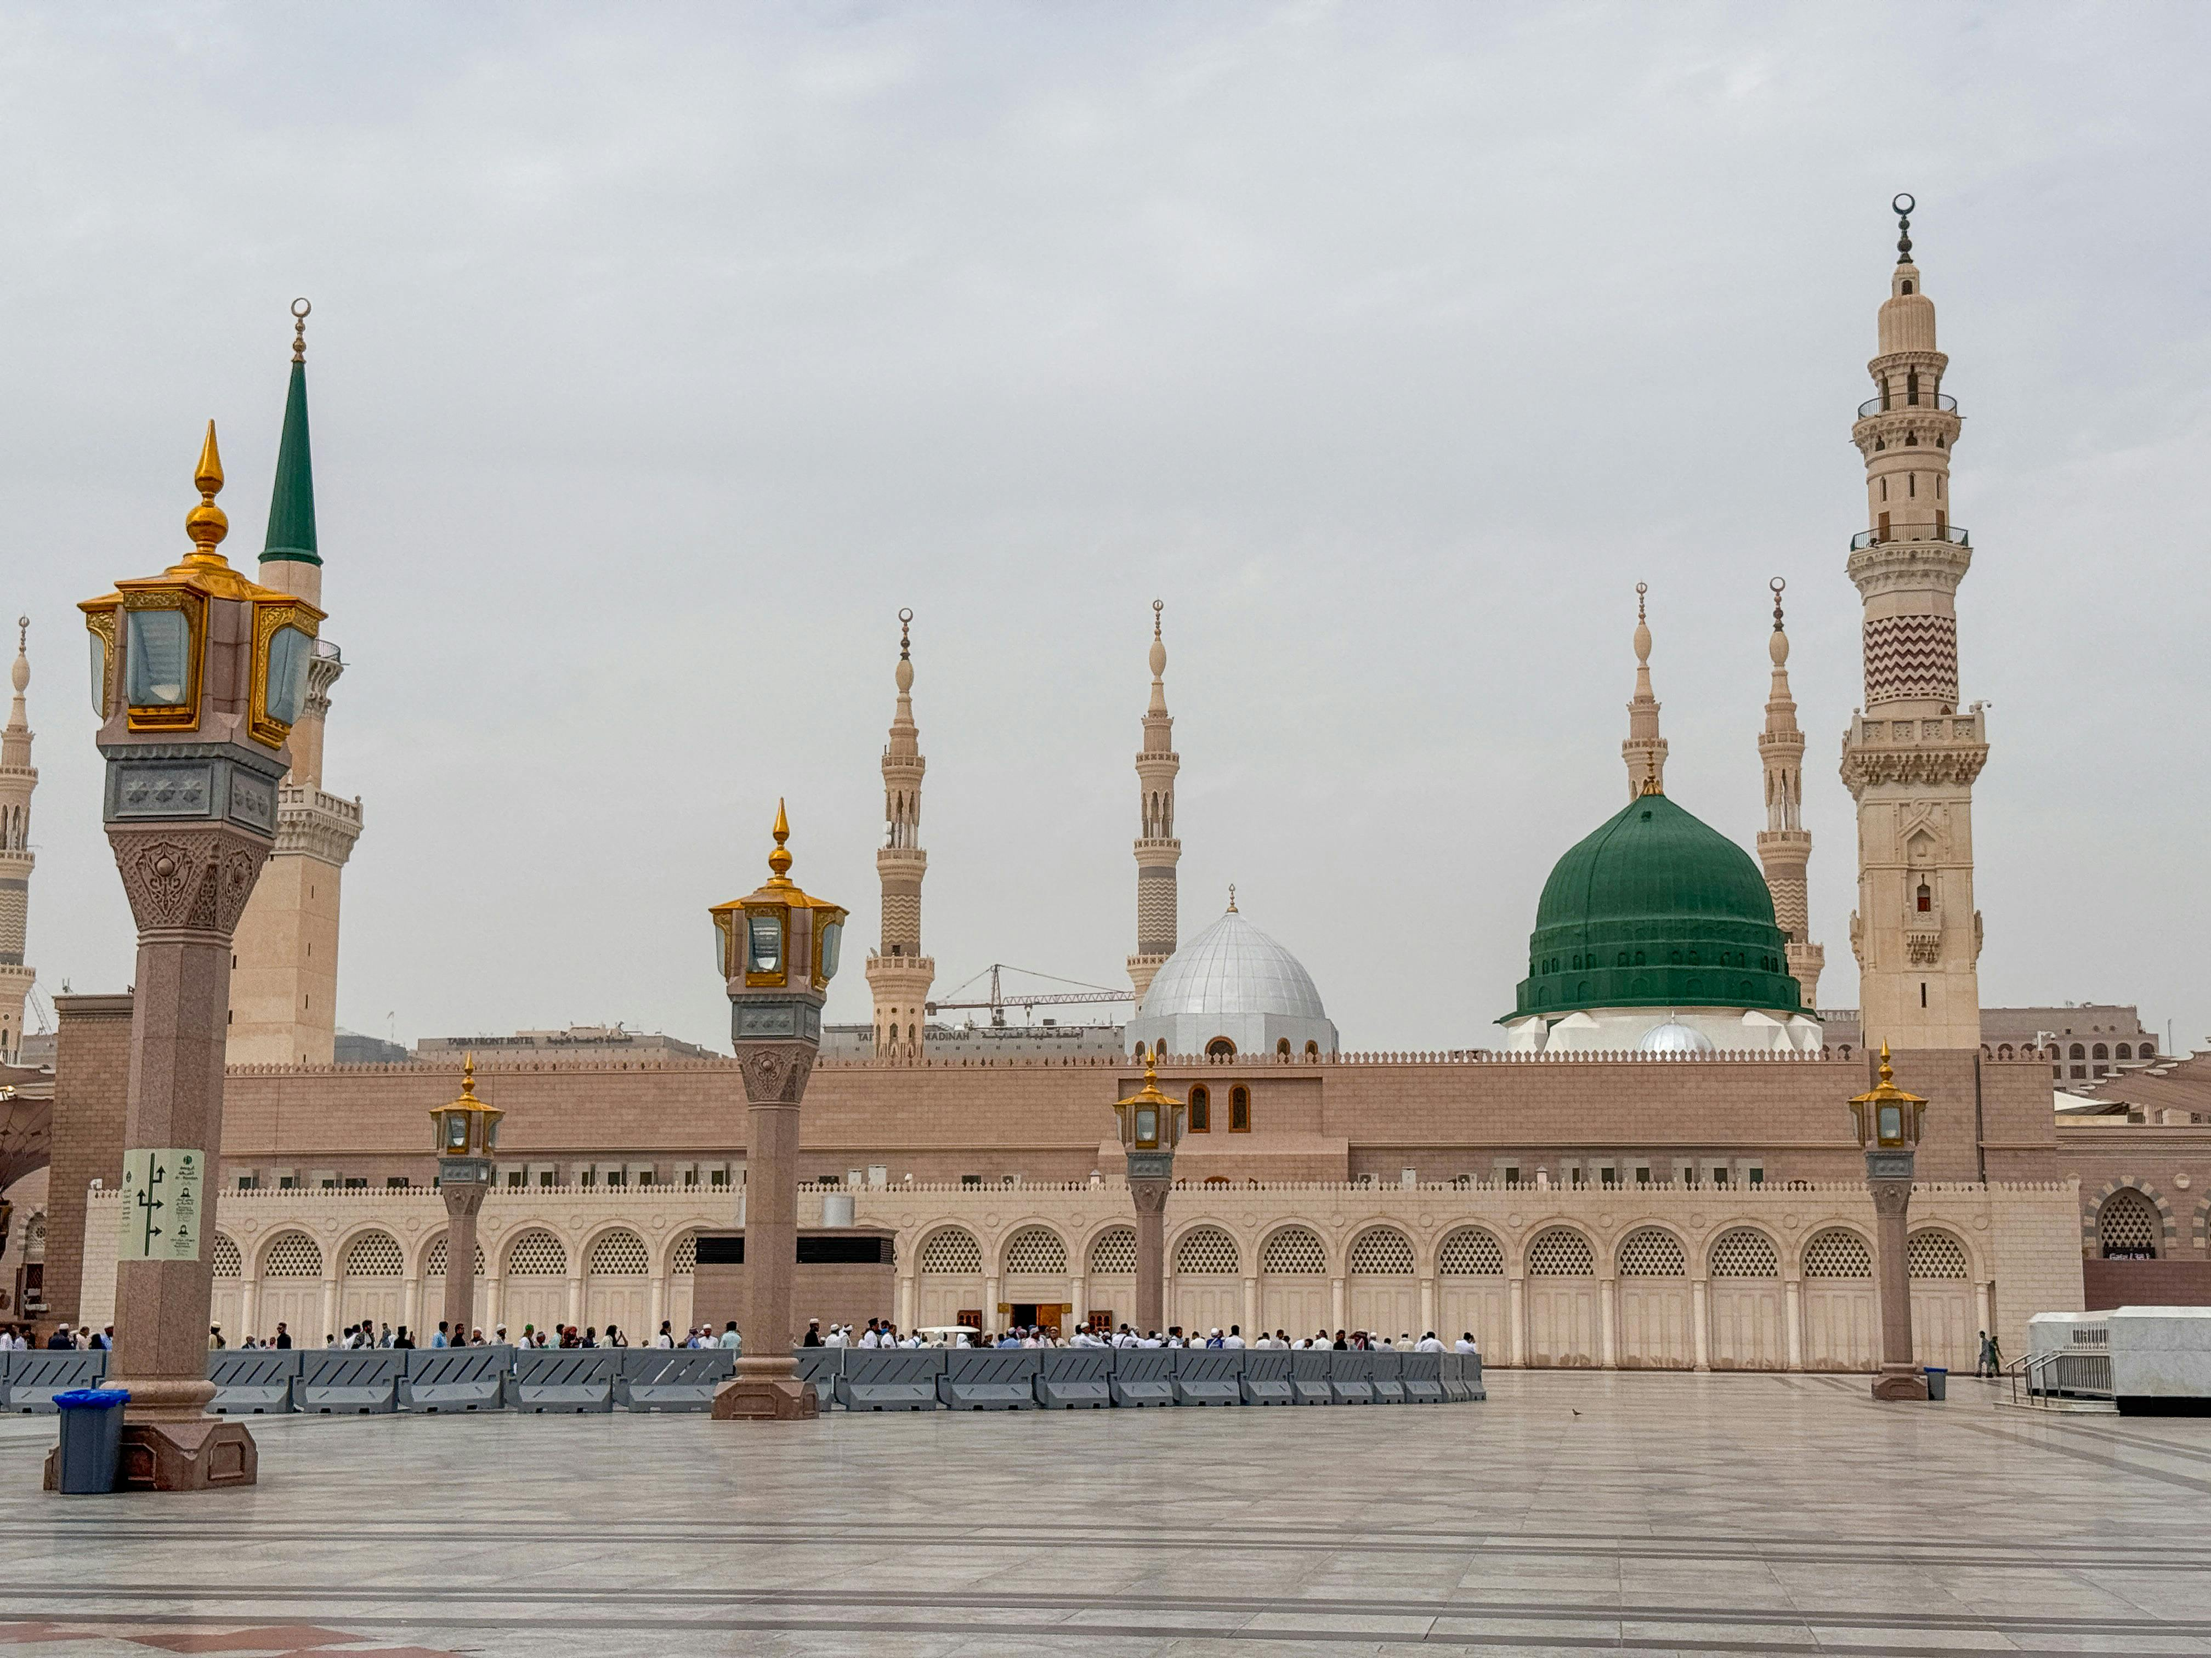
HADITH
(sayings of the Holy Prophet Muhammad^{sas})
"يُوۡشِكُ مَنْ عَاشَ مِنْكُمْ أَنْ يَلْقَى عِيسَى ابْنَ مَرْيَمَ إِمَامًا مَهْدِيًّا وَحَكَمًا عَدْلًا فَيَكْسِرُ الصَّلِيبَ وَيَقْتُلُ الْخِنْزِيرَ۔"
(Hadiqat-us-Saliheen, Hadith 957)
Notes:
After Tilawat, spend 5 mins catching up with Atfal. What they've been getting up to in the past week.
Hadith:
Whoever, reads the Hadith out, should do so in the proper manner. i.e. recite Durood Shareef first and then the Hadith.
Have a brief discussion about the meaning of this hadith in light of the questions on the screen.

Slide 6
HADITH
(sayings of the Holy Prophet Muhammad^{sas})
“Yushiku man aasha minkun an yalqa Esabnu Maryama, Imaman mahdiyan wa hakaman adlan fayaksiru Saleeba wa yaqtulul
khinzeera.”
(Hadiqat-us-Saliheen, Hadith 957)
Notes:
After Tilawat, spend 5 mins catching up with Atfal. What they've been getting up to in the past week.
Hadith:
Whoever, reads the Hadith out, should do so in the proper manner. i.e. recite Durood Shareef first and then the Hadith.
Have a brief discussion about the meaning of this hadith in light of the questions on the screen.

Slide 7
HADITH
(sayings of the Holy Prophet Muhammad^{sas})
“Whoever among you lives will (God willing) witness the time of Jesus, son of Mary. He will be the Imam Mahdi and a just ruler who will break the cross and kill the swine.”
(Hadiqat-us-Saliheen, Hadith 957)
Notes:
After Tilawat, spend 5 mins catching up with Atfal. What they've been getting up to in the past week.
Hadith:
Whoever, reads the Hadith out, should do so in the proper manner. i.e. recite Durood Shareef first and then the Hadith.
Have a brief discussion about the meaning of this hadith in light of the questions on the screen.

Slide 8



THOUGHT
OF THE WEEK
TOPIC:
The Promised Messiah^{as} Day
(Masih Maud^{as})

Slide 9
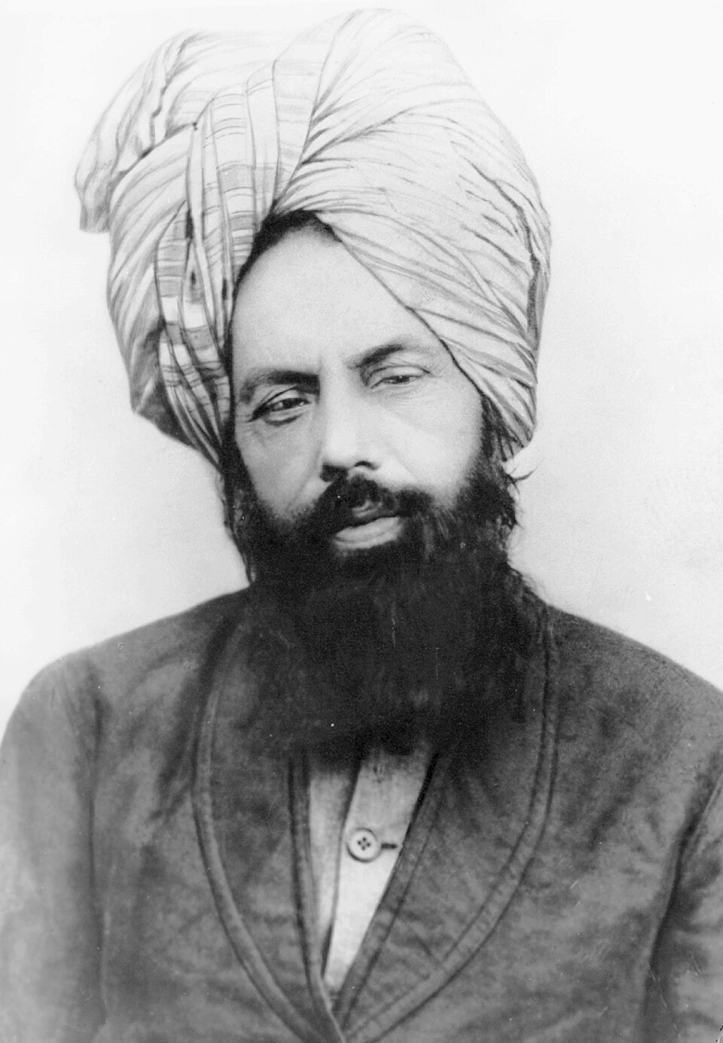
Jalsa Masih Maud^{as}
The Promised Messiah^{as} Day
The Promised Messiah (as) Day, also known as Masih Maud (as) day, is celebrated every year on March 23rd.
This day celebrates the establishment of the Ahmadiyya Jama’at by the Promised Messiah^{as} on 23rd March 1889.
Huzoor^{as} took Bai’at (Pledge of Allegiance) on this day.
40 Companions did Bai’at on this Day in Ludhiana at the house of Sufi Ahmad Jan^{ra} Sahib.

Slide 10





HOMEWORK
Have you done your homework for this week?
Make sure to note down your homework for next week!

Slide 11

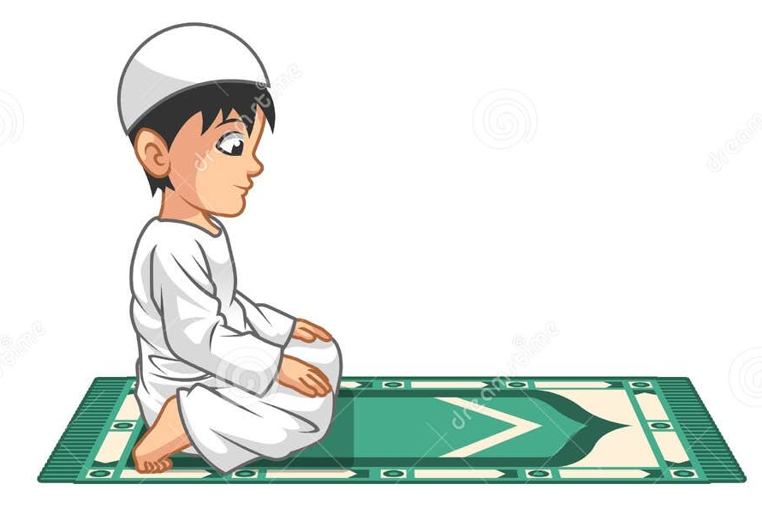
Concluding Prayers
رَبِّ اجۡعَلۡنِیۡ مُقِیۡمَ الصَّلٰوۃِ وَ مِنۡ ذُرِیَّتِیۡ
SALAT
Rabbijalni muqimusalati wa min zuriyyati
Lets Recap a part of our Salat!
Translation:
‘O my Lord enable me and my children to observe prayer.’
NEXT WEEK RECAP:
Tashahhud
الصَّلٰوۃِ | مُقِیۡمَ | اجۡعَلۡنِیۡ | رَبِّ
Prayer | Observer | Enable/ make me | O my Lord

Slide 12
Concluding Prayers
رَبِّ اجۡعَلۡنِیۡ مُقِیۡمَ الصَّلٰوۃِ وَ مِنۡ ذُرِیَّتِیۡ
SALAT
Rabbijalni muqimusalati wa min zuriyyati
Lets Recap a part of our Salat!
Translation:
‘O my Lord enable me and my children to observe prayer.’
NEXT WEEK RECAP:
Tashahhud
ذُرِیَّتِیۡ | مِنۡ | وَ
My children | from | and

Slide 13

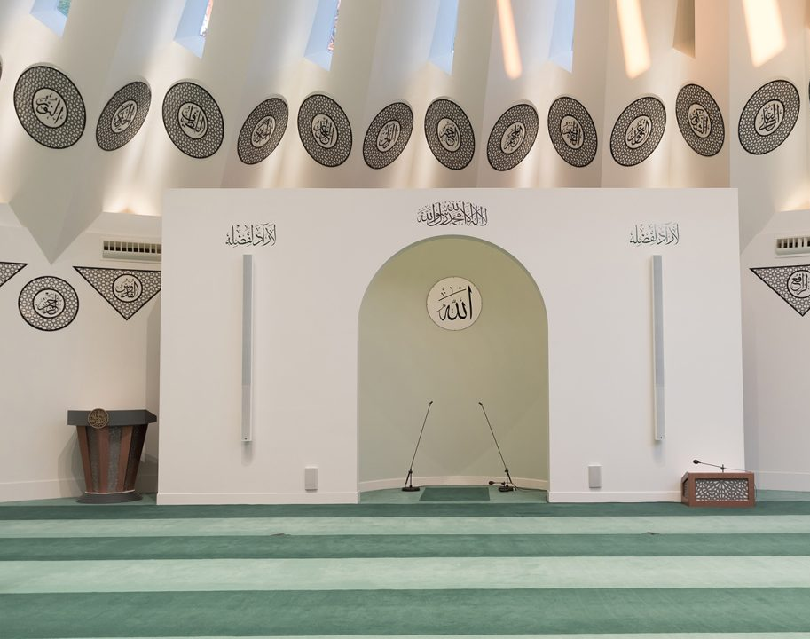
FRIDAY
SERMON
Friday 27th March
2026

Slide 14

FRIDAY SERMON
The Holy Prophet Muhammad (Saw) Protective Zeal For Tauheed
Huzoor-e-Aqdas (aba) spoke regarding the Holy Prophet Muhammad (saw) firmness against associating partners with God.
The Holy Prophet (sa) had instructed that all things besides Allah which had become the object of worship should be destroyed.

Slide 15
FRIDAY SERMON
The Holy Prophet Muhammad (Saw) Protective Zeal For Tauheed
Once, the Holy Prophet(sa) heard Hazrat Umar(ra) swearing by his father, to which the Holy Prophet(sa) said that God had forbidden swearing by one’s forefathers. If one is to swear by anything, then they should swear by God; otherwise, they should remain silent.

Slide 16

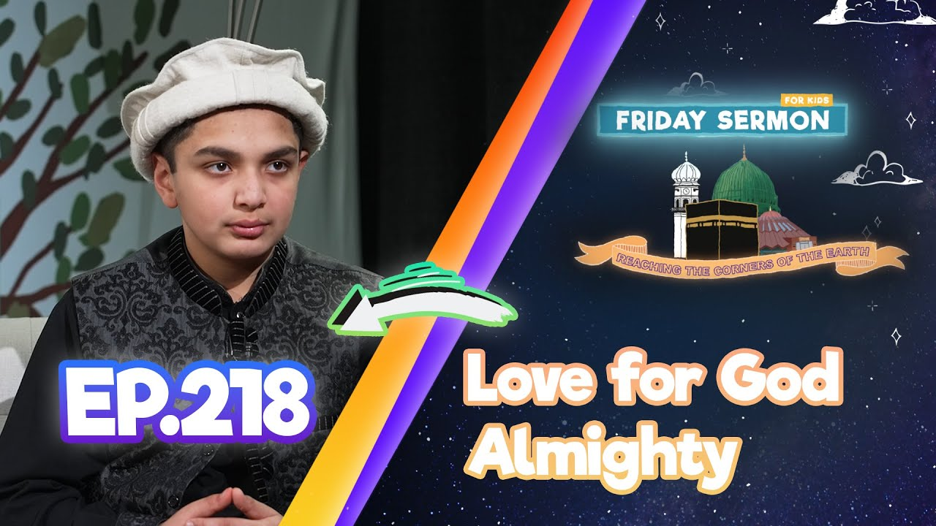
FRIDAY SERMON
The Prophet (sa) as the Guardian and Teacher of Tauheed
The Holy Prophet(sa) said that the thing he feared most for his people was the Subtle Shirk.
As Ahmadis, we can only do justice to our pledge of allegiance to the Promised Messiah(as) when we truly and firmly uphold the unity of God.
Even the last message of the Holy Prophet(sa) to his people before his demise was not to make him an object of worship and associating partners with God
Watch this weeks Friday Sermon 4 Kids!

Slide 17
FRIDAY SERMON
The Prophet (sa) as the Guardian and Teacher of Tauheed
The Holy Prophet(sa) said that the thing he feared most for his people was the Subtle Shirk.
As Ahmadis, we can only do justice to our pledge of allegiance to the Promised Messiah(as) when we truly and firmly uphold the unity of God.
Even the last message of the Holy Prophet(sa) to his people before his demise was not to make him an object of worship and associating partners with God
Watch this weeks Friday Sermon 4 Kids!

Slide 18

FRIDAY SERMON
TAKEAWAY AND TASK FOR THIS WEEK
Help maintain the Oneness of God within yourself and your families.
Ponder over the meanings of Surah Al Ikhlas.

Slide 19
THE QUIZ!!!
RECAP OF LAST FEW WEEKS!
ARE YOU READY???

Slide 20
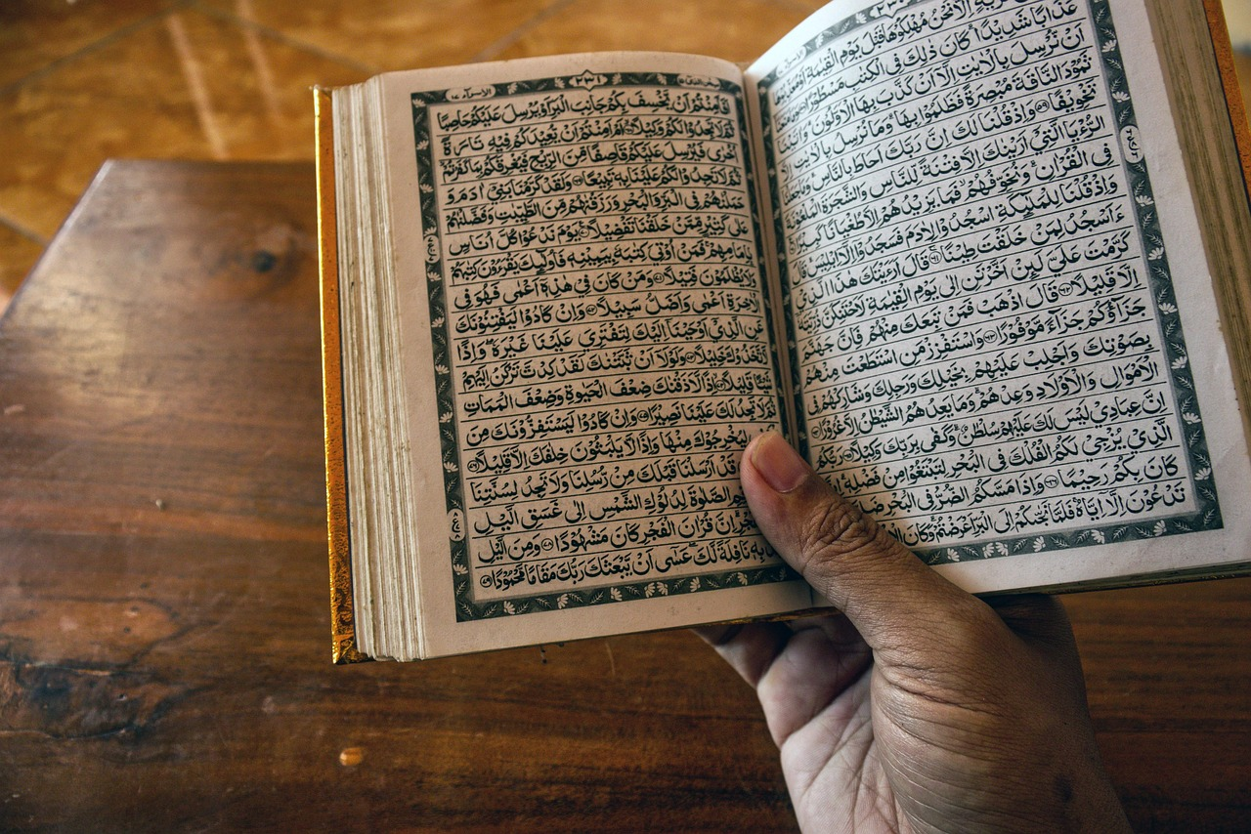

THE QUIZ!!!
TESTING YOUR KNOWLEDGE ON THE TOPICS COVERED IN THE PAST MONTH
Q1: IN WHICH MONTH DID THE RVELATION OF THE HOLY QURAN BEGIN?
Muharram
Sha’ban
Ramadan
Jamadi-ul-Awwal
Click the icon to reveal the answer

Slide 21
THE QUIZ!!!
TESTING YOUR KNOWLEDGE ON THE TOPICS COVERED IN THE PAST MONTH
Q1: IN WHICH MONTH DID THE RVELATION OF THE HOLY QURAN BEGIN?
Muharram
Sha’ban
Ramadan
Jamadi-ul-Awwal

Slide 22
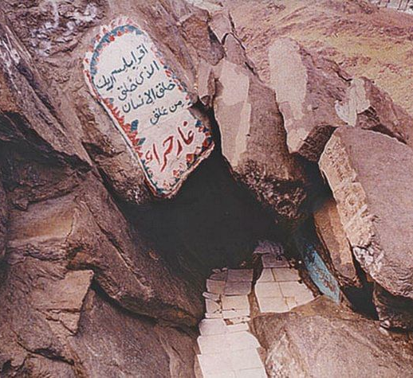
THE QUIZ!!!
TESTING YOUR KNOWLEDGE ON THE TOPICS COVERED IN THE PAST MONTH
Q2: WHAT IS THE NAME OF THE ANGEL THAT CAME TO THE HOLY PROPHET MUHAMMAD (SAW) TO REVEAL THE HOLY QU’RAN?
Angel Jibrael (as)
Angel Israfil (as)
Angel Mika’il (as)
Angel Israil (as)

Slide 23
THE QUIZ!!!
TESTING YOUR KNOWLEDGE ON THE TOPICS COVERED IN THE PAST MONTH
Q2: WHAT IS THE NAME OF THE ANGEL THAT CAME TO THE HOLY PROPHET MUHAMMAD (SAW) TO REVEAL THE HOLY QU’RAN?
Angel Jibrael (as)
Angel Israfil (as)
Angel Mika’il (as)
Angel Israil (as)

Slide 24
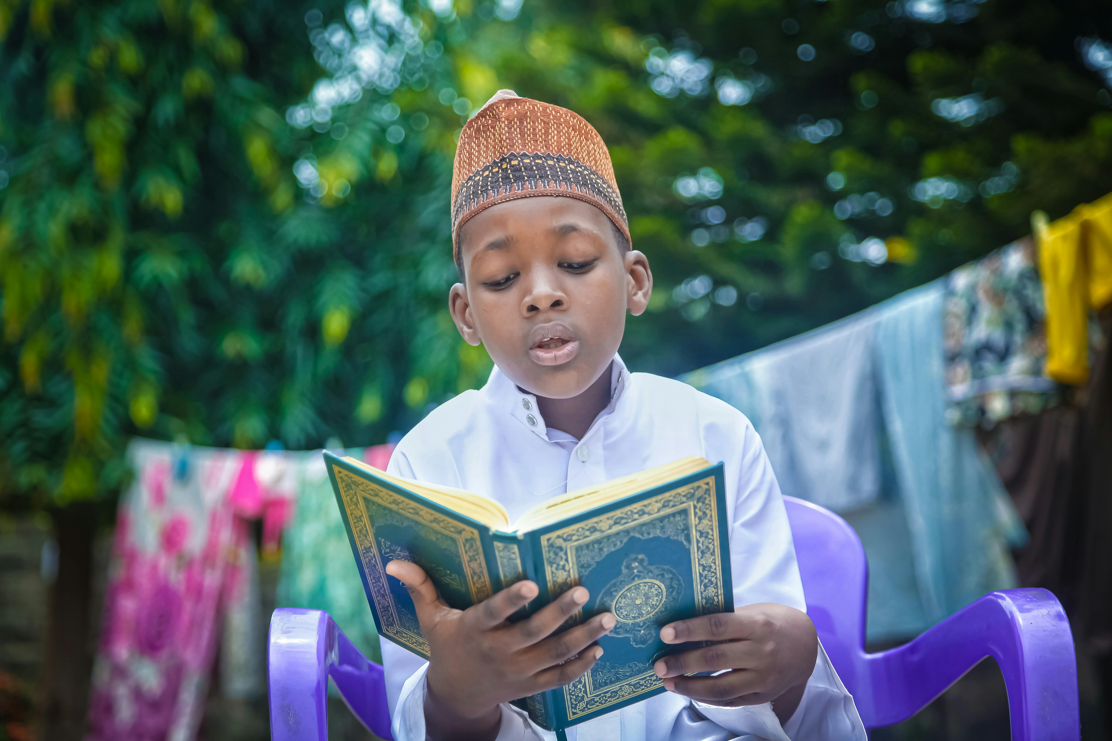
THE QUIZ!!!
TESTING YOUR KNOWLEDGE ON THE TOPICS COVERED IN THE PAST MONTH
Q3: WHAT DO MUSLIMS AIM TO DO IN THE MONTH OF RAMADAN?
Try finishing 1 part of the Holy Qu’ran
Try finishing 10 parts of the Holy Qu’ran
Try finishing 15 parts of the Holy Qu’ran
Try finishing the complete Holy Qu’ran

Slide 25
THE QUIZ!!!
TESTING YOUR KNOWLEDGE ON THE TOPICS COVERED IN THE PAST MONTH
Q3: WHAT DO MUSLIMS AIM TO DO IN THE MONTH OF RAMADAN?
Try finishing 1 part of the Holy Qu’ran
Try finishing 10 parts of the Holy Qu’ran
Try finishing 15 parts of the Holy Qu’ran
Try finishing the complete Holy Qu’ran

Slide 26
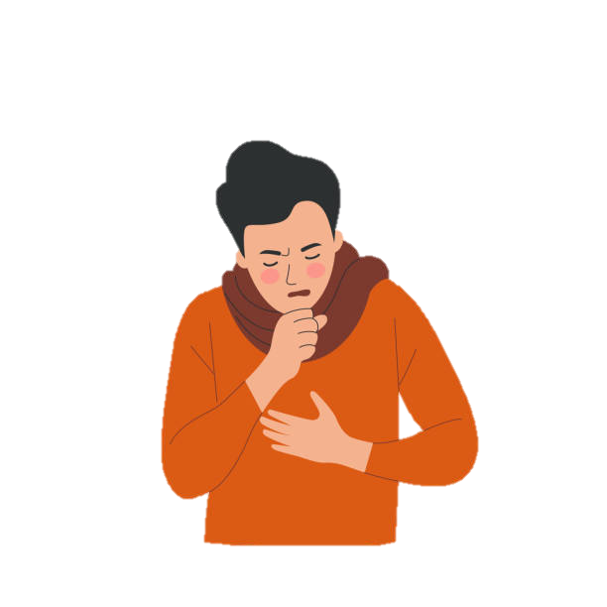
THE QUIZ!!!
TESTING YOUR KNOWLEDGE ON THE TOPICS COVERED IN THE PAST MONTH
Q4: WHAT DOES THE HOLY QU’RAN SAY REGARDING THOSE THAT ARE ILL OR ON A JOURNEY REGARDING FASTING?
They should still fast
They should only fast for half of the day
They should not fast
If they feel better or finish their journey, they should immediately start fasting

Slide 27
THE QUIZ!!!
TESTING YOUR KNOWLEDGE ON THE TOPICS COVERED IN THE PAST MONTH
Q4: WHAT DOES THE HOLY QU’RAN SAY REGARDING THOSE THAT ARE ILL OR ON A JOURNEY REGARDING FASTING?
They should still fast
They should only fast for half of the day
They should not fast
If they feel better or finish their journey, they should immediately start fasting

Slide 28
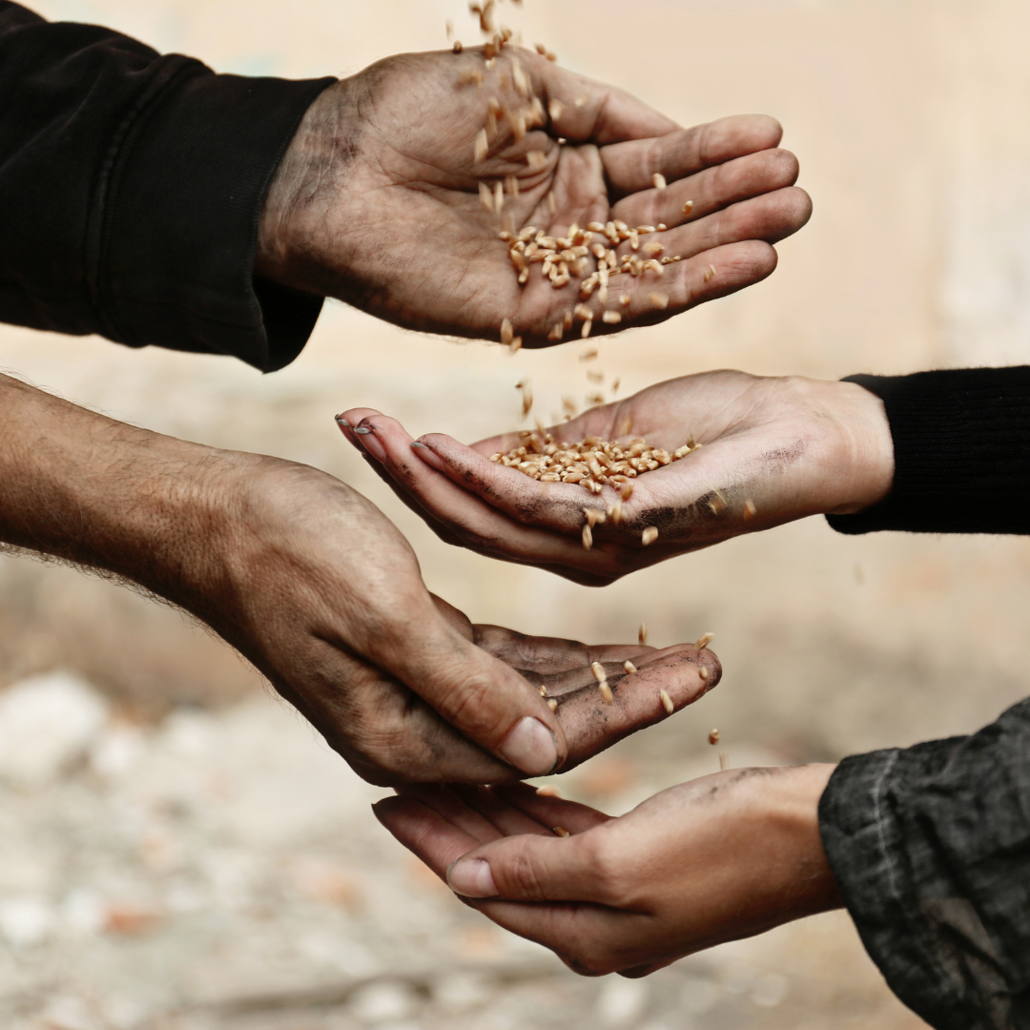
THE QUIZ!!!
TESTING YOUR KNOWLEDGE ON THE TOPICS COVERED IN THE PAST MONTH
Q5: THOSE THAT CANNOT FAST OR MISS THEIR FASTS, WHAT DO THEY PAY?
Wasiyyat
Fidya
Fitrana
Eid Fund

Slide 29
THE QUIZ!!!
TESTING YOUR KNOWLEDGE ON THE TOPICS COVERED IN THE PAST MONTH
Q5: THOSE THAT CANNOT FAST OR MISS THEIR FASTS, WHAT DO THEY PAY?
Wasiyyat
Fidya
Fitrana
Eid Fund

Slide 30

THE QUIZ!!!
TESTING YOUR KNOWLEDGE ON THE TOPICS COVERED IN THE PAST MONTH
Q6: LENT FASTS ARE KEPT BEFORE WHAT CELEBRATION?
Christmas
Eid
Diwali
Easter

Slide 31
THE QUIZ!!!
TESTING YOUR KNOWLEDGE ON THE TOPICS COVERED IN THE PAST MONTH
Q6: LENT FASTS ARE KEPT BEFORE WHAT CELEBRATION?
Christmas
Eid
Diwali
Easter

Slide 32
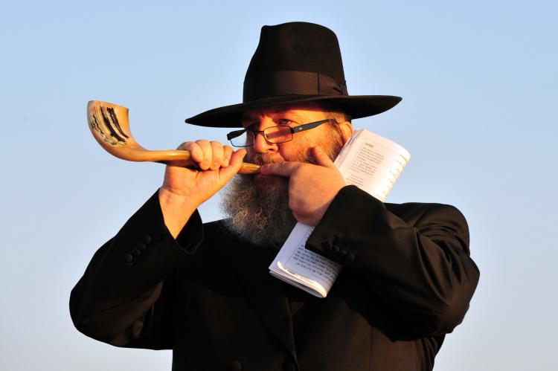
THE QUIZ!!!
TESTING YOUR KNOWLEDGE ON THE TOPICS COVERED IN THE PAST MONTH
Q7: WHICH RELIGIOUS GROUP KEEPS A FAST ON “YOM KIPPUR DAY?”
Jews
Christians
Muslims
Buddhists

Slide 33
THE QUIZ!!!
TESTING YOUR KNOWLEDGE ON THE TOPICS COVERED IN THE PAST MONTH
Q7: WHICH RELIGIOUS GROUP KEEPS A FAST ON “YOM KIPPUR DAY?”
Jews
Christians
Muslims
Buddhists

Slide 34
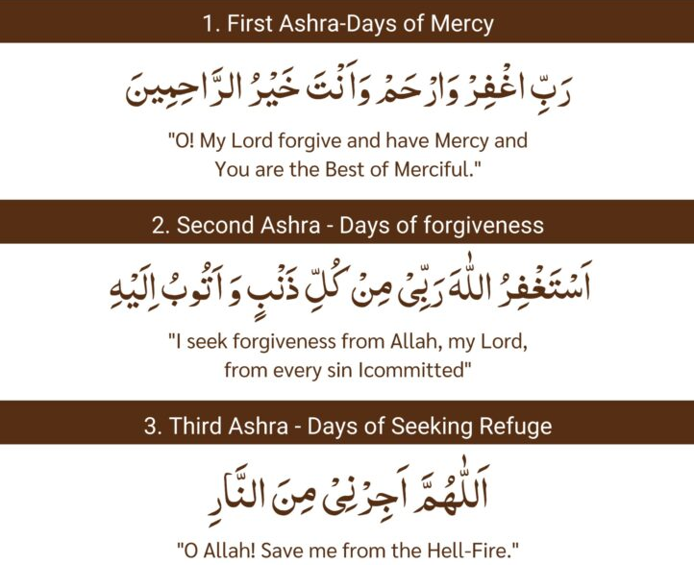
THE QUIZ!!!
TESTING YOUR KNOWLEDGE ON THE TOPICS COVERED IN THE PAST MONTH
Q8: WHAT DOES AN ASHRA MEAN?
1 days
2 days
5 days
10 days

Slide 35
THE QUIZ!!!
TESTING YOUR KNOWLEDGE ON THE TOPICS COVERED IN THE PAST MONTH
Q8: WHAT DOES AN ASHRA MEAN?
1 days
2 days
5 days
10 days

Slide 36
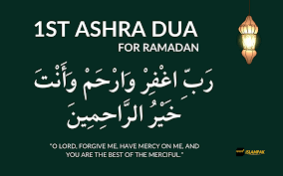
THE QUIZ!!!
TESTING YOUR KNOWLEDGE ON THE TOPICS COVERED IN THE PAST MONTH
Q9: WHAT IS THE NAME OF THE FIRST ASHRA OF RAMADAN?
Forgiveness
Mercy
Salvation from Hell
Trust

Slide 37
THE QUIZ!!!
TESTING YOUR KNOWLEDGE ON THE TOPICS COVERED IN THE PAST MONTH
Q9: WHAT IS THE NAME OF THE FIRST ASHRA OF RAMADAN?
Forgiveness
Mercy
Salvation from Hell
Trust

Slide 38
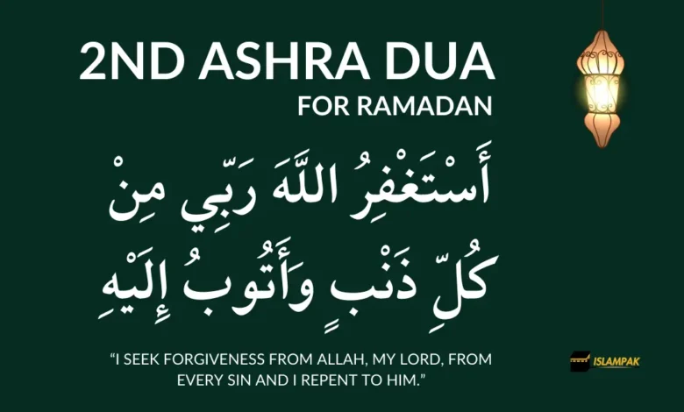
THE QUIZ!!!
TESTING YOUR KNOWLEDGE ON THE TOPICS COVERED IN THE PAST MONTH
Q10: WHAT IS THE NAME OF THE SECOND ASHRA OF RAMADAN?
Forgiveness
Mercy
Salvation from Hell
Trust

Slide 39
THE QUIZ!!!
TESTING YOUR KNOWLEDGE ON THE TOPICS COVERED IN THE PAST MONTH
Q10: WHAT IS THE NAME OF THE SECOND ASHRA OF RAMADAN?
Forgiveness
Mercy
Salvation from Hell
Trust

Slide 40
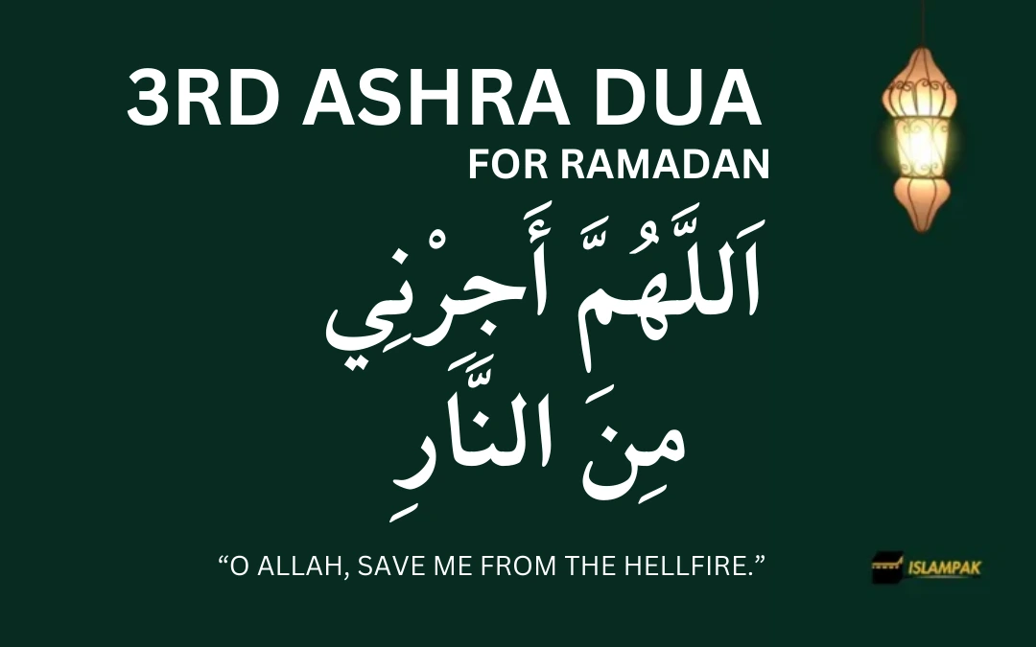
THE QUIZ!!!
TESTING YOUR KNOWLEDGE ON THE TOPICS COVERED IN THE PAST MONTH
Q11: WHAT IS THE NAME OF THE THIRD ASHRA OF RAMADAN?
Forgiveness
Mercy
Salvation from Hell
Trust

Slide 41
THE QUIZ!!!
TESTING YOUR KNOWLEDGE ON THE TOPICS COVERED IN THE PAST MONTH
Q11: WHAT IS THE NAME OF THE THIRD ASHRA OF RAMADAN?
Forgiveness
Mercy
Salvation from Hell
Trust

Slide 42

THE QUIZ!!!
TESTING YOUR KNOWLEDGE ON THE TOPICS COVERED IN THE PAST MONTH
Q12: WHAT DOES THE WORD “SALVATION” MEAN?
Great sadness
Being saved from harm or sin
A type of prayer
A place of worship

Slide 43
THE QUIZ!!!
TESTING YOUR KNOWLEDGE ON THE TOPICS COVERED IN THE PAST MONTH
Q12: WHAT DOES THE WORD “SALVATION” MEAN?
Great sadness
Being saved from harm or sin
A type of prayer
A place of worship

Slide 44
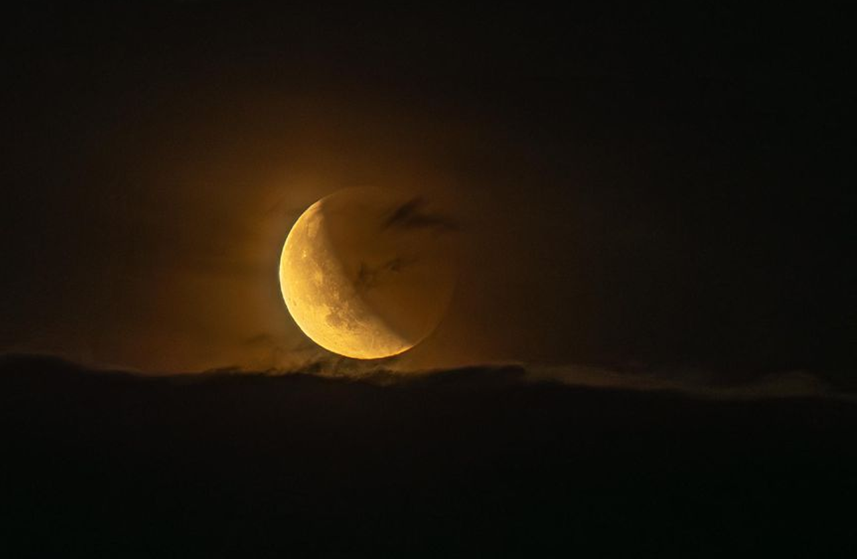
THE QUIZ!!!
TESTING YOUR KNOWLEDGE ON THE TOPICS COVERED IN THE PAST MONTH
Q13: THE NIGHT OF DESTINY IS BETTER THAN…?
1 month
12 months
100 months
1,000 months

Slide 45
THE QUIZ!!!
TESTING YOUR KNOWLEDGE ON THE TOPICS COVERED IN THE PAST MONTH
Q13: THE NIGHT OF DESTINY IS BETTER THAN…?
1 month
12 months
100 months
1,000 months

Slide 46
THE QUIZ!!!
TESTING YOUR KNOWLEDGE ON THE TOPICS COVERED IN THE PAST MONTH
Q14: WHAT HAS THE HOLY PROPHET MUHAMMAD (SAW) REGARDING FINDING THE NIGHT OF DESTINY?
Find it throughout the whole Ramadan
Find in throughout the first half of Ramadan
Find it in the odd nights
Find it in the odd nights of the last 10 days of Ramadan

Slide 47
THE QUIZ!!!
TESTING YOUR KNOWLEDGE ON THE TOPICS COVERED IN THE PAST MONTH
Q14: WHAT HAS THE HOLY PROPHET MUHAMMAD (SAW) REGARDING FINDING THE NIGHT OF DESTINY?
Find it throughout the whole Ramadan
Find in throughout the first half of Ramadan
Find it in the odd nights
Find it in the odd nights of the last 10 days of Ramadan

Slide 48
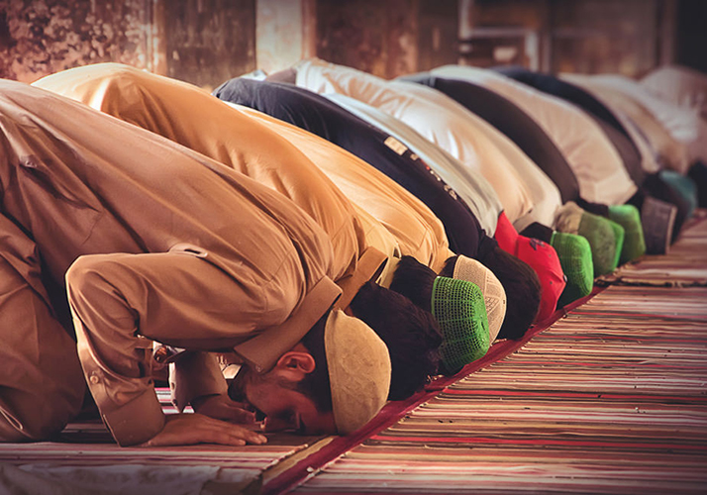
THE QUIZ!!!
TESTING YOUR KNOWLEDGE ON THE TOPICS COVERED IN THE PAST MONTH
Q15: HOW DO YOU FIND LAILAT-UL-QADR?
By fasting
By praying Tuhujjad
By taking part in Jama’at Events
By praying Tarawih

Slide 49
THE QUIZ!!!
TESTING YOUR KNOWLEDGE ON THE TOPICS COVERED IN THE PAST MONTH
Q15: HOW DO YOU FIND LAILAT-UL-QADR?
By fasting
By praying Tuhujjad
By taking part in Jama’at Events
By praying Tarawih

Slide 50
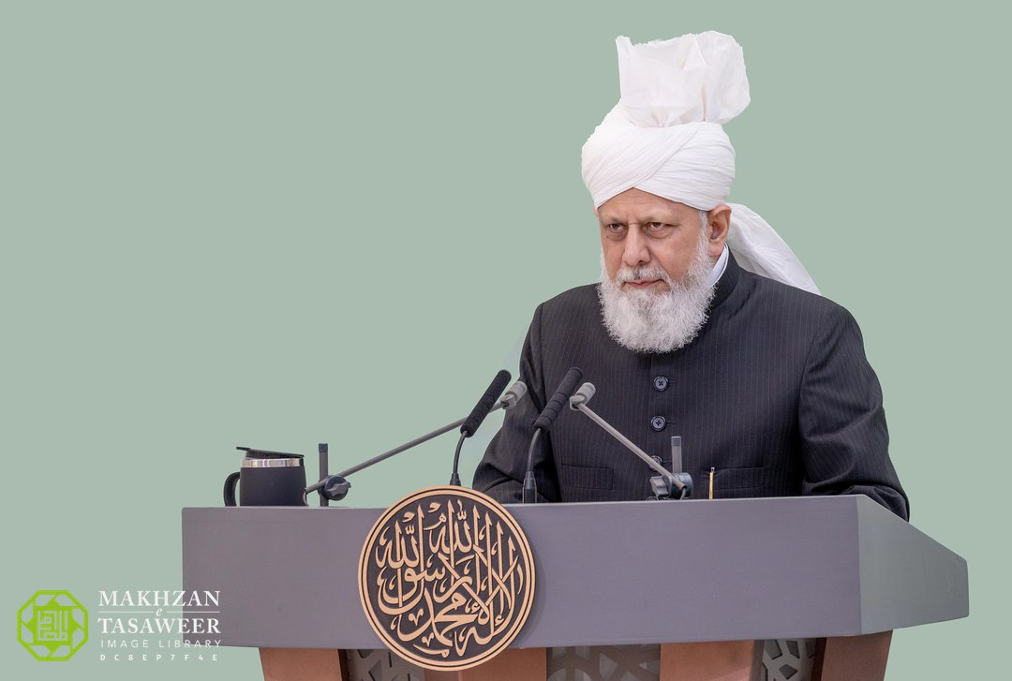
THE QUIZ!!!
TESTING YOUR KNOWLEDGE ON THE TOPICS COVERED IN THE PAST MONTH
Q16: ON EID, WHEN IS THE EID KHUTBA DELIVERED?
Before Eid Namaz
After Eid Namaz

Slide 51
THE QUIZ!!!
TESTING YOUR KNOWLEDGE ON THE TOPICS COVERED IN THE PAST MONTH
Q16: ON EID, WHEN IS THE EID KHUTBA DELIVERED?
Before Eid Namaz
After Eid Namaz

Slide 52
THE QUIZ!!!
TESTING YOUR KNOWLEDGE ON THE TOPICS COVERED IN THE PAST MONTH
Q17: WHEN IS EID-UL-FITR CELEBRATED?
In the month of Shawwal
In the month of Ramadan
In the month of Muharram
In the month of Dhul Hijjah

Slide 53
THE QUIZ!!!
TESTING YOUR KNOWLEDGE ON THE TOPICS COVERED IN THE PAST MONTH
Q17: WHEN IS EID-UL-FITR CELEBRATED?
In the month of Shawwal
In the month of Ramadan
In the month of Muharram
In the month of Dhul Hijjah

Slide 54
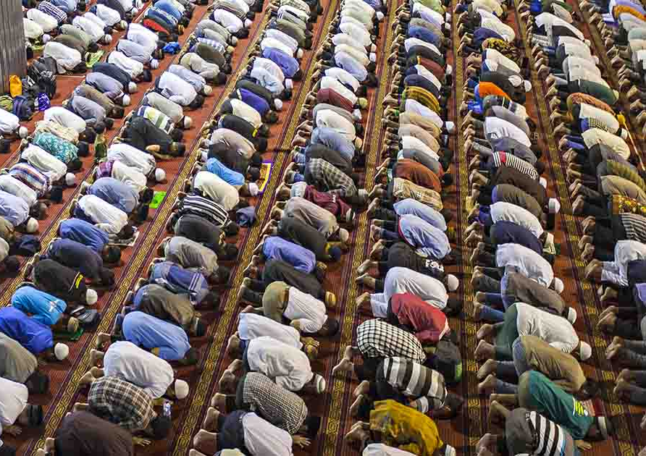
THE QUIZ!!!
TESTING YOUR KNOWLEDGE ON THE TOPICS COVERED IN THE PAST MONTH
Q18: HOW MANY RAKAT ARE OFFERED FOR THE EID NAMAZ?
1 Rakat
2 Rakat
3 Rakat
4 Rakat

Slide 55
THE QUIZ!!!
TESTING YOUR KNOWLEDGE ON THE TOPICS COVERED IN THE PAST MONTH
Q18: HOW MANY RAKAT ARE OFFERED FOR THE EID NAMAZ?
1 Rakat
2 Rakat
3 Rakat
4 Rakat

Slide 56
THE QUIZ!!!
TESTING YOUR KNOWLEDGE ON THE TOPICS COVERED IN THE PAST MONTH
Q19: HOW MANY TAKBEERAT ARE OFFERED FOR THE FIRST RAKA’AT?
1 Takbir
3 Takbeerat
5 Takbeerat
7 Tabkeerat

Slide 57
THE QUIZ!!!
TESTING YOUR KNOWLEDGE ON THE TOPICS COVERED IN THE PAST MONTH
Q19: HOW MANY TAKBEERAT ARE OFFERED FOR THE FIRST RAKA’AT?
1 Takbir
3 Takbeerat
5 Takbeerat
7 Tabkeerat

Slide 58
THE QUIZ!!!
TESTING YOUR KNOWLEDGE ON THE TOPICS COVERED IN THE PAST MONTH
Q20: HOW MANY TAKBEERAT ARE OFFERED FOR THE SECOND RAKA’AT?
1 Takbir
3 Takbeerat
5 Takbeerat
7 Tabkeerat

Slide 59
THE QUIZ!!!
TESTING YOUR KNOWLEDGE ON THE TOPICS COVERED IN THE PAST MONTH
Q20: HOW MANY TAKBEERAT ARE OFFERED FOR THE SECOND RAKA’AT?
1 Takbir
3 Takbeerat
5 Takbeerat
7 Tabkeerat

Slide 60
THE QUIZ!!!
TESTING YOUR KNOWLEDGE ON THE TOPICS COVERED IN THE PAST MONTH
Q21: WHAT IS THE SECOND NAME FOR FITRANA?
Zakat-ul-Maal
Sadaqat-ul-Fitr
Kaffarah
Fidya

Slide 61
THE QUIZ!!!
TESTING YOUR KNOWLEDGE ON THE TOPICS COVERED IN THE PAST MONTH
Q21: WHAT IS THE SECOND NAME FOR FITRANA?
Zakat-ul-Maal
Sadaqat-ul-Fitr
Kaffarah
Fidya

Slide 62
THE QUIZ!!!
TESTING YOUR KNOWLEDGE ON THE TOPICS COVERED IN THE PAST MONTH
Q22: WHAT IS FITRANA?
£5 which is obligatory for only working members.
£5 which is recommended for everyone
£10 which is obligatory for earning members
£5 which is obligatory for everyone

Slide 63
THE QUIZ!!!
TESTING YOUR KNOWLEDGE ON THE TOPICS COVERED IN THE PAST MONTH
Q22: WHAT IS FITRANA?
£5 which is obligatory for only working members.
£5 which is recommended for everyone
£10 which is obligatory for earning members
£5 which is obligatory for everyone

Slide 64
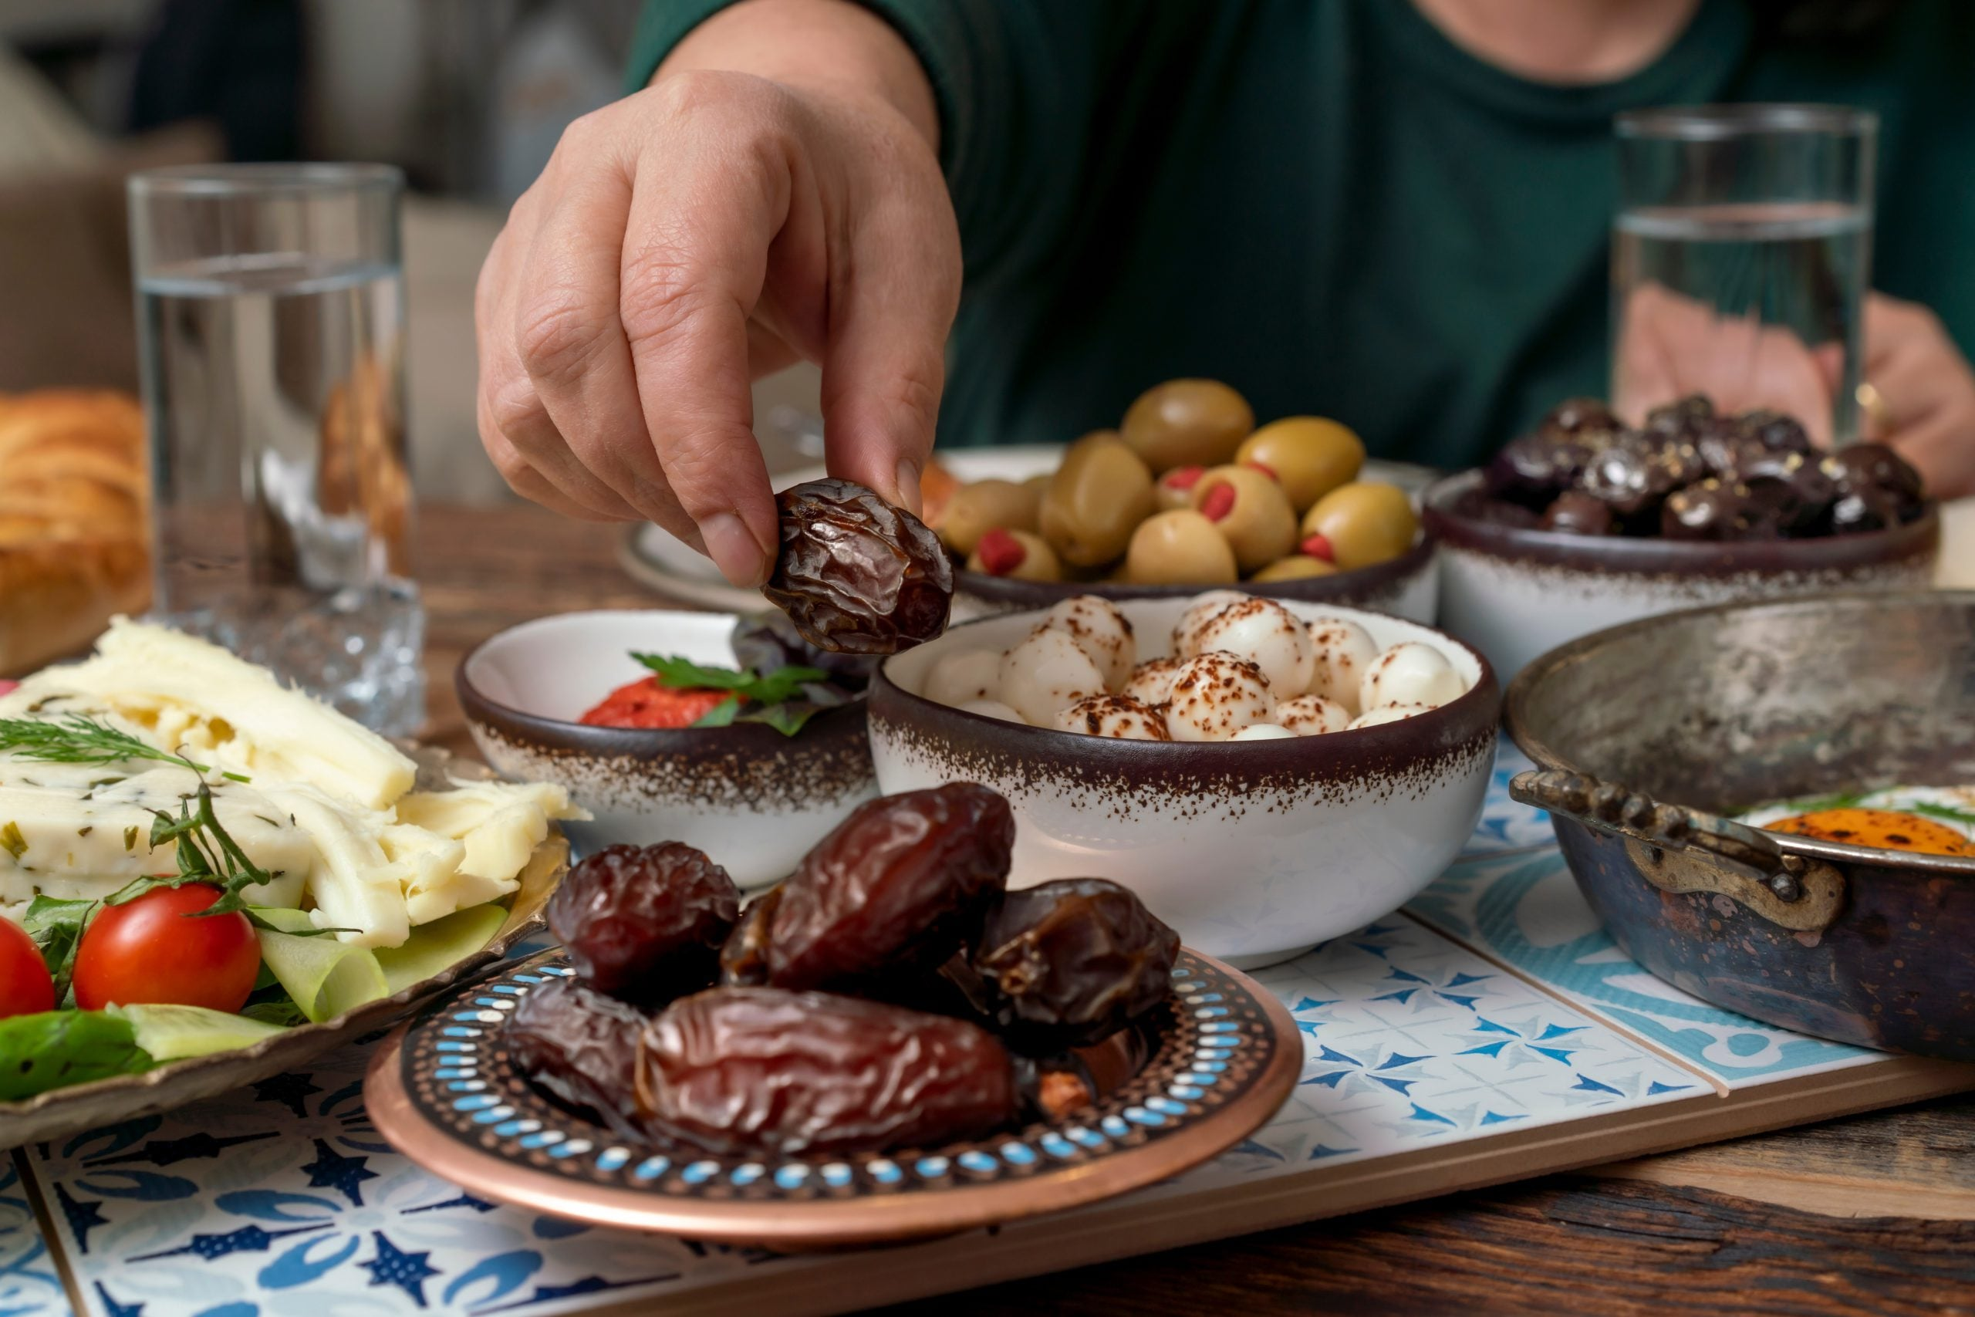
THE QUIZ!!!
TESTING YOUR KNOWLEDGE ON THE TOPICS COVERED IN THE PAST MONTH
Q23: What is Fidya?
Paid by those that keep all 30 fasts
Paid by those that have missed fasts throughout the month
Paid by those that couldn’t read Tarawih
Paid by those that couldn’t attend Dars-ul-Qu’ran

Slide 65
THE QUIZ!!!
TESTING YOUR KNOWLEDGE ON THE TOPICS COVERED IN THE PAST MONTH
Q23: What is Fidya?
Paid by those that keep all 30 fasts
Paid by those that have missed fasts throughout the month
Paid by those that couldn’t read Tarawih
Paid by those that couldn’t attend Dars-ul-Qu’ran

Slide 66
THE QUIZ!!!
TESTING YOUR KNOWLEDGE ON THE TOPICS COVERED IN THE PAST MONTH
Q24: WHAT IS EID FUND?
£5 which is obligatory for only working members.
£5 which is recommended for everyone
£10 which is obligatory for earning members
£5 which is obligatory for everyone

Slide 67
THE QUIZ!!!
TESTING YOUR KNOWLEDGE ON THE TOPICS COVERED IN THE PAST MONTH
Q24: WHAT IS EID FUND?
£5 which is obligatory for only working members.
£5 which is recommended for everyone
£10 which is obligatory for earning members
£5 which is obligatory for everyone

Slide 68

THE QUIZ!!!
TESTING YOUR KNOWLEDGE ON THE TOPICS COVERED IN THE PAST MONTH
Q25: HOW MANY TIMES IS THE EID PRAYER OFFERED IN ONE YEAR?
1
2
3
4

Slide 69
THE QUIZ!!!
TESTING YOUR KNOWLEDGE ON THE TOPICS COVERED IN THE PAST MONTH
Q25: HOW MANY TIMES IS THE EID PRAYER OFFERED IN ONE YEAR?
1
2
3
4

Slide 70
THE QUIZ!!!
TESTING YOUR KNOWLEDGE ON THE TOPICS COVERED IN THE PAST MONTH
Q26: WHAT WAS THE PRACTICE OF THE HOLY PROPHET MUHAMMAD (SAW) ON EID DAY?
He would eat an odd number of dates before leaving his house
He would offer prayers on the Eid night
He would take a different route to and from the Eid Gah
All of the above

Slide 71
THE QUIZ!!!
TESTING YOUR KNOWLEDGE ON THE TOPICS COVERED IN THE PAST MONTH
Q26: WHAT WAS THE PRACTICE OF THE HOLY PROPHET MUHAMMAD (SAW) ON EID DAY?
He would eat an odd number of dates before leaving his house
He would offer prayers on the Eid night
He would take a different route to and from the Eid Gah
All of the above

Slide 72
THE QUIZ!!!
TESTING YOUR KNOWLEDGE ON THE TOPICS COVERED IN THE PAST MONTH
Q27: WHAT WAS THE OVERALL TOPIC OF THIS MONTH'S FRIDAY SERMONS DELIVERED BY HAZRAT KHALIFAT-UL-MASIH V (ABA)?
Trust
Obedience
Unity of Allah
Ramadan

Slide 73
THE QUIZ!!!
TESTING YOUR KNOWLEDGE ON THE TOPICS COVERED IN THE PAST MONTH
Q27: WHAT WAS THE OVERALL TOPIC OF THIS MONTH'S FRIDAY SERMONS DELIVERED BY HAZRAT KHALIFAT-UL-MASIH V (ABA)?
Trust
Obedience
Unity of Allah
Ramadan

Slide 74
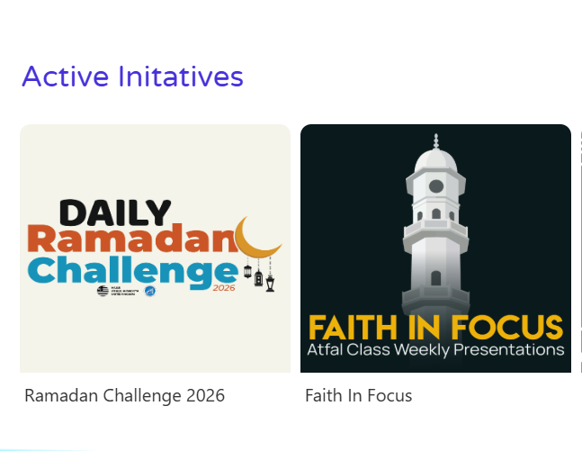
ANNOUNCEMENTS!
LEARNING TIME
Be sure to look out for NEW Learning Time Material coming soon on the Atfal Website!
Different Topics, covered in 4 Presentations, followed by 1 Quiz Presentation, Inshallah!

