Slide 1
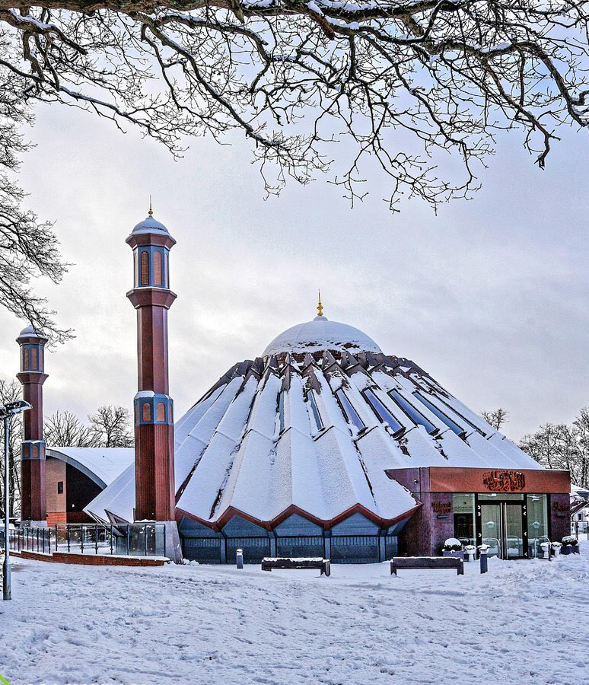


TALIM DEPARTMENT MAA UK
THE EXISTENCE OF GOD
Learning Time Topic 1 Test
TALIM DEPARTMENT MAA UK
www.atfal.org.uk/talim
talim@atfal.co.uk

Slide 2

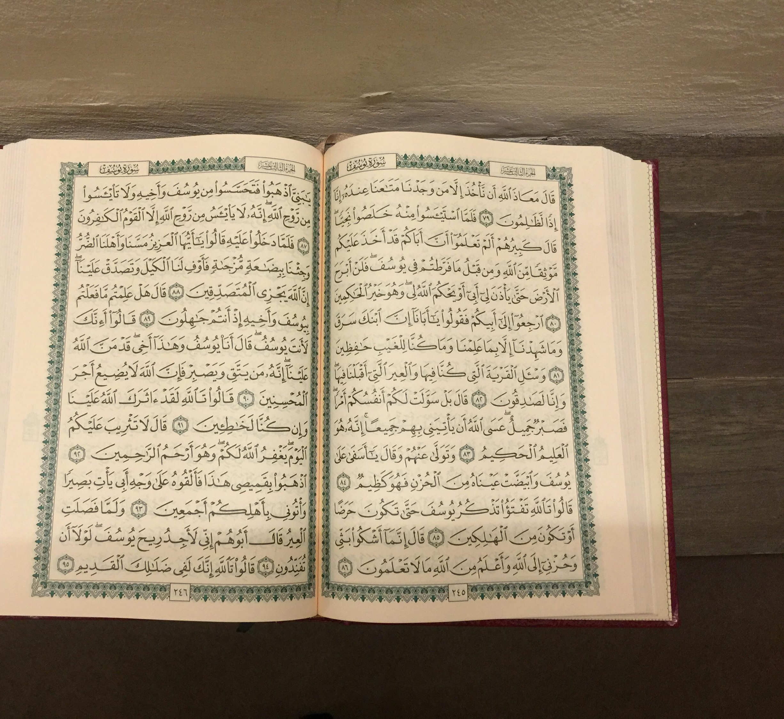

TILAWAT
فَتَعٰلَی اللّٰہُ الۡمَلِکُ الۡحَقُّ ۚ وَلَا تَعۡجَلۡ بِالۡقُرۡاٰنِ مِنۡ قَبۡلِ اَنۡ یُّقۡضٰۤی اِلَیۡکَ وَحۡیُہٗ ۫ وَقُلۡ رَّبِّ زِدۡنِیۡ عِلۡمًا
TRANSLATION
““Exalted then is Allah, the True King! And be not impatient for the Qur’an ere its revelation is completed unto thee, but only say, ‘O my Lord, increase me in knowledge.”
(The Holy Quran, Surah Taha, 20:115)

Slide 3

HADITH
(sayings of the Holy Prophet Muhammad^{sas})
عَنْ أَنَسِ بْنِ مَالِكٍ، قَالَ قَالَ رَسُولُ اللّٰہِ صَلَّى اللّٰهُ عَلَيْهِ وَسَلَّمَ
‏ ‏ طَلَبُ الْعِلْمِ فَرِيضَةٌ عَلَى كُلِّ مُسْلِمٍ
Translation:
It was narrated from Anas bin Malik^{ra} that the Messenger of Allahﷺ said: “Seeking knowledge is a duty upon every Muslim.”
Notes:
After Tilawat, spend 5 mins catching up with Atfal. What they've been getting up to in the past week.
Hadith:
Whoever, reads the Hadith out, should do so in the proper manner. i.e. recite Durood Shareef first and then the Hadith.
Have a brief discussion about the meaning of this hadith in light of the questions on the screen.

Slide 4


Slide 5


Question 1
Does God exist and if yes, how do we know that he is there?
Yes, we know he exists because he accepts our prayers.
No, God does not exist.
Yes, because we can see him with our physical eyes.
No, it is not necessary for God to exist.

Slide 6
Question 1
Does God exist and if yes, how do we know that he is there?
Yes, we know he exists because he accepts our prayers.
No, God does not exist.
Yes, because we can see him with our physical eyes.
No, it is not necessary for God to exist.

Slide 7
Question 2
What are the key beliefs about God in the majority of religions?
He is Lord of the Heavens and Earth.
He is a universal being looking everywhere at once.
He is everywhere at all times.
All of the above

Slide 8
Question 2
What are the key beliefs about God in the majority of religions?
He is Lord of the Heavens and Earth.
He is a universal being looking everywhere at once.
He is everywhere at all times.
All of the above

Slide 9
Question 3
Do we need to see God with our physical eyes in order to see him?
Yes we need to see him. Only then we will believe in him.
Yes, looking at something is the best way of believing in it.
No, just like air and electricity which we cannot see but believe in, in the same way, we also believe in God.
No, but we need to be able to see God spiritually

Slide 10
Question 3
Do we need to see God with our physical eyes in order to see him?
Yes we need to see him. Only then we will believe in him.
Yes, looking at something is the best way of believing in it.
No, just like air and electricity which we cannot see but believe in, in the same way, we also believe in God.
No, but we need to be able to see God spiritually

Slide 11
Question 4
Does God Almighty still speak and communicate with us?
No, he only used to speak in the past.
Yes, with a physical mouth
No, there is no need for him to speak anymore.
Yes, he speaks to Prophets and accepts our prayers.

Slide 12
Question 4
Does God Almighty still speak and communicate with us?
No, he only used to speak in the past.
Yes, with a physical mouth
No, there is no need for him to speak anymore.
Yes, he speaks to Prophets and accepts our prayers.

Slide 13
Question 5
What are some of the religions that believe in God?
Muslim, Christians, Hindus
Hindus, Buddhism and Jews
Confucianism, Atheism and Muslims
Humanism, Agnostics and Jews

Slide 14
Question 5
What are some of the religions that believe in God?
Muslim, Christians, Hindus
Hindus, Buddhism and Jews
Confucianism, Atheism and Muslims
Humanism, Agnostics and Jews

Slide 15
Question 6
Brahma is associated with which Religion?
Muslim
Christians
Hinduism
Sikhism

Slide 16
Question 6
Brahma is associated with which Religion?
Muslim
Christians
Hinduism
Sikhism

Slide 17
Question 7
Waheguru is associated with which Religion?
Muslim
Christians
Hinduism
Sikhism

Slide 18
Question 7
Waheguru is associated with which Religion?
Muslim
Christians
Hinduism
Sikhism

Slide 19
Question 8
Which three religions believe that there are other gods beside the main God or there are different parts of the same God?
Muslim, Christians, Hindus
Hindus, Buddhism and Jews
Hindu, Sikh and Christianity
Humanism, Agnostics and Jew

Slide 20
Question 8
Which three religions believe that there are other gods beside the main God or there are different parts of the same God?
Muslim, Christians, Hindus
Hindus, Buddhism and Jews
Hindu, Sikh and Christianity
Humanism, Agnostics and Jew

Slide 21
Question 9
What are some of the signs of God that make us believe in him?
The creation of the universe
The creation of the sun and the moon
The creation of the stars and galaxies
All of the above

Slide 22
Question 9
What are some of the signs of God that make us believe in him?
The creation of the universe
The creation of the sun and the moon
The creation of the stars and galaxies
All of the above

Slide 23
Question 10
What do Atheists believe about God?
He does exist.
They do not know whether God exists.
He does not exist
They believe in different parts of the same God

Slide 24
Question 10
What do Atheists believe about God?
He does exist.
They do not know whether God exists.
He does not exist
They believe in different parts of the same God

Slide 25
Question 11
What do Agnostics believe about God?
He does exist.
They do not know whether God exists.
He does not exist
They believe in different parts of the same God

Slide 26
Question 11
What do Agnostics believe about God?
He does exist.
They do not know whether God exists.
He does not exist
They believe in different parts of the same God

Slide 27
Question 12
What are two of the key beliefs about Atheists regarding God? (2 Answers)
They believe that the world can be explained by science.
They think that religion was created by people themselves.
They believe that God is higher than them in status.
They used to believe in him but do not anymore.

Slide 28
Question 12
What are two of the key beliefs about Atheists regarding God? (2 Answers)
They believe that the world can be explained by science.
They think that religion was created by people themselves.
They believe that God is higher than them in status.
They used to believe in him but do not anymore.

Slide 29
Question 13
Which one does not convince an Atheist that God does exist?
Everything that is created in the world cannot be created by man with such a level of perfection.
How many people would have been needed to create the world and how would they have worked in such peace and harmony together.
Who gave man knowledge to create these things in the way they are.
What is the need of God when he has created man

Slide 30
Question 13
Which one does not convince an Atheist that God does exist?
Everything that is created in the world cannot be created by man with such a level of perfection.
How many people would have been needed to create the world and how would they have worked in such peace and harmony together.
Who gave man knowledge to create these things in the way they are.
What is the need of God when he has created man

Slide 31
Question 14
Do we need God to behave morally?
No, we have free will. We can live however we like.
Yes, but he doesn't need to teach us how to live in the world.
No, because Prophets can teach us but then who sent the Prophets?
Yes, God sent religious law to all people in which he taught the ways to live in a civilised manner to all people of religion.

Slide 32
Question 14
Do we need God to behave morally?
No, we have free will. We can live however we like.
Yes, but he doesn't need to teach us how to live in the world.
No, because Prophets can teach us but then who sent the Prophets?
Yes, God sent religious law to all people in which he taught the ways to live in a civilised manner to all people of religion.

Slide 33
Question 15
What one does science not use to explain the world?
Experiments
Religion
Observation
Evidence

Slide 34
Question 15
What one does science not use to explain the world?
Experiments
Religion
Observation
Evidence

Slide 35
Question 16
What is the main belief of science with regards to the Existence of God?
Science supports the idea of a God
Science does not support the idea of a God
Science stays neutral about the matter
Science supports the idea but through its own ways

Slide 36
Question 16
What is the main belief of science with regards to the Existence of God?
Science supports the idea of a God
Science does not support the idea of a God
Science stays neutral about the matter
Science supports the idea but through its own ways

Slide 37
Question 17
How does Science prove that God does exist?
Through prayers
Science doesn’t prove; God Almighty cannot be physically tested
Through performing different experiments and tests
Through seeing God

Slide 38
Question 17
How does Science prove that God does exist?
Through prayers
Science doesn’t prove; God Almighty cannot be physically tested
Through performing different experiments and tests
Through seeing God

Slide 39
Question 18
Which of the following is NOT a proof that science uses to suggest that God exists?
The Universe is very organised and balanced
Life is complex so it cannot happen by chance
Who caused the Big Bang to happen
You can see God spiritually

Slide 40
Question 18
Which of the following is NOT a proof that science uses to suggest that God exists?
The Universe is very organised and balanced
Life is complex so it cannot happen by chance
Who caused the Big Bang to happen
You can see God spiritually

Slide 41
Question 19
Do we believe in things that are unseen to the eye?
No because we cannot see them with our physical senses
Yes, through other means we find out that these things exist.

Slide 42
Question 19
Do we believe in things that are unseen to the eye?
No because we cannot see them with our physical senses
Yes, through other means we find out that these things exist.

Slide 43
Question 20
Which of the following is NOT an example of something that we believe which is unseen?
Thoughts
Fog
Gravity
Electricity

Slide 44
Question 20
Which of the following is NOT an example of something that we believe which is unseen?
Thoughts
Fog
Gravity
Electricity

Slide 45
Jazakallah

