Slide 1



TALIM DEPARTMENT MAA UK
THE EXISTENCE OF GOD
Learning Time Topic 1 Module 3
TALIM DEPARTMENT MAA UK
www.atfal.org.uk/talim
talim@atfal.co.uk

Slide 2

Lesson Objectives
What are the beliefs of atheists regarding God?
How can we explain to an Atheist that God does really exist?
“People can behave morally without the belief in God” --- How would you answer this allegation?

Slide 3



PAIR ACTIVITY
Discuss the following 3 questions with the person next to you:
What are the beliefs of atheists regarding God?
How can we explain to an Atheist that God does really exist?
“People can behave morally without the belief in God” How would you answer this allegation?
THE EXISTENCE OF GOD

Slide 4

BELIEF OF ATHEISTS REGARDING GOD
Atheists do not believe in God or a Higher Power.
They think there is no clear proof that God exists in the world.
Many atheists believe the world can be explained by science.
They may think religion was created by people to explain things.
Some atheists say, “We don’t know everything,” but they want proof before believing.

Slide 5

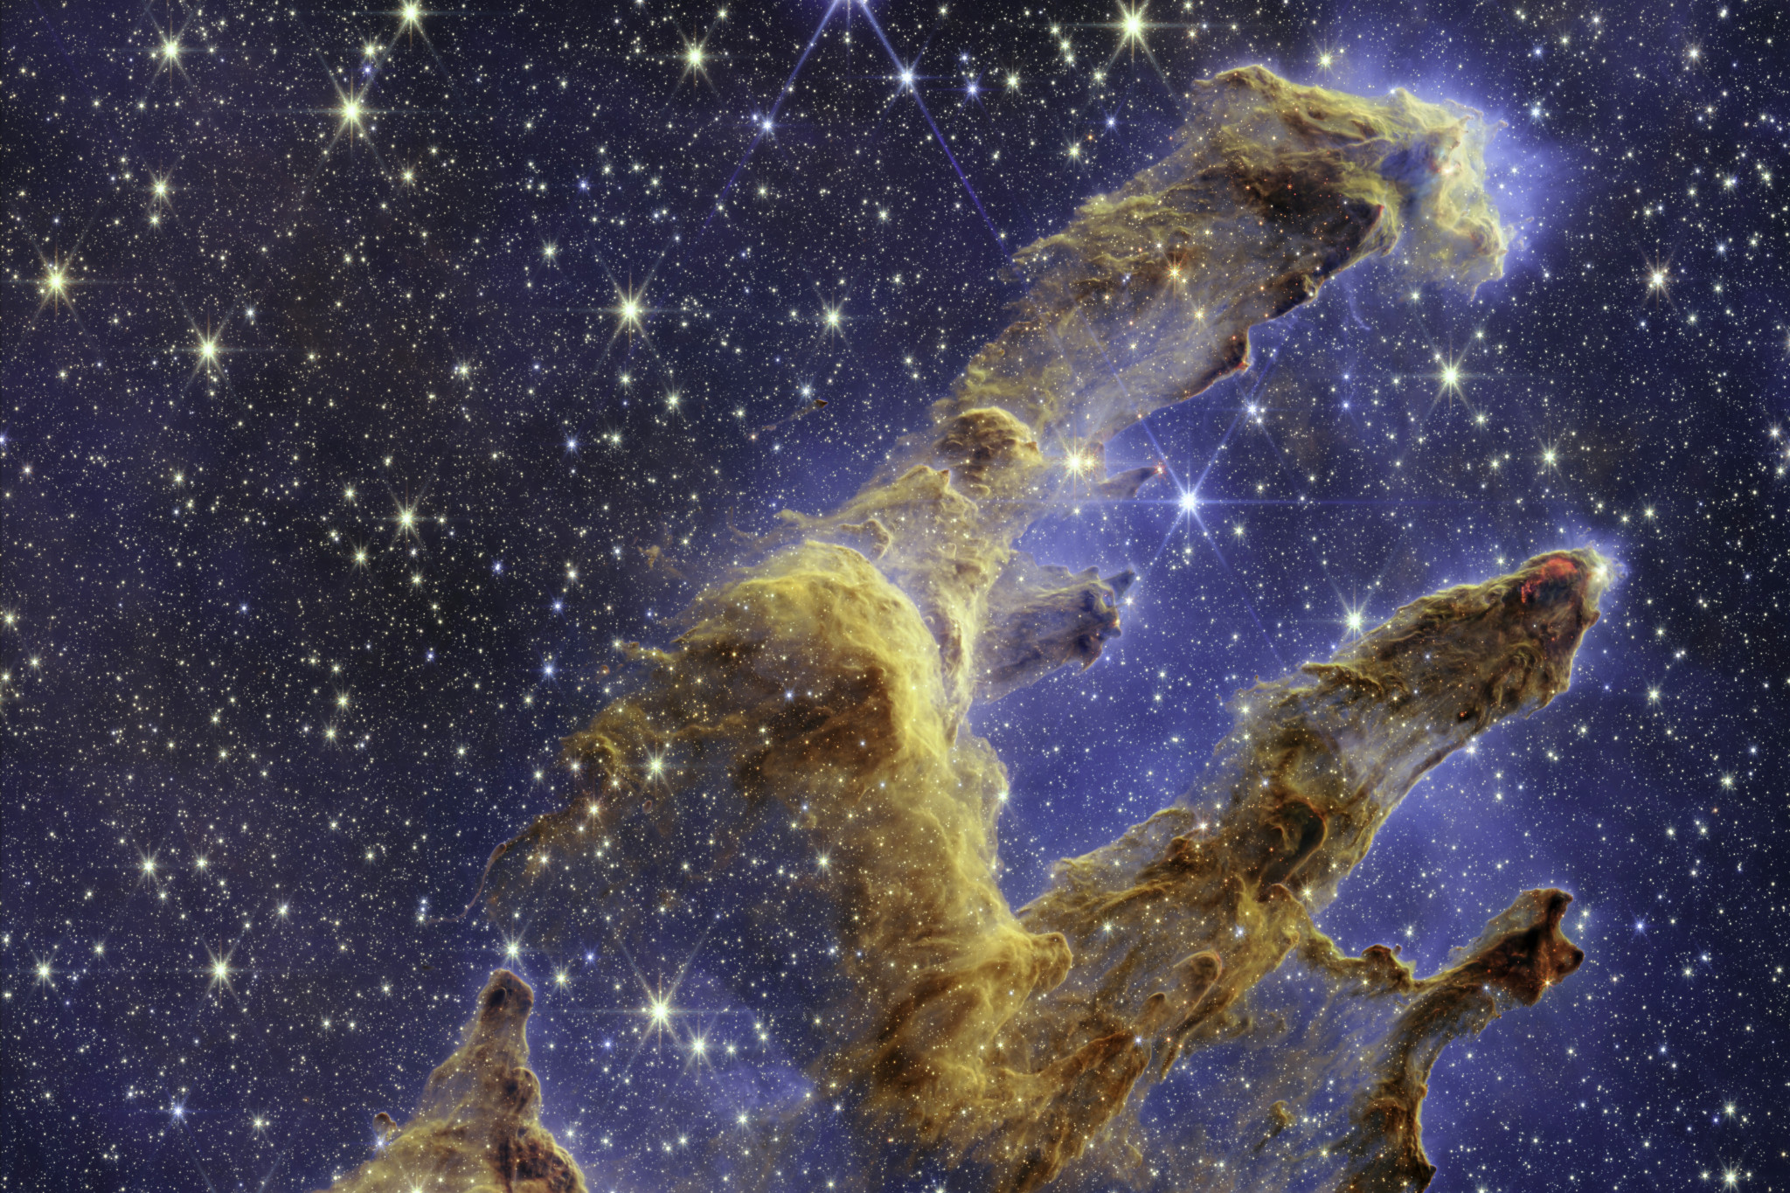
BELIEF OF ATHEISTS REGARDING GOD
For a person who doesn’t believe in God or a higher power, it is Difficult to explain the concept of God to them
However, we can say to an Atheist that all the things around us have been created by God.

Slide 6

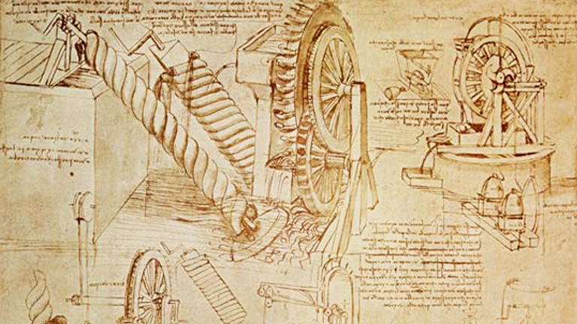
BELIEF OF ATHEISTS REGARDING GOD
It has to be created by a supreme being as:
Man is not capable and has not been given the power to create things in perfection in the way that they have been created by God
It would not be possible for man to create everything in a short amount of time because over the years, natural disasters and wars have taken place which requires things to be made again.
This leaves us with the question “Has man created things multiple times over and over again?”

Slide 7

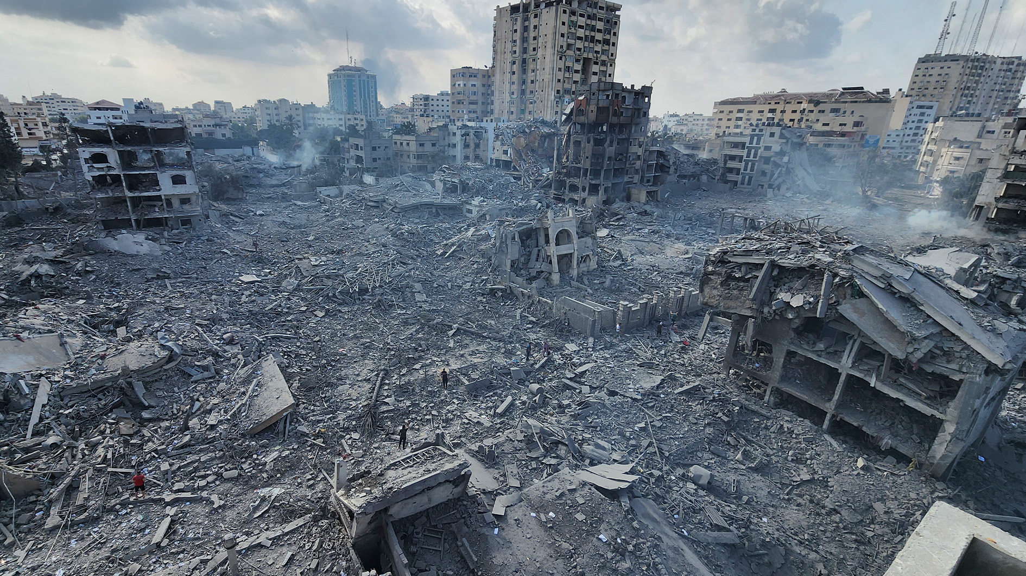
BELIEF OF ATHEISTS REGARDING GOD
Another question to ask is “How many people were required to create the world?”
If it is a large number of people then, how were they all successfully able to create the world without any disputes and arguments and worked in harmony with each other when we see in today’s society that even family members cannot live with each other?

Slide 8
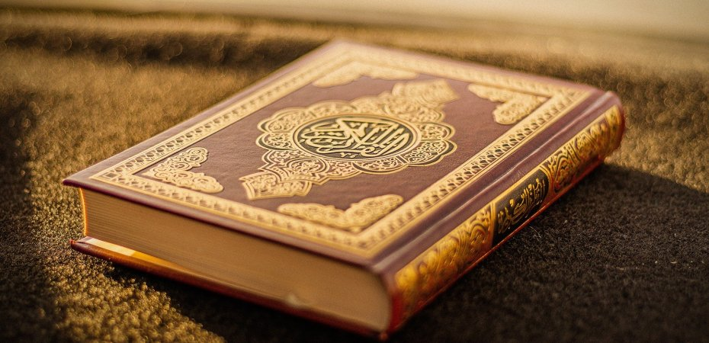
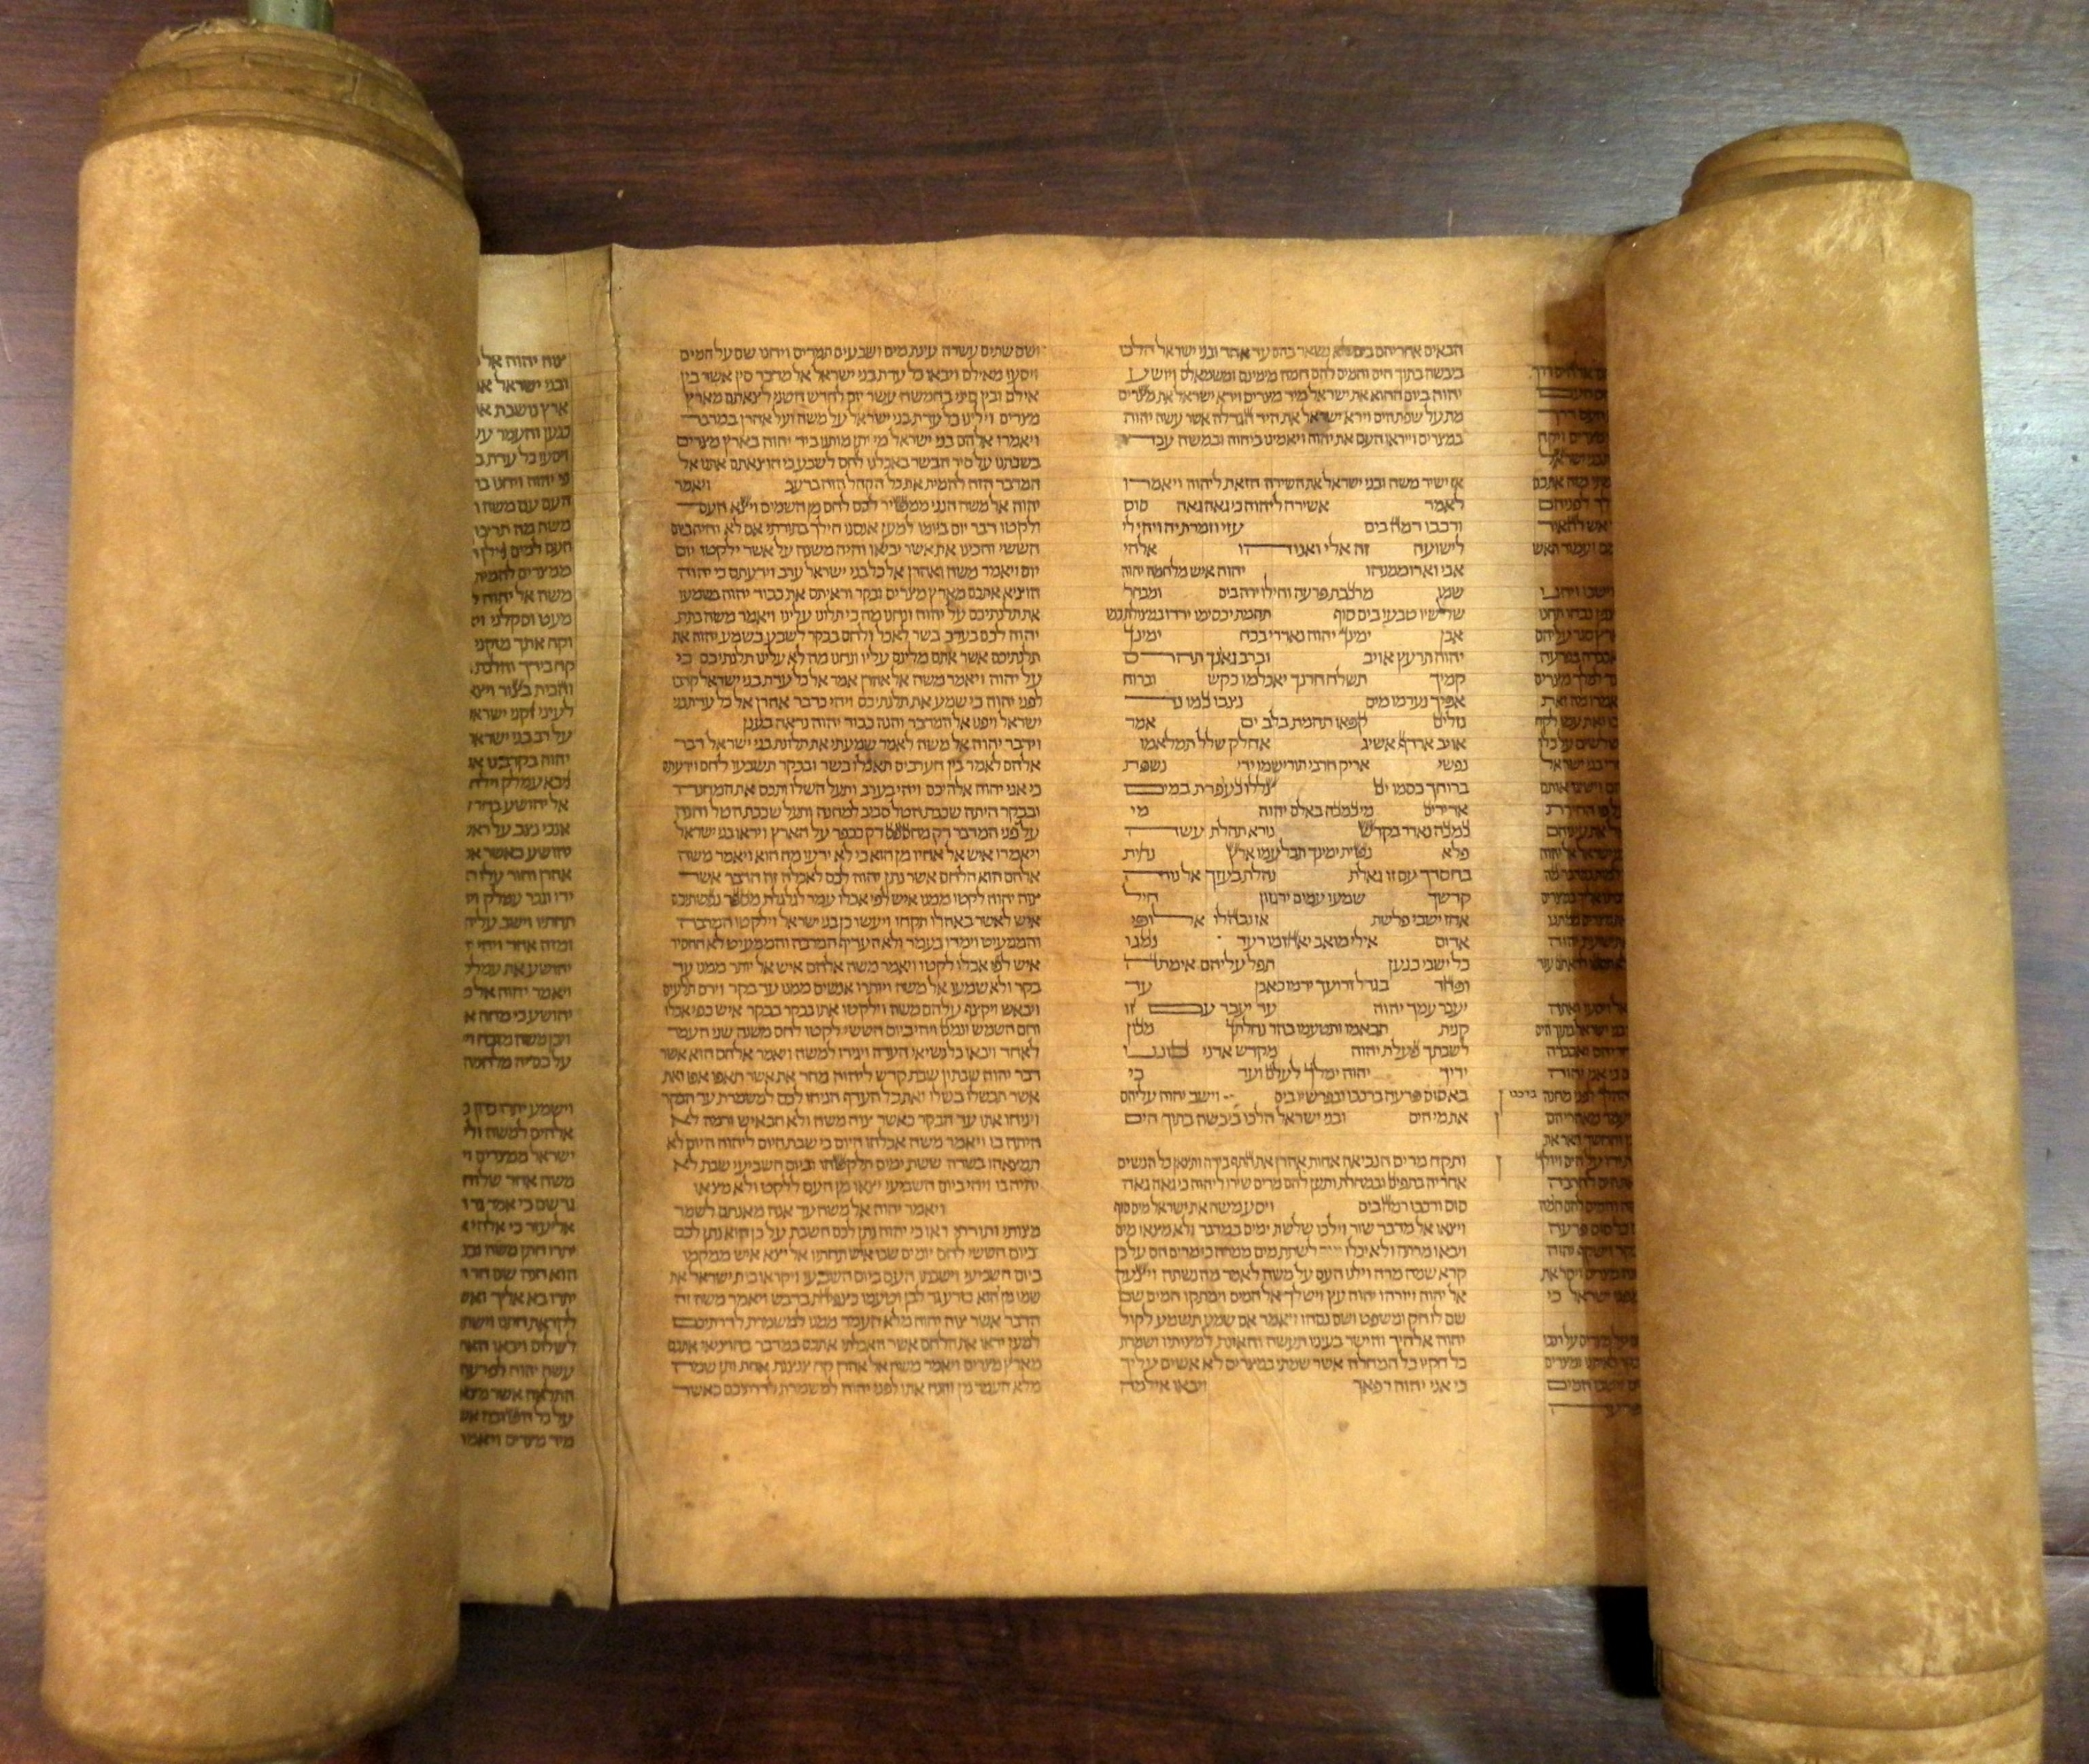
BELIEF OF ATHEISTS REGARDING GOD
I would disagree with the statement.
This is because it is God who has taught every person- regardless of their religion- as to how to live their lives in accordance with the commands of God Almighty in their respective holy books.

Slide 9
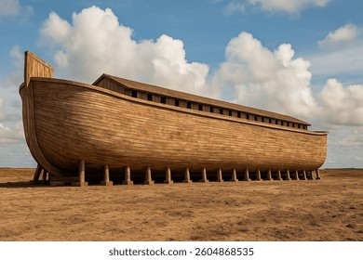
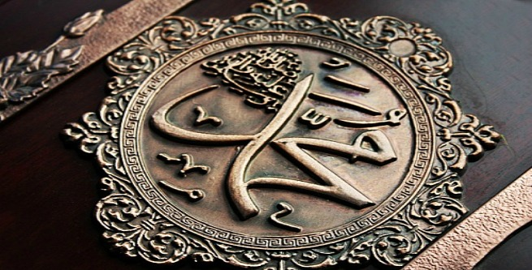
BELIEF OF ATHEISTS REGARDING GOD
Not only that, but God Almighty has sent 124,000 Prophets to the world who all had the same purpose of drawing their people’s attention towards God and they practically showed their people how to live in a civilised manner by demonstrating it themselves.

Slide 10
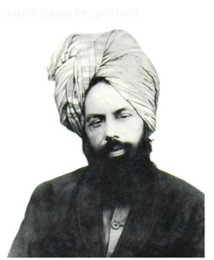
BELIEF OF ATHEISTS REGARDING GOD
We see in the world today, it has been 117 years since the Promised Messiah (as) passed away, and people have forgotten how to live with each other.
There are constant arguments, disputes and the threat of a war breaking out is also very imminent.
This means that it is important that we need God, Prophets and Religion to show mankind how to behave morally and live in a civilised manner.

Slide 11
The Existence Of God
https://youtu.be/RW8ADilF26c?si=Rj3lTxGTa87m_S-R
https://youtu.be/iIYZMn6mRj8?si=4y3xdTKbwRm_1Qw7

Slide 12

Today’s Recap
Atheists do not believe in God.
Everything in the world cannot possibly be created by man. However, God has given knowledge and wisdom to create certain man made things.
We need God and his teachings in order to live our lives in a civilised manner.

Slide 13

Test
Be sure to look out for another test at the end of next month for the Learning Time Section.
Please continue revising throughout the month in small chunks.
All PowerPoint and resources can be found on the Atfal Website at www.atfal.org.uk/taleem

