Slide 1
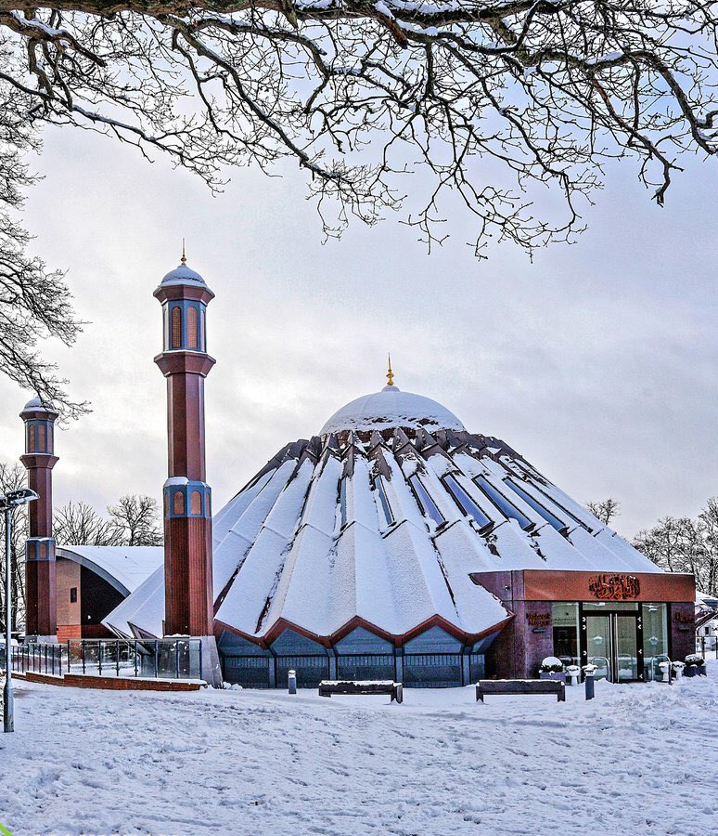


TALIM DEPARTMENT MAA UK
THE EXISTENCE OF GOD
Learning Time Topic 1 Module 4
TALIM DEPARTMENT MAA UK
www.atfal.org.uk/talim
talim@atfal.co.uk

Slide 2

Lesson Objectives
What does Science believe regarding the Existence of God?
How do they prove through science that God does exist?
“There is no direct, measurable proof of God” How would you answer this allegation?

Slide 3



PAIR ACTIVITY
Discuss the following 3 questions with the person next to you:
What does Science believe regarding the Existence of God?
How do they prove through science that God does exist?
“There is no direct, measurable proof of God” How would you answer this allegation?
THE EXISTENCE OF GOD

Slide 4
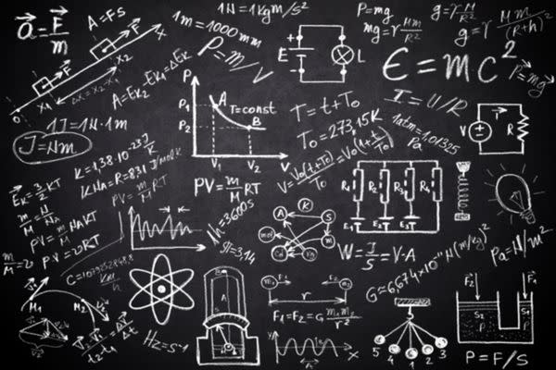

BELIEF OF SCIENCE REGARDING GOD
Science is a way of learning about the world using experiments, evidence, and observation.
Science studies things that can be seen, tested, and measured.
Because of this, science does not prove or disprove God. It stays neutral.
God is understood as beyond physical testing, so science cannot test Him like it tests nature.

Slide 5
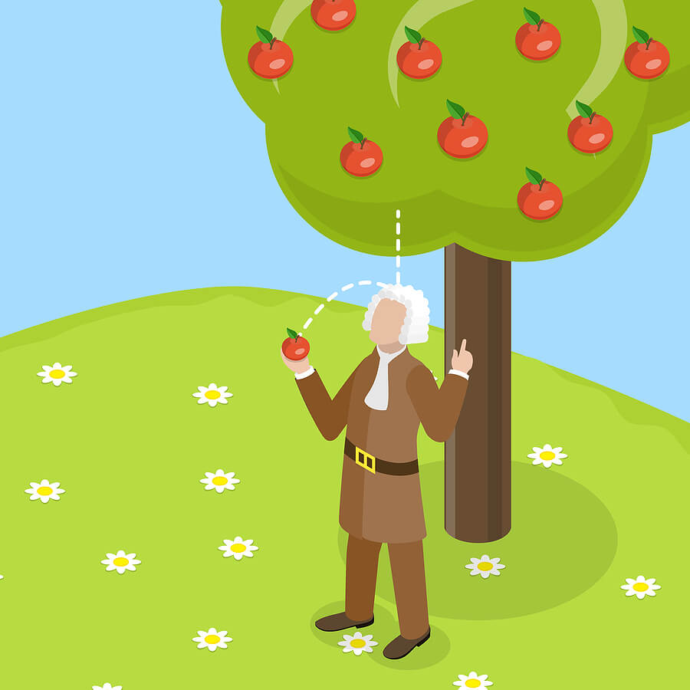
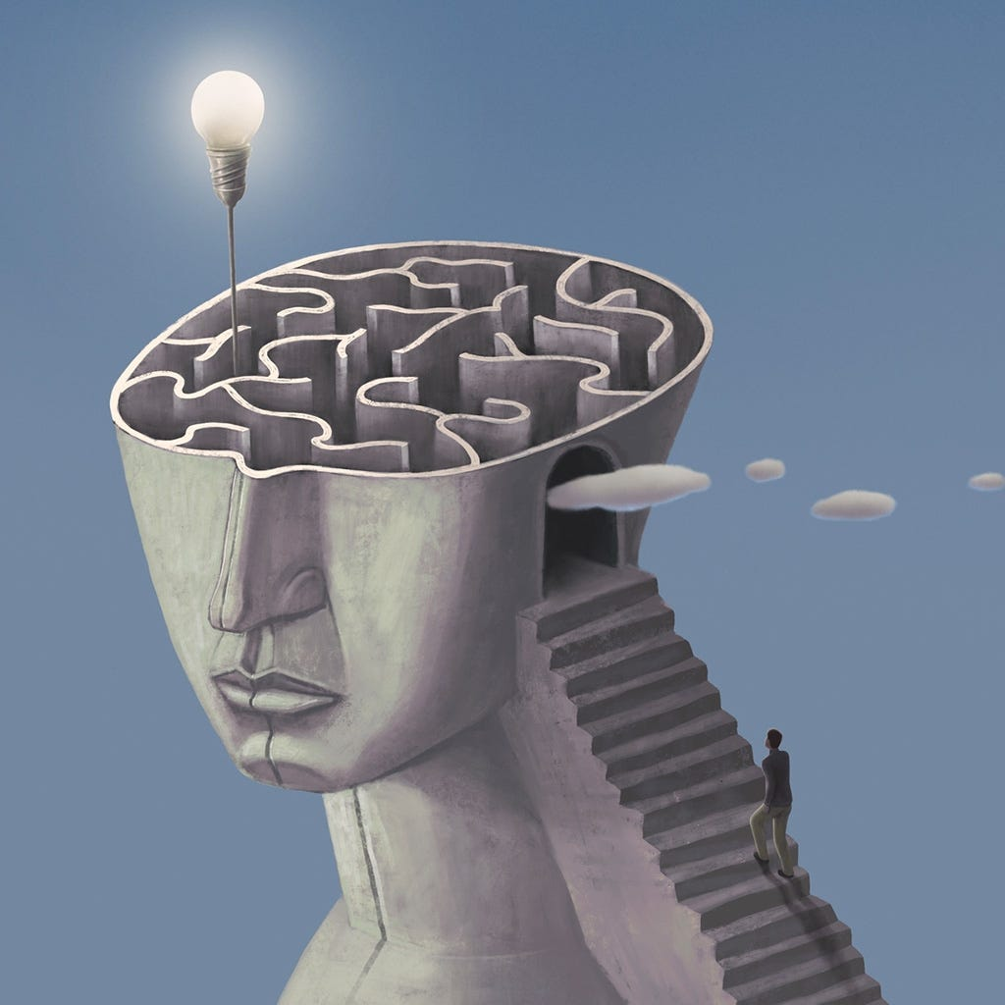
BELIEF OF SCIENCE REGARDING GOD
Many scientists focus on explaining how the universe works (like gravity & planets).
Questions like “Why are we here?” or “Who created everything?” are often answered by religion and philosophy, not science alone.
So science itself stays neutral about God.

Slide 6
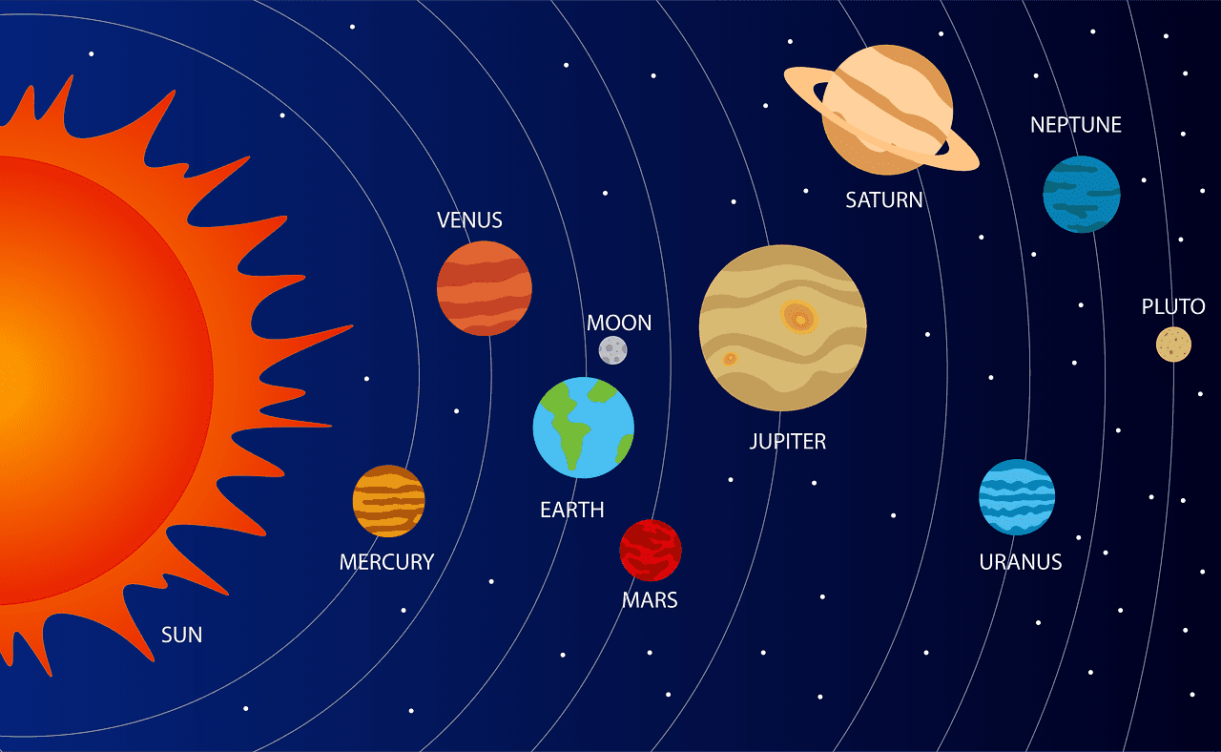
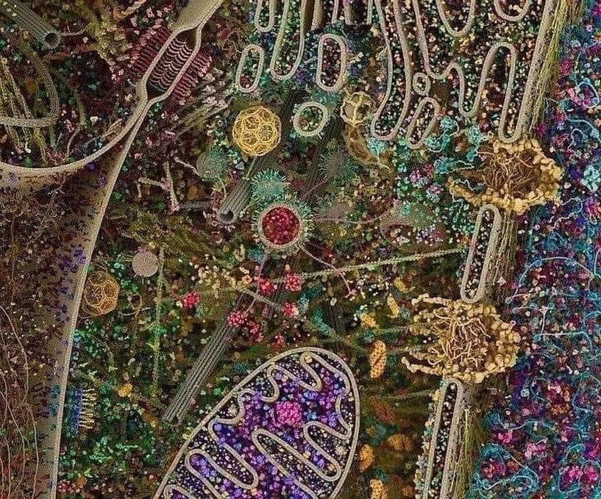
BELIEF OF SCIENCE REGARDING GOD
Some people use science-based ideas to support belief in God:
The universe is very organized and balanced (like the sun, planets, and laws of nature) which suggests that a Creator exists.
Life on Earth is very complex, and some believe it did not happen by chance.

Slide 7
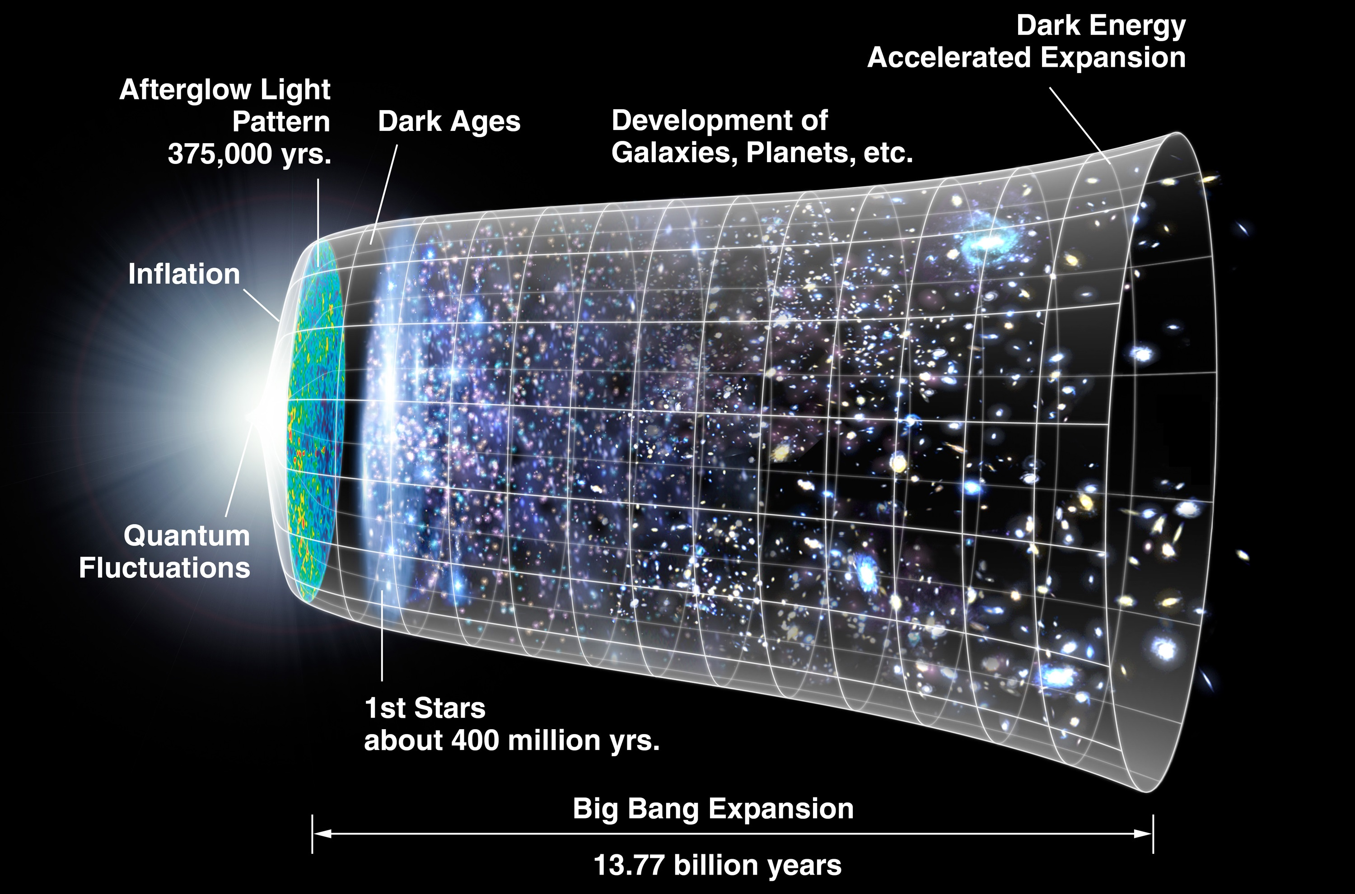
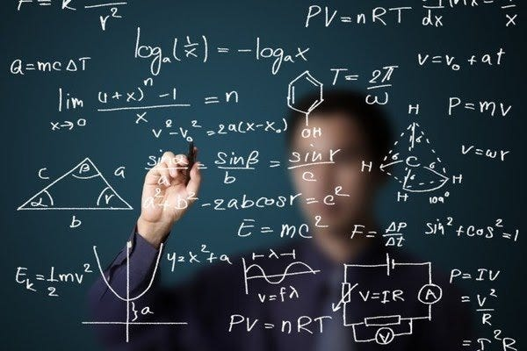
BELIEF OF SCIENCE REGARDING GOD
The fact that the universe had a beginning (like the Big Bang) leads some to ask: Who caused it?
Other people (including some scientists) do not agree and believe the universe can be explained without God.

Slide 8

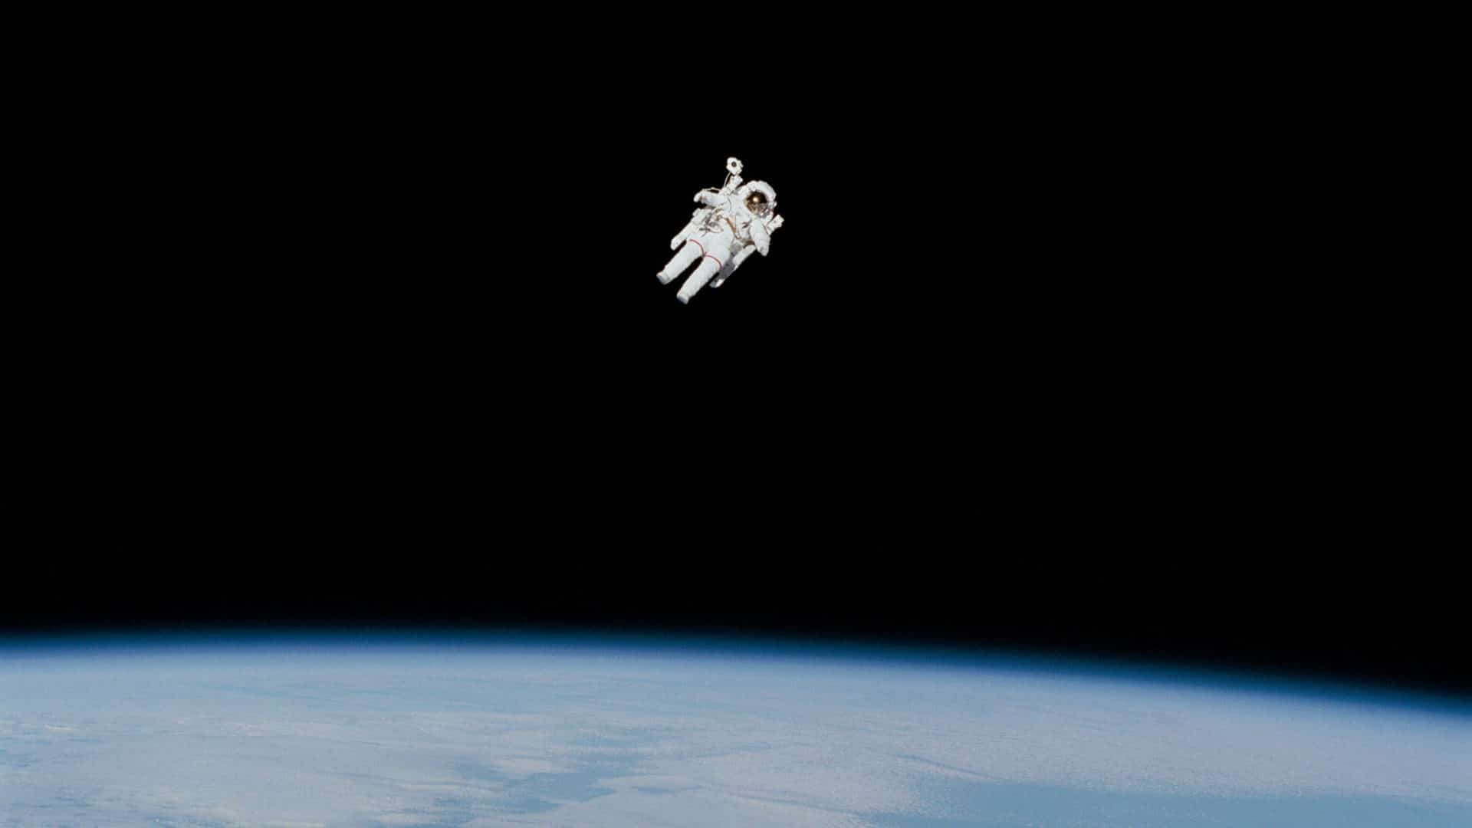
BELIEF OF SCIENCE REGARDING GOD
It is true that there is no direct, measurable proof of God like in a science experiment.
But not everything real can be seen or measured.
For example, we cannot see love, thoughts, or gravity, yet we know they exist by their effects.

Slide 9
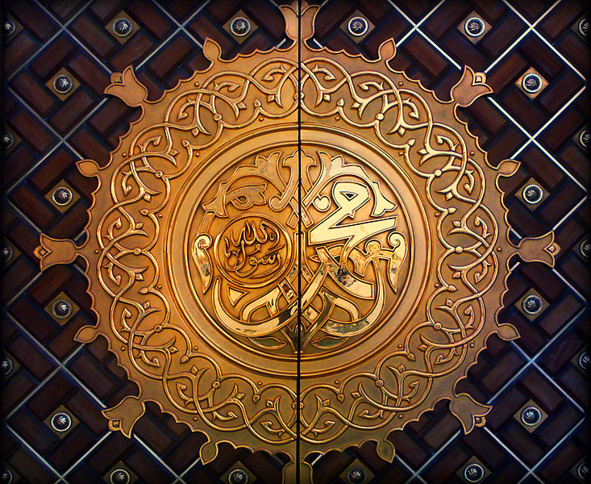
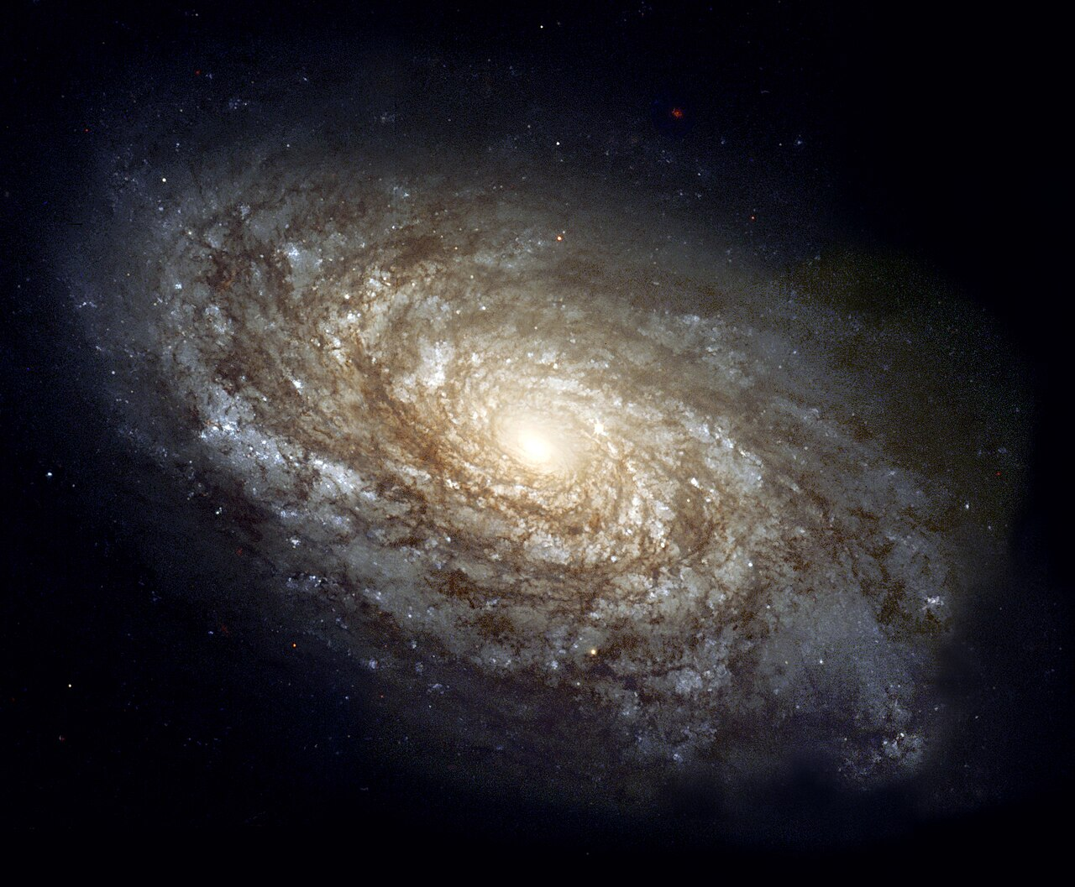
BELIEF OF SCIENCE REGARDING GOD
Many people believe God can be known through His creation, like the universe.
God has also sent prophets and guidance to help people understand Him.
Belief in God is also about faith and thinking, not just physical proof.
If God were fully visible, then belief would not be a choice or test.

Slide 10
The Existence Of God
https://youtu.be/NDsllJKLzoI?si=0F0V0VJF2q56Ntcq

Slide 11

Today’s Recap
Science cannot prove that God exists but use science based ideas to prove his existence.
They use experiments and evidence to prove his existence like the perfection of the Solar System.
There is no direct proof that God exists but true believers go out of their way to seek and find God.

Slide 12

Test
Be sure to look out for another test at the end of next month for the Learning Time Section.
Please continue revising throughout the month in small chunks.
All PowerPoint and resources can be found on the Atfal Website at www.atfal.org.uk/taleem

