Slide 1
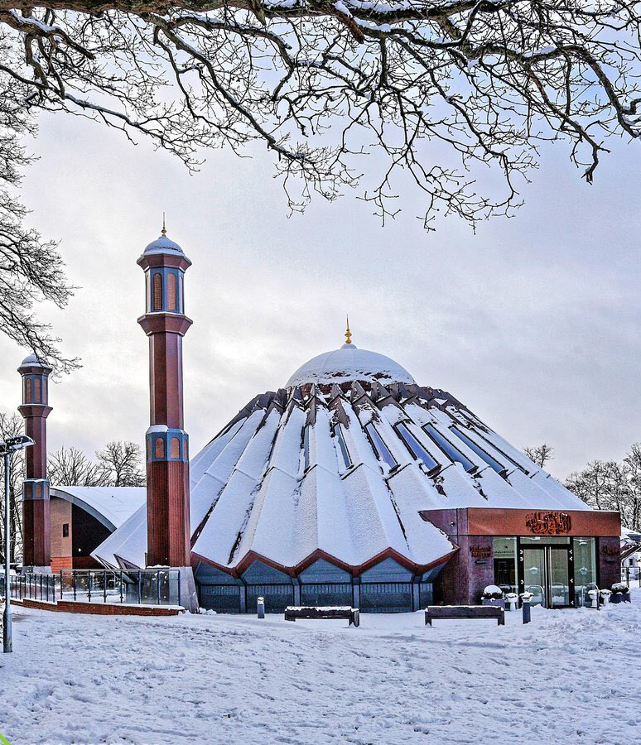


TALIM DEPARTMENT MAA UK
THE EXISTENCE OF GOD
Learning Time Topic 1 Module 2
TALIM DEPARTMENT MAA UK
www.atfal.org.uk/talim
talim@atfal.co.uk

Slide 2

Lesson Objectives
Which other Religions believe in the Existence of God?
In what ways do they believe in the Existence of God? (Whether one single being or split into several parts like Christians)
“If God wants people to believe in him, why does he remain hidden?” How would you answer this allegation?

Slide 3



PAIR ACTIVITY
Discuss the following 3 questions with the person next to you:
Which other Religions believe in the Existence of God?
In what ways do they believe in the Existence of God? (Whether one single being or split into several parts like Christians)
“If God wants people to believe in him, why does he remain hidden?” How would you answer this allegation?
THE EXISTENCE OF GOD

Slide 4
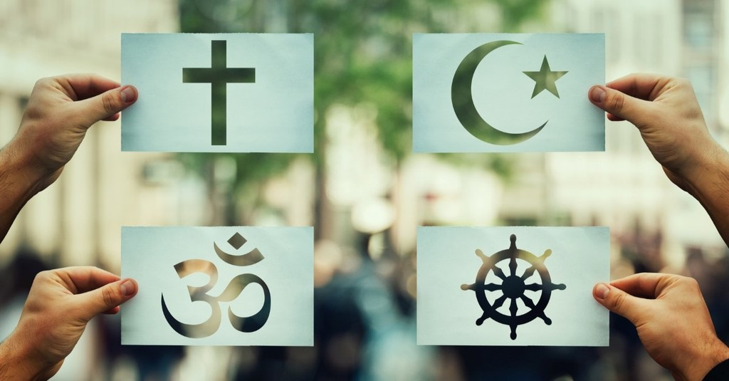
BELIEFS ABOUT GOD IN OTHER RELIGIONS
Islam, Christianity, Judaism, Sikhism and Hinduism all believe in God.
All of these Religions have the same concept about God that He is a higher power who governs over the Heavens and Earth and has created all things.
However, some religions have differing beliefs regarding the purpose of God.

Slide 5

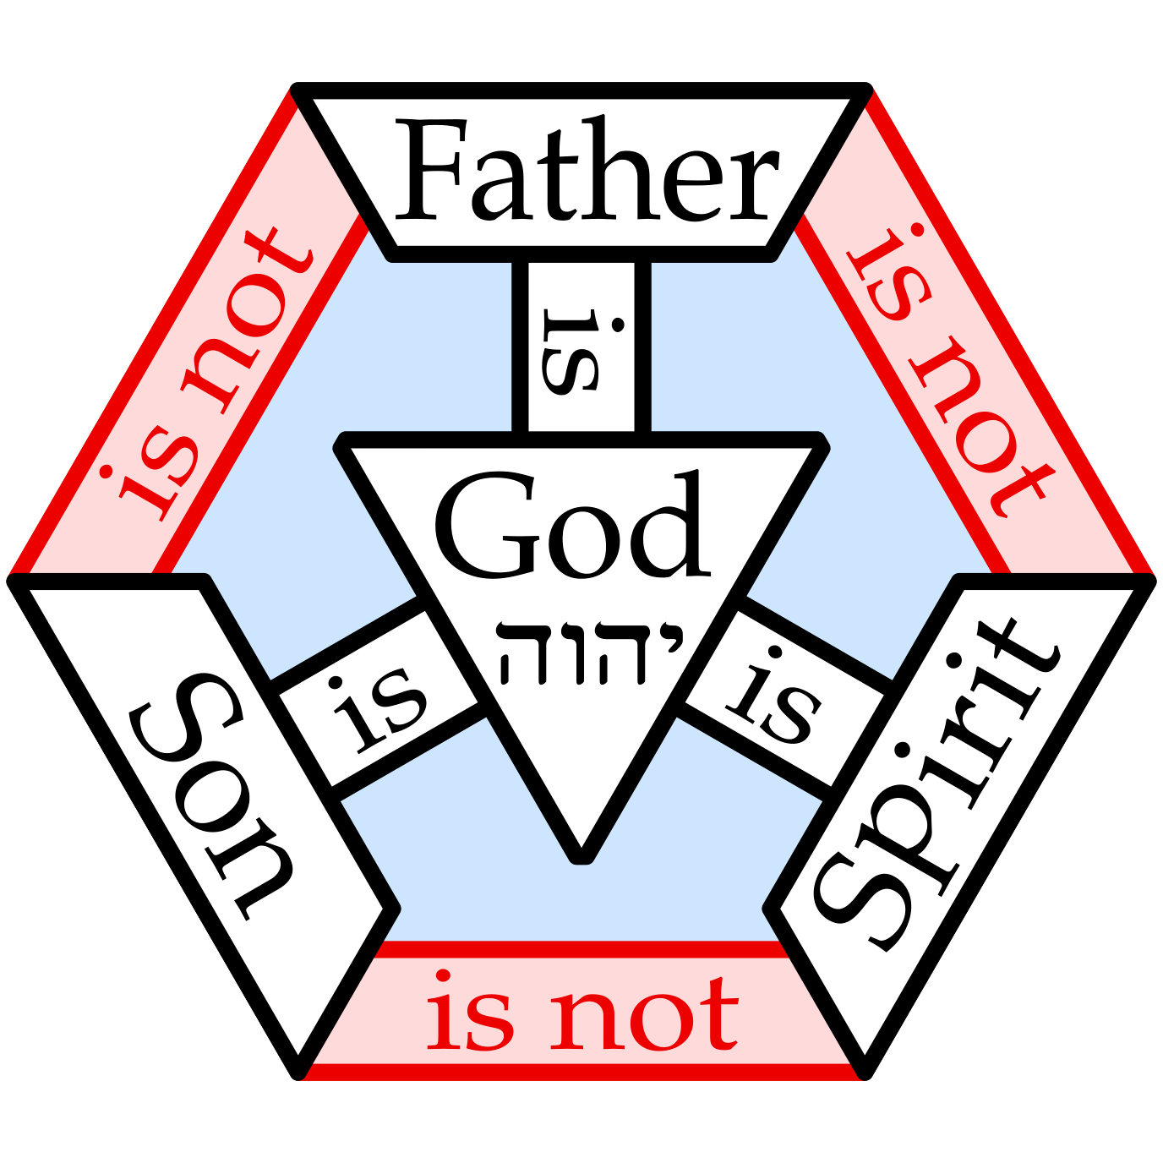
BELIEFS ABOUT GOD IN OTHER RELIGIONS
Muslims believe in one God called Allah. He is creator of the Heavens and The Earth, and his name is personal and unique only to Him.
Christians believe in a God who has three parts. There is the God followed by the son of God, who they believe to be Jesus (as) and the Holy Spirit.

Slide 6
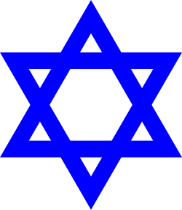

BELIEFS ABOUT GOD IN OTHER RELIGIONS
Jews believes in one God who created the world and guides His people.
Sikhs believes in one God called Waheguru who is eternal and close to all people.

Slide 7
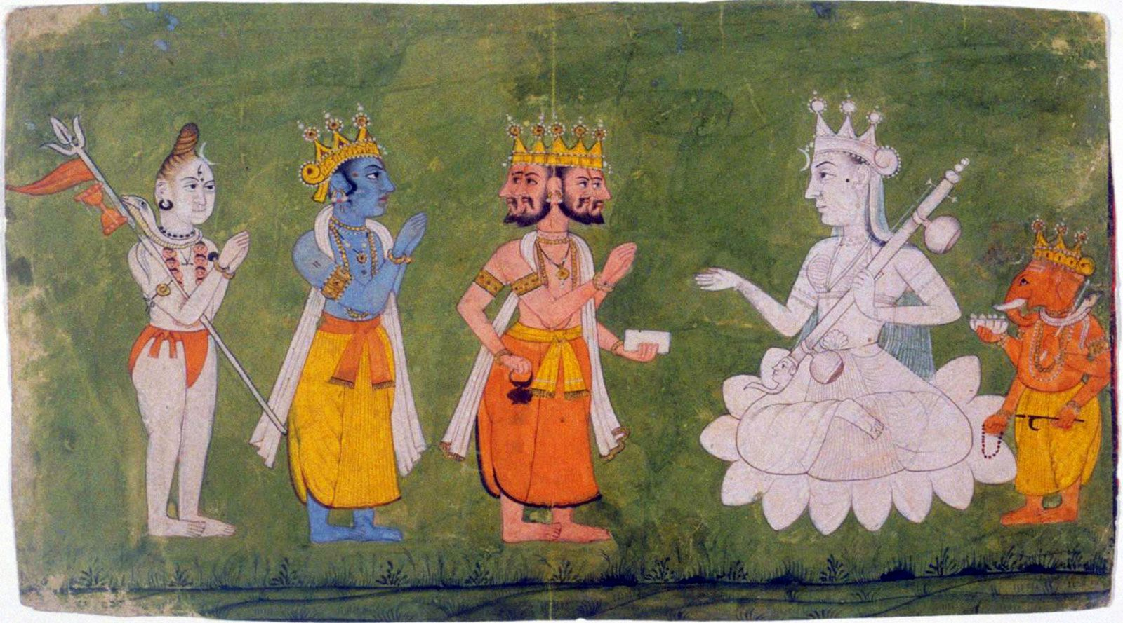
BELIEFS ABOUT GOD IN OTHER RELIGIONS
Hinduism belief can vary; many Hindus believe in one Supreme Reality called Brahman, while also worshipping different deities.
Hindus believe there are many different Gods for different things such as God of Fire, God of Light etc.

Slide 8
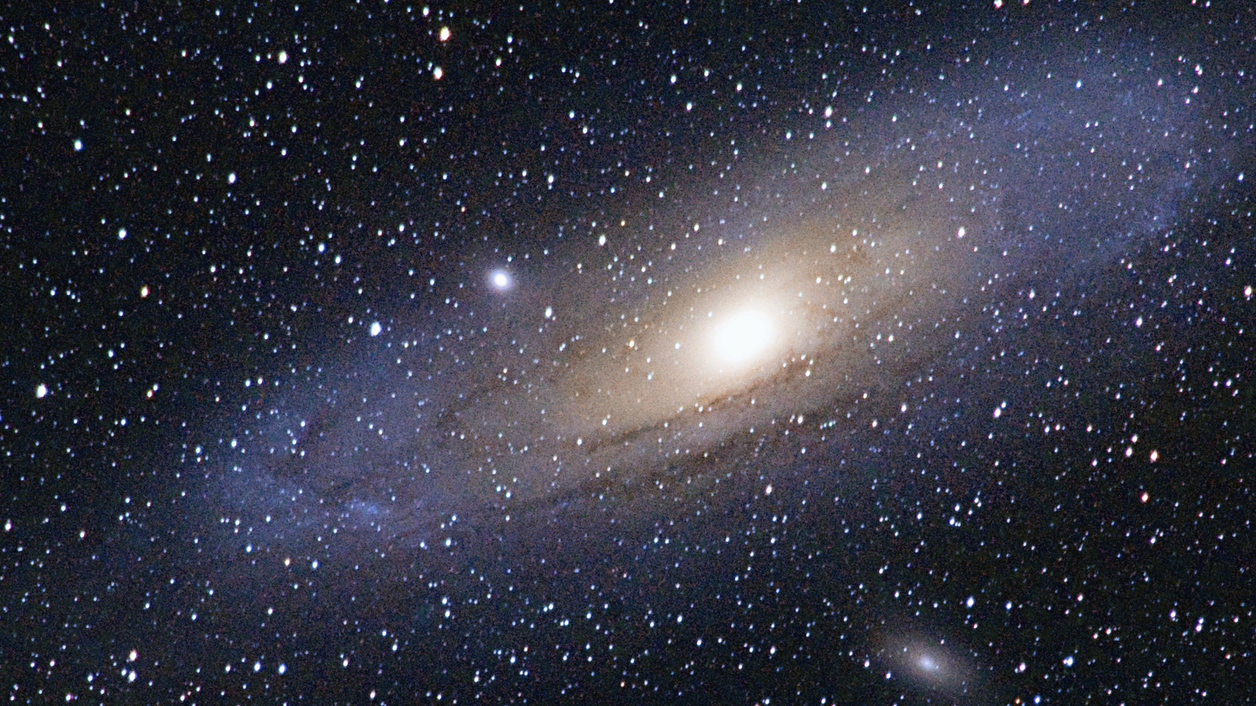

BELIEFS ABOUT GOD IN OTHER RELIGIONS
God is not seen with our eyes, but many people believe His signs can be seen in the world such as the acceptance of prayers.
We can see the sun, moon, stars, animals, plants, and our own bodies.

Slide 9
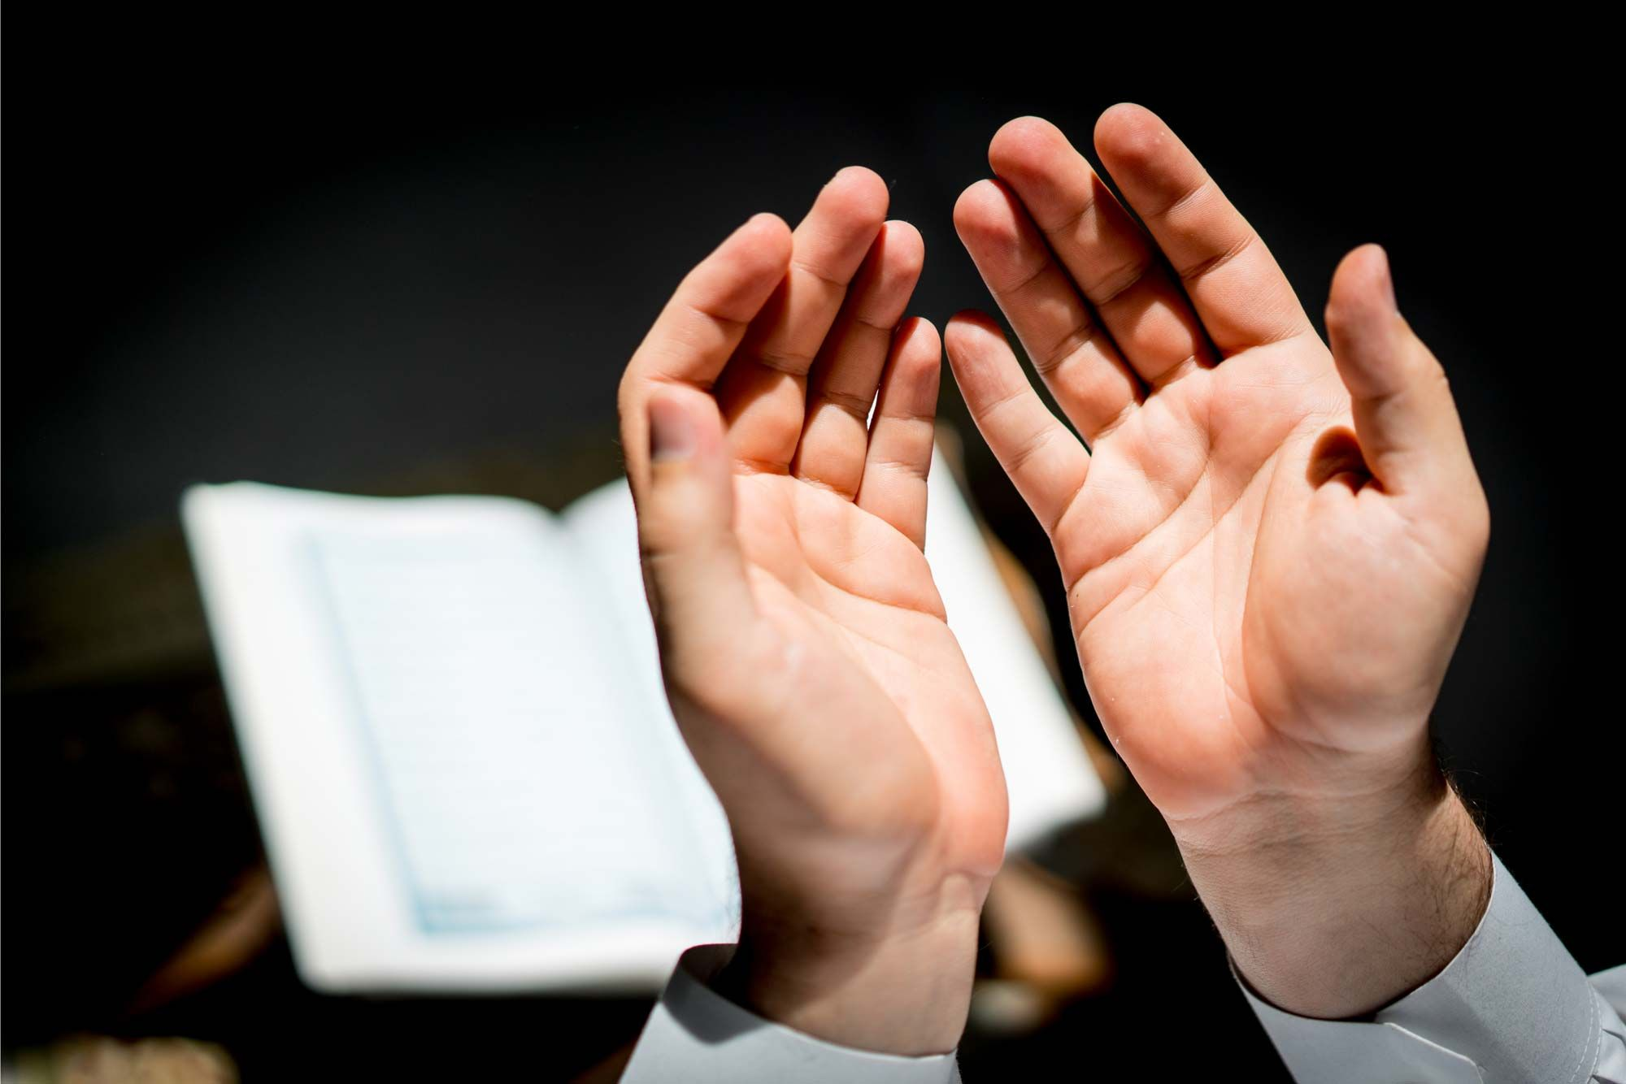
BELIEFS ABOUT GOD IN OTHER RELIGIONS
Many believers say these are signs of a Creator.
Just because we cannot see something does not always mean it is not real.
For example, we cannot see air, but we know it is there.
In the same way, believers say God can be known by His signs, help, and guidance.

Slide 10
The Existence Of God
https://youtu.be/96rgZ6K4mXw?si=fGlr8dYt1v0fNy5J
4:47-8:26

Slide 11

Today’s Recap
All of the major religions of the world believe in a God or a higher power.
However, there are different concepts of believing in him.
We believe in things that we cannot see so why is it necessary for us to see God in order to believe in him?

Slide 12

Test
Be sure to look out for another test at the end of next month for the Learning Time Section.
Please continue revising throughout the month in small chunks.
All PowerPoint and resources can be found on the Atfal Website at www.atfal.org.uk/taleem

