Slide 1
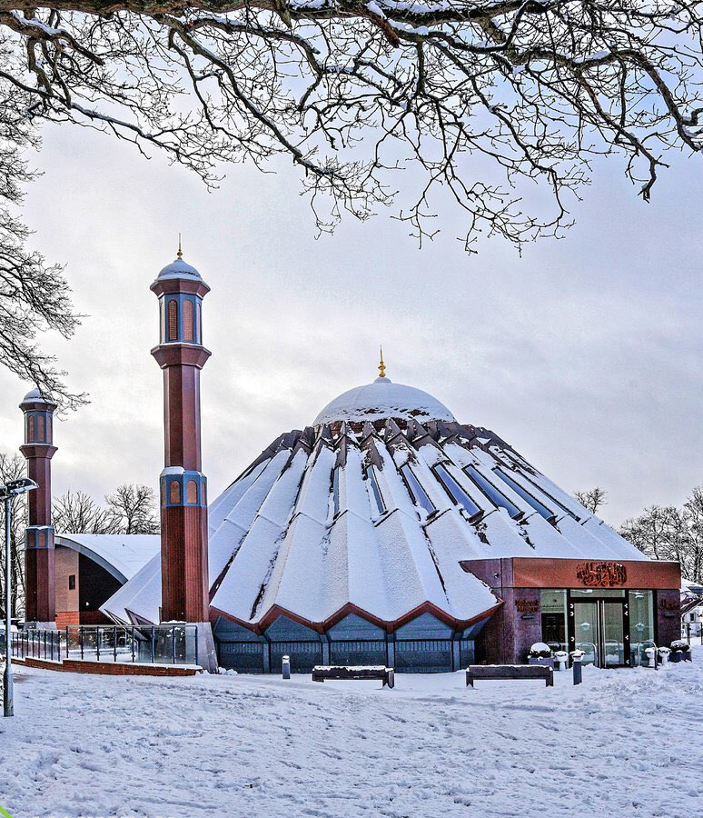


TALIM DEPARTMENT MAA UK
The Death of
Jesus (as)
Learning Time Topic 2 Module 1
TALIM DEPARTMENT MAA UK
www.atfal.org.uk/talim
talim@atfal.co.uk

Slide 2

Lesson Objectives
To learn the belief of Christians regarding the death of Hazrat Isa (as).
To be able to answer one allegation regarding Hazrat Isa (as) being alive.

Slide 3



PAIR ACTIVITY
Discuss the following 3 questions with the person next to you:
What is the Christian belief regarding the death of Hazrat Isa (as)?
What is the significance of him being resurrected to Heaven?
“If the Holy Prophet Muhammad (saw) went to Heaven, why is it not possible for Hazrat Isa (as) to ascend to Heaven?” How would an Ahmadi answer the allegation?
Death of Jesus

Slide 4
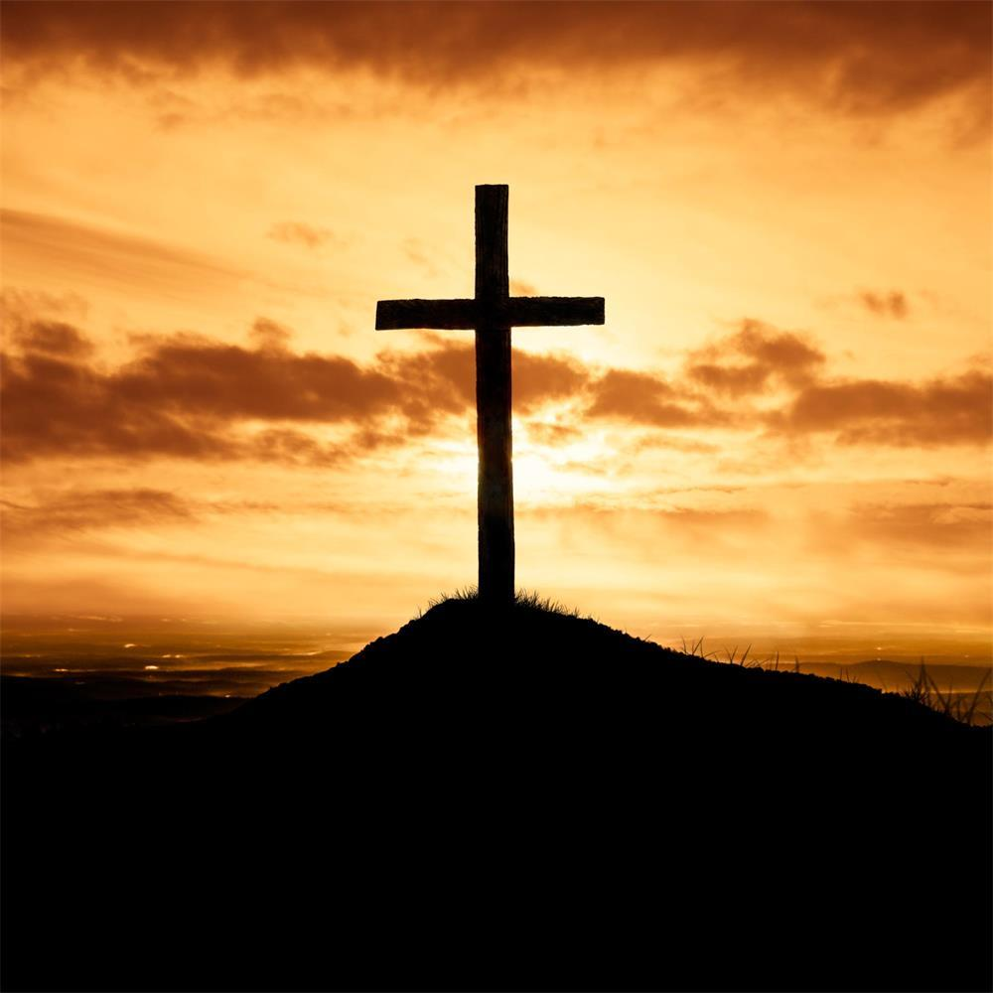
CHRISITAN VIEW OF THE DEATH OF HAZRAT ISA (AS)
Christians believe that Jesus was raised to the heavens alive.
Jesus is still alive in the heavens and will return to the earth sometime in the latter days.

Slide 5
CHRISITAN VIEW OF THE DEATH OF HAZRAT ISA (AS)
Christians believe that Jesus died on the cross, was resurrected, went to heaven in his earthly body, seated himself on the right hand of his Father and will return to the earth for judgment in the latter days.

Slide 6
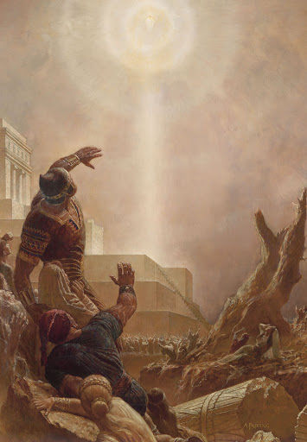
CHRISITAN VIEW OF THE DEATH OF HAZRAT ISA (AS)
Christians believe that Jesus was arrested and crucified, owing to his betrayal by Judas Iscariot.
This means that Jesus (as) has not passed away but has been alive for the past 2,000 years waiting in Heaven to come down.

Slide 7
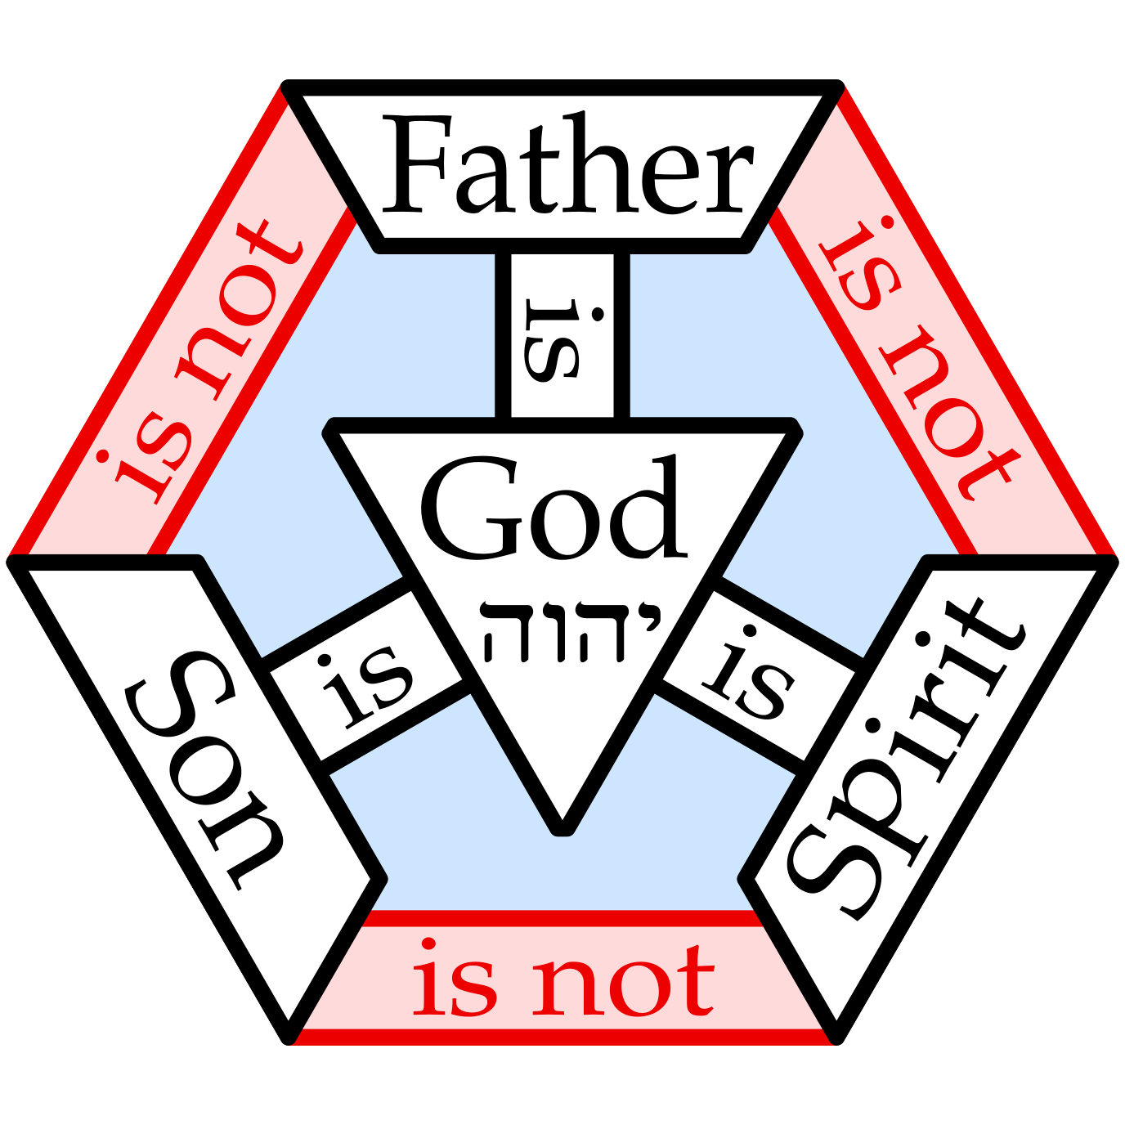
CHRISITAN VIEW OF THE DEATH OF HAZRAT ISA (AS)
The significance of being raised to Heaven is that Christians believe that Jesus (as) was sent to this world as the “son of God.”
They believe that he came and took away the sins of all Christians.

Slide 8
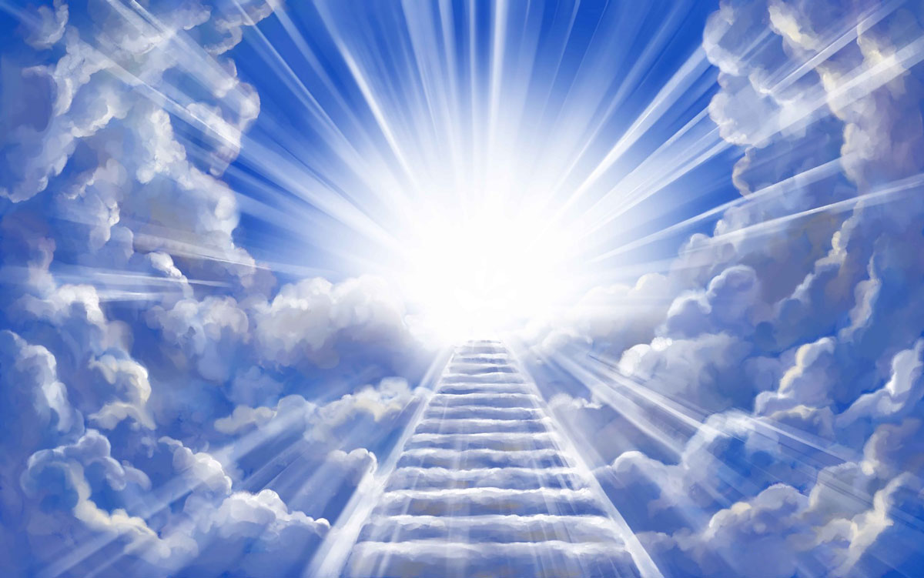
CHRISITAN VIEW OF THE DEATH OF HAZRAT ISA (AS)
This meant that all Christians became pure just like a new born is pure from any sins and evil at birth.
They believe that by being raised to Heaven with all their sins, the Christians are able to attain Salvation.

Slide 9
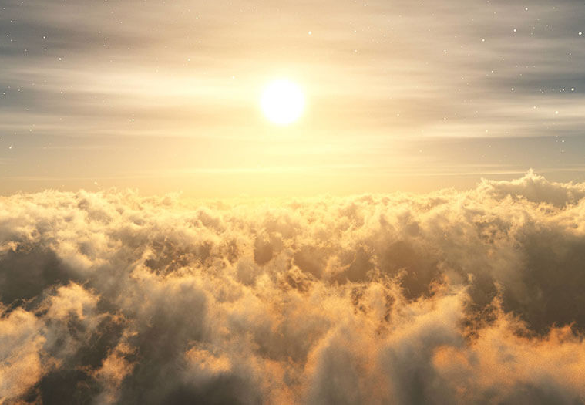
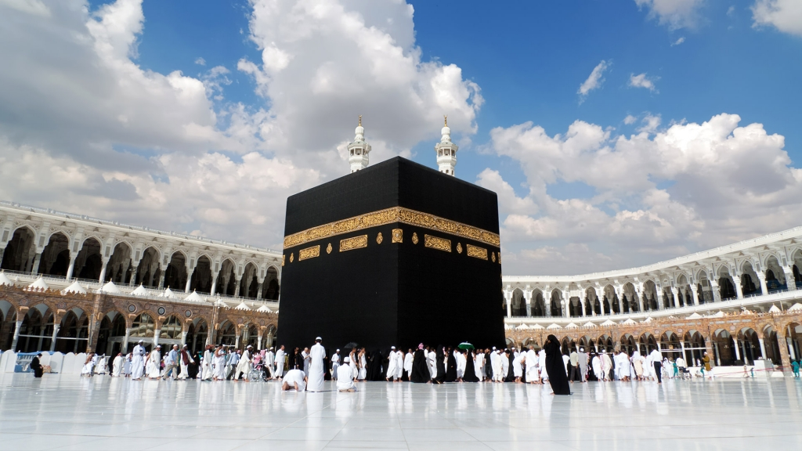
ISLAMIC VIEW OF THE DEATH OF HAZRAT ISA (AS)
The Holy Prophet Muhammad (saw) did not physically ascend to Heaven during the journey of Mi’raaj with his body.
However, we believe that he was shown the heavens in a state of vision.

Slide 10
ISLAMIC VIEW OF THE DEATH OF HAZRAT ISA (AS)
The soul of the Holy Prophet Muhammad (saw) possessed the highest amount of purity and ability and that is why he was able to ascend to the highest point in Heaven spiritually which no other person is able to do.

Slide 11
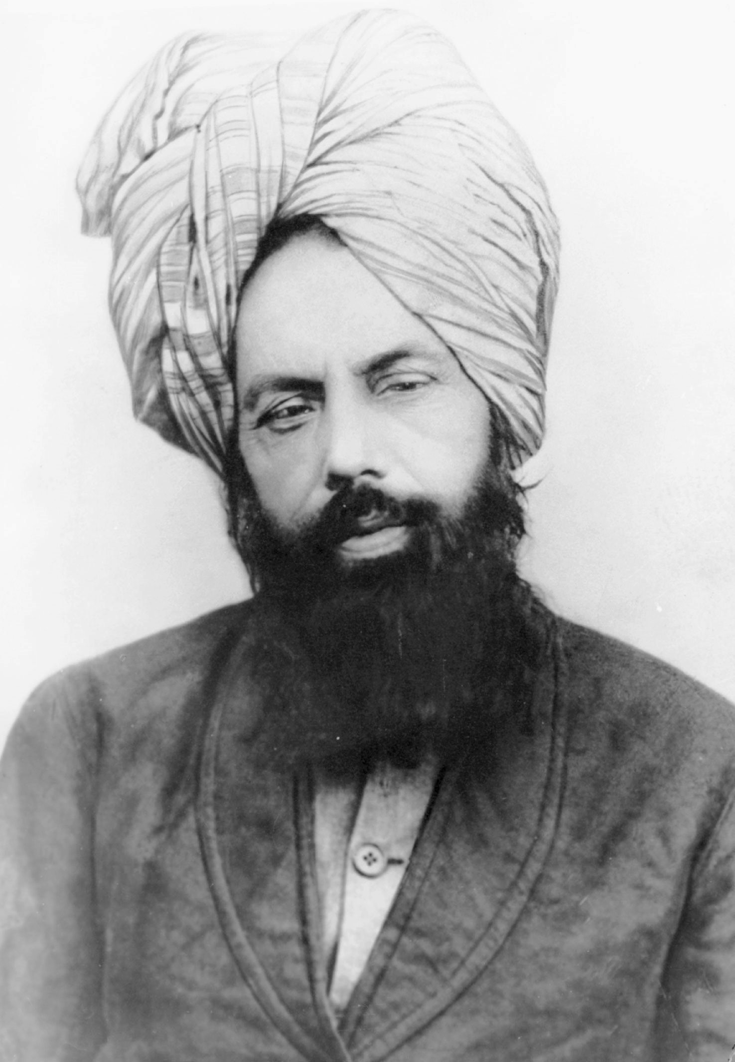
ISLAMIC VIEW OF THE DEATH OF HAZRAT ISA (AS)
The Promised Messiah (as) in his book, Izala Auham states: “I do not call it a dream at all, nor do I consider it among the lower level of vision; rather, it is the highest station of vision, which in reality is wakefulness — and indeed, in comparison to this dense wakefulness, that state is purer and more luminous.”
(Izala Auham, Rohani Khuzain, Vol 3, pg 126. )

Slide 12
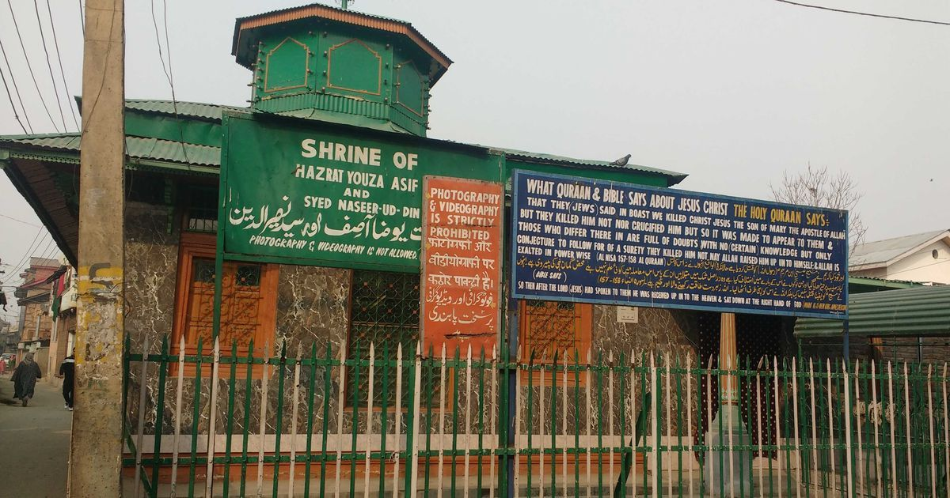
ISLAMIC VIEW OF THE DEATH OF HAZRAT ISA (AS)
On the other hand, Christians believe that Jesus (as) has been alive in heaven for the past 2,000 years and if his body did ascend to Heaven alive, we would have to believe that he passed away and was buried in heaven as well which is not possible.

Slide 13

THE DEATH OF HAZRAT ISA (AS)
https://youtu.be/1tRgKMmCbeo?si=mUbmcCd8soQjVQF5
12:30-19:30

Slide 14

Today’s Recap
Christians believe that Jesus (as) was crucified and then ascended to heaven.
They believe he came to take away the sins of mankind.
Christians strongly believe in the idea of Salvation.
Jesus (as) cannot perform miracles because it would mean that he is doing the work of God Almighty which is Shirk.

Slide 15

Test
Be sure to look out for another test at the end of next month for the Learning Time Section.
Please continue revising throughout the month in small chunks.
All PowerPoint and resources can be found on the Atfal Website at www.atfal.org.uk/taleem

