Slide 1



TALIM DEPARTMENT MAA UK
WEEKLY
ATFAL CLASS
(May – Week 1)
TALIM DEPARTMENT MAA UK
www.atfal.org.uk/talim
talim@atfal.co.uk

Slide 2

Class Rules
Arrive on time and be prepared
Always say “Assalamu Alaikum” when you enter the room
Pay attention and listen to the teacher quietly.
Raise your hand if you have a question.
Listen to others when they are speaking.
Work hard and try your best to learn something new.

Slide 3


Lesson Plan
1. Tilawat
2. Hadith
3. Thought of the Week
4. Homework Recap
5. Salat Recap
6. Friday Sermon
7. Learning Time
8. Announcements!
Are you prepared for today’s lesson?
Topi
Class Handout
Pen / Pencil

Slide 4

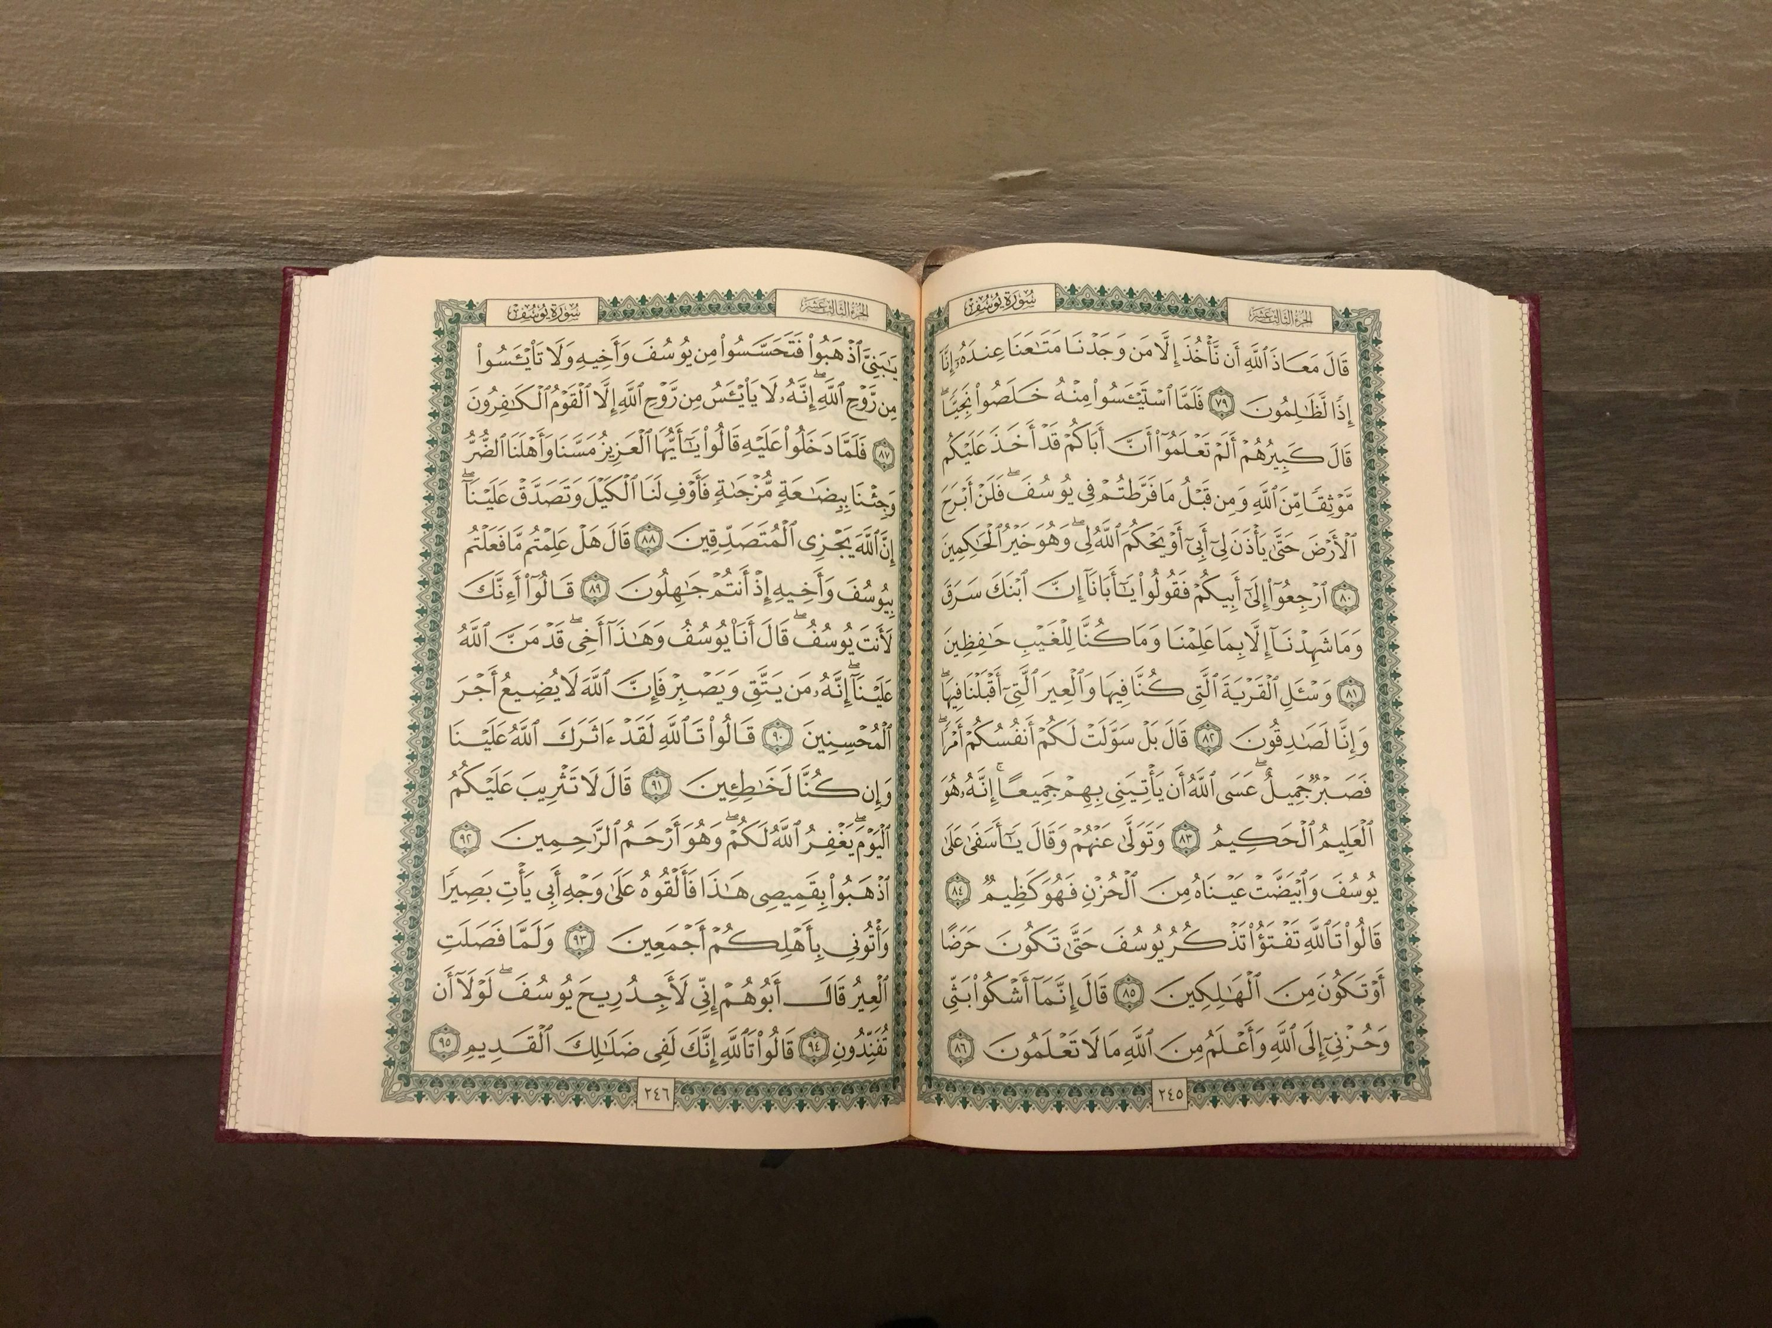

TILAWAT
وَلَا تَبۡخَسُوا النَّاسَ اَشۡیَآءَہُمۡ
وَلَا تَعۡثَوۡا فِی الۡاَرۡضِ مُفۡسِدِیۡنَ﴿﴾ۚ
TRANSLATION
“And do not pay people less than the true value of their things, nor act corruptly in the earth, making mischief.”
(The Holy Quran, Surah Ash-Shu’ara, 26:184)

Slide 5


HADITH
(sayings of the Holy Prophet Muhammad^{sas})
The Holy Prophet^{sas} states: “Your [workers] are your brothers whom Allah has placed under your command. So, if one has one's brother under one's control, one should feed him with the like of what one eats and clothe him with the like of what one wears. You should not overburden them with what they cannot bear, and if you do so, help them (in their hard job).”
(Hadith Book: Sahih Al-Bukhari)
Notes:
After Tilawat, spend 5 mins catching up with Atfal. What they've been getting up to in the past week.
Hadith:
Whoever, reads the Hadith out, should do so in the proper manner. i.e. recite Durood Shareef first and then the Hadith.
Have a brief discussion about the meaning of this hadith in light of the questions on the screen.

Slide 6



THOUGHT
OF THE WEEK
TOPIC:
“FAIR TRADE DAY!”

Slide 7

WHAT IS FAIRTRADE DAY?
Fairtrade is when people who make the things we buy, are treated fairly and paid properly for their hard work.
Fairtrade is essential for people working in poorer, less developed countries.
There are a number of Fairtrade logos on the packaging of items to tell us if the product is Fairtrade.
Fairtrade groups have been set up to form positive relationships between producers and buyers.

Slide 8


HISTORY OF FAIRTRADE
In 1946, Byler, who was an American businesswoman, visited a women’s sewing group in Puerto Rico.
She began selling the group’s crafts to friends and neighbours in the USA.
In the 1940s and 50s, some groups started to work together to ensure farmers and workers, particularly in poor countries, got a fair deal.
Over time, more and more people around the world started to support Fairtrade, and In 1992, the Fairtrade Foundation was established.
Examples of some Fairtrade products are tea, chocolate, sugar, vanilla, and fruit.

Slide 9





HOMEWORK
Have you done your homework for this week?
Make sure to note down your homework for next week!

Slide 10
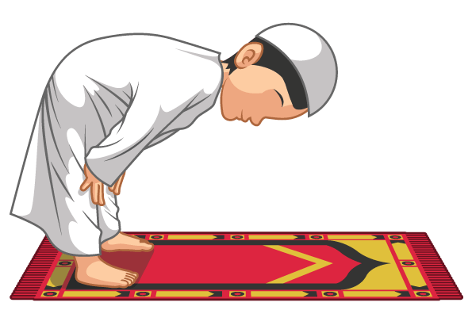

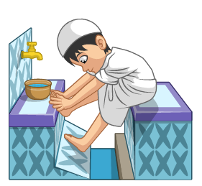
The Prayer after Ablution
اَللَّهُمَّ اجْعَلْنِیْ مِنَ التَّوَّابِیْنَ
وَ اجْعَلْنِیْ مِنَ الْمُتَطَھِّرِیْنَ
SALAT
Lets Recap a part of our Salat!
Allahumaj‘alni minattawaabina
waj’alni mina almutatahireen.
NEXT WEEK RECAP:
Niyyat
Translation:
"O Allah, Make me from among those who repent of their sins and from among those who keep themselves pure and clean."

Slide 11


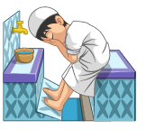
التَّوَّابِیْنَ | مِنَ | اجْعَلْنِیْ | اللَّهُمَّ
Those who repent of their sins | From among | Make me | O Allah
الْمُتَطَھِّرِیْنَ | مِنَ | اجْعَلْنِیْ | وَ
Those who keep themselves pure and clean | From among | Make me | And
Prayer After Ablution

Slide 12

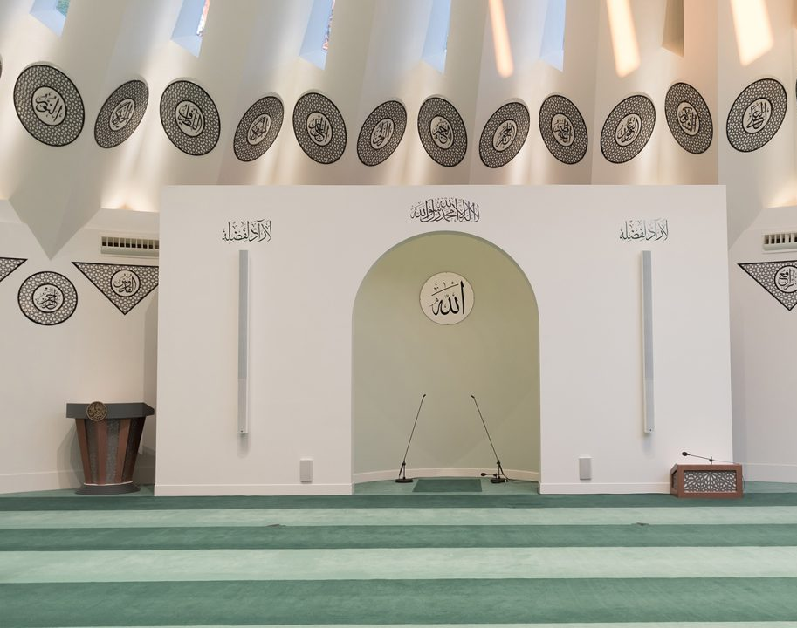
FRIDAY
SERMON
Friday 1st May
2026

Slide 13






FRIDAY SERMON
The Promised Messiah’s^{as} Example of Truthfulness
Truth over Trial: Victory through Honesty
Approximately fifteen or sixteen years earlier, Mirza Ghulam Ahmad(as) sent an article for publication to a Christian editor, Rallia Ram, in Amritsar. Along with the article, he included a letter in the same postal packet, unaware that this violated postal regulations and could result in a fine or imprisonment.
The editor, due to religious differences, reported the matter, and a legal case was filed against him. When summoned to court, lawyers strongly advised him to deny placing the letter in the packet and even suggested producing false witnesses to secure an acquittal. Despite the risk, he firmly refused to lie, choosing to remain truthful regardless of the outcome.
In court, when questioned, he openly admitted that the letter and packet were his, clarifying that there was no ill intent. Upon hearing his honest statement, the judge's attitude changed, he dismissed the arguments against him, and released him without punishment. The Promised Messiah (as) later expressed that this deliverance was a result of adhering firmly to truth, trusting in Allah even in a difficult trial.
Watch this weeks Friday Sermon 4 Kids!

Slide 14

FRIDAY SERMON TAKEAWAY POINTS
Am I willing to sacrifice personal benefit, honour, or wealth for the sake of truth?
Do I truly believe that Allah supports and grants success to the truthful?

Slide 15

PAIR ACTIVITY
Discuss today’s lesson with the Tifl next to you and come up with 3 new things you learned today!

Slide 16

ANNOUNCEMENTS
National Atfal Quiz Time is out!
We are delighted to announce the National Atfal Talim Quiz, beginning at Regional levels soon!
🌟 Why take part?
Compete with fellow Atfal across 6 exciting topics!
Open to Atfal aged 10–15
🏆 Regional Winners through to the Final!
📌 Don’t miss your chance to showcase your knowledge and have fun along the way!
👉 For Sign up & Syllabus:
https://www.atfal.org.uk/atfal-quiz-time📖 Be sure to check out the Rules and Syllabus provided in the above link!
Let the challenge begin!

