Slide 1



TALIM DEPARTMENT MAA UK
WEEKLY
ATFAL CLASS
(May – Week 2)
TALIM DEPARTMENT MAA UK
www.atfal.org.uk/talim
talim@atfal.co.uk

Slide 2

Class Rules
Arrive on time and be prepared
Always say “Assalamu Alaikum” when you enter the room
Pay attention and listen to the teacher quietly.
Raise your hand if you have a question.
Listen to others when they are speaking.
Work hard and try your best to learn something new.

Slide 3


Lesson Plan
1. Tilawat
2. Hadith
3. Thought of the Week
4. Homework Recap
5. Salat Recap
6. Friday Sermon
7. Learning Time
8. Announcements!
Are you prepared for today’s lesson?
Topi
Class Handout
Pen / Pencil

Slide 4

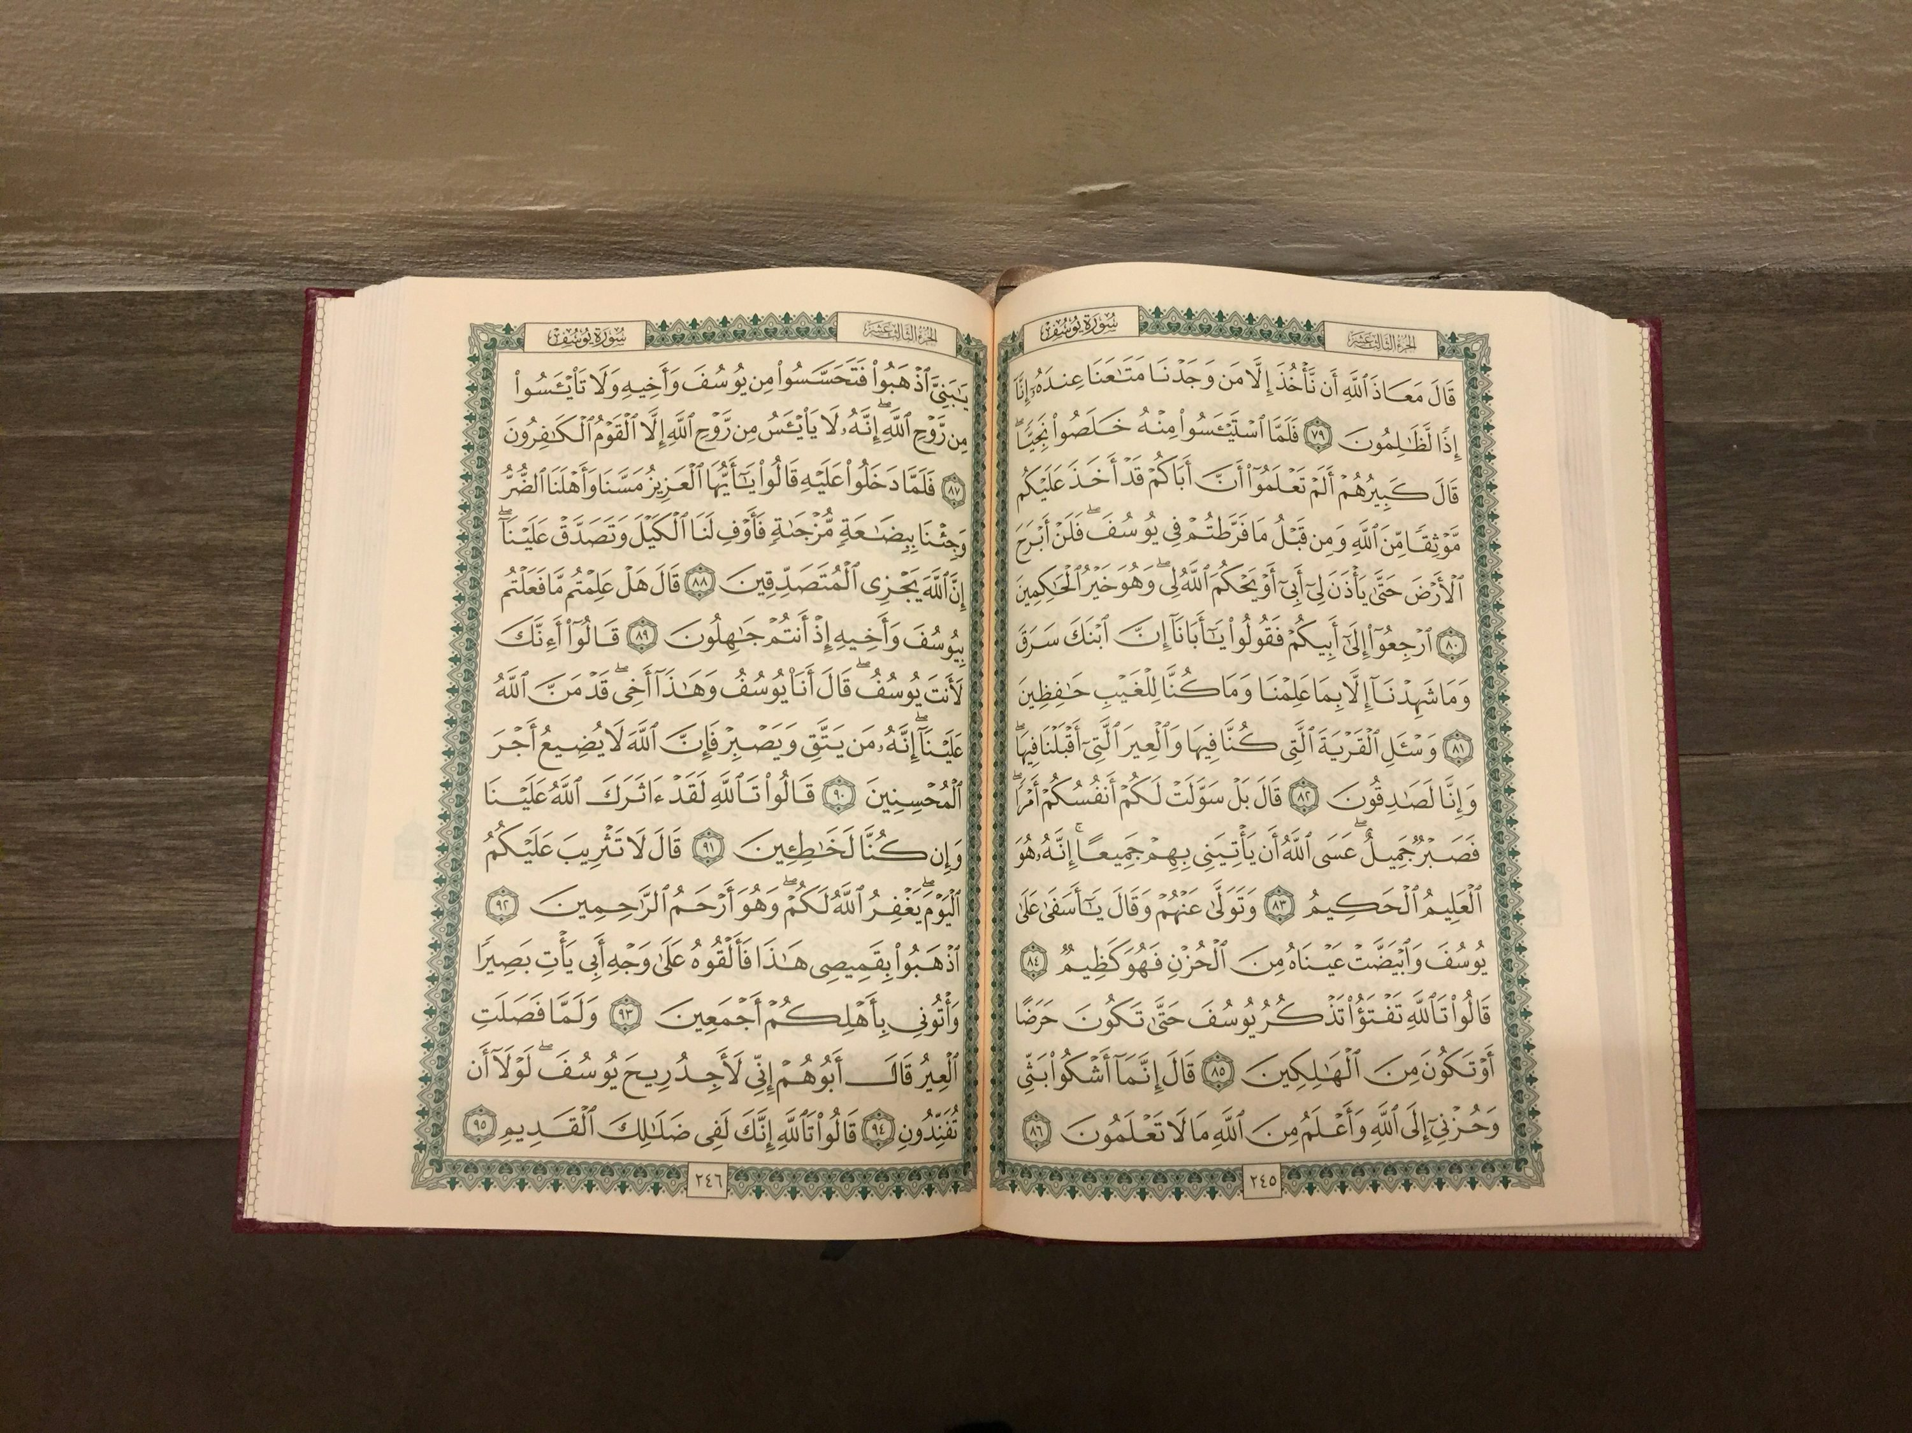

TILAWAT
وَاِذَا مَرِضۡتُ فَہُوَ یَشۡفِیۡنِ
TRANSLATION
“And when I am ill, it is He Who restores me to health;”
(The Holy Quran, Surah Ash-Shu’arah, 26:81)

Slide 5


HADITH
(sayings of the Holy Prophet Muhammad^{sas})
قَالَ رَسُولُ اللَّهِ ﷺ
‏ مَا يُصِيبُ الْمُؤْمِنَ مِنْ وَصَبٍ وَلَا نَصَبٍ وَلَاسَقَمٍ وَلَاحَزَنٍ حَتَّى الْهَمِّ يُهَمُّهُ إِلَّا كُفِّرَ بِهِ مِنْ سَيِّئَاتِهِ ‏
The Holy Prophet^{sa} states: “Never a believer is stricken with discomfort, hardship or illness, grief or even with mental worry except that his sins are expiated for him.”
(Hadith Book: Sahih Muslim)
Notes:
After Tilawat, spend 5 mins catching up with Atfal. What they've been getting up to in the past week.
Hadith:
Whoever, reads the Hadith out, should do so in the proper manner. i.e. recite Durood Shareef first and then the Hadith.
Have a brief discussion about the meaning of this hadith in light of the questions on the screen.

Slide 6



THOUGHT
OF THE WEEK
TOPIC:
“MENTAL HEALTH AWARENESS WEEK”

Slide 7

WHAT IS MENTAL HEALTH?
Mental health is about how you think, feel, and act every day.
It affects, your emotions, thoughts, how you get along with others and how you handle problems and stress.
Just like your body can be healthy or unhealthy, your mind can too.
Having difficult feelings is normal sometimes.
Talking about feelings is a sign of strength, not weakness.

Slide 8
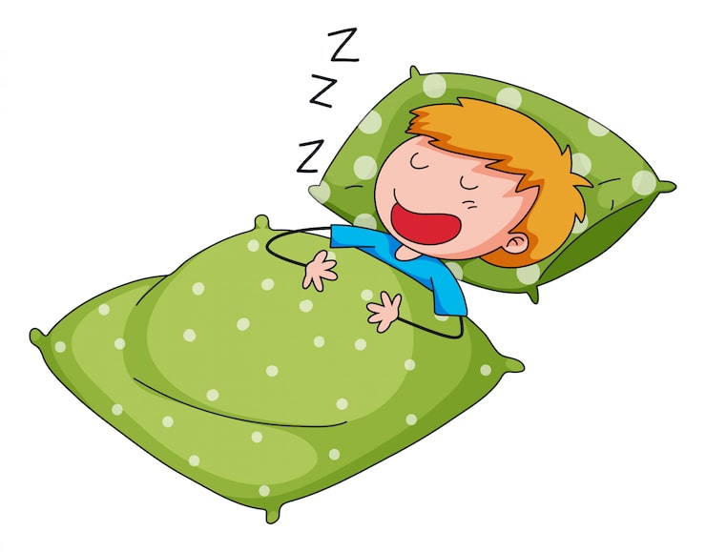


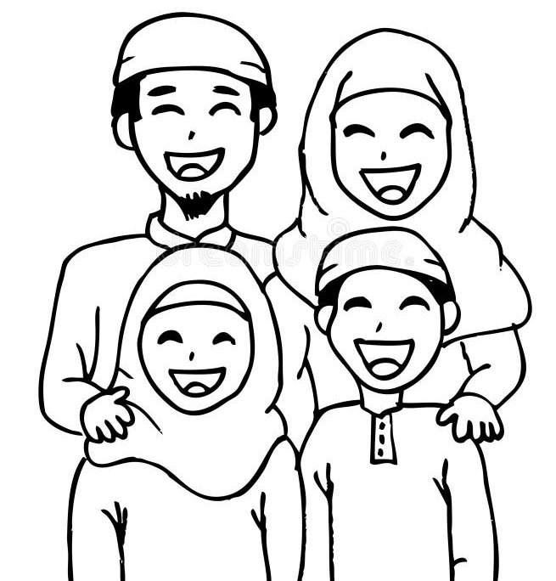
WHAT IMPROVES
MENTAL HEALTH?
The following things can help to improve the mental state of a person:
Sleeping well
Eating healthy food
Playing and exercising
Spending time with friends and family
Talking to someone you trust
Doing hobbies you enjoy

Slide 9
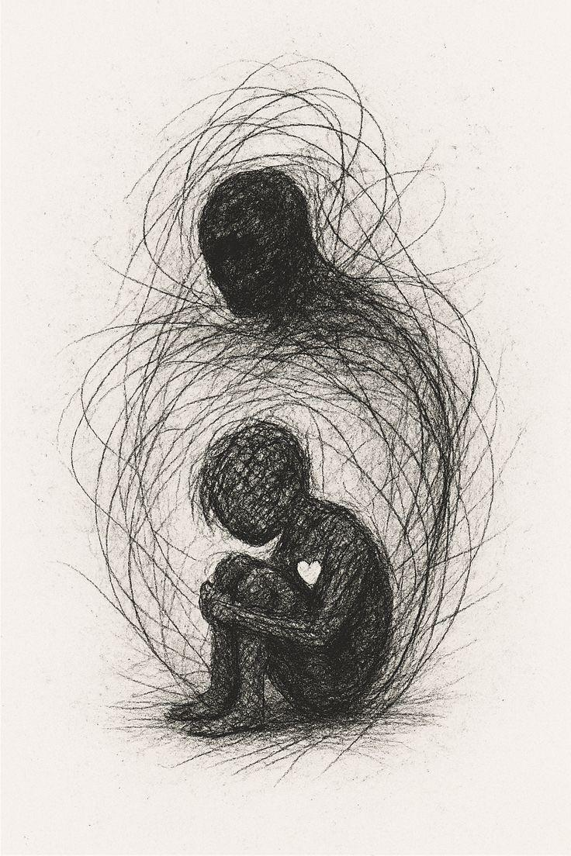
WHAT DESTROYS
MENTAL HEALTH?
The following things can destroy the mental state of a person:
Bullying
Feeling lonely
Too much stress
Lack of sleep
Keeping feelings bottled up
Spending too much time worrying

Slide 10
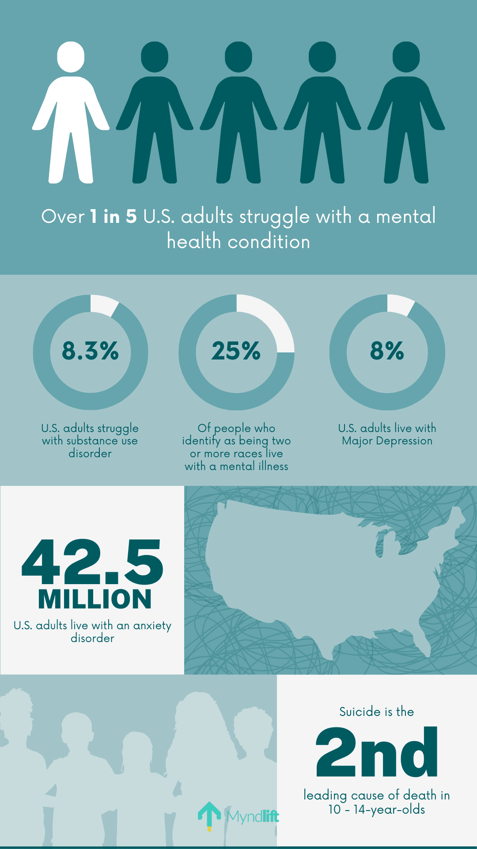
STATISTICS REGARDING MENTAL HEALTH?
One in five (20.2%) adults in England have a Common Mental Health Condition, with higher in women than men.
Young people are more likely to have a Common Mental Health Condition than older people.
Among 16 to 24 year olds, Common Mental Health Condition has risen from 17.5% in 2007 and 18.9% in 2014, to 25.8% in 2023/4.

Slide 11

ISLAMIC VIEW ON MENTAL HEALTH
Regarding Mental Health, the Holy Qu’ran states:
الَّذِيۡنَ اٰمَنُوۡا وَتَطۡمَئِنُّ قُلُوۡبُہُمۡ بِذِکۡرِ اللّٰہِ ؕ اَلَا بِذِکۡرِ اللّٰہِ تَطۡمَئِنُّ الۡقُلُوۡبُ
“Those who believe, and whose hearts find comfort in the remembrance of Allah. Aye! it is in the remembrance of Allah that hearts can find comfort.”
(The Holy Quran, Surah Ar-Ra’d, 13:29)

Slide 12

ISLAMIC VIEW ON MENTAL HEALTH
Regarding Mental Health, the Holy Prophet states:
‏ إِنَّ اللّٰهَ يَقُولُ أَنَا عِنْدَ ظَنِّ عَبْدِي بِي
وَأَنَا مَعَهُ إِذَا دَعَانِي‏
“Indeed Allah the Most High says, ‘I am as My slave thinks of Me, and I am with him when He calls upon Me.”
(Sahih Muslim, Kitab Adh-Dhikri, Hadith No. 2675)

Slide 13

ISLAMIC VIEW ON MENTAL HEALTH
Regarding Mental Health, the Promised Messiah (as) states:
“No difficulty or affliction can persist if one demonstrates steadfastness and patience while placing trust and faith in God Almighty. ‘When God is yours, what grief can you have?’”
(Malfuzat, Vol .5, Page. 274)

Slide 14





HOMEWORK
Have you done your homework for this week?
Make sure to note down your homework for next week!

Slide 15
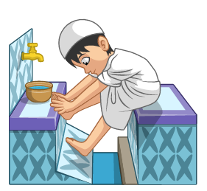
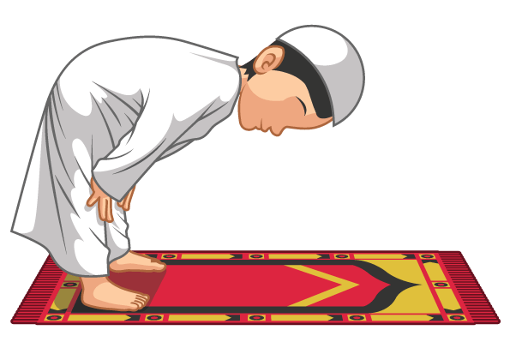

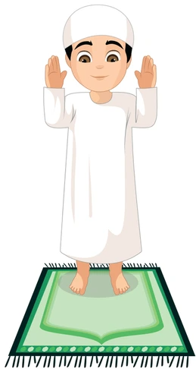
The Niyyat (Intention)
وَجَّهْتُ وَجْهِيَ لِلَّذِي فَطَرَ السَّمٰوٰتِ وَالْأَرْضَ حَنِيفًا وَ مَا أَنَا مِنَ الْمُشْرِكِينَ
SALAT
Lets Recap a part of our Salat!
Wajjah-tu wajhiya lilladhee faṭaras-samāwāti wal-arḍa ḥaneefan wa mā ana minal-mushrikeen.
Translation:
NEXT WEEK RECAP:
Thana
I have turned my full attention towards Him Who has created the heavens and the earth, being ever inclined to Him, and I am not one of those who associate partners with Allah

Slide 16
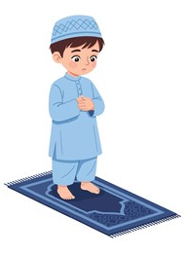
فَطَرَ | لِلَّذِي | وَجْهِيَ | وَجَّهْتُ
He has created | Towards he who | My full attention | I have turned
وَ مَا أَنَا | حَنِيفًا | وَالْأَرْضَ | السَّمٰوٰتِ
And I am not | Being ever-inclined to him | And the Earth | The Heavens
Niyyat (Intention)
الْمُشْرِكِينَ | مِنَ
Those who associate partners with Allah | From among

Slide 17

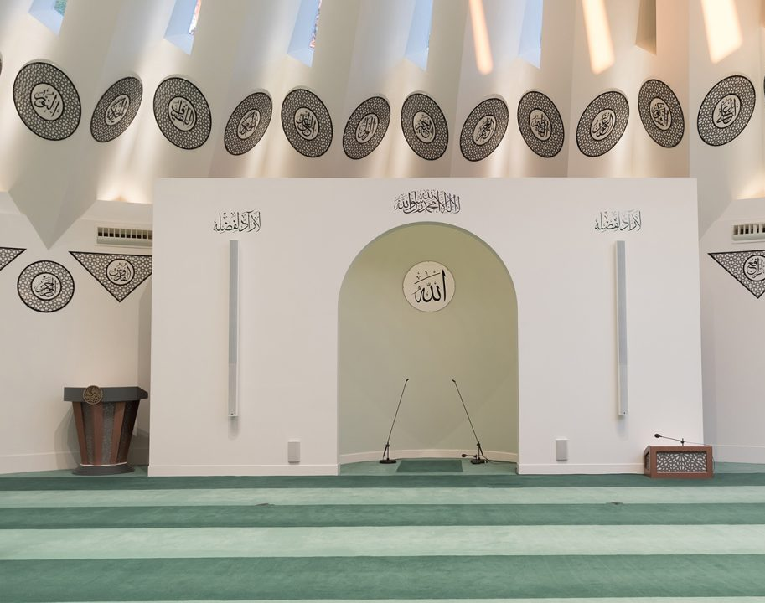
FRIDAY
SERMON
Friday 8th May
2026

Slide 18






FRIDAY SERMON
The Promised Messiah’s^{as} Example of Truthfulness
Truth over Trial: Victory through Honesty
Once, a person named Dr Henry Martyn Clark charged the Promised Messiah(as) with attempted murder.
Maulvi Muhammad Hussein Batalvi, appeared as a witness and did his utmost to establish the case against me.
The case was heard by ----- Captain Douglas
Abdul Hamid admitted his lie. He confessed that he had been forced into making his earlier statement and deposed that Mirza Sahib had never sent him to murder anyone.
There was a Hindu man who had known the Promised Messiah(as) since his childhood, as they were the same age. He said that from his childhood, he had known the Promised Messiah(as) to be truthful, trustworthy and pious.
The Hindu man said that he felt as though Parmeshwar had come down and adopted the form of the Promised Messiah(as).
A man who was travelling missed his train. He happened to meet the Promised Messiah (as), and realised that those who opposed the Promised Messiah (as) were wrong, because the man he was seeing before him could certainly never be a liar or false. Thus, he did Bai’at.
Watch this weeks Friday Sermon 4 Kids!

Slide 19

FRIDAY SERMON TAKEAWAY POINTS
Resolve this week never to give an ambiguous answer when a clear, truthful one is required of you.
If you face pressure (social, professional, or personal) to soften the truth, ask yourself: What would please God rather than people?

Slide 20

PAIR ACTIVITY
Discuss today’s lesson with the Tifl next to you and come up with 3 new things you learned today!

Slide 21

ANNOUNCEMENTS
National Atfal Quiz Time is out!
We are delighted to announce the National Atfal Talim Quiz, beginning at Regional levels soon!
🌟 Why take part?
Compete with fellow Atfal across 6 exciting topics!
Open to Atfal aged 10–15
🏆 Regional Winners through to the Final!
📌 Don’t miss your chance to showcase your knowledge and have fun along the way!
👉 For Sign up & Syllabus:
https://www.atfal.org.uk/atfal-quiz-time 📖 Be sure to check out the Rules and Syllabus provided in the above link!
Let the challenge begin!

