Slide 1
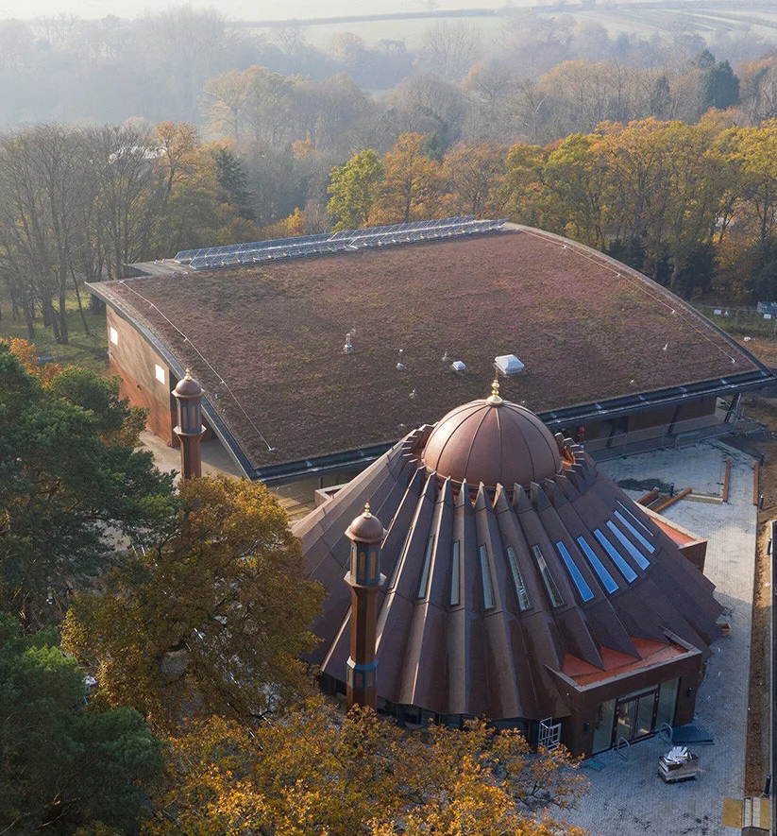



TALIM DEPARTMENT MAA UK
WEEKLY
ATFAL CLASS
(May – Week 3)
TALIM DEPARTMENT MAA UK
www.atfal.org.uk/talim
talim@atfal.co.uk

Slide 2


Class Rules
Arrive on time and be prepared
Always say “Assalamu Alaikum” when you enter the room
Pay attention and listen to the teacher quietly.
Raise your hand if you have a question.
Listen to others when they are speaking.
Work hard and try your best to learn something new.

Slide 3


Lesson Plan
1. Tilawat
2. Hadith
3. Thought of the Week
4. Homework Recap
5. Salat Recap
6. Friday Sermon
7. Learning Time
8. Announcements!
Are you prepared for today’s lesson?
Topi
Class Handout
Pen / Pencil

Slide 4

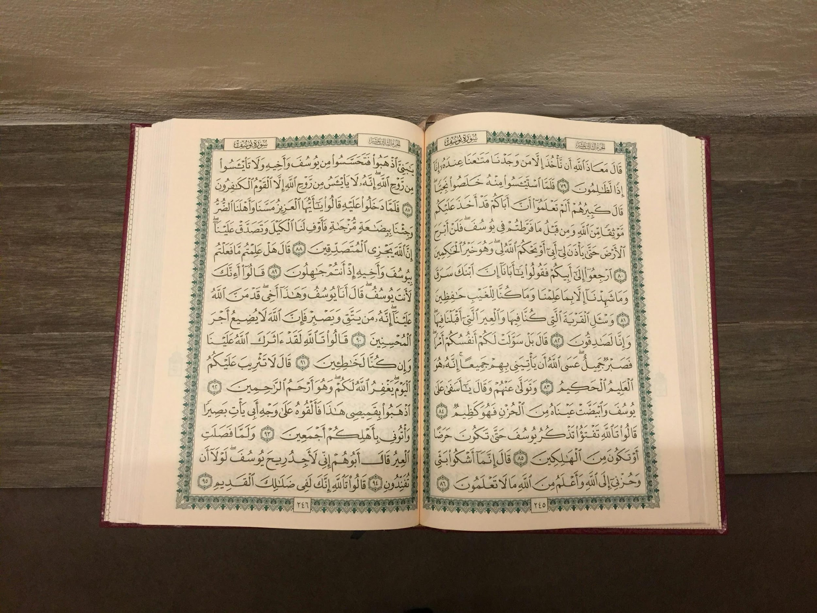

TILAWAT
لَا خَیۡرَ فِیۡ کَثِیۡرٍ مِّنۡ نَّجۡوٰٮہُمۡ اِلَّا مَنۡ اَمَرَ بِصَدَقَۃٍ اَوۡ مَعۡرُوۡفٍ اَوۡ اِصۡلَاحٍۭ بَیۡنَ النَّاسِ ؕ وَمَنۡ یَّفۡعَلۡ ذٰلِکَ ابۡتِغَآءَ مَرۡضَاتِ اللّٰہِ فَسَوۡفَ نُؤۡتِیۡـہِ اَجۡرًا عَظِیۡمًا
TRANSLATION
There is no good in many of their conferences except the conferences of such as enjoin charity, or goodness, or the making of peace among men. And whoso does that, seeking the pleasure of Allah, We shall soon bestow on him a great reward.
(The Holy Quran, Surah Al Nisa, 4:115)

Slide 5
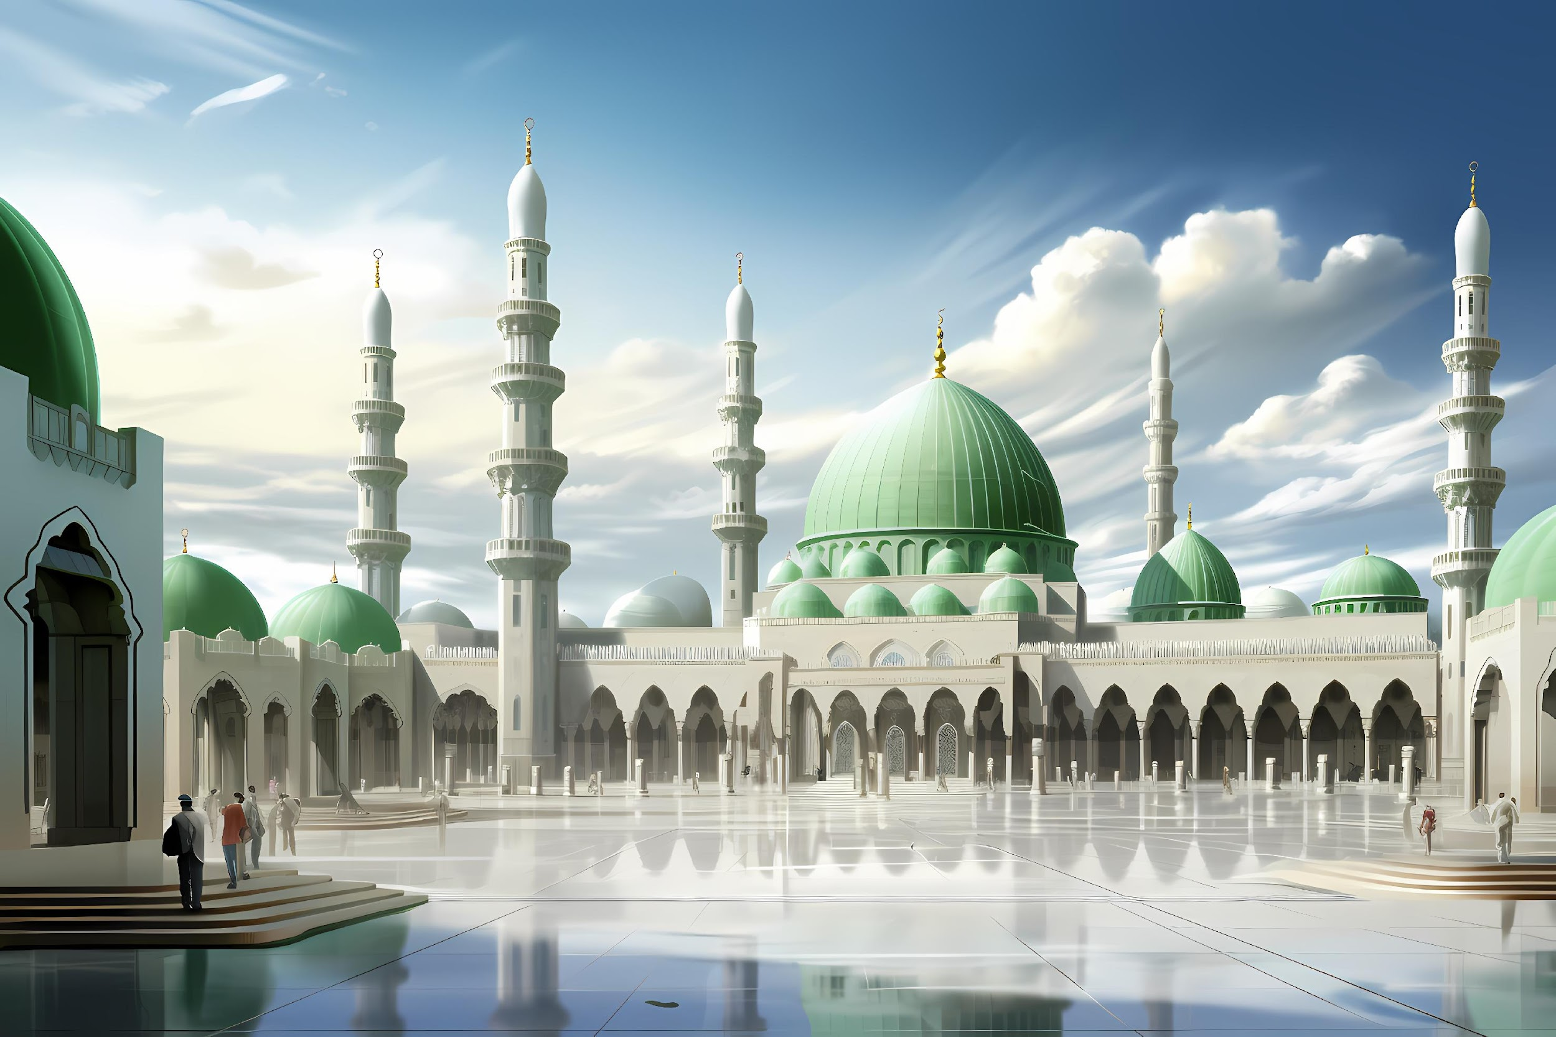

HADITH
(sayings of the Holy Prophet Muhammad^{sas})
Hazrat Umm-e-Kulthum (ra) relates that she heard the Holy Prophet (saw) say: “He who brings about peace between people and attains good or says that which is good is not a liar.”
(Hadith Book: Bukhari & Sahih Muslim)
Notes:
After Tilawat, spend 5 mins catching up with Atfal. What they've been getting up to in the past week.
Hadith:
Whoever, reads the Hadith out, should do so in the proper manner. i.e. recite Durood Shareef first and then the Hadith.
Have a brief discussion about the meaning of this hadith in light of the questions on the screen.

Slide 6



THOUGHT
OF THE WEEK
TOPIC:
JANG-E-MUQADDAS (THE HOLY WAR)

Slide 7

WHAT WAS THE HOLY WAR?
The Holy War was a debate that took place between the Promised Messiah (as) and one of his opponents, Abdullah Atham.
Abdullah Atham was a Christian opponent.
This Debate took place from 22nd May to 5th June 1893 in Amritsar.
Abdullah Atham was a Muslim by birth but later, on 28th March 1853, he was baptised and converted to Christianity.

Slide 8
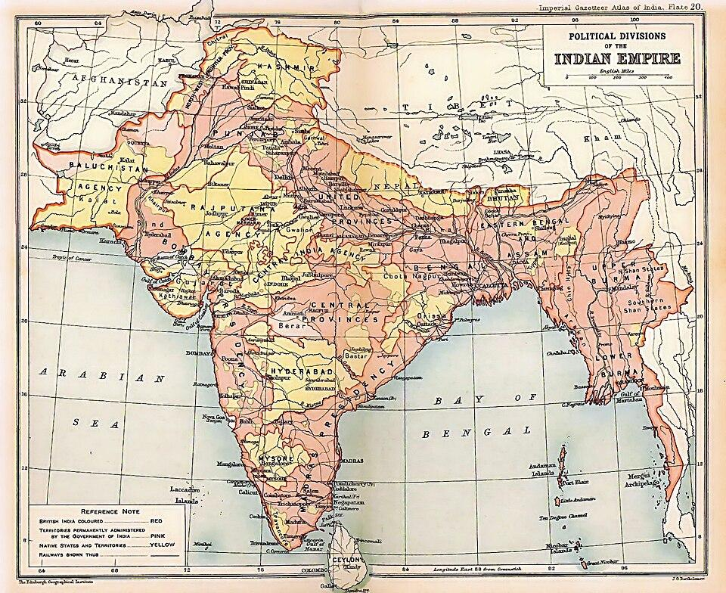
EVENTS BEFORE THE DEBATE:
In 1893, tensions arose in Jandiala, where a local panda (religious teacher) firmly resisted the activities of the Christian medical mission.
Dr Clark issued a public challenge to a religious debate.
The Muslims of Jandiala requested the Promised Messiah (as) to represent them.
Representatives from both parties gathered at Dr Clark’s residence to establish the rules for the upcoming debate.

Slide 9

THE DEBATE
The Debate continued for the next 15 days.
On the last day of the debate, 5 June 1893, a powerful prophecy was revealed by Allah the Almighty to the Promised Messiah (as).
“He gave me this Sign in the form of a glad tiding that in this debate, whichever party from among the two is deliberately adopting falsehood and abandoning the True God and is making a mere mortal into God, will be cast into Hell and utterly disgraced corresponding to the very days of this debate—in other words, taking one month for each day, meaning, within fifteen months.”
(Jang-e-Muqaddas, pp. 287-288)

Slide 10
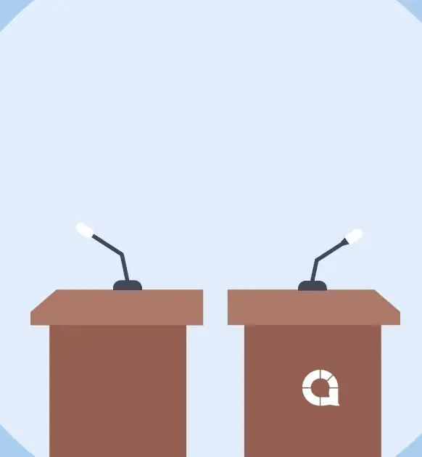
AFTERMATH OF
THE DEBATE
Dr Martin Clarke was constantly on the run, traveling from Amritsar to his son-in-law.
He had long since lost the use of his right hand and had recently told his wife that he felt death was near.
He lost his voice as well.
On 27th July 1896, Dr Martin Clarke passed away.

Slide 11





HOMEWORK
Have you done your homework for this week?
Make sure to note down your homework for next week!

Slide 12
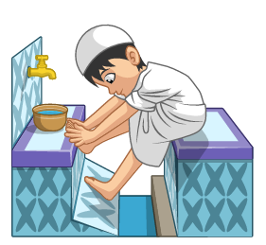
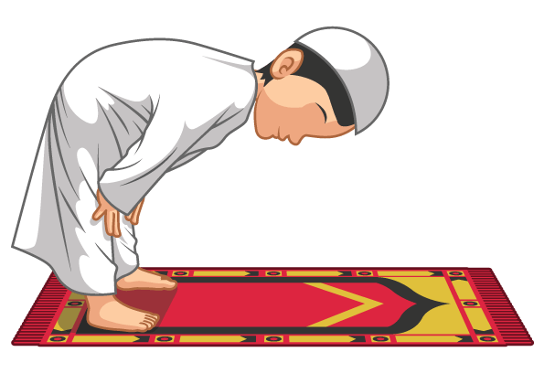

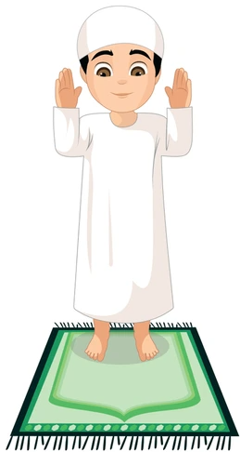
Thanaa Prayer
سُبْحْنَكَ اللَّهُمَّ وَ بِحَمْدِكَ وَ تَبَارَكَ اسْمُكَ وَتَعَالَى جَدُّكَ وَلَا إِلَهَ غَيْرُكَ
SALAT
Lets Recap a part of our Salat!
Subhanaka Allahumma Wa Bihamdika Watabarakasmuka wa ta’aalaa jadduka, wa laa ‘ilaaha ghayruka.
Translation:
NEXT WEEK RECAP:
Attawuz
Holy are You, O Allah, the Praiseworthy, and blessed is Your name, and exalted is Your Majesty, and there is none to be worshipped besides You

Slide 13
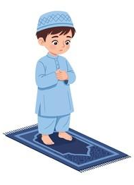
وَ تَبَارَك | وَ بِحَمْدِك | اللَّهُمّ | سُبْحْنَكَ
and blessed | the Praiseworthy | O Allah | Holy are You
ولَا إِلَهَ | جَدُّكَ | وَتَعَالَى | اسْمُكَ
and there is none to be worshipped | is Your Majesty | and exalted | is Your name
Thanaa Prayer
غَيْرُكَ
besides You

Slide 14

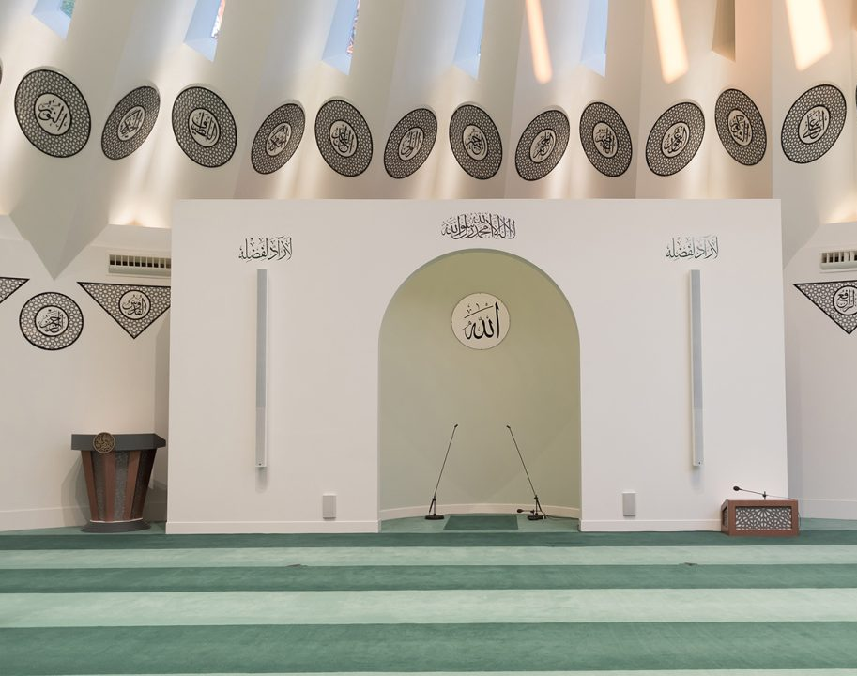
FRIDAY
SERMON
Friday 15th May
2026

Slide 15








FRIDAY SERMON
The Pinnacle of Humanity
Humility in the Life of the Prophet (sa)
Ahmadis believe that if ever there was a perfect person in the world, it was the Holy Prophet Muhammad (sa).
The Holy Prophet (sa) once said that a person who adopts humility ascended to the seventh heaven. Once, the Holy Prophet (sa) was heard praying, ‘O Allah, let me live in meekness, let me die in meekness, and raise me up among the meek.’
It is recorded that whenever the Holy Prophet (sa) met the Ansar, he would greet their children, place his hand on their heads and pray for them.
Once, a man went to the Holy Prophet (sa) to speak with him, but due to the awe of being in the presence of the Holy Prophet (sa), the man began shaking. The Holy Prophet (sa) told him to remain calm, for he was the son of a woman who would eat dried meat.
On the way to the Battle of Badr, there were three people assigned to one camel. When it was the Holy Prophet (sa)'s turn to walk, his two companions requested that he continue sitting on the camel while they walked. The Holy Prophet (sa) replied by saying that they did not have more endurance to walk than he did, nor was he any different from them, and insisted that they rode on the camel while he walked.
Watch this weeks Friday Sermon 4 Kids!

Slide 16

FRIDAY SERMON TAKEAWAY POINTS
Practise the habit of adopting humility within yourself.
Try to adopt the practices and qualities of the Holy Prophet Muhammad (saw) so that you can strive to become a better person.
Try to help out at home in any sort of way and adopt a mindset that no task is too little for you to complete.

Slide 17

PAIR ACTIVITY
Discuss today’s lesson with the Tifl next to you and come up with 3 new things you learned today!

Slide 18
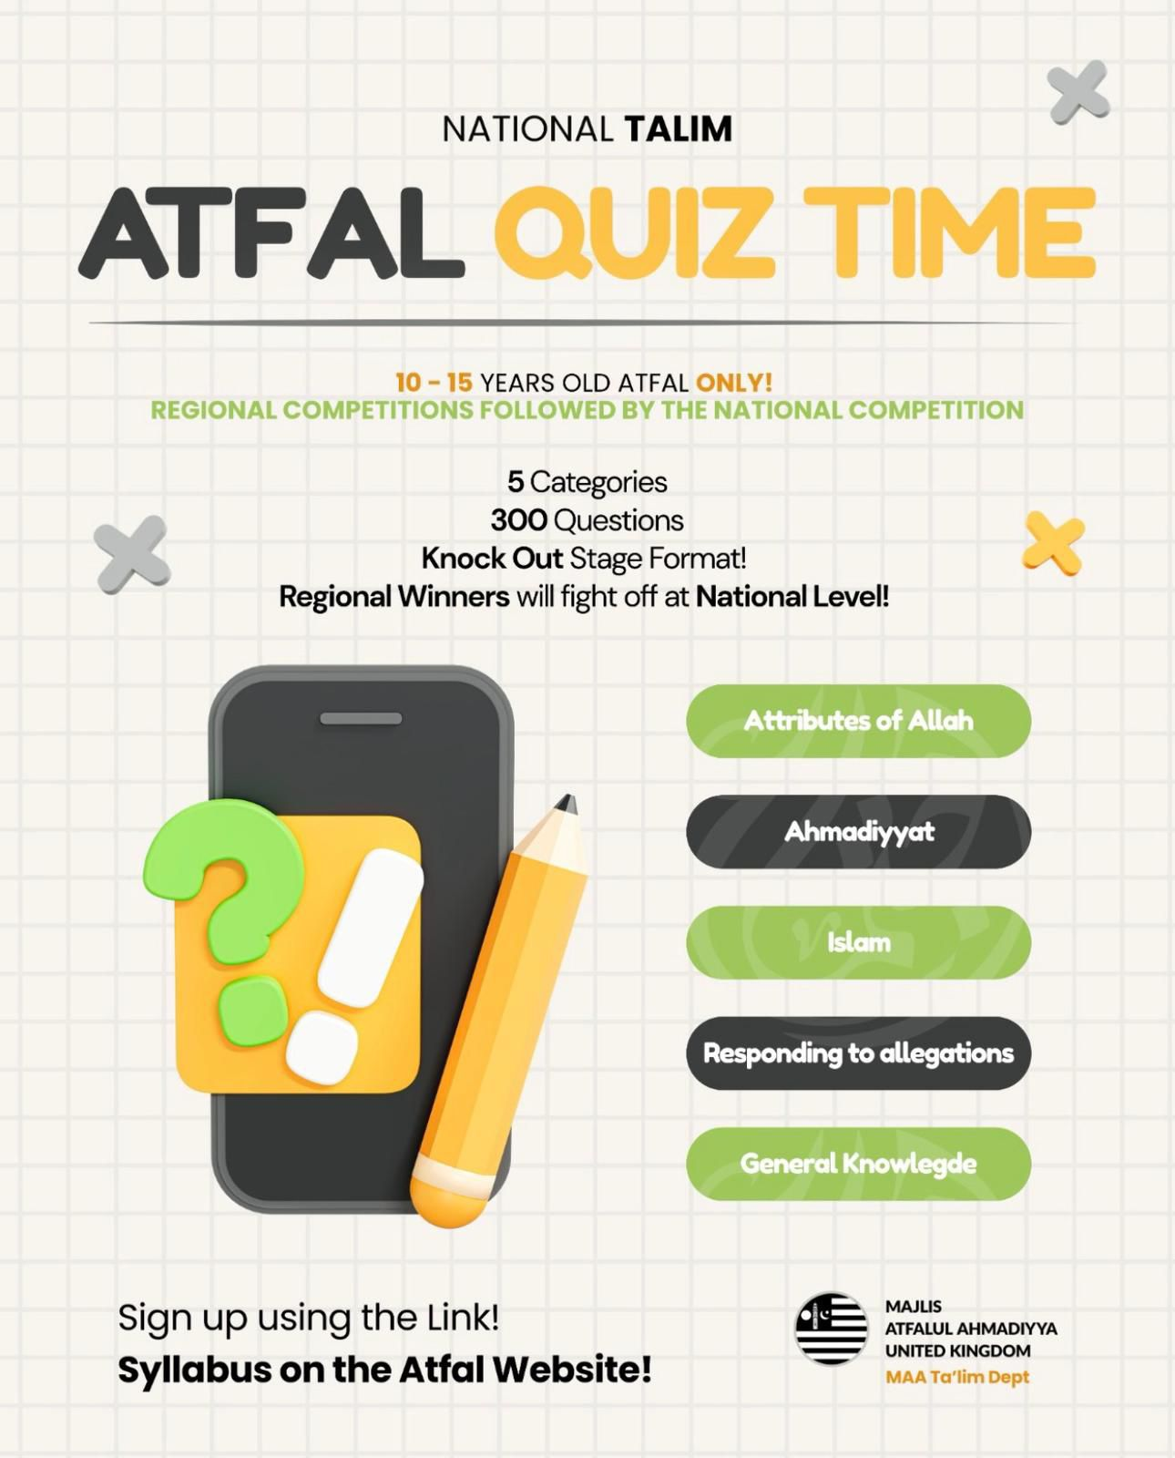
ANNOUNCEMENTS
National Atfal Quiz Time is out!
We are delighted to announce the National Atfal Talim Quiz, beginning at Regional levels soon!
🌟 Why take part?
Compete with fellow Atfal across 6 exciting topics!
Open to Atfal aged 10–15
🏆 Regional Winners through to the Final!
📌 Don’t miss your chance to showcase your knowledge and have fun along the way!
👉 For Sign up & Syllabus:
https://www.atfal.org.uk/atfal-quiz-time 📖 Be sure to check out the Rules and Syllabus provided in the above link!
Let the challenge begin!

