Slide 1




TALIM DEPARTMENT MAA UK
WEEKLY
ATFAL CLASS
(May – Week 4)
TALIM DEPARTMENT MAA UK
www.atfal.org.uk/talim
talim@atfal.co.uk

Slide 2


Class Rules
Arrive on time and be prepared
Always say “Assalamu Alaikum” when you enter the room
Pay attention and listen to the teacher quietly.
Raise your hand if you have a question.
Listen to others when they are speaking.
Work hard and try your best to learn something new.

Slide 3


Lesson Plan
1. Tilawat
2. Hadith
3. Thought of the Week
4. Homework Recap
5. Salat Recap
6. Friday Sermon
7. Learning Time
8. Announcements!
Are you prepared for today’s lesson?
Topi
Class Handout
Pen / Pencil

Slide 4

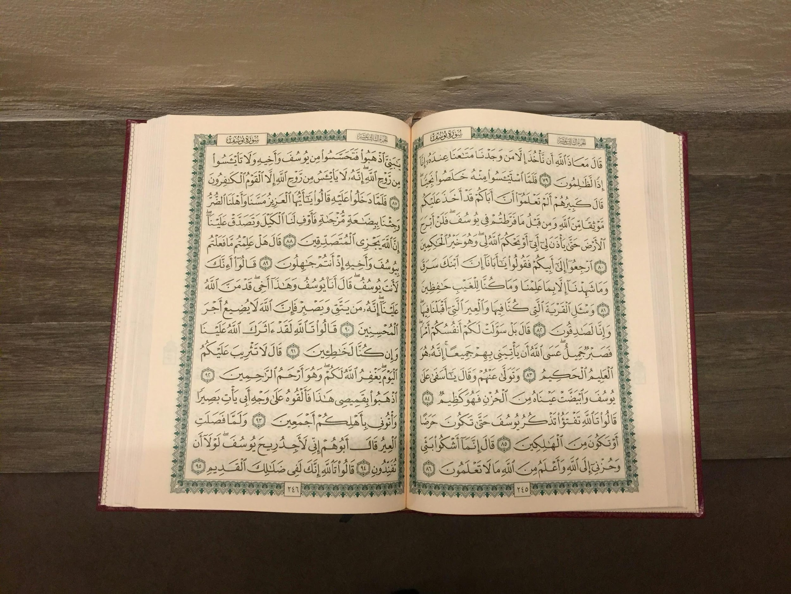

TILAWAT
وَعَدَ اللّٰہُ الَّذِیۡنَ اٰمَنُوۡا مِنۡکُمۡ وَعَمِلُوا الصّٰلِحٰتِ لَیَسۡتَخۡلِفَنَّہُمۡ فِی الۡاَرۡضِ کَمَا اسۡتَخۡلَفَ الَّذِیۡنَ مِنۡ قَبۡلِہِمۡ ۪ وَلَیُمَکِّنَنَّ لَہُمۡ دِیۡنَہُمُ الَّذِی ارۡتَضٰی لَہُمۡ وَلَیُبَدِّلَنَّہُمۡ مِّنۡۢ بَعۡدِ خَوۡفِہِمۡ اَمۡنًا ؕ

Slide 5
TRANSLATION
Allah has promised to those among you who believe and do good works that He will surely make them Successors in the earth, as He made Successors from among those who were before them; and that He will surely establish for them their religion which He has chosen for them; and that He will surely give them in exchange security and peace after their fear.
(The Holy Quran, Surah Al Noor, 24:56)

Slide 6
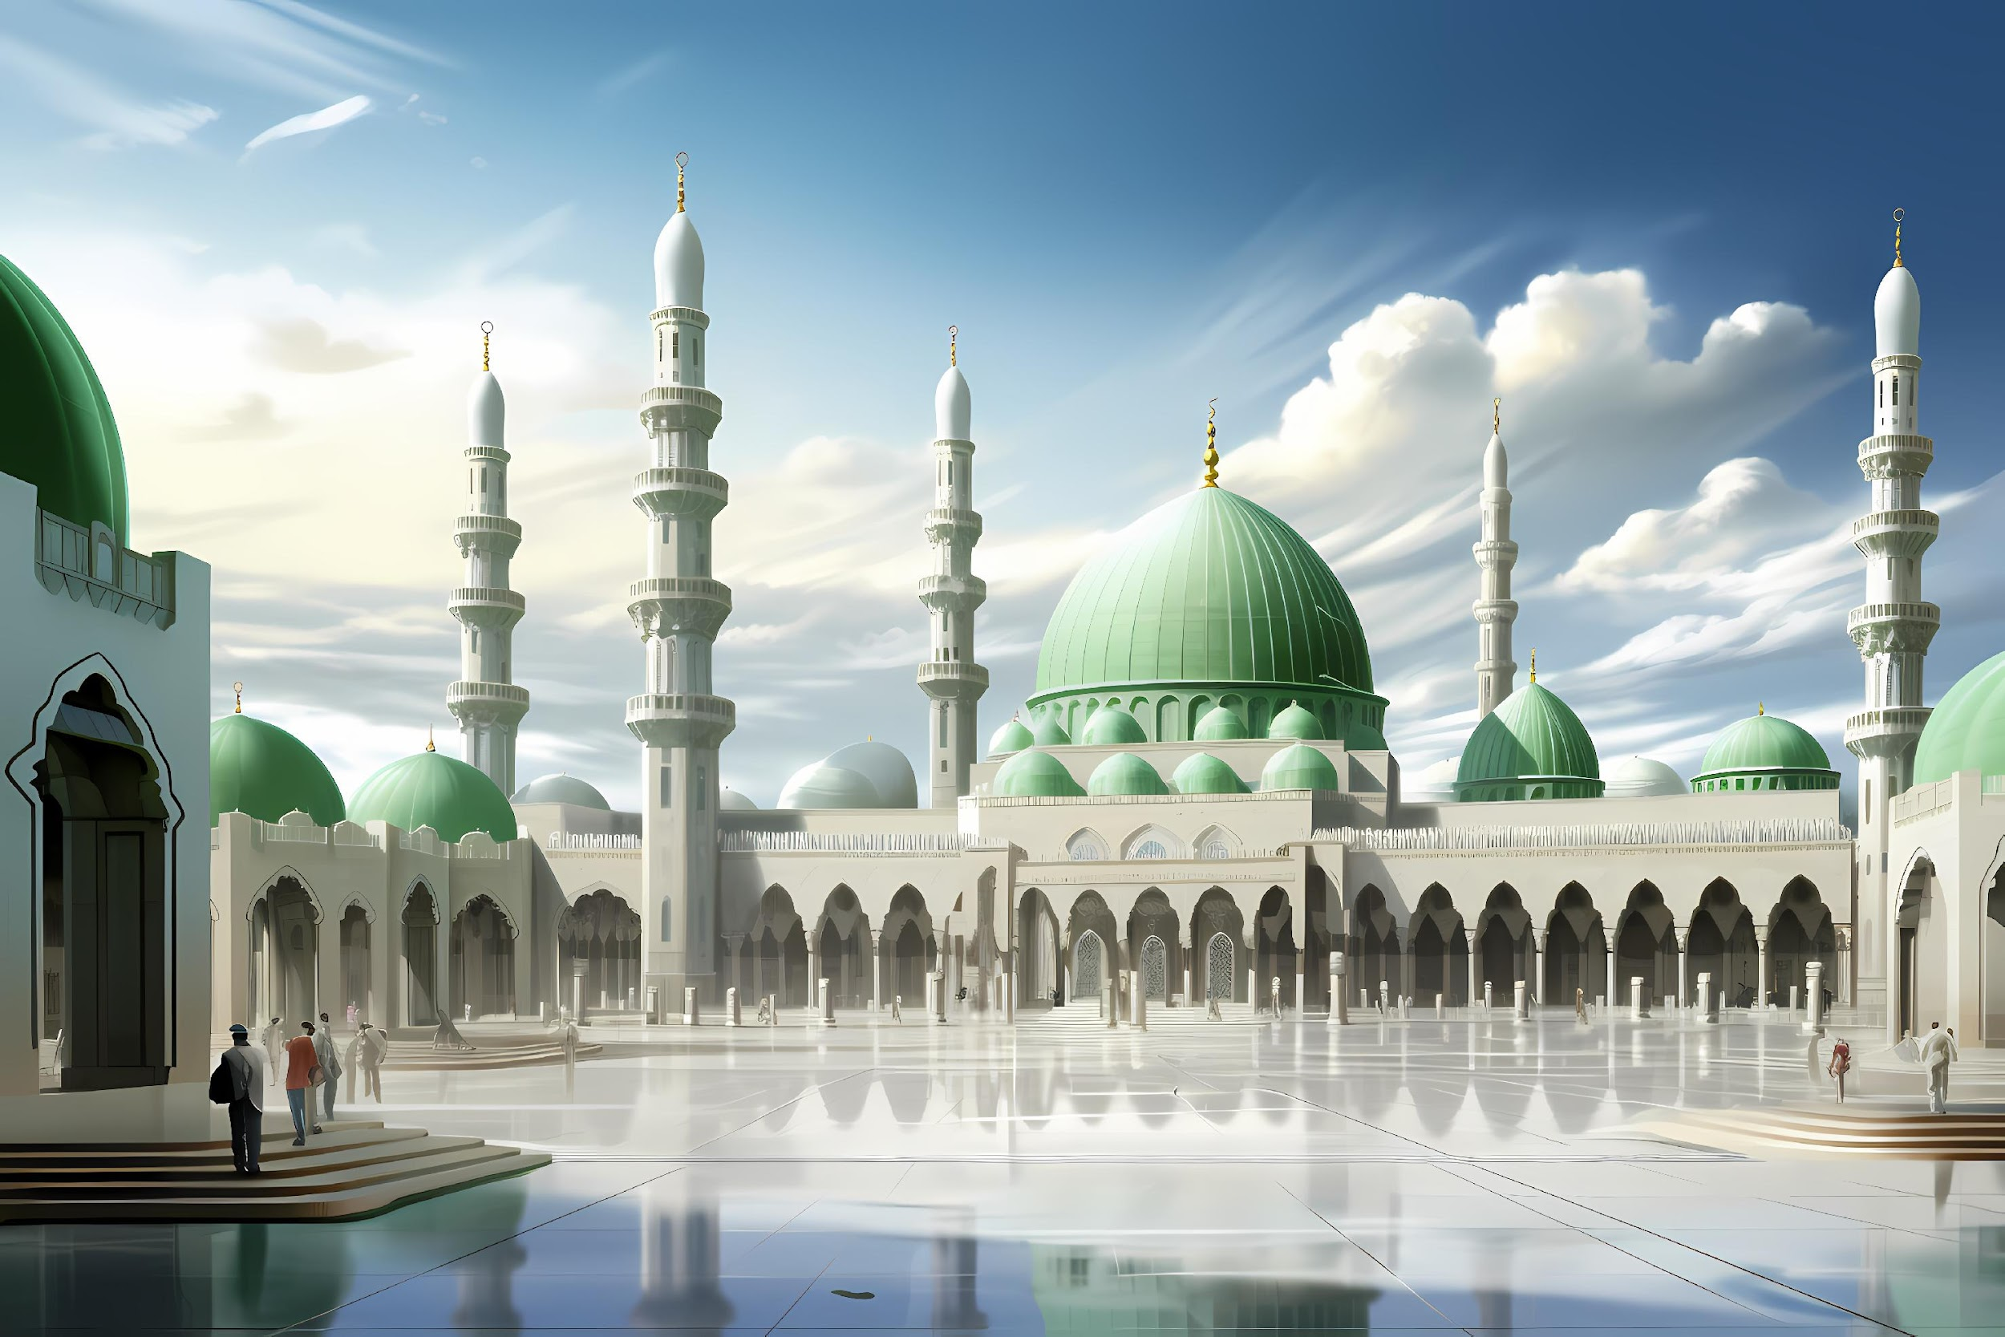

HADITH
(sayings of the Holy Prophet Muhammad^{sas})
The Holy Prophet (saw) said: “Prophethood shall remain among you as long as Allah shall will. He will bring about its end and follow it with Khilafat on the precepts of prophethood for as long as He shall will and then bring about its end. A tyrannical monarchy will then follow and will remain as long as Allah shall and then come to an end. There will thereafter monarchial despotism to last as long as Allah shall and come to an end upon His decree. There will then emerge Khilafat on the precept of Prophethood.” The Holy Prophet said no more.”
(Hadith Book: Hadiqat-us-Saliheen, Hadith 989)
Notes:
After Tilawat, spend 5 mins catching up with Atfal. What they've been getting up to in the past week.
Hadith:
Whoever, reads the Hadith out, should do so in the proper manner. i.e. recite Durood Shareef first and then the Hadith.
Have a brief discussion about the meaning of this hadith in light of the questions on the screen.

Slide 7



THOUGHT
OF THE WEEK
TOPIC:
KHILAFAT DAY!

Slide 8

WHAT IS KHILAFAT?
The word “Khilafat” means successorship.
The Ahmadi sect is the only sect that is led by a Khalifa.
27th May 2026 will be the start of the 118th year of Khilafat.
The Promised Messiah (as) mentioned the system of Khilafat in his book “The Will.”

Slide 9
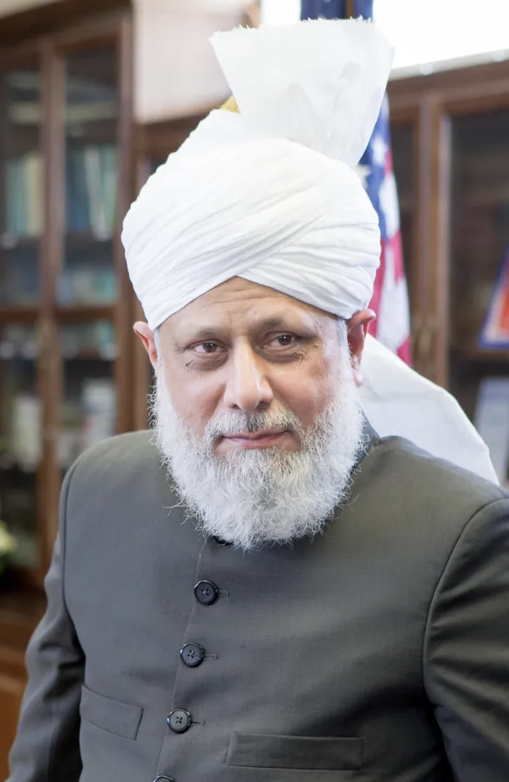
WHY DO WE NEED KHILAFAT?
A Khalifa is chosen to lead his followers.
We see that the other 72 sects that are present are not led by a Khalifa.
This is why there are a lot of misconceptions and misunderstandings that have occurred in their beliefs.
However, because the Ahmadiyya Muslim Community has followed under one leadership for the past 118 years, they have maintained their beliefs throughout.

Slide 10
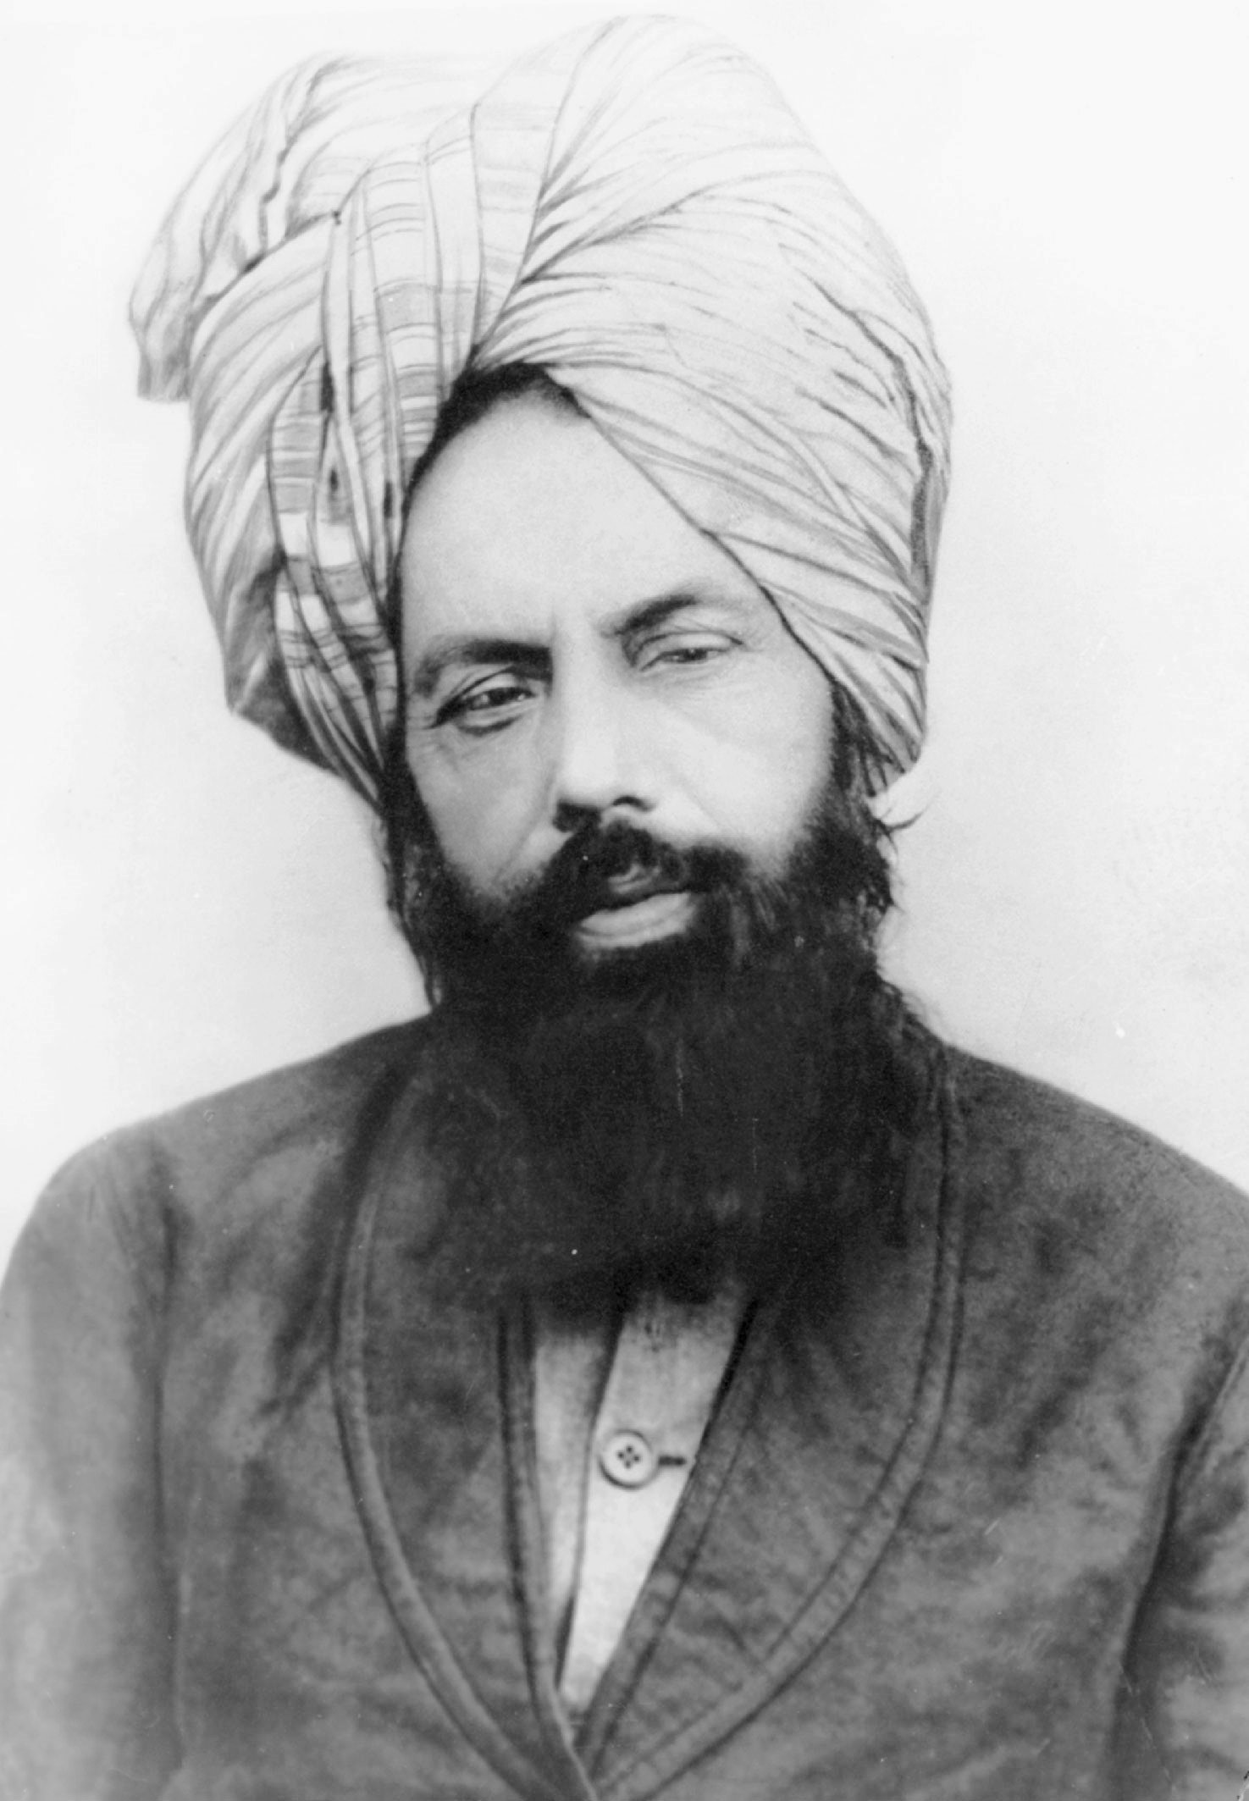
WHEN DOES THE SYSTEM OF KHILAFAT COMMENCE?
The system of Khilafat commences after the coming of a Prophet.
That Prophet can be a law bearing or a non law bearing Prophet.
For example, the system of Khilafat commenced after the coming of both the Holy Prophet Muhammad (saw) and the Promised Messiah (as).

Slide 11

HOW ARE THE KHULAFA CHOSEN?
For a Khalifa to be elected, there is an electoral college set up which includes members of the Jama’at that are high in authority or have a good understanding of the system of the Jama’at.
The members of the Electoral College sit and nominate candidates.

Slide 12
HOW ARE THE KHULAFA CHOSEN?
After the names of candidates have been presented, the system of voting takes place and a Khalifa is elected.
However, from the incidents of members that have been present in this committee, they believe that it is Allah who had put in their hearts the candidate that they voted for and believe that a Khalifa is divinely elected.

Slide 13
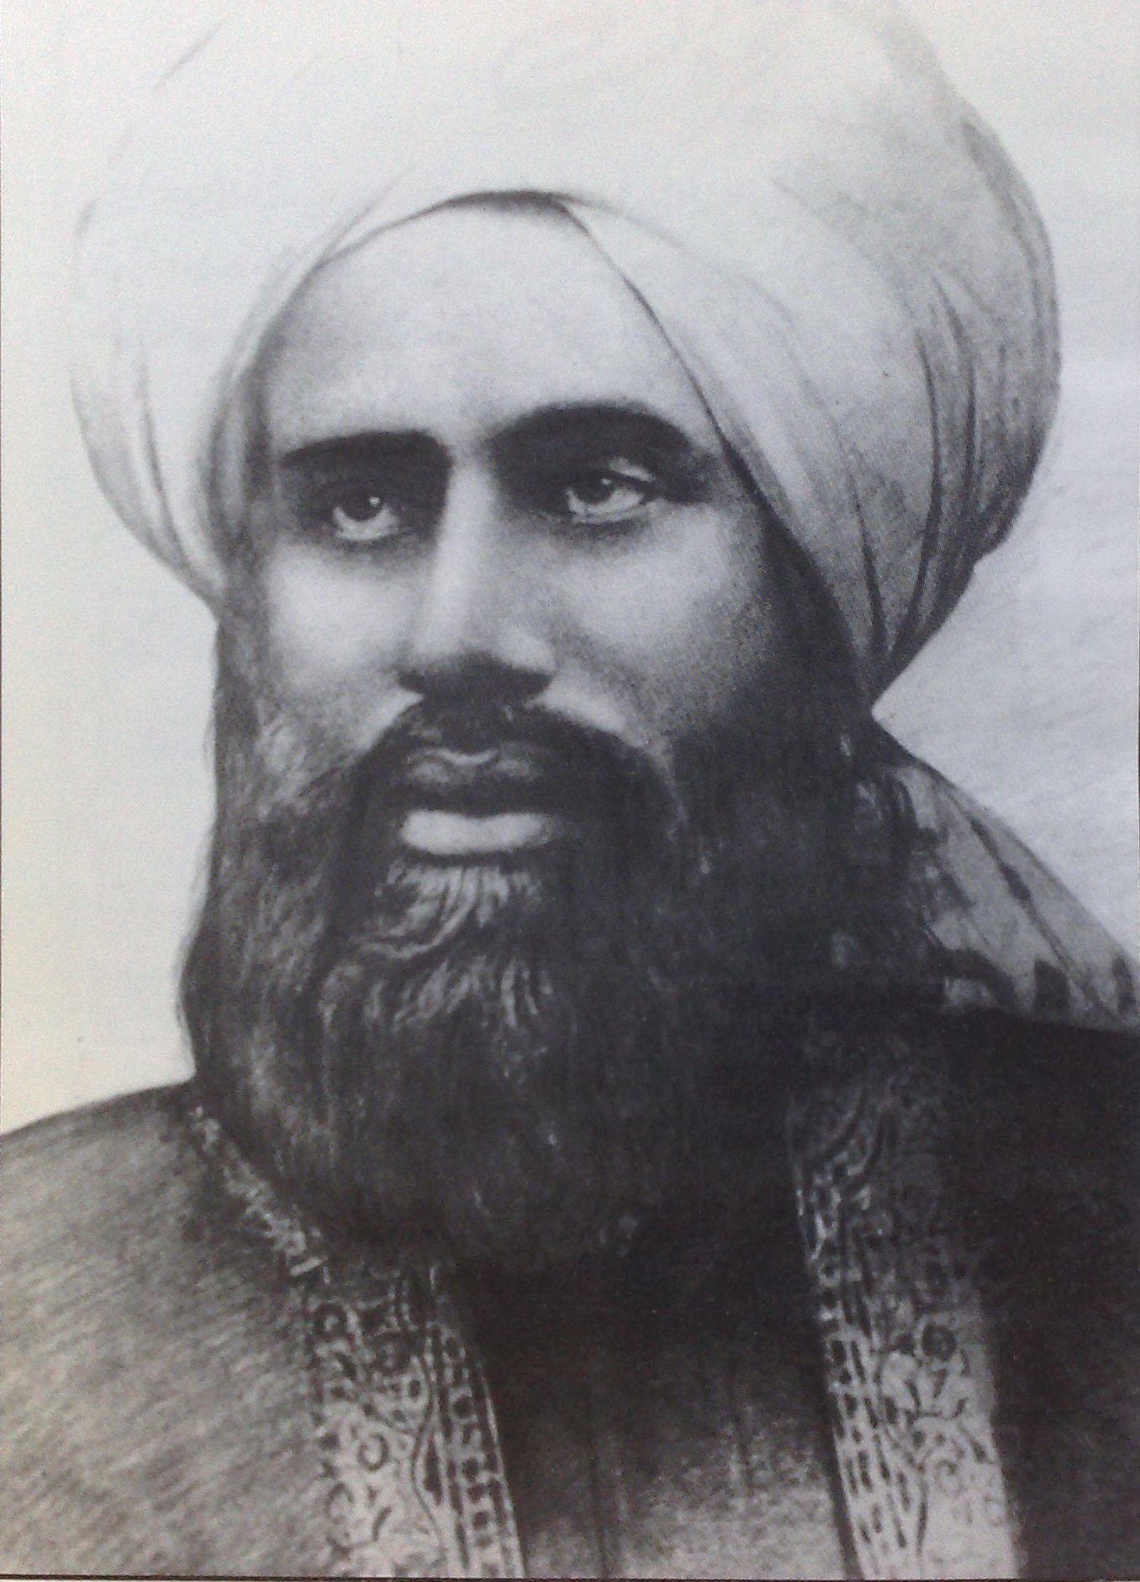
WHY DO WE CELEBRATE JALSA KHILAFAT?
It is important to understand that the Promised Messiah (as) passed away on 26th May 1908.
The very next day, Hazrat Hakeem Maulvi Noor-ud-Din Sahib (ra) was elected as the first Khalifa of the Ahmadiyya Muslim Community.
Therefore, Jalsa Khilafat is celebrated as a joyous occasion—Allah the Almighty continued to support the Jama’at and established the system of Khilafat so that the Jama’at would continue to progress.

Slide 14
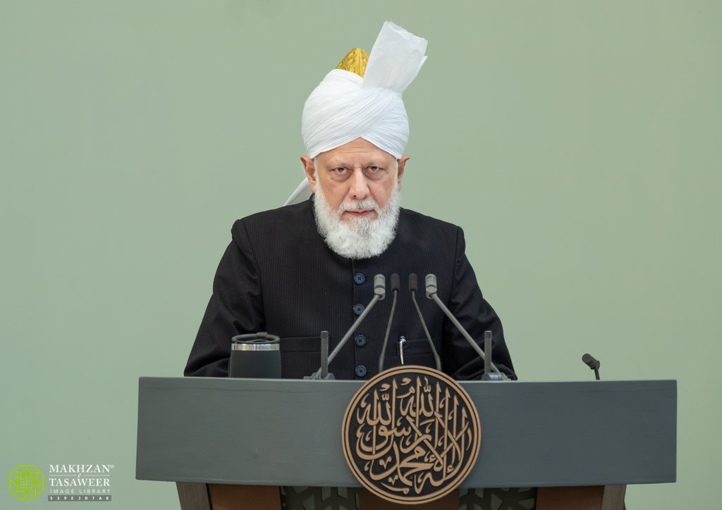
VIDEO
https://youtu.be/kZf8BktTWGw?si=zrAc4L-dG_PBn9k2
https://youtu.be/33klQjRrDKg?si=dQ0ozEDcNDMzGE4T
32:31-38:16

Slide 15


Question 1
How many years has it been since the establishment of Khilafat?
100
110
117
118

Slide 16
Question 1
How many years has it been since the establishment of Khilafat?
100
110
117
118

Slide 17
Question 2
Who was the first Khalifa of the Ahmadiyya Muslim Community?
Hazrat Mirza Nasir Ahmad (rh)
Hazrat Mirza Bashir-ud-Din Mahmood Ahmad (ra)
Hazrat Maulvi Hakeem Noor-ud-Din (ra)
Hazrat Mirza Masroor Ahmad (aba)

Slide 18
Question 2
Who was the first Khalifa of the Ahmadiyya Muslim Community?
Hazrat Mirza Nasir Ahmad (rh)
Hazrat Mirza Bashir-ud-Din Mahmood Ahmad (ra)
Hazrat Maulvi Hakeem Noor-ud-Din (ra)
Hazrat Mirza Masroor Ahmad (aba)

Slide 19
Question 3
Since the establishment of Khilafat, how many countries has the Ahmadiyya Muslim Community spread to?
Over 50
Over 100
Over 150
Over 200

Slide 20
Question 3
Since the establishment of Khilafat, how many countries has the Ahmadiyya Muslim Community spread to?
Over 50
Over 100
Over 150
Over 200

Slide 21
Question 4
How long did the Khilafat of the first Khalifa last?
2 years
4 years
6 years
8 years

Slide 22
Question 4
How long did the Khilafat of the first Khalifa last?
2 years
4 years
6 years
8 years

Slide 23
Question 5
On which day is Jalsa Khilafat celebrated each year?
20th February
23rd March
26th May
27th May

Slide 24
Question 5
On which day is Jalsa Khilafat celebrated each year?
20th February
23rd March
26th May
27th May

Slide 25
Question 6
Which Khalifa remained Khalifa for the longest amount of time?
Hazrat Mirza Nasir Ahmad (rh)
Hazrat Mirza Bashir-ud-Din Mahmood Ahmad (ra)
Hazrat Maulvi Hakeem Noor-ud-Din (ra)
Hazrat Mirza Masroor Ahmad (aba)

Slide 26
Question 6
Which Khalifa remained Khalifa for the longest amount of time?
Hazrat Mirza Nasir Ahmad (rh)
Hazrat Mirza Bashir-ud-Din Mahmood Ahmad (ra)
Hazrat Maulvi Hakeem Noor-ud-Din (ra)
Hazrat Mirza Masroor Ahmad (aba)

Slide 27
Question 7
Which Khalifa had memorised the entire Holy Qu’ran?
Hazrat Mirza Nasir Ahmad (rh)
Hazrat Mirza Bashir-ud-Din Mahmood Ahmad (ra)
Hazrat Maulvi Hakeem Noor-ud-Din (ra)
Hazrat Mirza Masroor Ahmad (aba)

Slide 28
Question 7
Which Khalifa had memorised the entire Holy Qu’ran?
Hazrat Mirza Nasir Ahmad (rh)
Hazrat Mirza Bashir-ud-Din Mahmood Ahmad (ra)
Hazrat Maulvi Hakeem Noor-ud-Din (ra)
Hazrat Mirza Masroor Ahmad (aba)

Slide 29
Question 8
In which book did the Promised Messiah (as) mention the system of Khailafat?
Brahin-e-Ahmadiyya
Jesus in India
The Will
Malfuzat

Slide 30
Question 8
In which book did the Promised Messiah (as) mention the system of Khailafat?
Brahin-e-Ahmadiyya
Jesus in India
The Will
Malfuzat

Slide 31
Question 9
How is Hazrat Mirza Bashir-ud-Din Mahmood Ahmad (ra) related to the Promised Messiah (as)?
He was the nephew
He was the son
He was the cousin
He was the brother

Slide 32
Question 9
How is Hazrat Mirza Bashir-ud-Din Mahmood Ahmad (ra) related to the Promised Messiah (as)?
He was the nephew
He was the son
He was the cousin
He was the brother

Slide 33
Question 10
Can the system of Khilafat be taken away from us?
No, because it is directly from Allah
Yes, just like the Khilafat of Islam was taken away from Muslims

Slide 34
Question 10
Can the system of Khilafat be taken away from us?
No, because it is directly from Allah
Yes, just like the Khilafat of Islam was taken away from Muslims

Slide 35





HOMEWORK
Have you done your homework for this week?
Make sure to note down your homework for next week!

Slide 36

PAIR ACTIVITY
Discuss today’s lesson with the Tifl next to you and come up with 3 new things you learned today!

Slide 37

ANNOUNCEMENTS
National Atfal Quiz Time is out!
We are delighted to announce the National Atfal Talim Quiz, beginning at Regional levels soon!
🌟 Why take part?
Compete with fellow Atfal across 6 exciting topics!
Open to Atfal aged 10–15
🏆 Regional Winners through to the Final!
📌 Don’t miss your chance to showcase your knowledge and have fun along the way!
👉 For Sign up & Syllabus:
https://www.atfal.org.uk/atfal-quiz-time 📖 Be sure to check out the Rules and Syllabus provided in the above link!
Let the challenge begin!

