Slide 1



TALIM DEPARTMENT MAA UK
WEEKLY
ATFAL CLASS
(June – Week 1)
TALIM DEPARTMENT MAA UK
www.atfal.org.uk/talim
talim@atfal.co.uk

Slide 2

Class Rules
Arrive on time and be prepared
Always say “Assalamu Alaikum” when you enter the room
Pay attention and listen to the teacher quietly.
Raise your hand if you have a question.
Listen to others when they are speaking.
Work hard and try your best to learn something new.

Slide 3


Lesson Plan
1. Tilawat
2. Hadith
3. Thought of the Week
4. Homework Recap
5. Salat Recap
6. Friday Sermon
7. Learning Time
8. Announcements!
Are you prepared for today’s lesson?
Topi
Class Handout
Pen / Pencil

Slide 4

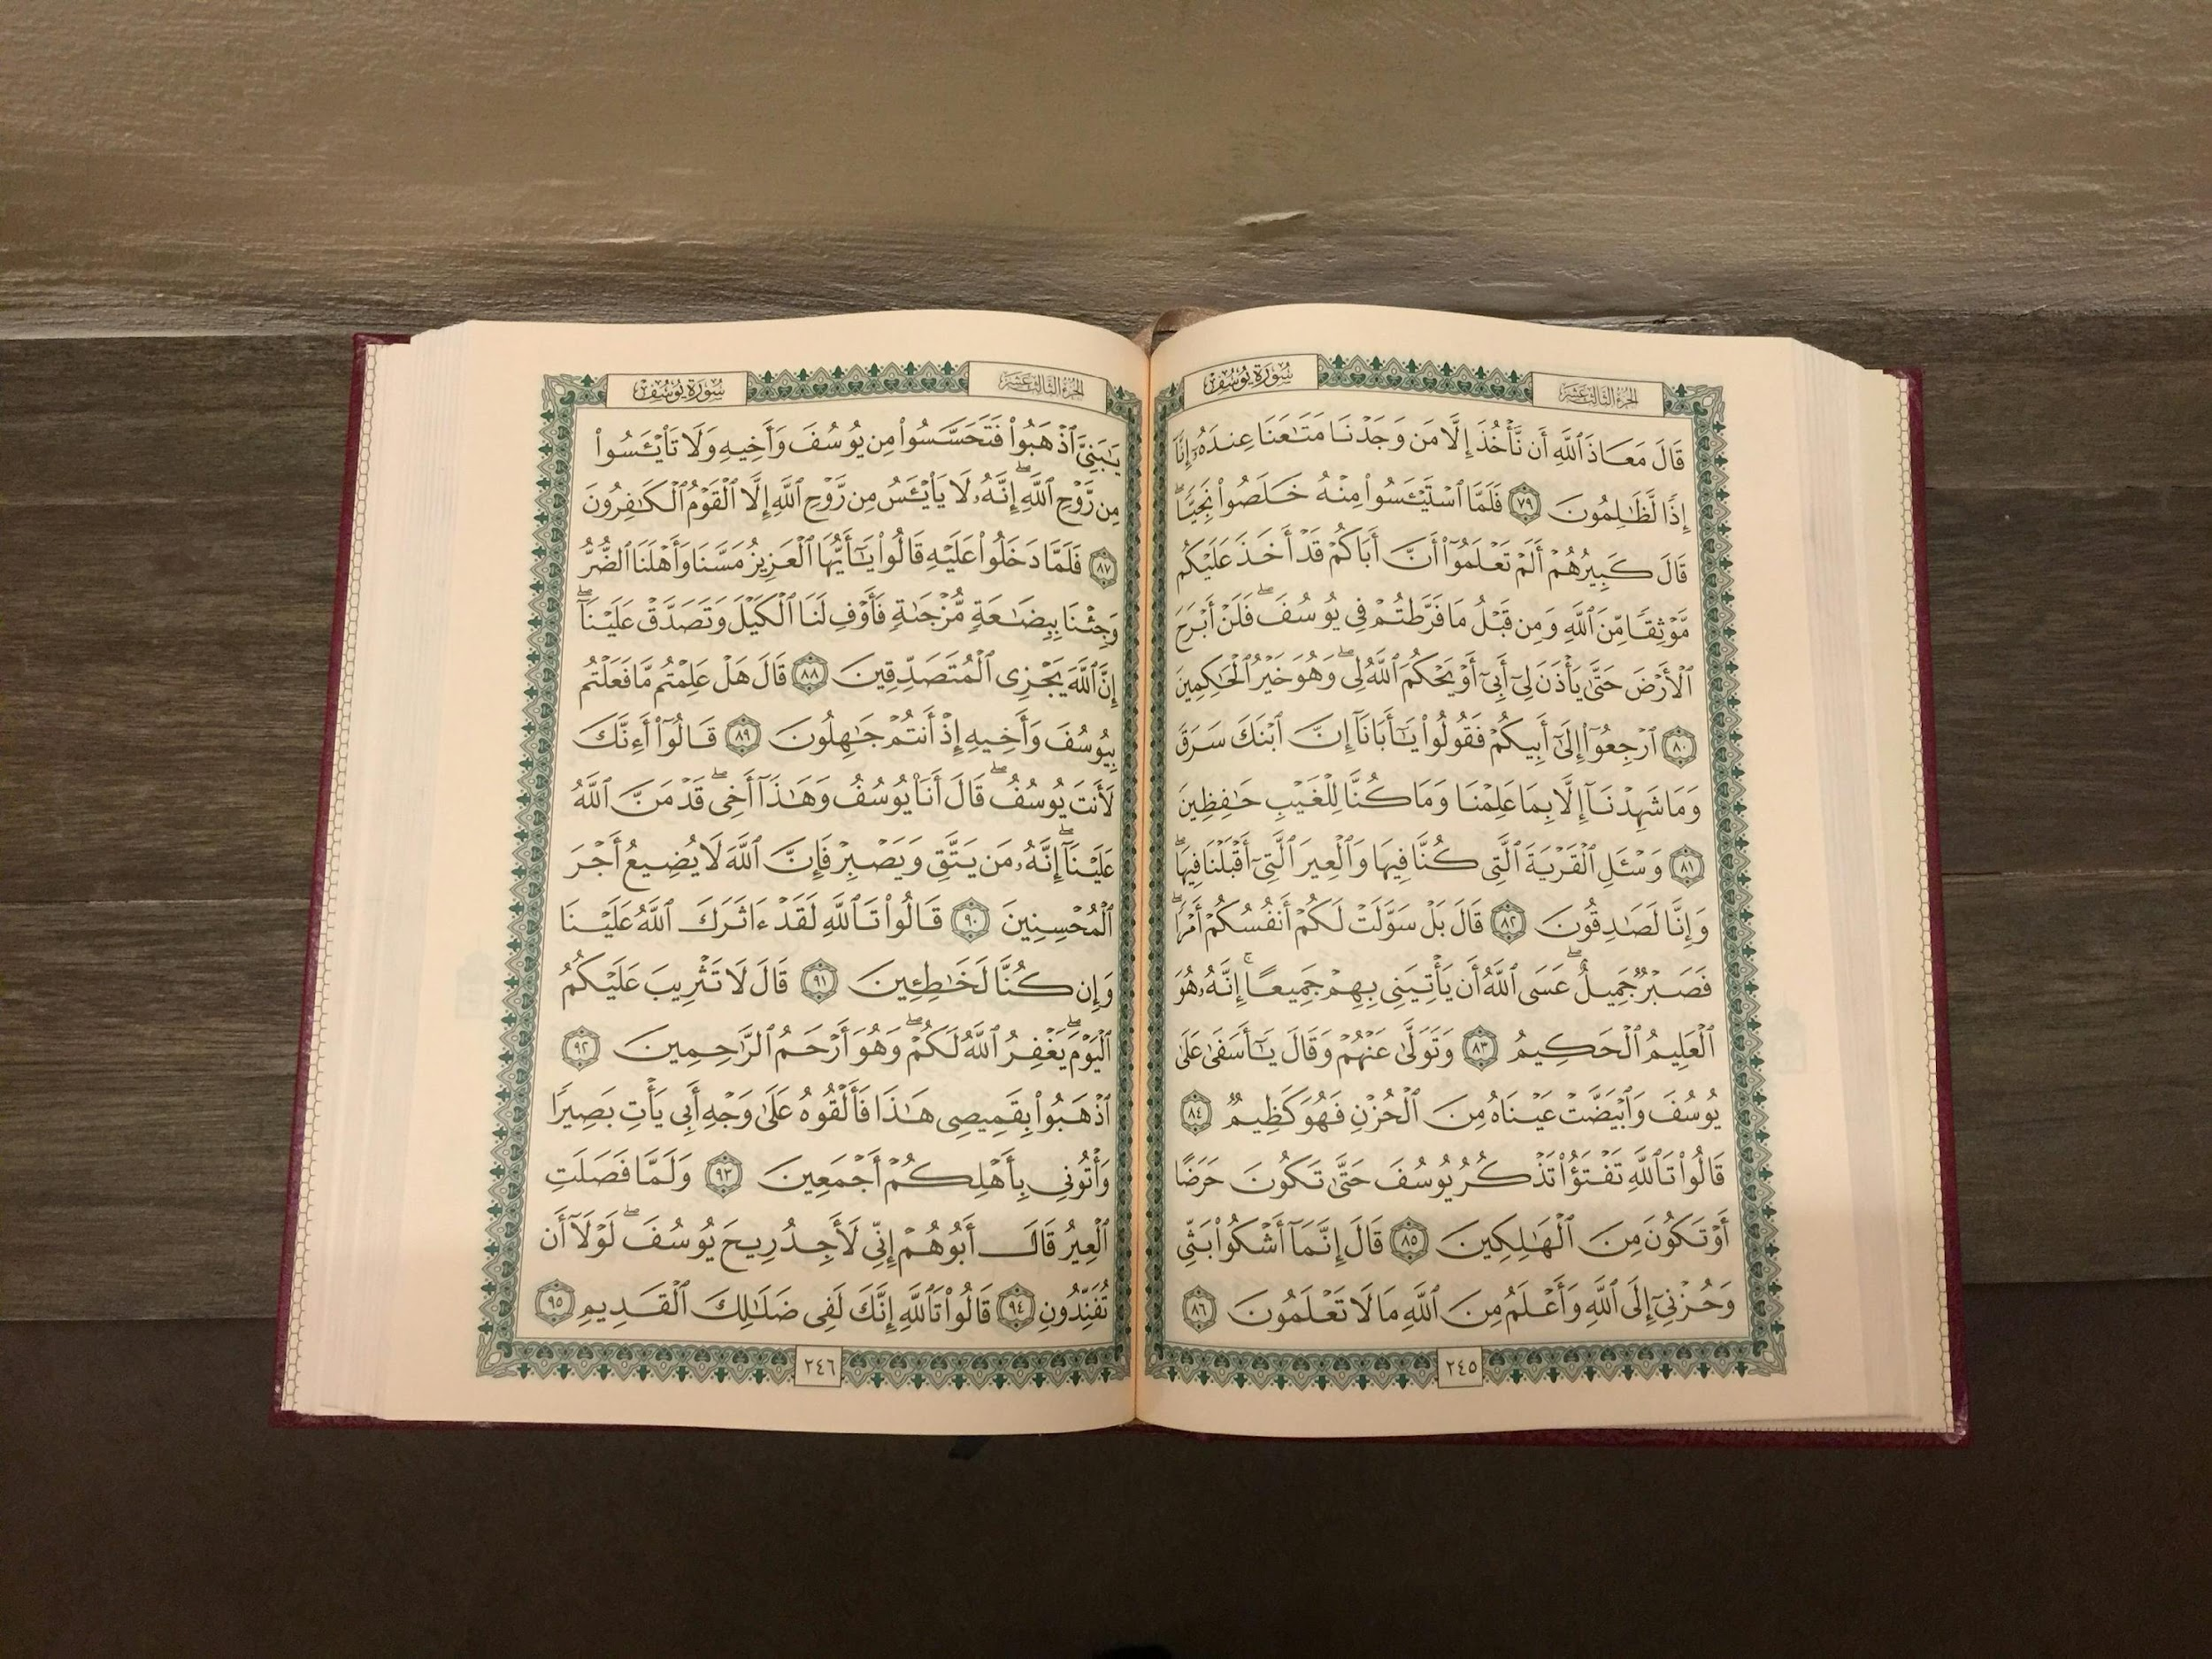
TILAWAT
فَلَمَّا بَلَغَ مَعَہُ السَّعۡیَ قَالَ یٰبُنَیَّ اِنِّیۡۤ اَرٰی فِی الۡمَنَامِ اَنِّیۡۤ اَذۡبَحُکَ فَانۡظُرۡ مَاذَا تَرٰی ؕ قَالَ یٰۤاَبَتِ افۡعَلۡ مَا تُؤۡمَرُ ۫ سَتَجِدُنِیۡۤ اِنۡ شَآءَ اللّٰہُ مِنَ الصّٰبِرِیۡنَ ﴿۱۰۳﴾ فَلَمَّاۤ اَسۡلَمَا وَتَلَّہٗ لِلۡجَبِیۡنِ ﴿۱۰۴﴾ وَنَادَیۡنٰہُ اَنۡ یّٰۤاِبۡرٰہِیۡمُ ﴿۱۰۵﴾ۙ قَدۡ صَدَّقۡتَ الرُّءۡیَا ۚ اِنَّا کَذٰلِکَ نَجۡزِی الۡمُحۡسِنِیۡنَ ﴿۱۰۶﴾

Slide 5

TRANSLATION
And when he was old enough to work with him, he said, ‘O my dear son, I have seen in a dream that I am slaughtering thee. So consider, what thou thinkest of it!’ He replied, ‘O my father, do as thou art commanded; thou wilt find me, if Allah please, of those who are patient.’ And when they both submitted to the Will of God, and he had thrown him down on his forehead, We called to him: ‘O Abraham, ‘Thou hast indeed fulfilled the dream.’ Thus indeed do We reward those who do good.
(The Holy Quran, Surah Al Noor, 24:56)

Slide 6
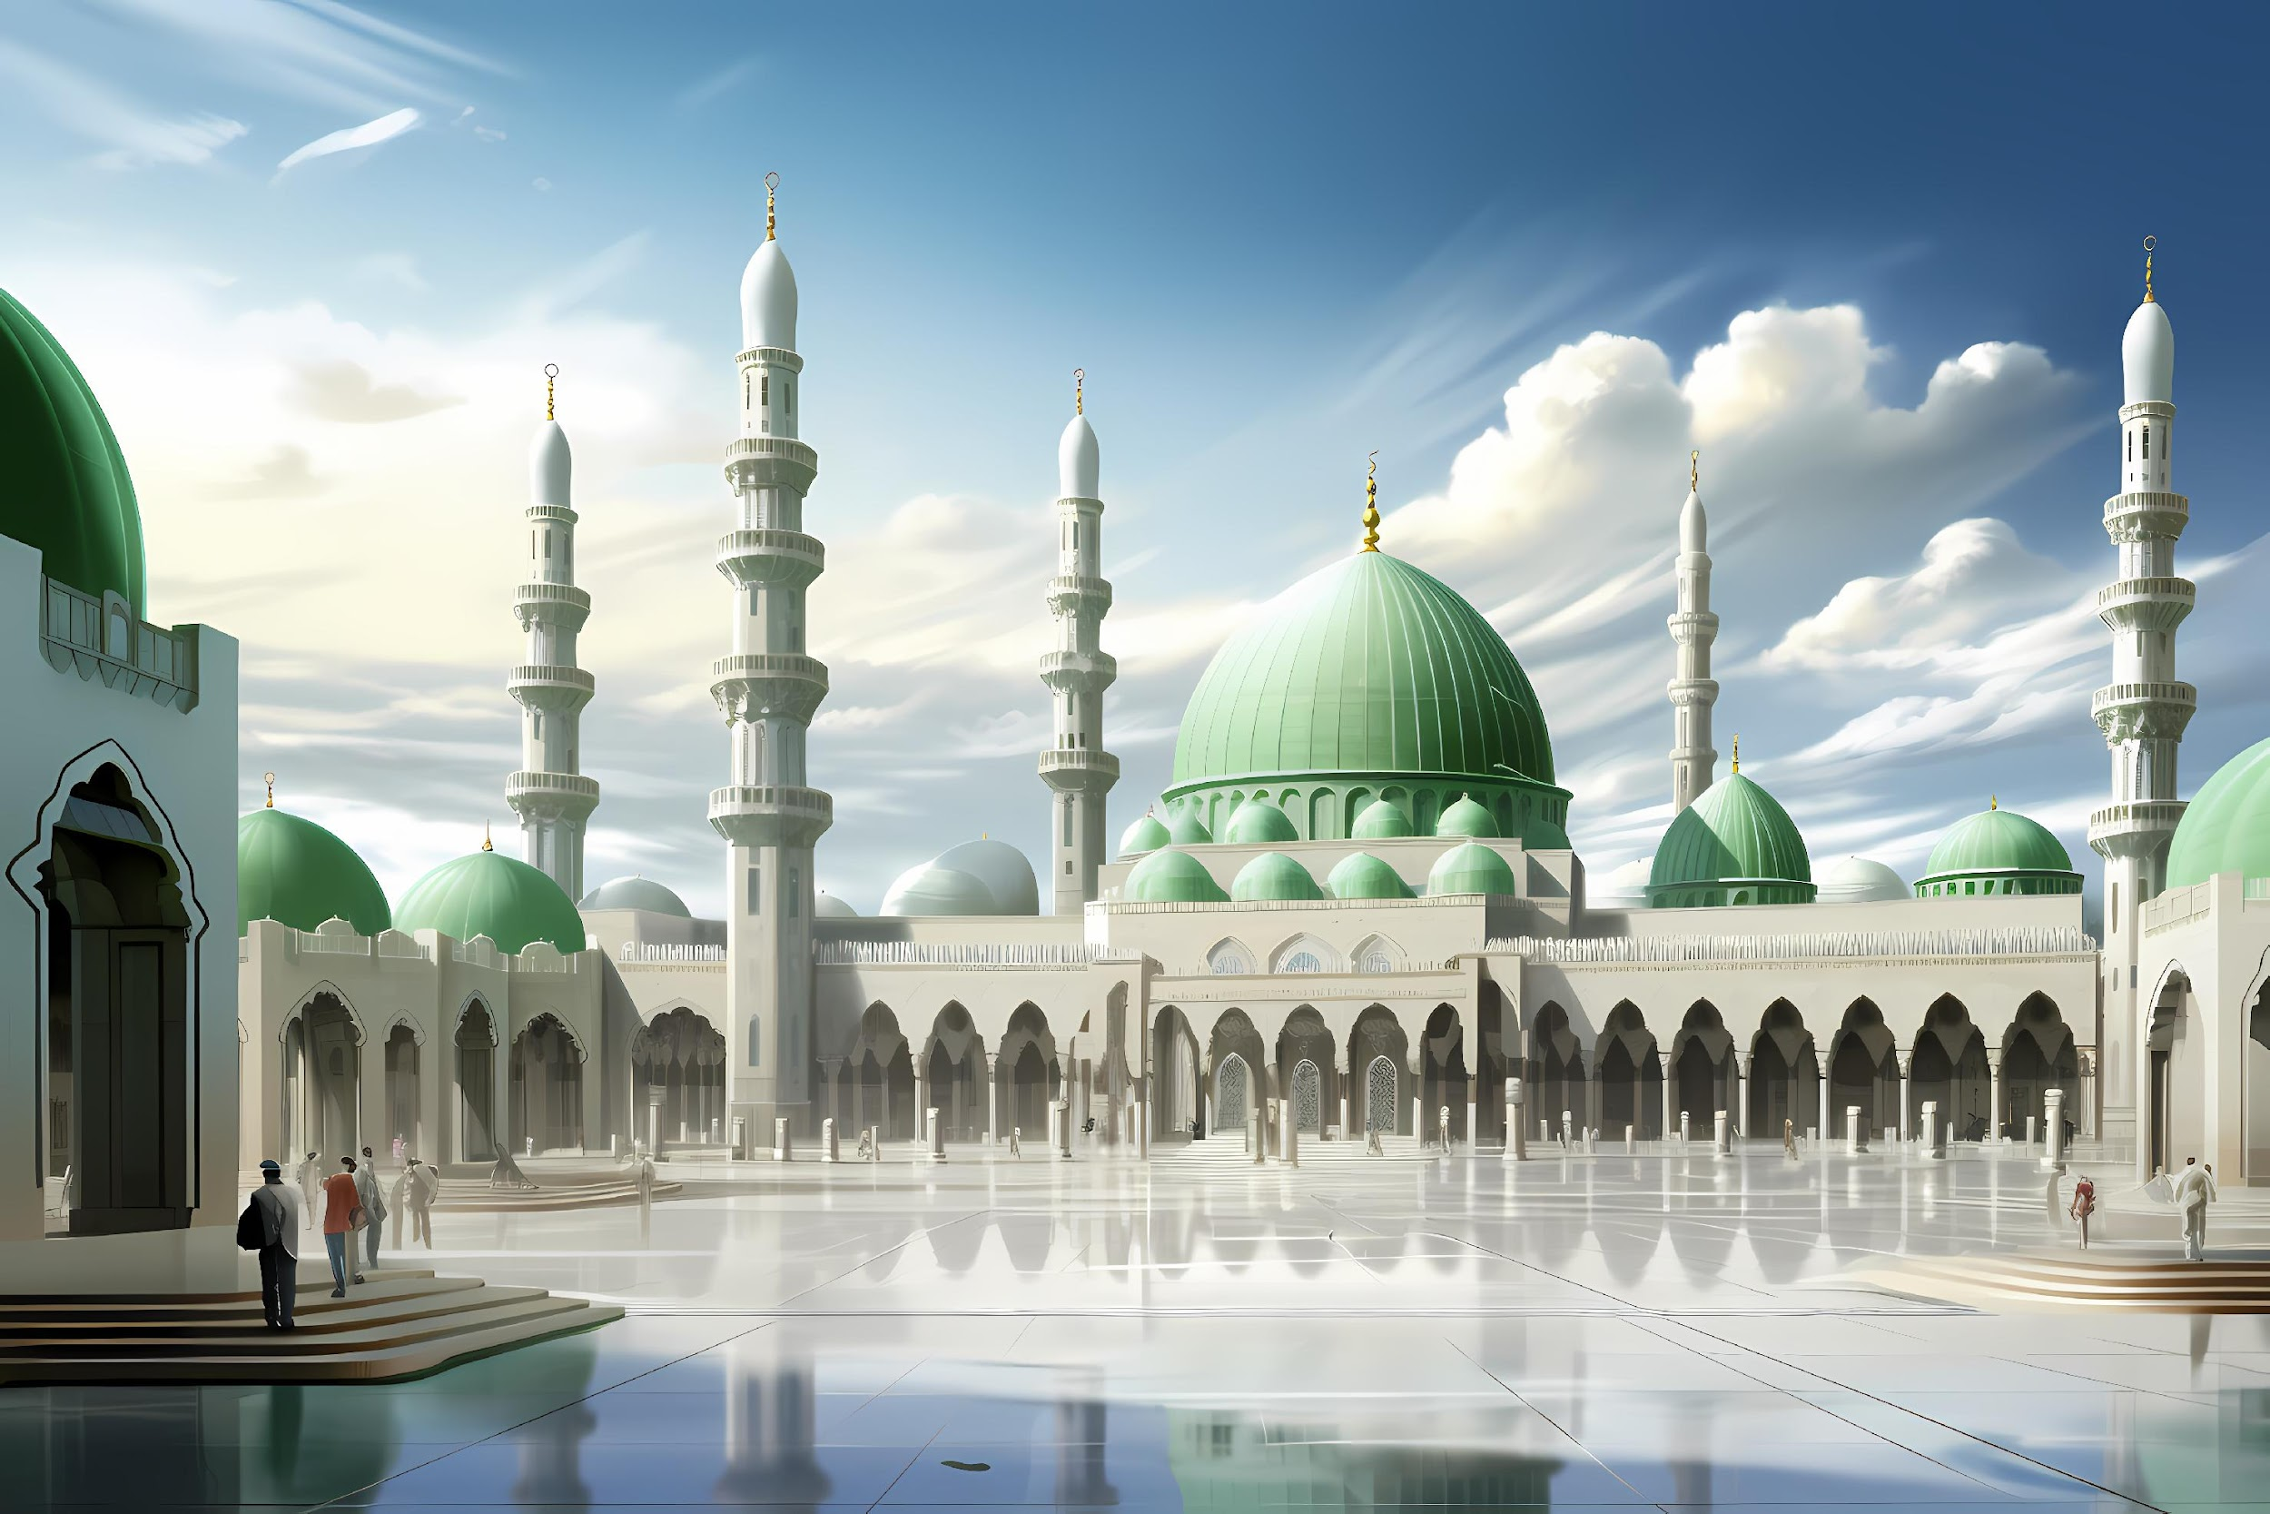

HADITH
(sayings of the Holy Prophet Muhammad^{sas})
عَنِ الْبَرَاءِ قَالَ سَمِعْتُ النَّبِيَّ صَلَّى اللّٰهُ عَلَيْهِ وَسَلَّمَ يَخْطُبُ فَقَالَ إِنَّ أَوَّلَ مَا نَبْدَأُ مِنْ يَوْمِنَا هَذَا أَنْ نُصَلِّيَ ثُمَّ نَرْجِعَ فَنَنْحَرَ فَمَنْ فَعَلَ فَقَدْ أَصَابَ سُنَّتَنَا
Narrated by Hazrat Al-Baraʾ (RA): He said, “I heard the Prophet ﷺ say:
‘The first thing we do on this day of our festival is perform the prayer. Then we return and offer the sacrifice. Whoever does that has acted in accordance with our Sunnah (way and practice).”
(Hadith Book: Sahih Al Bukhari, Hadith 951)
Notes:
After Tilawat, spend 5 mins catching up with Atfal. What they've been getting up to in the past week.
Hadith:
Whoever, reads the Hadith out, should do so in the proper manner. i.e. recite Durood Shareef first and then the Hadith.
Have a brief discussion about the meaning of this hadith in light of the questions on the screen.

Slide 7



THOUGHT
OF THE WEEK
TOPIC:
“EID UL ADHA!”

Slide 8
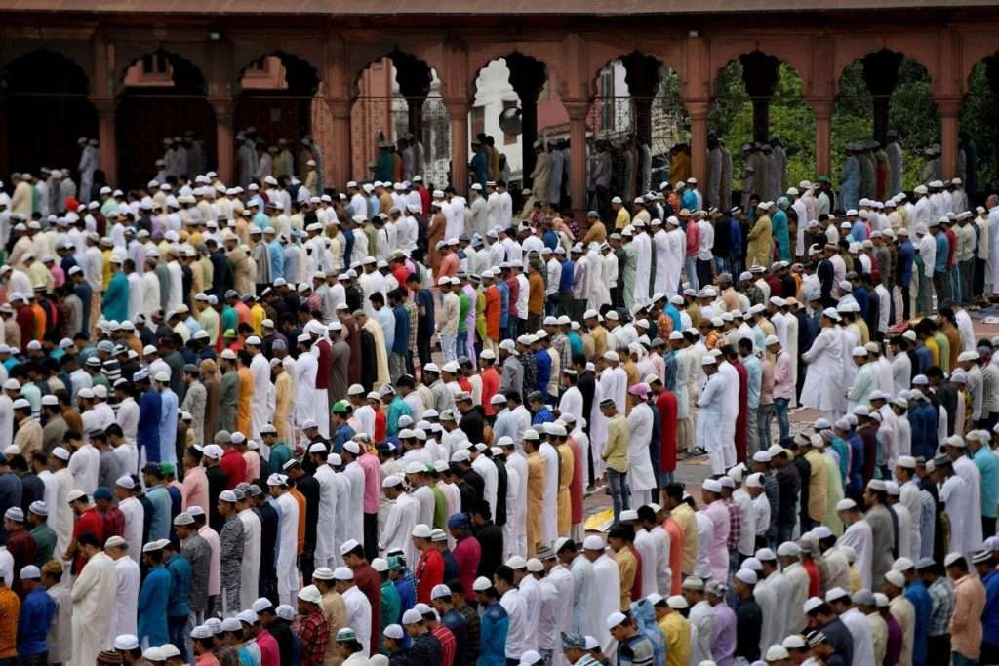
WHAT IS EID UL ADHA?
Eid ul Adha is a joyous festival that is celebrated once a year.
It is celebrated approximately 2 months and 10 days after Eid ul Fitr.
Eid ul Adha is an Eid known for sacrificing.
It is celebrated on 10th of Dhul Hijjah (the 12th month of the Islamic Calendar)

Slide 9
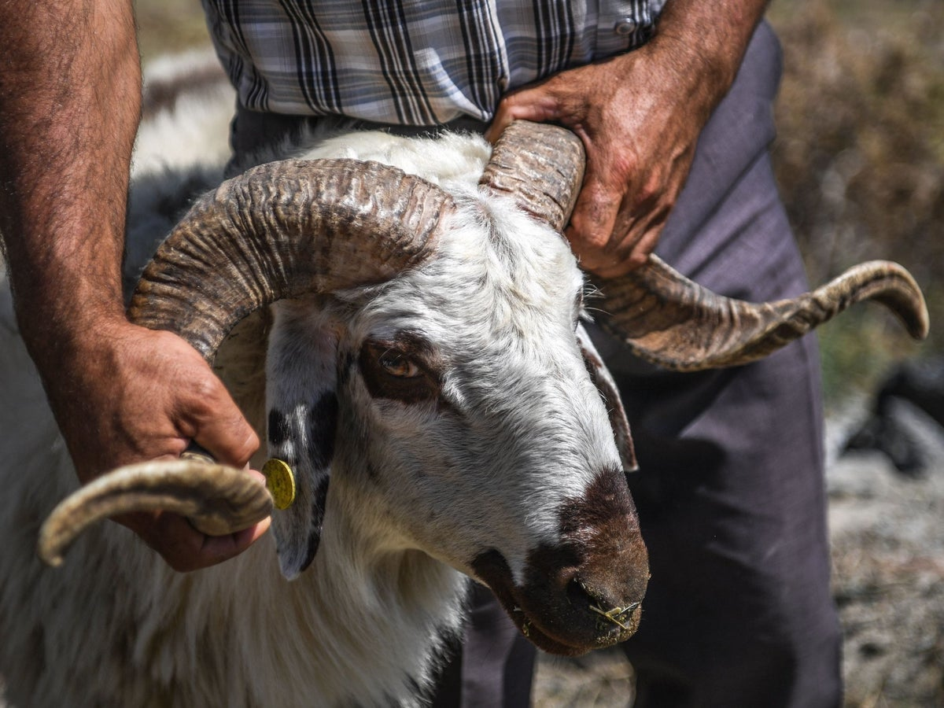
SIGNIFICANCE OF EID UL ADHA?
This Eid is celebrated remembering the sacrifice Hazrat Ibrahim (as) performed.
In a dream Hazrat Ibrahim (as) saw himself sacrifice his son, Hazrat Ismael (as) in the way of Allah the Almighty.
Without hesitation, Hazrat Ibrahim (as) obeyed the instructions and as he was about to physically sacrifice his son, Allah the Almighty stopped him.
Because Hazrat Ibrahim (as) had shown complete obedience to Allah, Allah instead instructed him to sacrifice an animal.
Because of this sacrifice, Muslims celebrate Eid ul Adha and sacrifice animals.

Slide 10
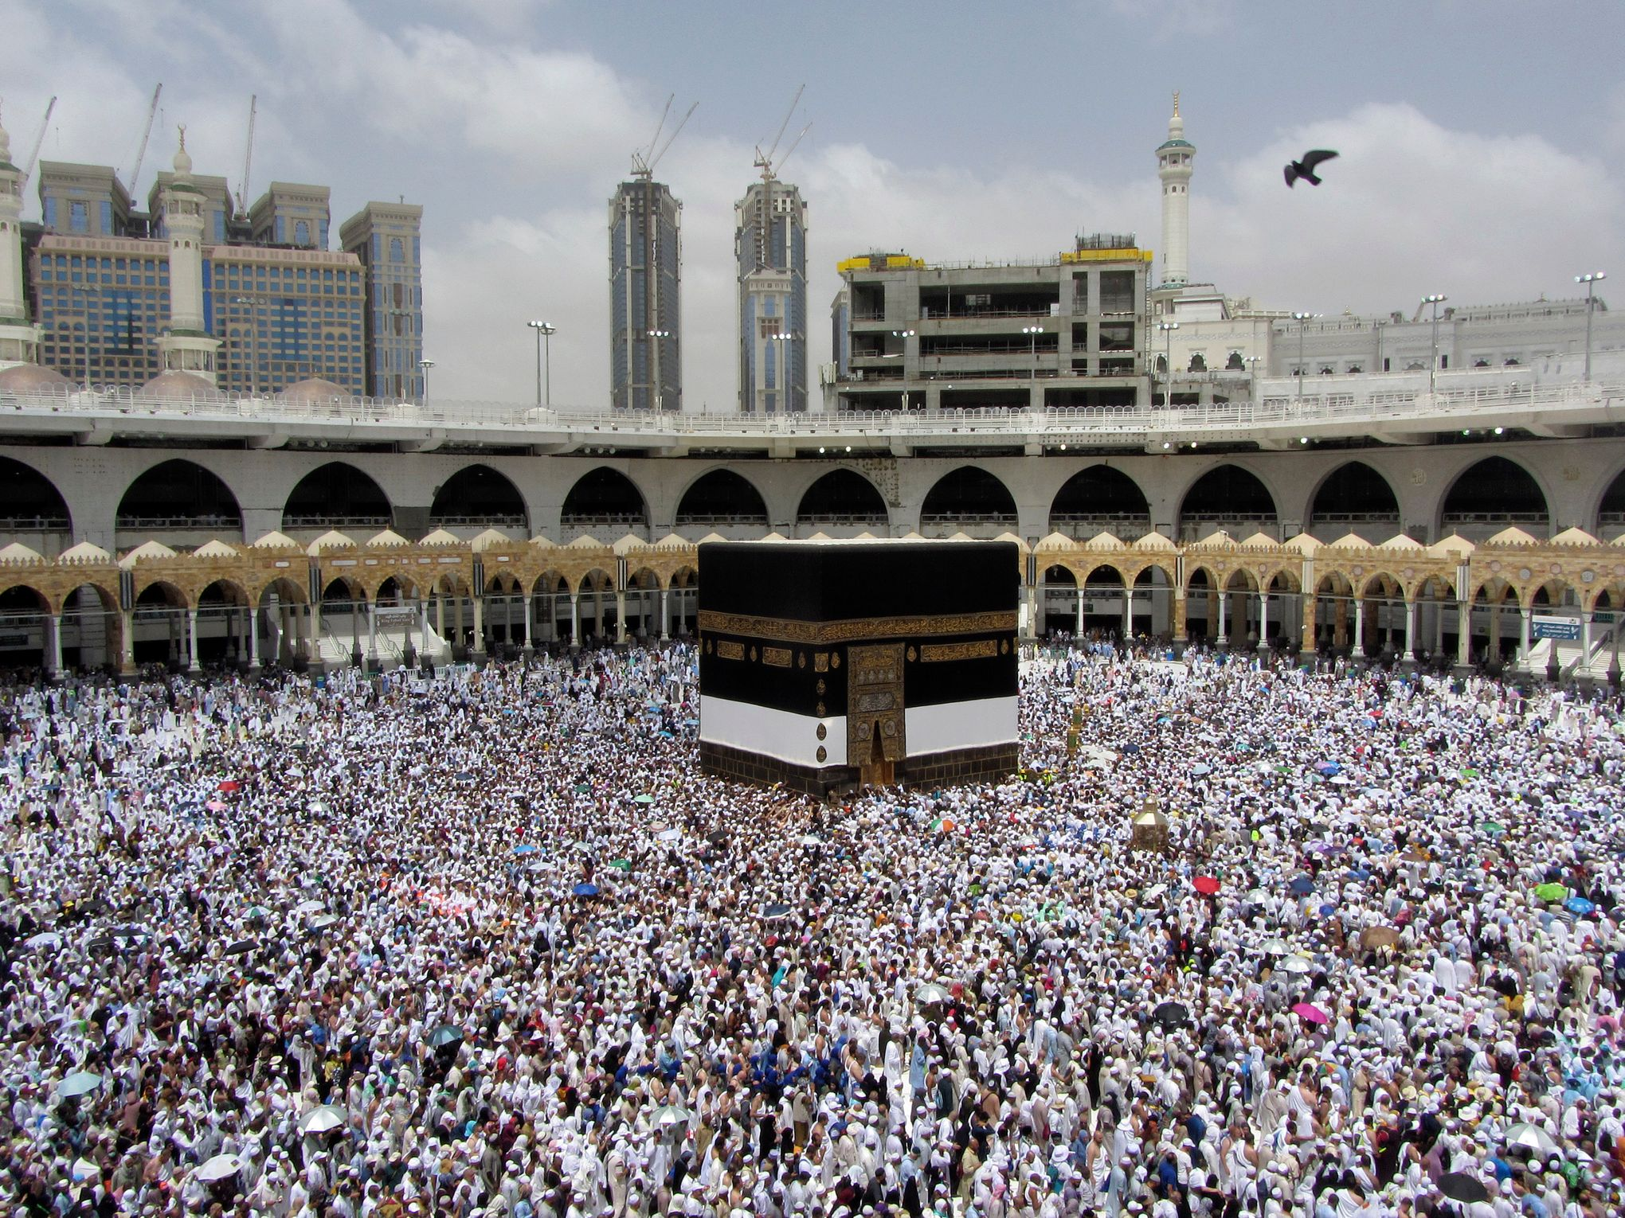
SIGNIFICANCE OF HAJJ IN
EID UL ADHA
Hajj is linked very closely to Eid ul Adha.
Many Muslims across the world perform Hajj starting from 8th Dhul Hijjah which concludes on 13th Dhul Hijjah.
A brief breakdown of how Hajj is performed is as follows:
  A person wears the Ihram and then starts by saying the Talbiyya.
  Then, he performs 7 circuits of the Ka’aba anti clockwise.
  Then, he runs between Safa and Marwa 7 times as well.

Slide 11
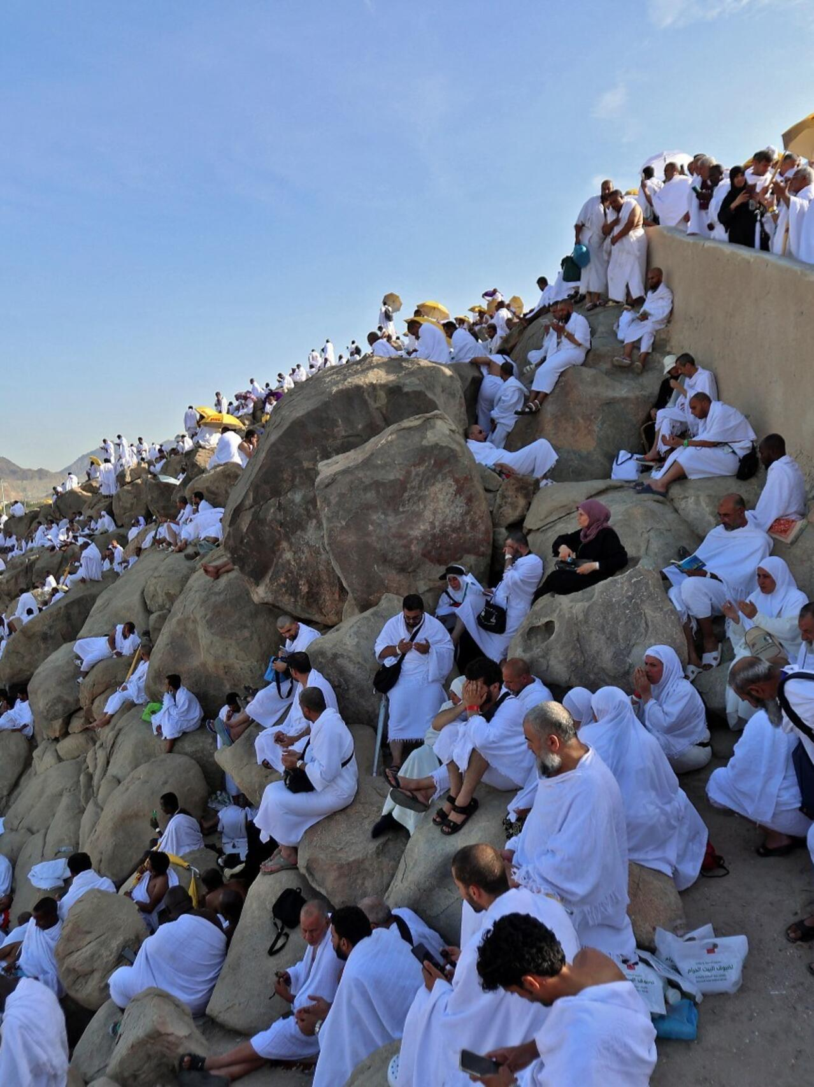
SIGNIFICANCE OF HAJJ IN
EID UL ADHA
A brief breakdown of how Hajj is performed is as follows:
  Then, a pilgrim travels to Mina where he spends the time.
  Then, a pilgrim travels to Arafat where he offers prayers and listens to a Sermon.
  The pilgrim comes to Muzdalifa where the person spends the night.
  The next morning, he returns to Mina on 10th Dhul Hijjah.
  On this day, he throws pebbles on the pillars as well as sacrificing an animal and cutting off the hair.

Slide 12
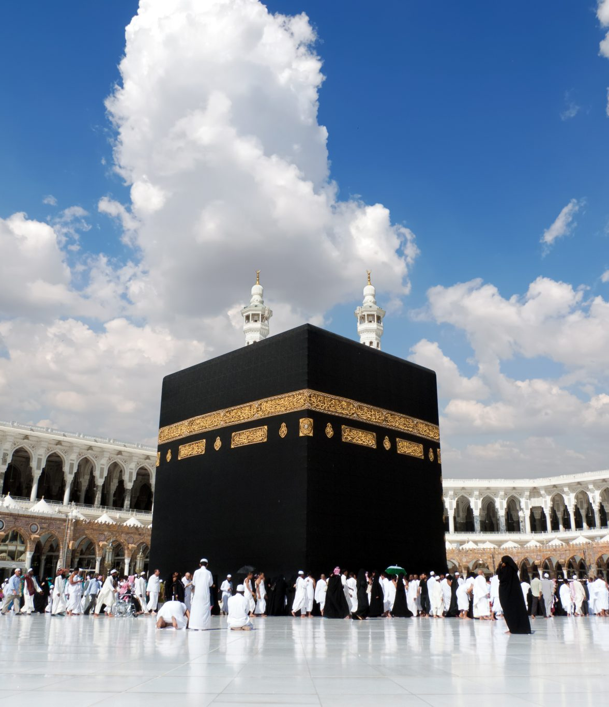
SIGNIFICANCE OF HAJJ IN
EID UL ADHA
A brief breakdown of how Hajj is performed is as follows:
  The pilgrim then performs another Tawaaf of the Ka’aba as well as running between Safa and Marwa.
  The Pilgrim then goes back to Mina where for the next 2 days they continue their worship and strike pebbles on the pillar.
  Then on 12/13th Dhul Hijjah, a pilgrimage returns back to Makkah where he performs one final Tawwaf of the Ka’aba and the Hajj is complete.

Slide 13





HOMEWORK
Have you done your homework for this week?
Make sure to note down your homework for next week!

Slide 14
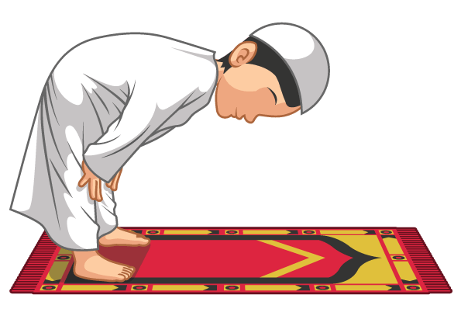

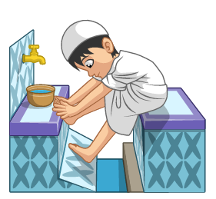
The Prayer after Ablution
اَللَّهُمَّ اجْعَلْنِیْ مِنَ التَّوَّابِیْنَ
وَ اجْعَلْنِیْ مِنَ الْمُتَطَھِّرِیْنَ
SALAT
Lets Recap a part of our Salat!
Allahumaj‘alni minattawaabina
waj’alni mina almutatahireen.
NEXT WEEK RECAP:
Niyyat
Translation:
"O Allah, Make me from among those who repent of their sins and from among those who keep themselves pure and clean."

Slide 15

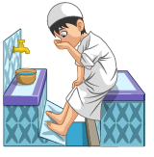
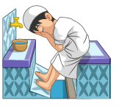
التَّوَّابِیْنَ | مِنَ | اجْعَلْنِیْ | اللَّهُمَّ
Those who repent of their sins | From among | Make me | O Allah
الْمُتَطَھِّرِیْنَ | مِنَ | اجْعَلْنِیْ | وَ
Those who keep themselves pure and clean | From among | Make me | And
Prayer After Ablution

Slide 16

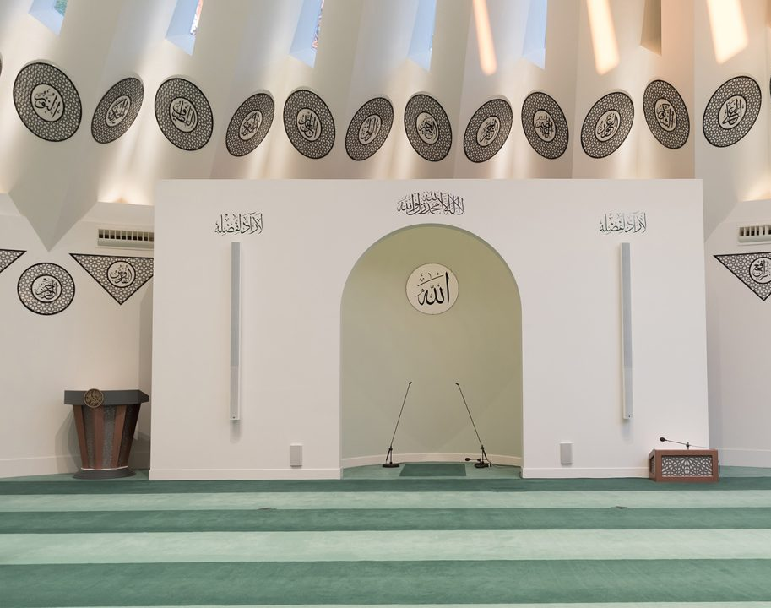
FRIDAY
SERMON
Friday 22nd May
2026

Slide 17






FRIDAY SERMON
Every Step in Humility: The Prophet (sa)
Whenever a person came before the Holy Prophet^{(sa)} to meet him and shook his hand, the Holy Prophet^{(sa)} would not let go of that person’s hand until they let go. Similarly, he would not turn away from the person until they turned away first.
Once the Holy Prophet^{(sa)} slept on a cot that left marks on his back. Some companions requested that they be allowed to make a softer bed for him. The Holy Prophet^{(sa)} said that he was not concerned with the comforts of this world. He said he was like a traveller who stops in the shade of a tree for a while, then leaves and moves on.
The Holy Prophet^{(sa)} himself would sweep the mosque to clean it and never considered such work to be beneath him.
Once, an angel descended upon the Holy Prophet^{(sa)} who had never descended upon anyone else before. This angel asked the Holy Prophet^{(sa)} if he would be considered a King and Prophet or a servant and Messenger. Such was the humble nature of the Holy Prophet^{(sa)} that he chose the option of being regarded as a servant and Messenger.
Once, it was said that the Holy Prophet (sa) eats like a slave and sits as a slave does, for after all, he was a human too. In other words, the Holy Prophet (sa) did not have the qualities of self-pride and ostentation as did other worldly rulers.
Watch this weeks Friday Sermon 4 Kids!

Slide 18
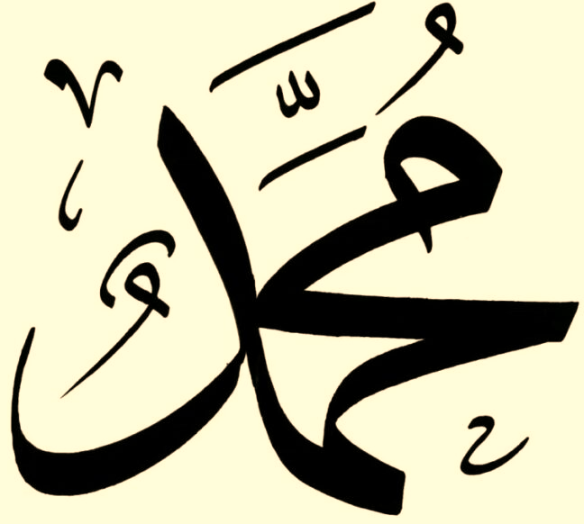
FRIDAY SERMON TAKEAWAY POINTS
Practise the habit of adopting humility within yourself.
Try to adopt the practices and qualities of the Holy Prophet Muhammad (saw) so that you can strive to become a better person.
Try to help out at home in any sort of way and adopt a mindset that no task is too little for you to complete.

Slide 19

PAIR ACTIVITY
Discuss today’s lesson with the Tifl next to you and come up with 3 new things you learned today!

Slide 20

ANNOUNCEMENTS
National Atfal Quiz Time is out!
We are delighted to announce the National Atfal Talim Quiz, beginning at Regional levels soon!
🌟 Why take part?
Compete with fellow Atfal across 6 exciting topics!
Open to Atfal aged 10–15
🏆 Regional Winners through to the Final!
📌 Don’t miss your chance to showcase your knowledge and have fun along the way!
👉 For Sign up & Syllabus:
https://www.atfal.org.uk/atfal-quiz-time📖 Be sure to check out the Rules and Syllabus provided in the above link!
Let the challenge begin!

