Slide 1

TALIM DEPARTMENT MAA UK
WEEKLY
ATFAL CLASS
(July – Week 3)
TALIM DEPARTMENT MAA UK
www.atfal.org.uk/talim
talim@atfal.co.uk

Slide 2
Class Rules
Arrive on time and be prepared
Always say “Assalamu Alaikum” when you enter the room
Pay attention and listen to the teacher quietly.
Raise your hand if you have a question.
Listen to others when they are speaking.
Work hard and try your best to learn something new.

Slide 3
Lesson Plan
1. Tilawat
2. Hadith
3. Thought of the Week
4. Homework Recap
5. Salat Recap
6. Friday Sermon
7. Announcements!
Are you prepared for today’s lesson?
Topi
Class Handout
Pen / Pencil

Slide 4
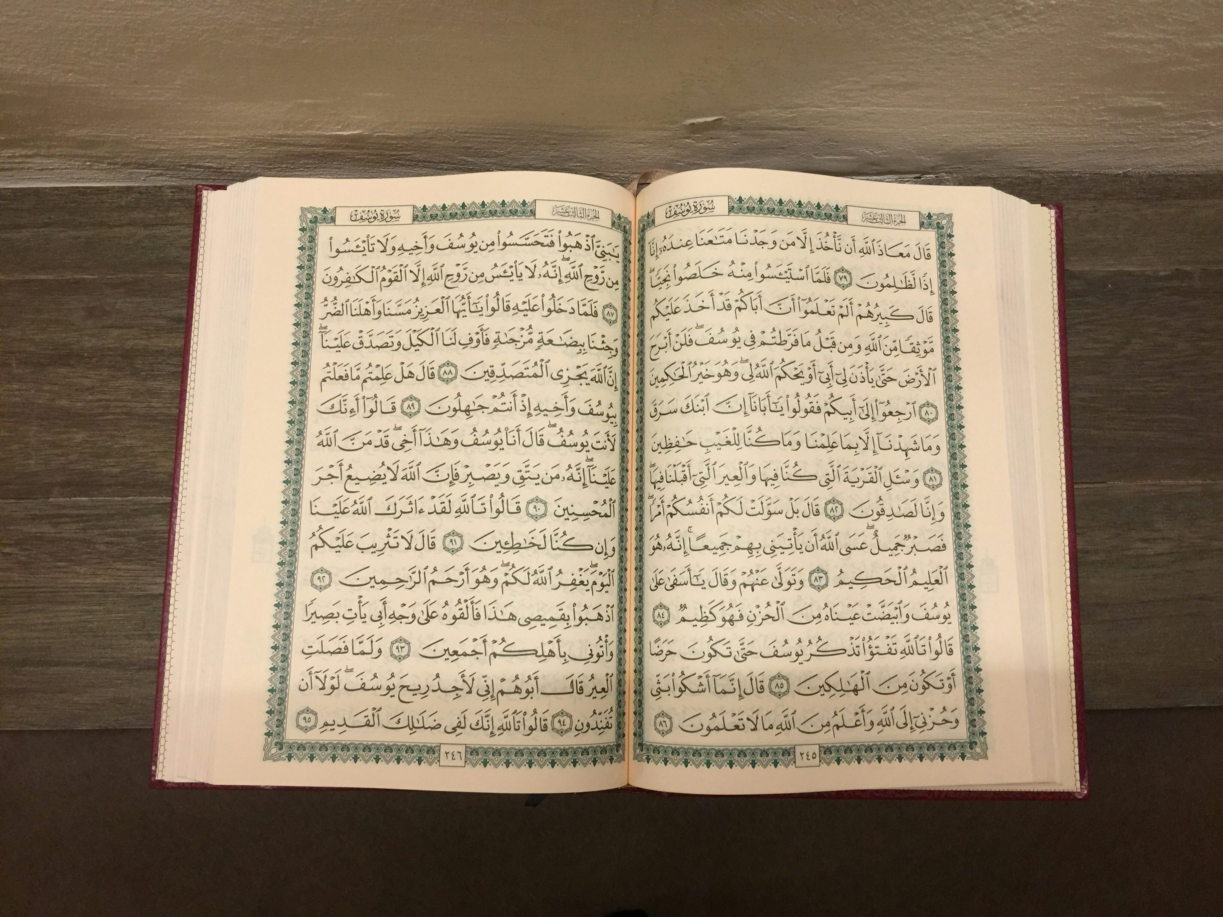

TILAWAT
یٰۤاَیُّہَا الَّذِیۡنَ اٰمَنُوۡا لَا یَسۡخَرۡ قَوۡمٌ مِّنۡ قَوۡمٍ عَسٰۤی اَنۡ یَّکُوۡنُوۡا خَیۡرًا مِّنۡہُمۡ وَلَا نِسَآءٌ مِّنۡ نِّسَآءٍ عَسٰۤی اَنۡ یَّکُنَّ خَیۡرًا مِّنۡہُنَّ ۚ وَلَا تَلۡمِزُوۡۤا اَنۡفُسَکُمۡ وَلَا تَنَابَزُوۡا بِالۡاَلۡقَابِ ؕ بِئۡسَ الِاسۡمُ الۡفُسُوۡقُ بَعۡدَ الۡاِیۡمَانِ ۚ وَمَنۡ لَّمۡ یَتُبۡ فَاُولٰٓئِکَ ہُمُ الظّٰلِمُوۡنَ ﴿۱۲﴾
TRANSLATION
“O ye who believe! Let not one people deride another people, who may be better than they. And defame not your own people, nor call one another by nicknames. Bad indeed is evil reputation after the profession of belief; and those who repent not are the wrongdoers.”
(The Holy Quran, Surah Al Hujurat, 49:12)

Slide 5
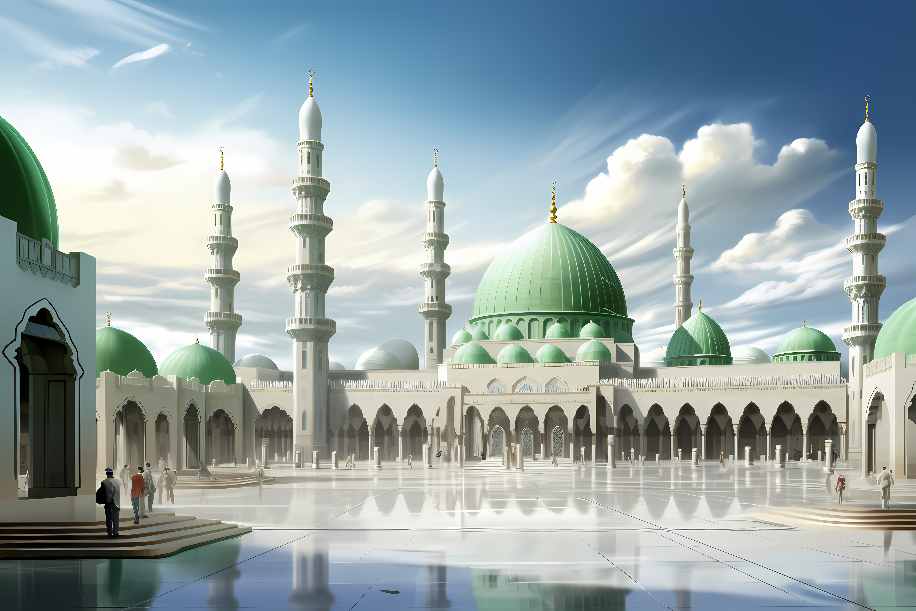
HADITH
(sayings of the Holy Prophet Muhammad^{sas})
یَاأَيُّهَا النَّاسُ، أَلَا إِنَّ رَبَّكُمْ وَاحِدٌ، وَإِنَّ أَبَاكُمْ وَاحِدٌ، أَلَا لَا فَضْلَ لِعَرَبِيٍّ عَلَى عَجَمِيٍّ، وَلَا لِعَجَمِيٍّ عَلَى عَرَبِيٍّ، وَلَا لِأَحْمَرَ عَلَى أَسْوَدَ، وَلَا لِأَسْوَدَ عَلَى أَحْمَرَ، إِلَّا بِالتَّقْوَى. أَبَلَّغْتُ؟ قَالُوا: بَلَّغَ رَسُولُ اللَّهِ ﷺ.
“O people! Be aware that your Lord is One and your father (Adam) is one. Remember! No Arab has superiority over a non-Arab, nor does a non-Arab have superiority over an Arab, nor does a white have superiority over a black, nor a black over a white – except by righteousness. Have I conveyed the message?” They (the Companions) replied: “The Messenger of Allah has conveyed the message.”
(Musnad Ahmad, Beirut: Mu’assasat al-Risala, 2001, Vol. 38, p. 747, Hadith 23489)
Notes:
After Tilawat, spend 5 mins catching up with Atfal. What they've been getting up to in the past week.
Hadith:
Whoever, reads the Hadith out, should do so in the proper manner. i.e. recite Durood Shareef first and then the Hadith.
Have a brief discussion about the meaning of this hadith in light of the questions on the screen.

Slide 6
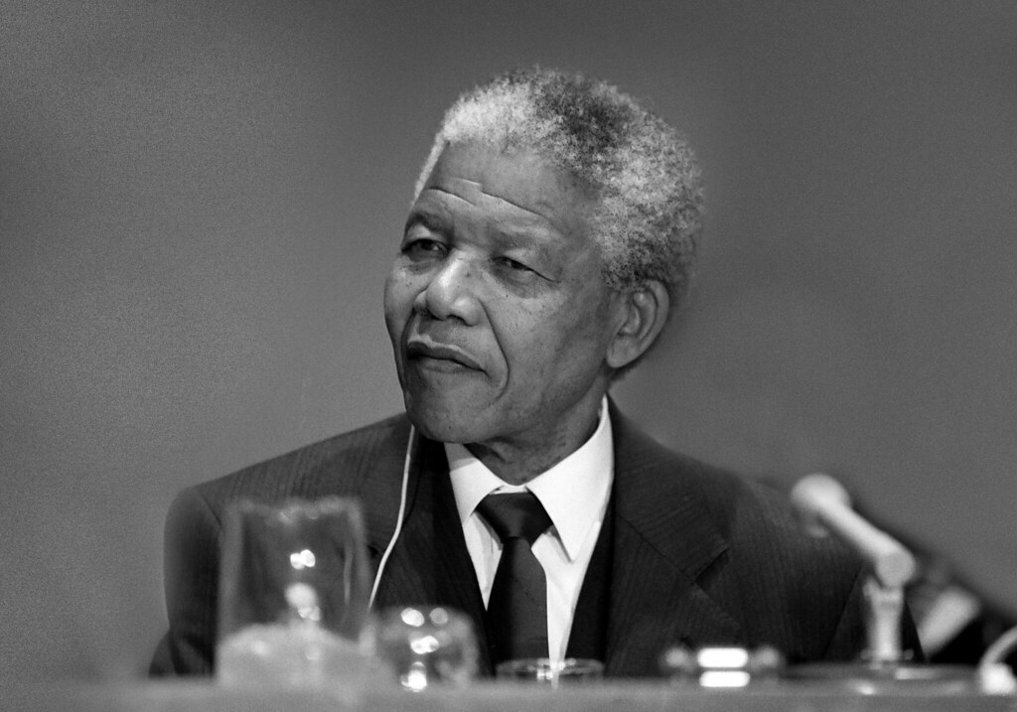
THOUGHT
OF THE WEEK
TOPIC:
“NELSON MANDELA INTERNATIONAL DAY”

Slide 7
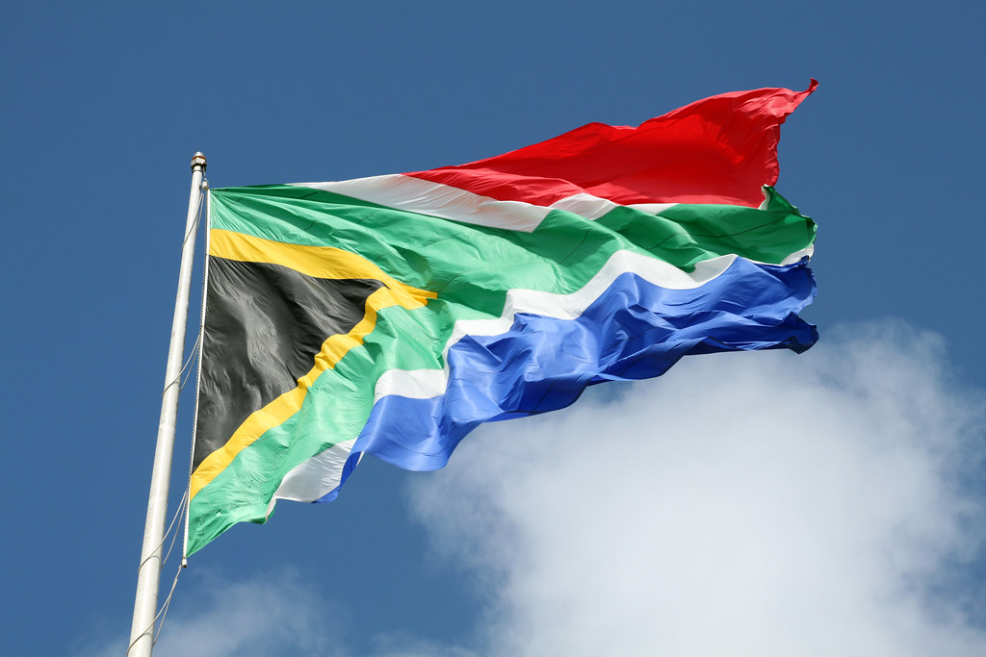
WHO WAS NELSON MANDELA?
Nelson Mandela was a leader from South Africa.
He was born on July 18, 1918.
He fought against a system called apartheid, which treated people differently based on the colour of their skin.
Mandela believed that all people should have equal rights and opportunities.
Because of his activism he was arrested and spent 27 years in prison.

Slide 8
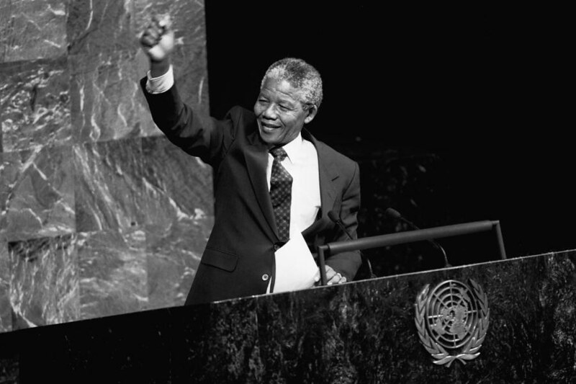
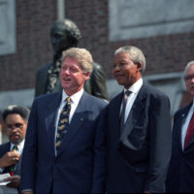
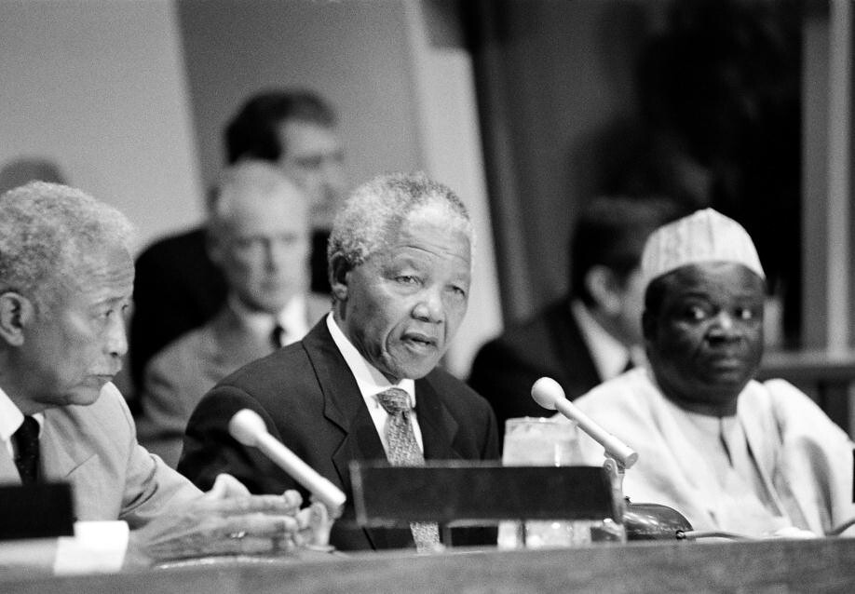
WHO WAS NELSON MANDELA?
(CONTINUED)
After Mandela was released from prison in 1990, he worked to bring people together peacefully.
In 1993, he received the Nobel Peace Prize for helping promote peace and reconciliation.
In 1994, he became the first Black President of South Africa.
He passed away on December 5, 2013.

Slide 9
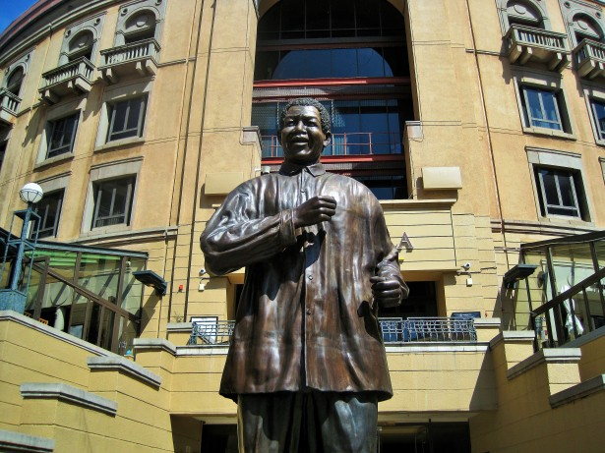
FUN FACTS ABOUT NELSON MANDELA
He loved learning and studied law.
Mandela enrolled in the University of London’s correspondence program and received a Bachelor of Law degree, all while he was still in prison.
He received more than 695 awards.
More than 25 schools, universities, and education institutions have been named after Nelson Mandela. At least 19 scholarships and foundations bear his name.

Slide 10

SIGNIFICANCE OF NELSON MANDELA INTERNATIONAL DAY
In 2009, the United Nations proclaimed Mandela’s birthday (July 18th) to be Nelson Mandela International Day.
He holiday asks people to spend 67 minutes doing something good for others, which represents the 67 years he spent working towards change.

Slide 11

HOMEWORK
Have you done your homework for this week?
Make sure to note down your homework for next week!

Slide 12
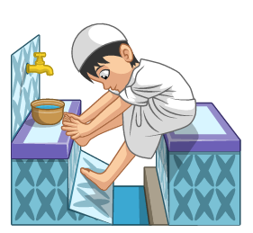
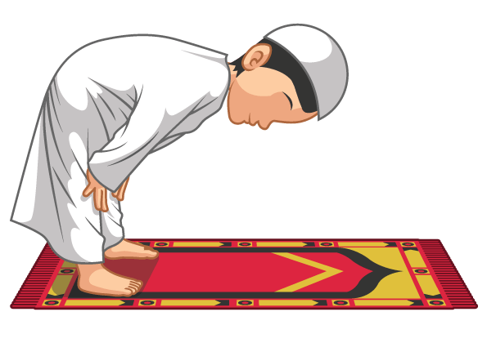
Concluding Prayers
SALAT
رَبَّنَا آتِنَا فِی الدُّنۡیَا حَسَنَۃً وَّ فِی الۡآخِرَۃِ حَسَنَۃً وَّ قِنَا عَذَابَ النَّارِ
Let’s recap a part of our Salat!
Rabbana aatinaa fiddunyaa hasanatan wa fil aakhirati hasanatan wa qina azaban naar.
Translation:
NEXT WEEK RECAP:
Thana
Our Lord, grant us good in this world, as well as good in the world to come, and protect us from the torment of the Fire.

Slide 13
Concluding Prayers
SALAT
حَسَنَۃً | فِی الدُّنۡیَا | آتِنَا | رَبَّنَا
Good | In this world | Grant us | Our Lord
Lets Recap a part of our Concluding Prayers!
وَّ قِنَا | حَسَنَۃً | فِی الۡآخِرَۃِ | وَّ
And protect us | Good | In the world to come | And
NEXT WEEK RECAP:
Tashahhad
النَّارِ | عَذَابَ
Of the fire | From the torment

Slide 14
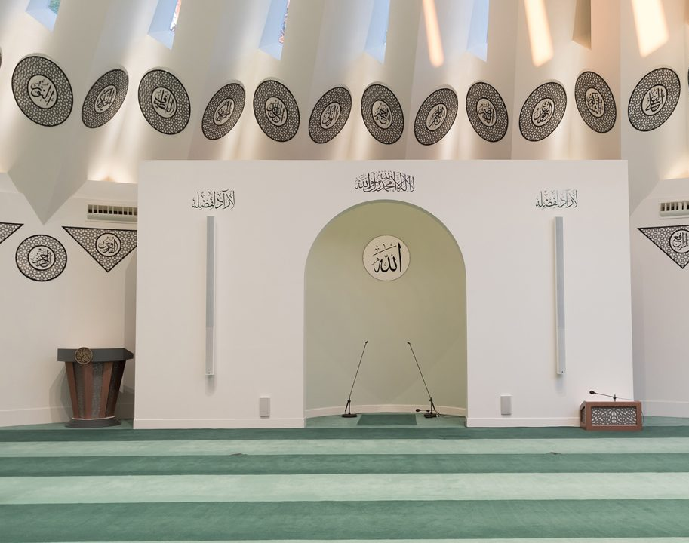
FRIDAY
SERMON
Friday 10th July
2026

Slide 15






FRIDAY SERMON
“Generosity and Ihsan in the life of the Promised Messiah^{(as)}”
The Promised Messiah (as) would show kindness even to those who opposed him.
At various times, Mirza Imamuddin would require financial assistance, and the Promised Messiah (as) would not hesitate to help him.
For example, once when Mirza Imamuddin was having trouble selling his horse, the Promised Messiah (as) helped him by sending him to Hazrat Hakim Maulvi Nooruddin (ra).
Mirza Muhammad Baig was another opponent of Ahmadiyyat and the family of the Promised Messiah (as).
When Mirza Muhammad Baig sought employment in Jammu, he approached the Promised Messiah (as) to request a letter of recommendation to Hazrat Hakim Maulvi Nooruddin (ra). The Promised Messiah (as) wrote a letter of recommendation, as a result Mirza Muhammad Baig secured a job.
Once, Mirza Nizamuddin, who was a poor man, walked from Kapurthala to Qadian to visit the Promised Messiah (as). Upon arriving in Qadian, he presented two rupees as a gift to the Promised Messiah (as). A few days later, when Mian Nizamuddin was about to depart, the Promised Messiah (as) gave him seven or eight rupees as a gift upon his departure.
Watch this weeks Friday Sermon 4 Kids!

Slide 16

TASK FOR THIS WEEK
Share an item of food with a person that you don’t normally engage in conversation with at school.
Read about the examples of how the Holy Prophet Muhammad (saw) showed generosity to people.

Slide 17

PAIR ACTIVITY
Discuss today’s lesson with the Tifl next to you and come up with 3 new things you learned today!

Slide 18
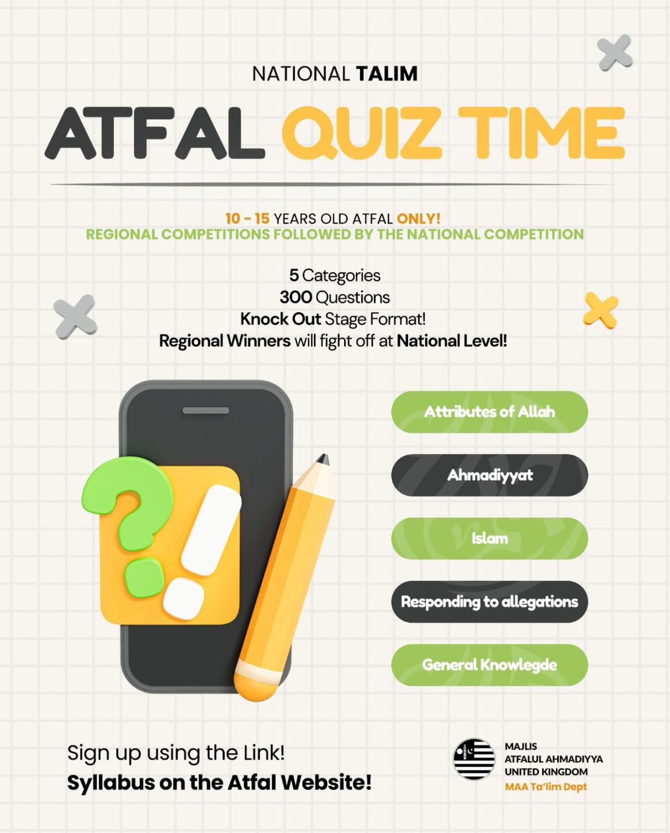
ANNOUNCEMENTS
National Atfal Quiz Time is out!
We are delighted to announce the National Atfal Talim Quiz, beginning at Regional levels soon!
🌟 Why take part?
Compete with fellow Atfal across 6 exciting topics!
Open to Atfal aged 10–15
🏆 Regional Winners through to the Final!
📌 Don’t miss your chance to showcase your knowledge and have fun along the way!
👉 For Sign up & Syllabus:
https://www.atfal.org.uk/atfal-quiz-time 📖 Be sure to check out the Rules and Syllabus provided in the above link!
Let the challenge begin!

